Slide 1
Lecture 18 Naive Bayes Classification
Min Chen

Slide 2
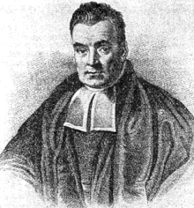
Bayes's theorem
Probability is orderly opinion, and inference from data is nothing other than the revision of such opinion in the light of relevant new information.
-- Thomas Bayes
Thomas Bayes
(1701-1761)

Slide 3
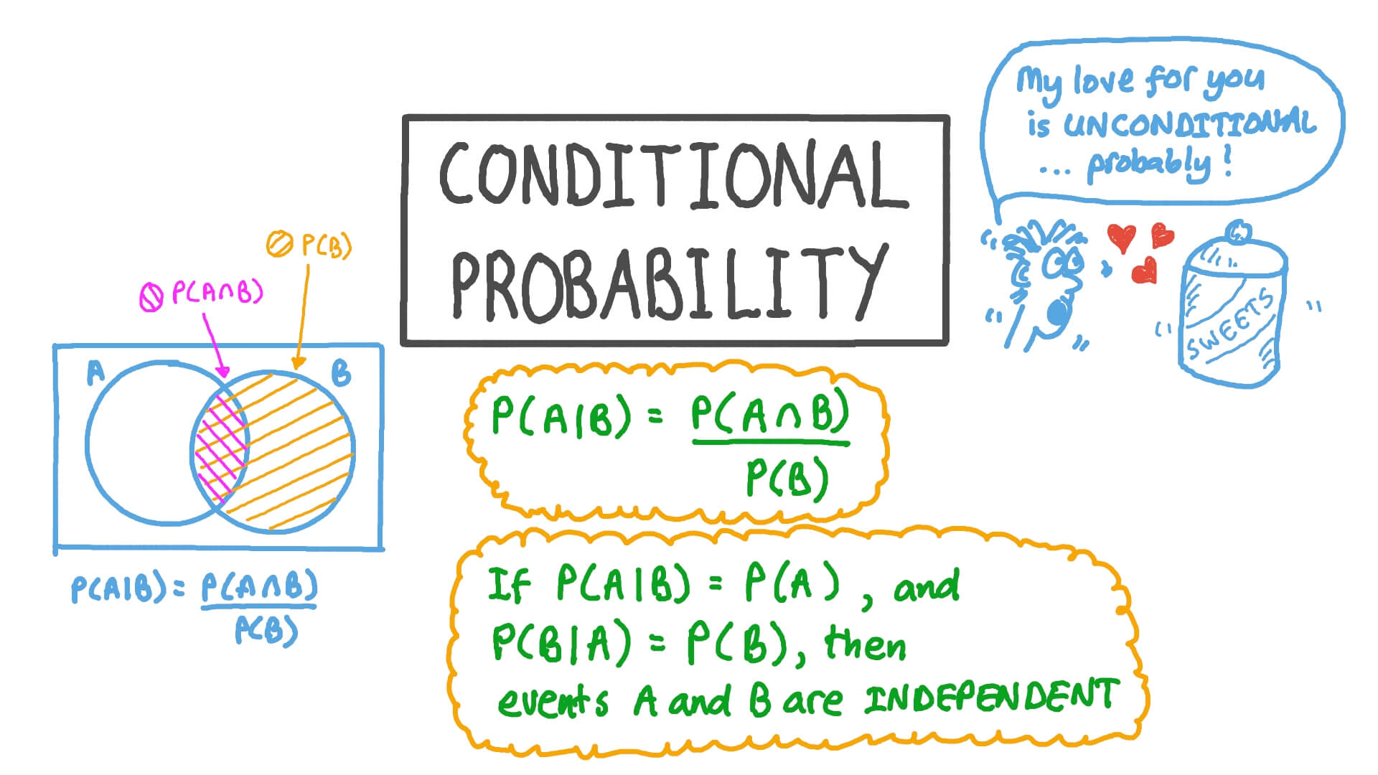
Bayes's theorem
Conditional probability
The conditional probability of an event B is the probability that the event will occur given the knowledge that an event A has already occurred.

Slide 4
Conditional Probability
If events A and B are not independent, then the probability of the intersection of A and B (the probability that both events occur) is defined by P(A .and. B) = P(A)P(B|A)
The conditional probability P(B|A) is easy to calculate:
P(B|A) = P(A .and. B)/P(A)

Slide 5
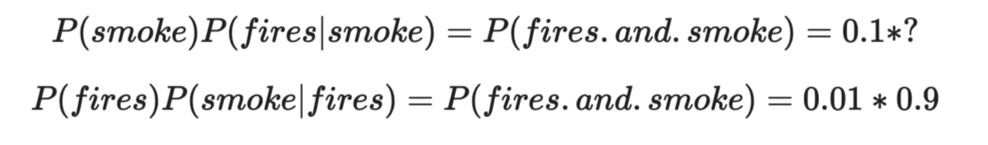
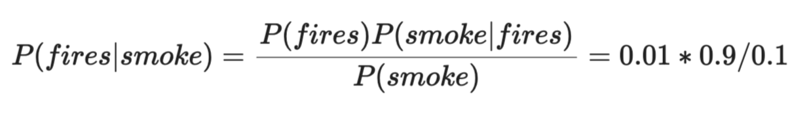
Conditional Probability
Assuming that you are visiting Yosemite National Park and you might see fires or smokes.
Here are some facts that you know:
dangerous fires are rare (1%)
smoke is fairly common (10%) due to barbecues
90% of dangerous fires make smoke
The probability of dangerous Fire when there is Smoke:

Slide 6
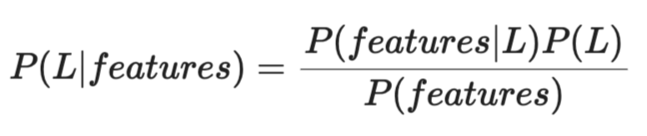
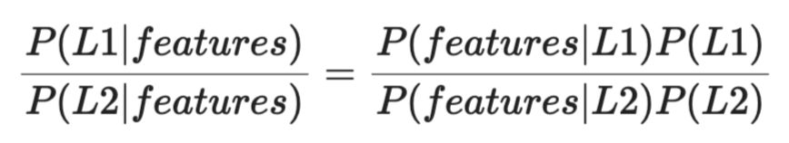
Bayes's theorem in machine learning
In machine learning, we are actually interested in identifying the probability of a label L with given features P(L|features)
According to Bayes’s theorem:
If we are trying to decide between two labels—let's call them L1 and L2—then one way to make this decision is to compute the ratio of the posterior probabilities for each label:

Slide 7
All we need now is some model by which we can compute P(features|L_{i}) for each label.
Such a model is called a generative model because it specifies the hypothetical random process that generates the data.
Specifying this generative model for each label is the main piece of the training of such a Bayesian classifier.
The general version of such a training step is a very difficult task, but we can make it simpler through the use of some simplifying assumptions about the form of this model.
This is where the "naive" in "naive Bayes" comes from:
The 'naive' aspect of the algorithm comes from its assumption that the features used to make the prediction are independent of each other,

Slide 8
Classification with Naïve Bayes
In the context of classification, we want to find the most probable class label C, given a set of features F1, F2, ..., Fn:
C = argmax P(C | F1, F2, ..., Fn)
Argmax is an operation that finds the argument that gives the maximum value from a target function.
Using Bayes' theorem, we can rewrite this expression as:
C = argmax (P(F1, F2, ..., Fn | C) * P(C)) / P(F1, F2, ..., Fn)
Since we are only interested in the class with the highest probability, we can ignore the denominator P(F1, F2, ..., Fn), as it remains constant for all classes:
C = argmax P(F1, F2, ..., Fn | C) * P(C)
Now, we apply the naive assumption that features are conditionally independent given the class:
C = argmax P(F1 | C) * P(F2 | C) * ... * P(Fn | C) * P(C)
This simplification allows us to compute the probability of each class easily, even with a large number of features.

Slide 9
Example: email classification
Labels: “Spam” (S) or “Not Spam” (NS)
Features: “free”, “offer”, “discount”
First, we need to calculate the prior probabilities of spam (S) and not spam (NS):
P(S) = (number of spam emails) / (total number of emails)
P(NS) = (number of not spam emails) / (total number of emails)
Next, we calculate the conditional probabilities for each word, given the class:
P("free" | S), P("offer" | S), P("discount" | S) P("free" | NS), P("offer" | NS), P("discount" | NS)
Now, we apply the Naive Bayesian formula:
P(S | "free", "offer", "discount") ∝ P("free" | S) * P("offer" | S) * P("discount" | S) * P(S)
P(NS | "free", "offer", "discount") ∝ P("free" | NS) * P("offer" | NS) * P("discount" | NS) * P(NS)
Finally, we compare these probabilities and assign the class with the highest probability:
If P(S | "free", "offer", "discount") > P(NS | "free", "offer", "discount"), the email is classified as spam; otherwise, it is classified as not spam.

Slide 10
Summary: How Naive Bayesian Classification Works
Model Training: During the training phase, the model calculates the probabilities of different classes based on the training data. It computes the prior probabilities P(A) for each class A and the likelihood P(B∣A) for every predictor B given class A.
Prediction: For a new instance with a set of predictors B, the model calculates the posterior probability P(A∣B) for each class A using Bayes' Theorem. The naive assumption of independence among predictors simplifies this calculation by allowing the model to treat the likelihood of a set of predictors as the product of the individual likelihoods.
Classification: The model assigns the new instance to the class with the highest posterior probability.

