Slide 1


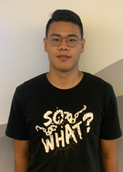
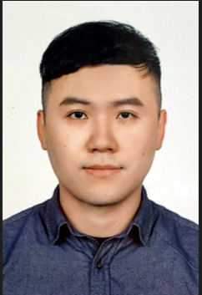
Group 3 : Train gympt
Software Engineering
Final Project Report
Advising Professor:
戴敏育 Professor
Min-Yuh Day
Information
Management
711136115
鄭安傑
Jay Cheng
Information
Management
711136117
谷敏杰
Joe Ku
Notes:
●Hello everyone, We are group 3, I’m is Joe and he is Jay, We come from the Information Management at National Taipei University.
We would like to present our project. The topic is “Train GymPT”
● Our advisor is Professor Day.

Slide 2
Outline
Chapter 1 - Introduction
Research Background
Research Motivation
Research Objective
Expected Research Contributions and Managerial Implication
Chapter 2 - Literature Review
Chapter 3 - Research Method & Results
References
Notes:
This is outline of our project.
research background, research motivation, research objective, and expected research contributions and managerial implication.

Slide 3
Chapter 1
Introduction
Notes:
Research background

Slide 4
Research Background
Fitness has become a trend
In recent years, fitness has become a global trend, with more and more people placing greater emphasis on health and fitness.
Fitness culture: Fitness has become a lifestyle and culture, with people placing greater value on health, pursuing physical beauty and health.
Socialization: Fitness has become a social activity, allowing people to meet new friends through exercise and share their fitness progress on social media.

Slide 5
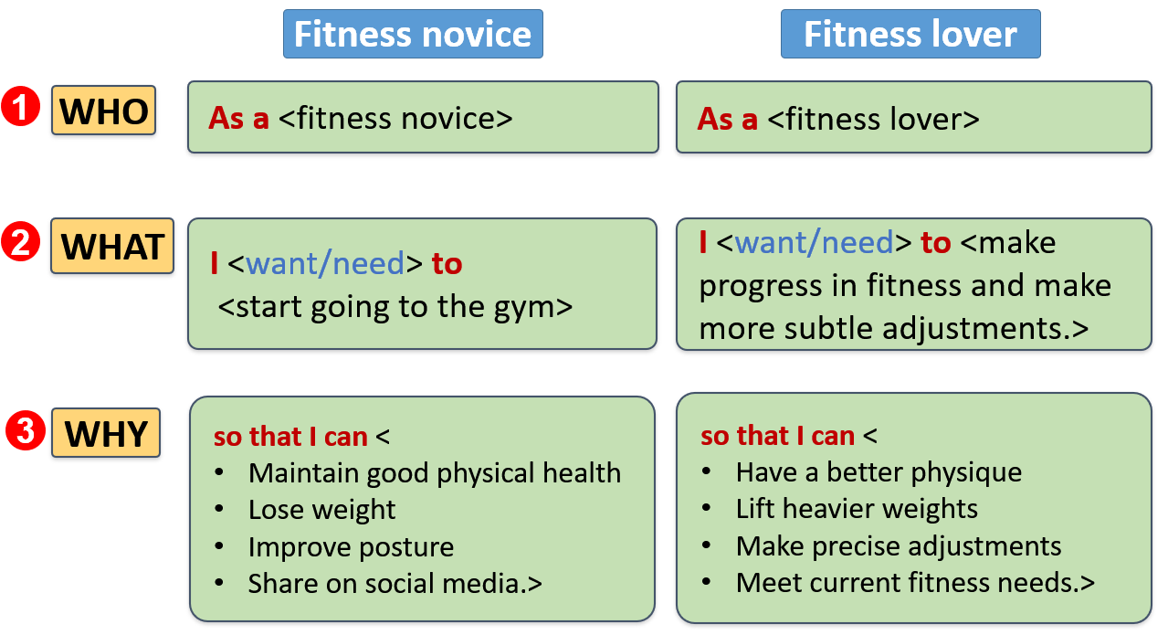
Research Background
Scenario analysis
Source: This study
Notes:
Personas: fitness novice
Scenarios:
有一個健身新手, 想要開始去健身房健身, 因為他從沒去過健身房, 所以什麼器材都沒有使用過, 也不知道要做什麼動作。更不知道要怎麼安排訓練內容,
而且他可能沒有運動的夥伴可以提供意見, 並且因為他只是新手可能想要先嘗試, 不想一開始就花錢請教練,
所以如果使用這個APP, 他就可以以他健身新手的情況, 請教AI, 指導他動作,當作他的私人教練, 並給予適合的初級訓練菜單
There is a fitness beginner who wants to start going to the gym for exercise. Because he has never been to a gym before, he has no experience using any gym equipment and doesn't know what exercises to do. Additionally, he may not have any workout partners to offer advice, and as a beginner, he may not want to spend money on a personal trainer right away.
By using this app, he can ask the AI for guidance on exercises tailored to his beginner level and use it as his personal trainer to receive suitable beginner training programs.

Slide 6
Research Motivation
Requirement analysis
User Interface:
The operation of TrainGymPT should be simple and easy to understand.
Can easily find and access the main functions
Personalized Recommendations:
For fitness novices: TrainGymPT help them find a suitable training program to get started.
For experienced fitness lovers: Provide personalized training plans and exercise guidance based on
Individual physical condition
Fitness goals
Other personalized requirements.
Notes:
使用者介面：健身App的操作應該非常簡單易懂，而且使用者界面應該要簡潔清楚明瞭，因為在健身時會處於一個很亢奮的狀態，需要方便尋找所需的功能，並且提供方便的紀錄表格，除了健身時方便使用，健身完後也可以直覺調出歷史資訊。
個人化建議：健身新手對於健身訓練可能一無所知，幫助他們起頭，找到適合自己的訓練計畫。而健身老手的需求都不盡相同，應該根據每個人的身體狀況、健身目標等個性化需求來提供適合的訓練計畫和動作指導。
User Interface: The operation of the fitness app should be simple and easy to understand, with a clear and concise user interface. Since users will be in an excited state during exercise, it is important that they can easily find the necessary functions and access convenient record forms. The app should also be designed to intuitively access historical information after workout sessions.
Personalized Recommendations: For fitness novices who may know very little about exercise training, personalized recommendations can help them find a suitable training program to get started. For experienced fitness enthusiasts, their needs may differ significantly, so the app should provide personalized training plans and exercise guidance based on their individual physical condition, fitness goals, and other personalized requirements.

Slide 7
Research Objective
What is Train gympt ?
Tarin GymPT is a Web used by fitness enthusiasts.
Become your fitness coach
Become your fitness assistant
Generate fitness menu
Give you diet Suggestions
Record fitness status,and feedback
Notes:
使用者介面：健身App的操作應該非常簡單易懂，而且使用者界面應該要簡潔清楚明瞭，因為在健身時會處於一個很亢奮的狀態，需要方便尋找所需的功能，並且提供方便的紀錄表格，除了健身時方便使用，健身完後也可以直覺調出歷史資訊。
個人化建議：健身新手對於健身訓練可能一無所知，幫助他們起頭，找到適合自己的訓練計畫。而健身老手的需求都不盡相同，應該根據每個人的身體狀況、健身目標等個性化需求來提供適合的訓練計畫和動作指導。
User Interface: The operation of the fitness app should be simple and easy to understand, with a clear and concise user interface. Since users will be in an excited state during exercise, it is important that they can easily find the necessary functions and access convenient record forms. The app should also be designed to intuitively access historical information after workout sessions.
Personalized Recommendations: For fitness novices who may know very little about exercise training, personalized recommendations can help them find a suitable training program to get started. For experienced fitness enthusiasts, their needs may differ significantly, so the app should provide personalized training plans and exercise guidance based on their individual physical condition, fitness goals, and other personalized requirements.

Slide 8
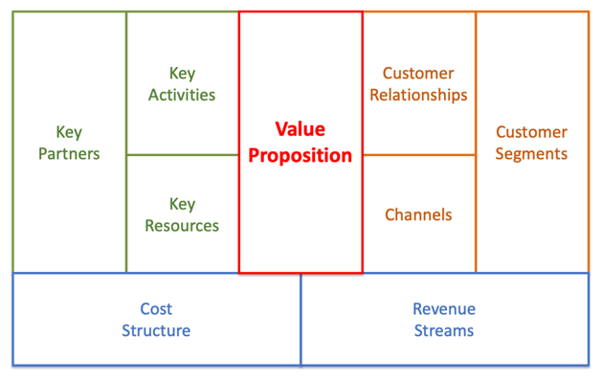
Research Objective
Business model
Key Partners:
1.Fitness product advertisers
2.Operation & maintenance service providers.
Key Activities:
1.Provide customized plans.
2.Offer a training record.
Value
Proposition:
1.Customized fitness & nutrition plan
2.Anytime fitness assistant.
Customer Relationships:
1.Meet customer needs
2.Providing instant responses
Customer Segments:
1.Who are health and fitness conscious
2.Who enjoy fitness and exercise.
Key Resources:
1.fitness & nutrition knowledge
2.Web technology.
Channels:
1.Promote it online
2.Advertise on various social media platforms.
Revenue Streams:
1.Cloud deployment cost
2.Operation and maintenance costs
3.Marketing costs.
Revenue Streams:
1.Website operates on a subscription payment model
2.Offer advertising space for fitness product manufacturers.
Source: This study
Notes:
This is business model of TrainGymPT.
1.First, there are two target customer segments: people who are health and fitness conscious, and people who enjoy fitness and exercise.
2.Second, our value proposition is a customized fitness and nutrition plan, as well as an anytime fitness assistant.
3.Third, As a website, we naturally promote it online and advertise on various social media platforms as our distribution channels.
4.Fourth, We prioritize personalized information and meeting customer needs in our customer relationships, while also placing an emphasis on providing instant responses to feedback.
5.Fifth, our website operates on a subscription payment model, and we also offer advertising space for fitness product manufacturers.
6.Sixth, our key resources consist of fitness and nutrition knowledge, as well as website technology.
7.Seventh, our key activities include providing customized fitness and nutrition plans, as well as offering a training record feature with personalized feedback.
8.Eighth, our key partners are undoubtedly OpenAI, as well as fitness product advertisers, and website operation and maintenance service providers.
9.Ninth, the cost structure of this website includes OpenAI token costs, operation and maintenance costs, and marketing costs.

Slide 9
Expected Research Contributions
Expected Managerial Implication
Provided a fitness website that combines fitness knowledge and AI technology to help users learn and practice fitness knowledge.
Provided personalized solutions to meet the different needs.
Innovation and collaboration between fitness and technology, providing a reference model for the future fitness industry.
Contribute to society by promoting the importance of fitness and healthy lifestyles through web promotion.
Notes:
研究貢獻：
提供了一個結合健身知識和AI技術的健身App，幫助使用者學習和實踐健身知識。
提供了對於健身新手和健身老手的不同需求的個性化解決方案。
健身和科技行業之間的創新和合作，推動該領域的進一步發展。
通過web推廣健身和健康生活的重要性，對社會作出貢獻。"

Slide 10
Chapter 2
Literature Review
Notes:
Research background

Slide 11
Fitness training
Alex and Avis (2020) believe that beginners need to gradually establish an exercise routine to achieve their goals of healthy weight loss, muscle gain, or improved endurance through consistent and sustained training. Beginners should be mindful of the adaptation period and moderate the intensity of their workouts to avoid excessive fatigue and injuries.
Ashish Sharma et al. (2006) mentioned exercise has significant benefits for mental health, reducing anxiety and depression, improving self-esteem, cognitive function, and aiding weight control. It is particularly crucial for individuals with lowering blood pressure, increasing energy, and strength. Regular exercise also improves sleep, endurance, mood, and overall cardiovascular health.
Notes:
健身訓練方法：包括不同的訓練類型（如重訓、有氧運動、柔軟性訓練等）、訓練頻率、強度、持續時間、休息間隔等。
營養指南：包括適當的飲食組成、餐前和餐後營養補充、碳水化合物、蛋白質、脂肪等的攝取建議，以及適應不同健身目標的飲食策略。
健身器材和設備：涉及各種健身器材和設備的功能、使用方法、安全使用指南等。
運動科學：涵蓋運動生理學、運動心理學、運動生物力學等方面的研究，以了解運動對身體的效應、運動的動力學和力學原理等。
健身目標和成果：關於不同健身目標（如減重、增肌、提升耐力等）的設定和達成的方法，以及對於健身成果的評估和衡量。
休息和恢復：關於休息和恢復的重要性，如適當的休息時間、睡眠、減壓和復原策略等。
健身計畫和進度管理：關於制定個人化的健身計畫、管理進度和設定目標的方法和技巧。

Slide 12
Chapter 3
Research Method & Results
Notes:
Research background

Slide 13




System architecture
Frontend
HTML/CSS
Javascript
React Native
UX/UI design
Backend
Python Flask
User
Source: This study

Slide 14
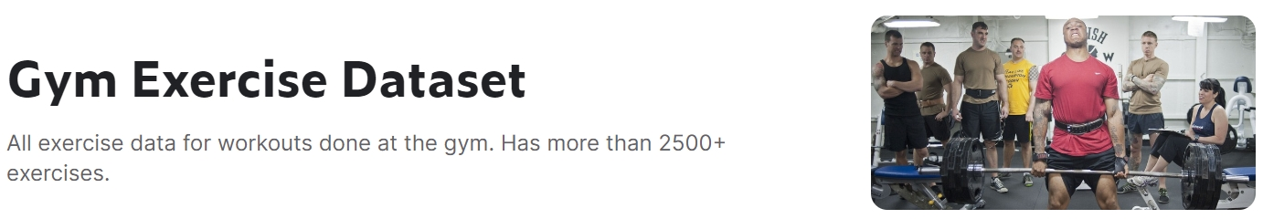
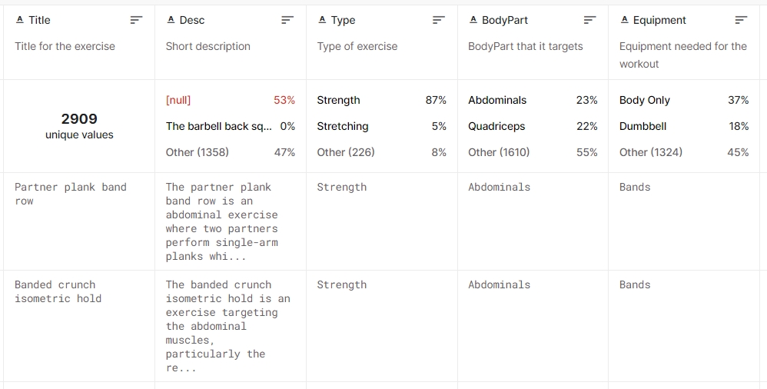
Data
Source: Pandit, N. (2023, January). Gym Exercise Dataset. Kaggle. https://www.kaggle.com/datasets/niharika41298/gym-exercise-data
Notes:
This APP can be your fitness coach, fitness assistant, and fitness assistant, guiding you how to do fitness well, how to learn fitness, giving you fitness menus, diet suggestions, and correcting you Posture, as well as record fitness status, and then give feedback.

Slide 15
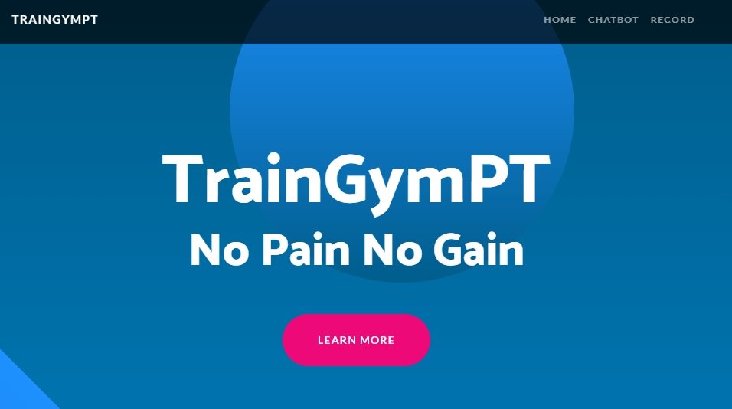
Result
Source: This study

Slide 16
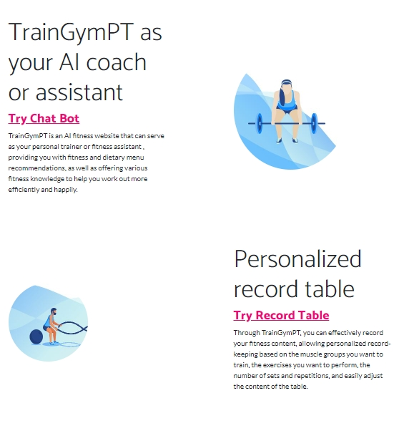
Result
Source: This study

Slide 17
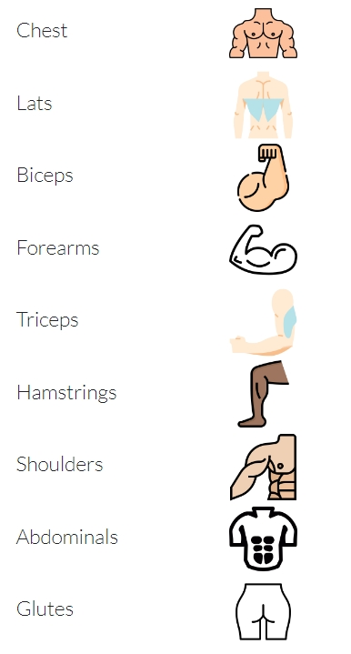
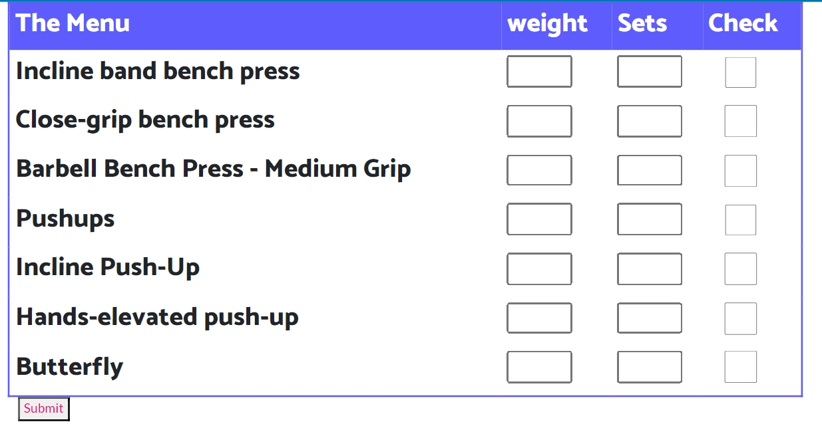
Result - Record Table
Source: This study

Slide 18
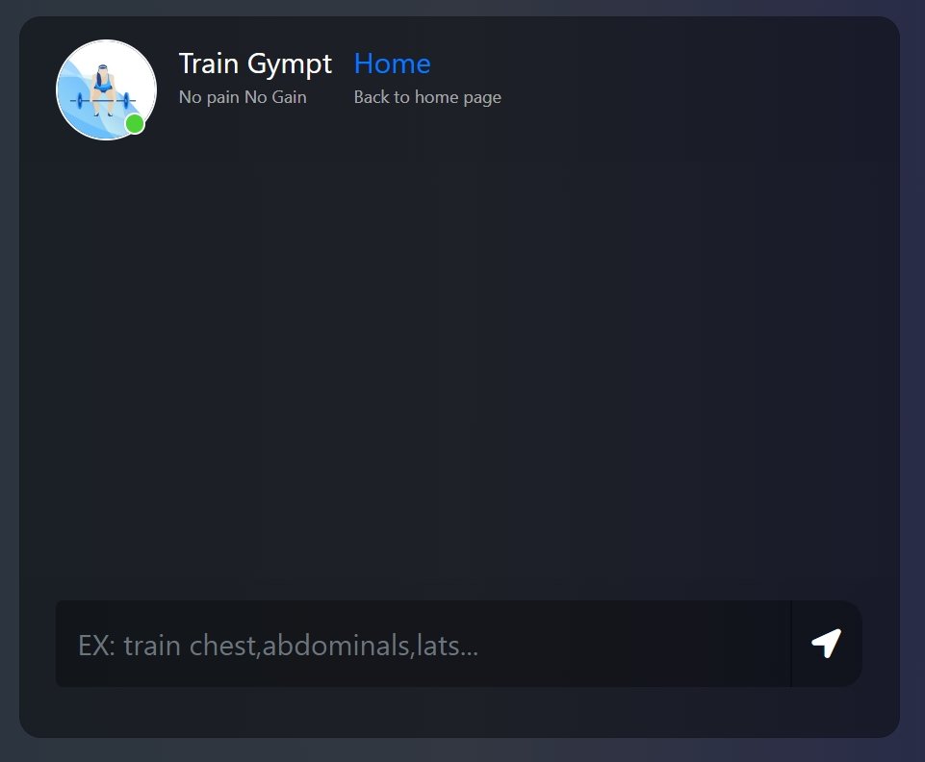
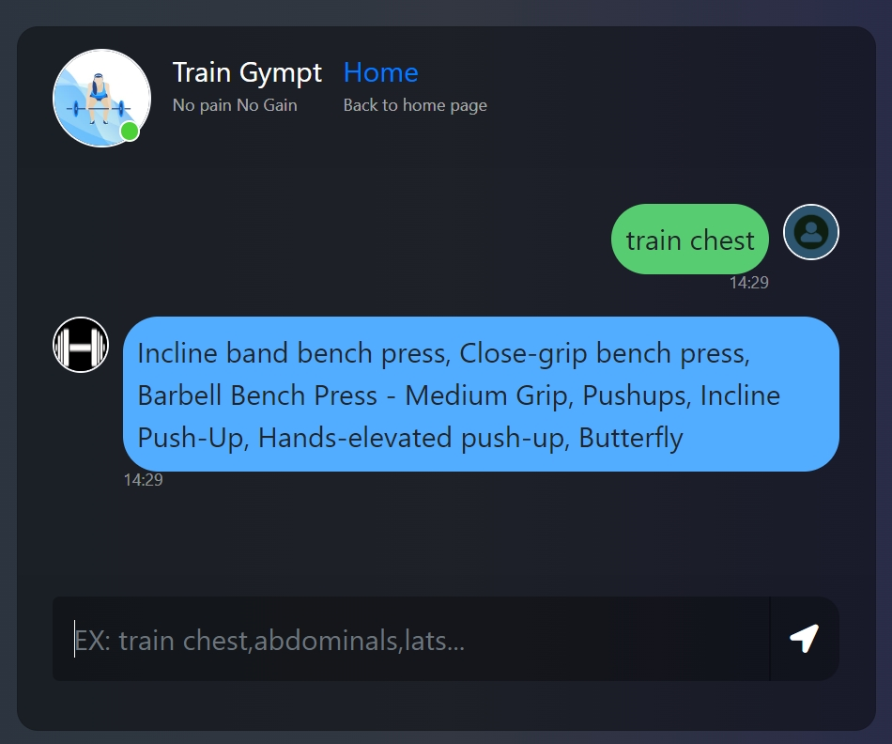
Result - ChatBot
Source: This study

Slide 19
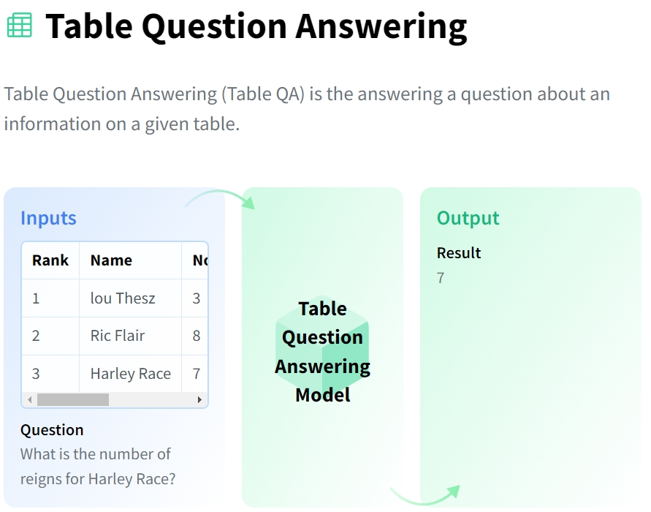
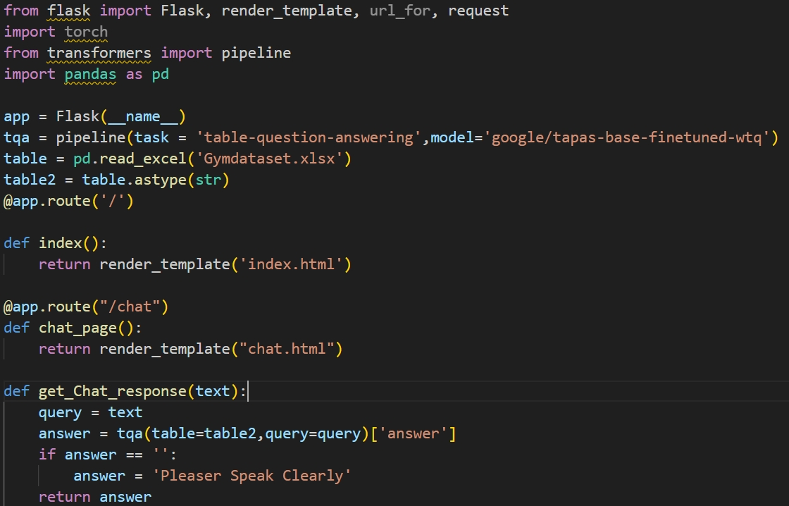
Result - ChatBot
Source: Hao, K. tieu. (n.d.). Table Question Answering. Hugging Face. https://huggingface.co/tasks/table-question-answering

Slide 20
References
Schneider, J. E., Wood, L., Hasson, R. E., & Faith, M. S. (2019). Using deep learning to predict gym membership cancellations. Journal of Personalized Medicine, 9(2), 20. https://doi.org/10.3390/jpm9020020
Pérez-Díaz, J. A., García-Soidán, J. L., & Rial-González, E. (2020). A review of artificial intelligence applications in sports science and physical activity. Healthcare, 8(1), 14. https://doi.org/10.3390/healthcare8010014
Liu, Y., Yang, Q., Liu, W., & Zhao, D. (2018). Intelligent personalized fitness training system based on deep learning and wearable sensor data. IEEE Access, 6, 55323-55331. https://doi.org/10.1109/ACCESS.2018.2875863
Vizcarrondo, A. G., Tavares, J. V., & Grampurohit, N. (2019). AI in fitness: A review. International Journal of Advanced Research in Computer Science, 10(5), 323-328. https://doi.org/10.26483/ijarcs.v10i5.6681
Brockman, G., Cheung, V., Pettersson, L., Schneider, J., Schulman, J., Tang, J., & Zaremba, W. (2016). OpenAI gym: A toolkit for developing and comparing reinforcement learning algorithms. arXiv preprint arXiv:1606.01540.
OpenAI. (2021). OpenAI API: A powerful API for building AI applications. https://beta.openai.com/docs/api-reference/introduction
Van der Meer, E. (2019). Applying OpenAI to workout planning. Medium. https://medium.com/@erwinvandermeer/applying-openai-to-workout-planning-9c9a30e68c46
sharma, A., Madaan, V., & Petty, F. D. (2006). Exercise for Mental Health. Prim Care Companion J Clin Psychiatry., 106.
Notes:
健身和科技行業之間的創新和合作，推動該領域的進一步發展。
通過APP推廣健身和健康生活的重要性，為整個社會的福祉作出貢獻。"

Slide 21
Group 3 : Train gympt
Thank you for listening. Q & A
Advising Professor:
戴敏育 Professor
Min-Yuh Day
Information
Management
711136115
鄭安傑
Jay Cheng
Information
Management
711136117
谷敏杰
Joe Ku

