Slide 1









PNUAirnow: Air quality dashboard
201924451 Kim Taehun

Slide 2
About the project…
Using HTML, CSS and JS
Create a responsive web application to monitor and display real-time air quality data
Including temperature, feelslike temperature, humidity, wind
PM2.5, PM10, CO, O3, NO2, SO2
Visualize trends for temperature and humidity over time
Represent the distribution of various pollutants using Bar charts and Doughnut chart
Implement color coding to indicate air quality levels

Slide 3

Air quality web page link
https://minchocoin.github.io/air-quality-dashboard/
You can download source code on
https://github.com/minchoCoin/air-quality-dashboard

Slide 4
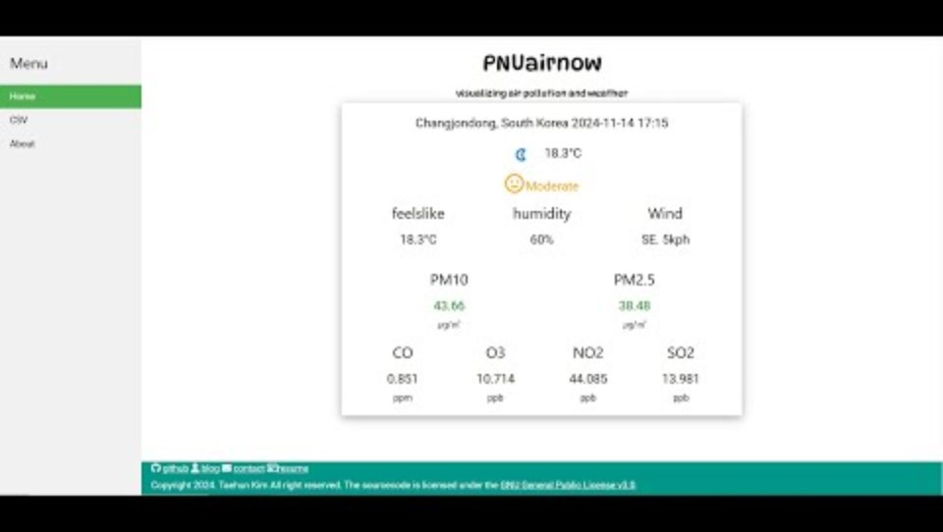
Demo video
https://youtu.be/VFPmD9clYjk

Slide 5
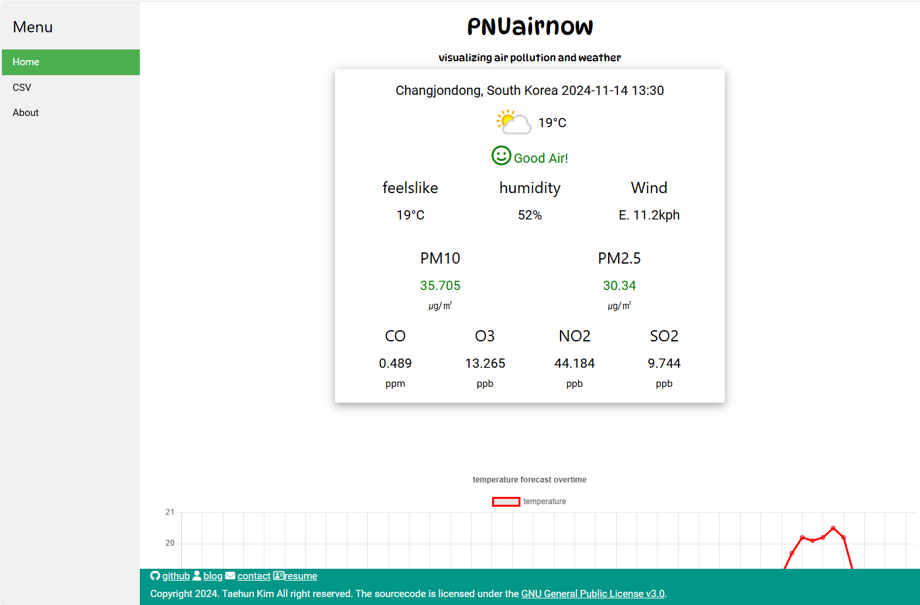
layout
Header
Navigation Bar
Main Dashboard
Footer

Slide 6

layout-header
Title of the application and a brief description.

Slide 7
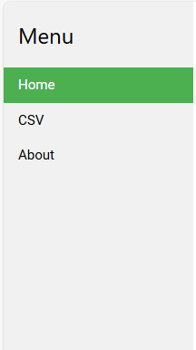

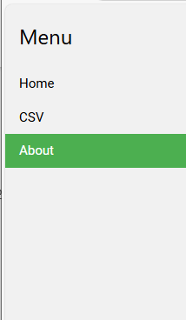
Layout-navigation bar
You can switch the page
through this navigation bar.

Slide 8
Layout- footer
You can view my github, blog, contact, resume link
License link(GNU General Public License v3.0)

Slide 9
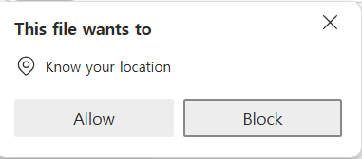
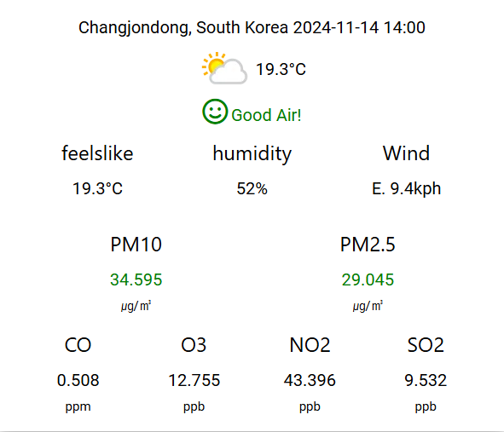
Feature1. real-time dashboard
Using Free Weather API, jquery and AJAX
Get real-time data
- City
- Country
- Last updated
- Weather image
- Air quality
- Temperature
- Feelslike temperature
- Humidity
- Wind
- Pm10
- Pm2.5
- CO
- O3
- NO2
- SO2

Slide 10
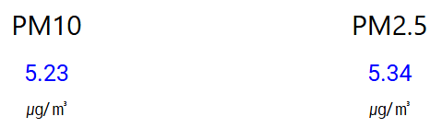
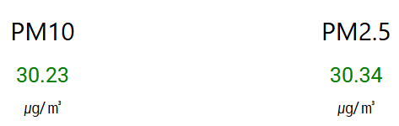
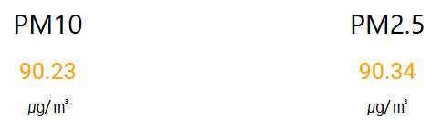
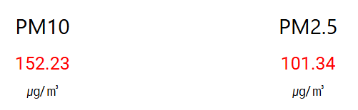

Featur1-1. color of PM10 and PM2.5
PM10 and PM2.5
Good: blue
Moderate: green
Bad: orange
Very bad: red

Slide 11




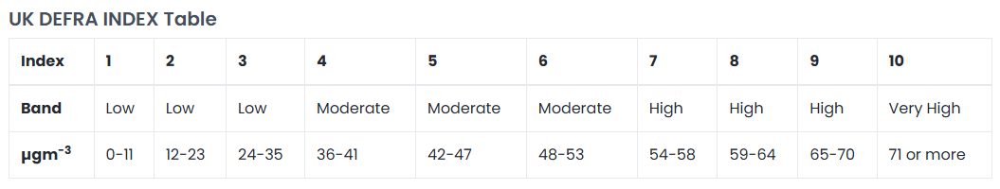
Feature 1-2. color of air quality
UK DEFRA INDEX
Good: blue
Moderate: green
Bad: orange
Very bad: red
* UK DEFRA INDEX tells you about levels of air pollution and provides recommended actions and health advice.

Slide 12
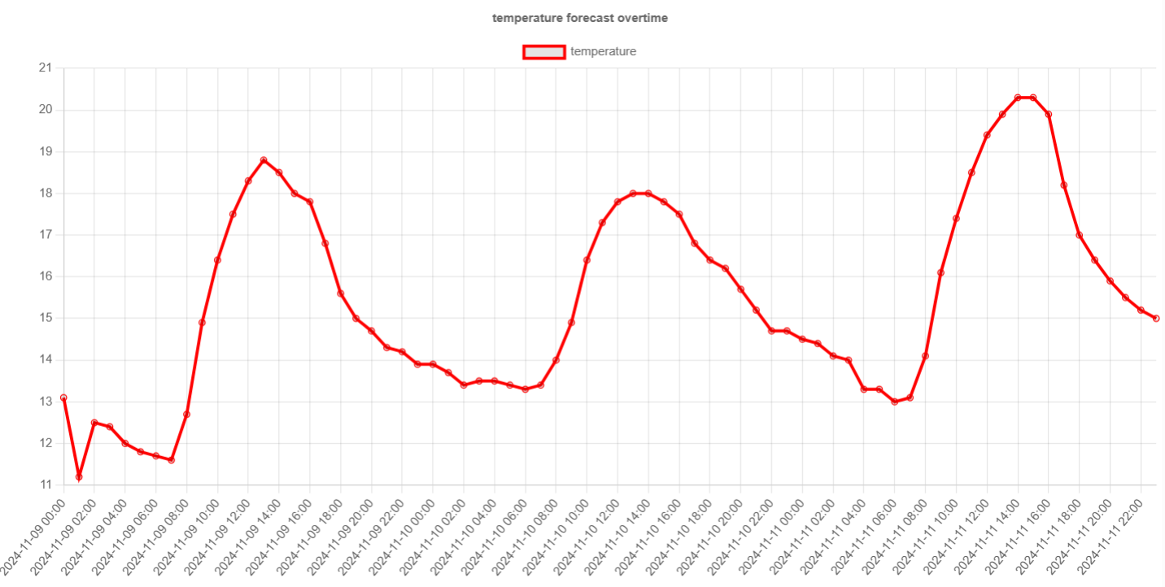
Feature2. temperature & humidity chart
Temperature 3day forecast chart by hour

Slide 13
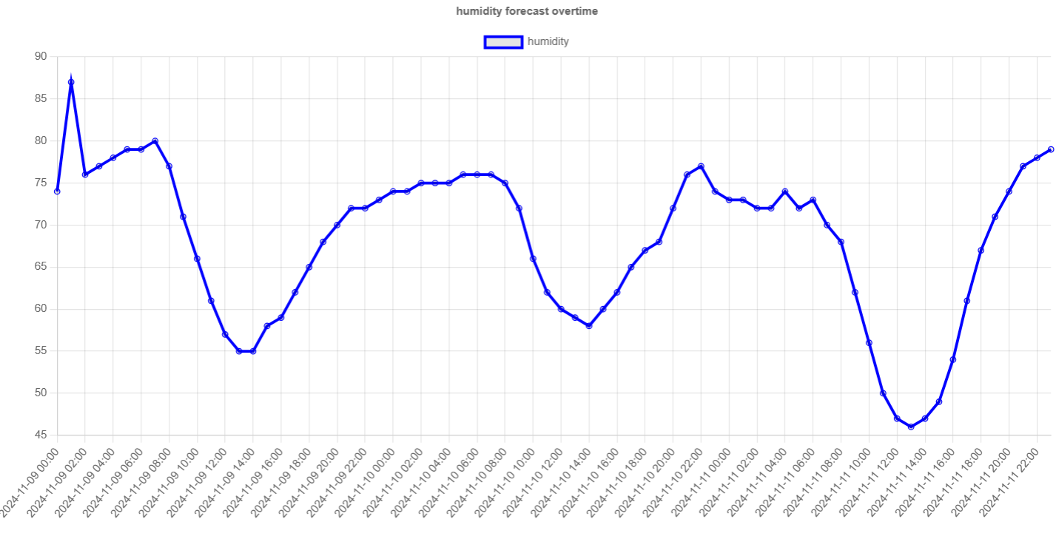
Feature2. temperature & humidity chart
humidity 3day forecast chart by hour

Slide 14
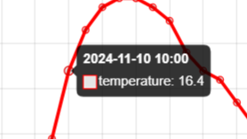
Feature2. temperature & humidity chart
You can check the value of the chart by hover the chart

Slide 15
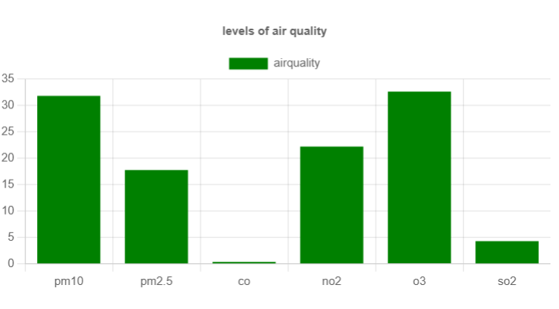
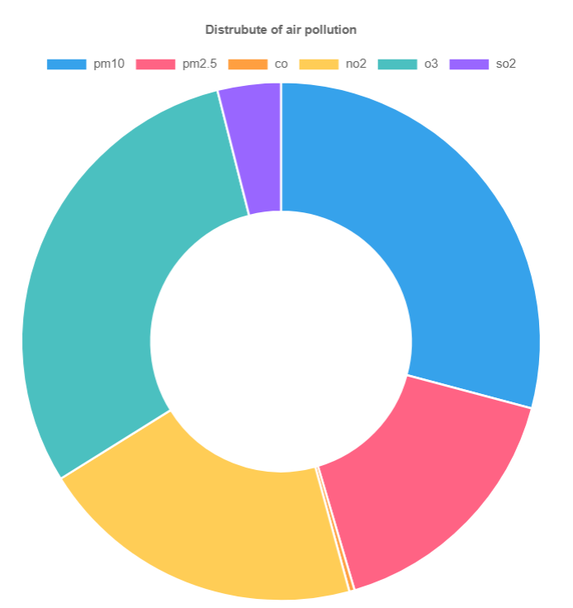
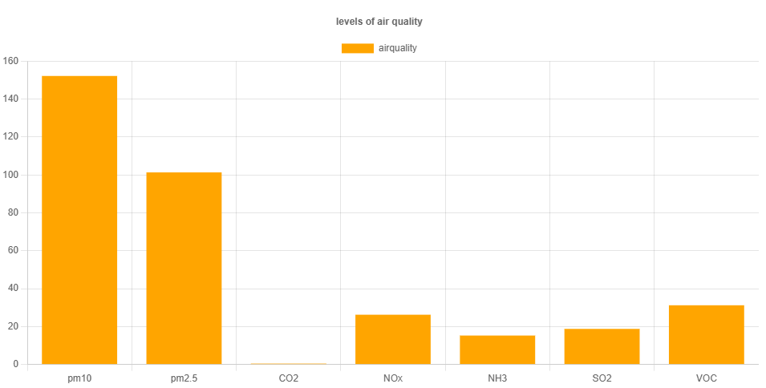
Feature3. Air pollutants chart
The color of air quality bar chart
is the color of air quality

Slide 16
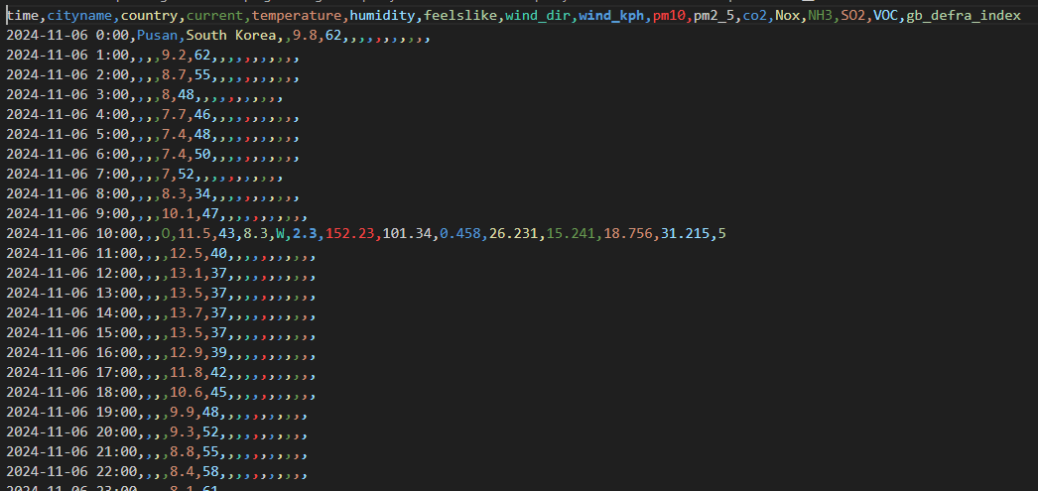
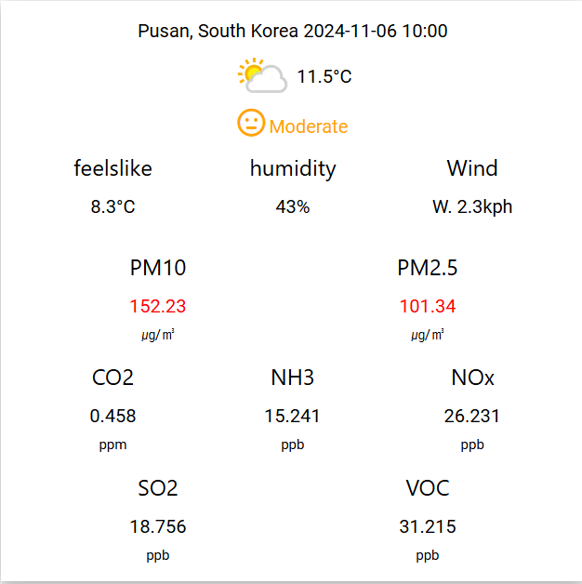
Feature4. CSV file dashboard
Read csv file and visualize
Time, cityname, country, temperature, humidity ,feelslike, wind, pm10,pm2.5, co2, Nox, NH3, SO2,VOC,defra_index

Slide 17
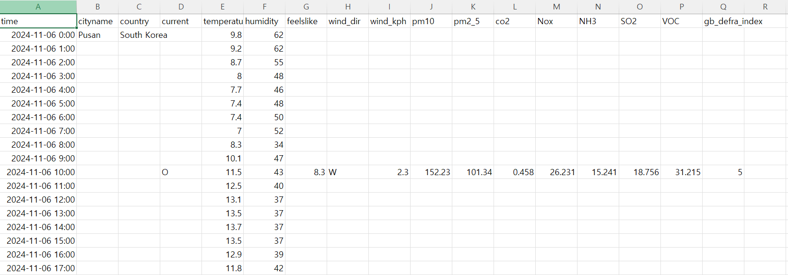
Sample of csv file
Index: time
Columns: cityname,country, current, temperature, humidity, feelslike, wind_dir, wind_kph,
pm10, pm2.5, co2, Nox, NH3, SO2, VOC, gb_defra_index
City name and country are needed only for the first row.
From "feelslike" to "gb_defra_index" columns, data is needed only for rows where "current" equals "O".

Slide 18
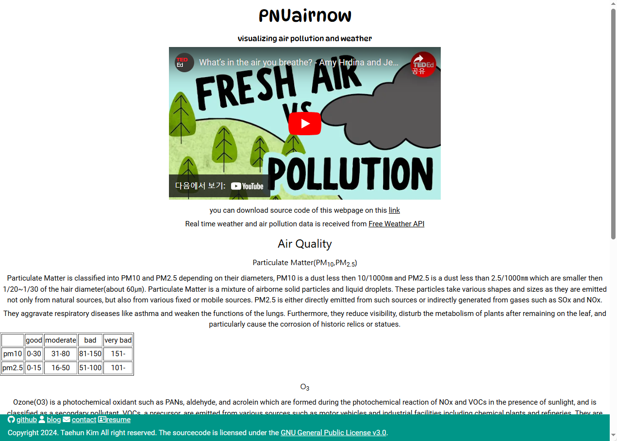
Feature5. about
Video about air pollutions
Information of air pollutions

Slide 19
Used Bootstrap & library
w3 css
font awesome 6.6.0
jquery 3.7.1
chart.js 4.4.1
papaparse 5.4.1

Slide 20
Fonts
Dynapuff: title and logo
Roboto: other contents except title

Slide 21
What will I do
Add air quality data(like what is the UK DEFRA INDEX) more in about.html
Add recommend action and health advices in index.html and csv.html
Change UI more user-friendly
Add error handling(API key expired, csv syntax error, etc)
And so on…

Slide 22
Thank you

