Slide 1
Are Americans choosing used cars over new?
A study of auto sales trends by Mimi Chung

Slide 2
Buying a car used or new
Factors in car decision making:
Car: Year, Make, Model, Color, Mileage, Price, history, features, etc.
You: Financing, location, parking situation, commute, etc.

Slide 3
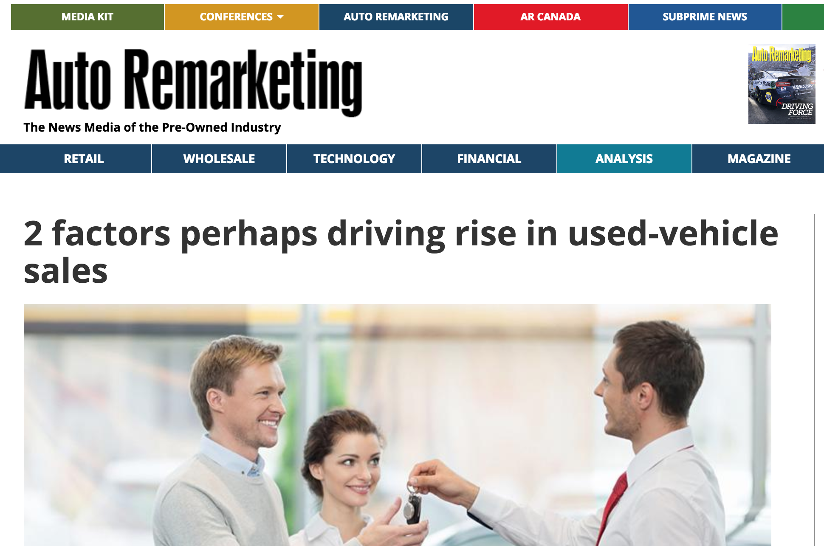

Slide 4
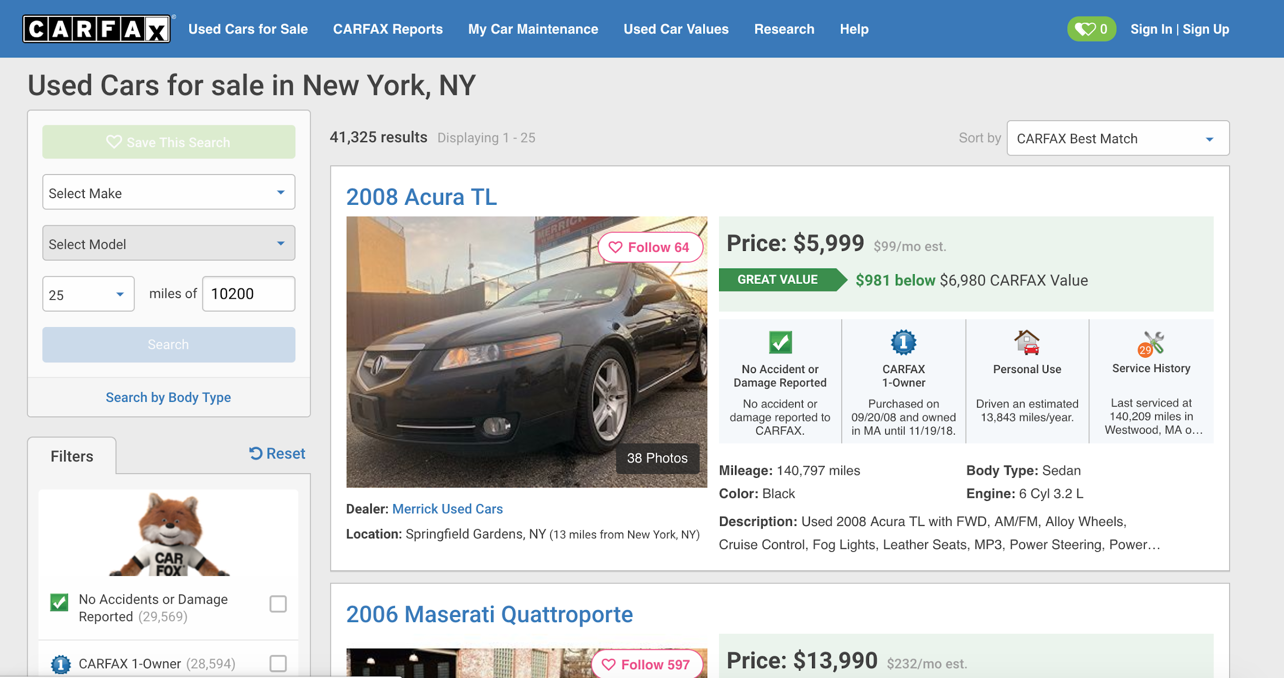

Slide 5
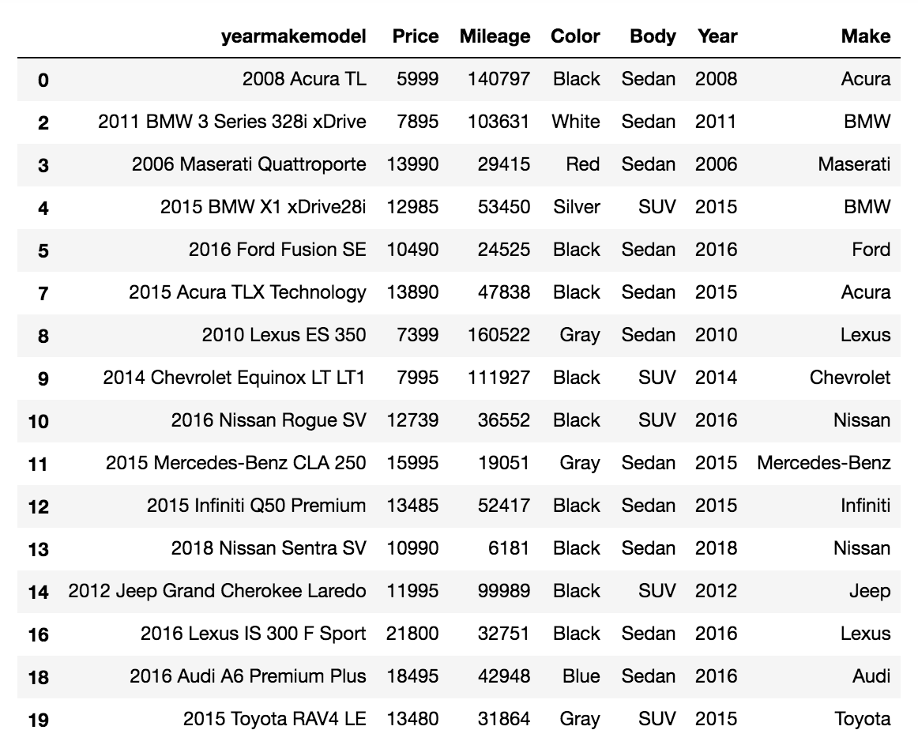
Different ways to compare
Different variables can be plotted in many different combinations

Slide 6
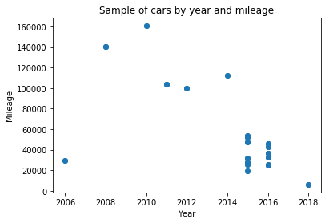
Typically, the lower the year, the higher the mileage. This is not the case in our data set.

Slide 7
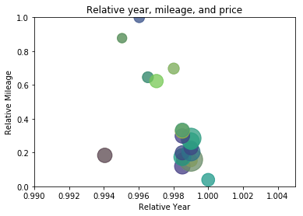
This compares the same set of vehicles scraped from the CarFax website.
The bigger the bubble, the more expensive for that particular car.
To get the best value, typically the smallest sized bubble, located on the lower end of the y-axis, and the higher end of the x-axis would be a good choice.

Slide 10
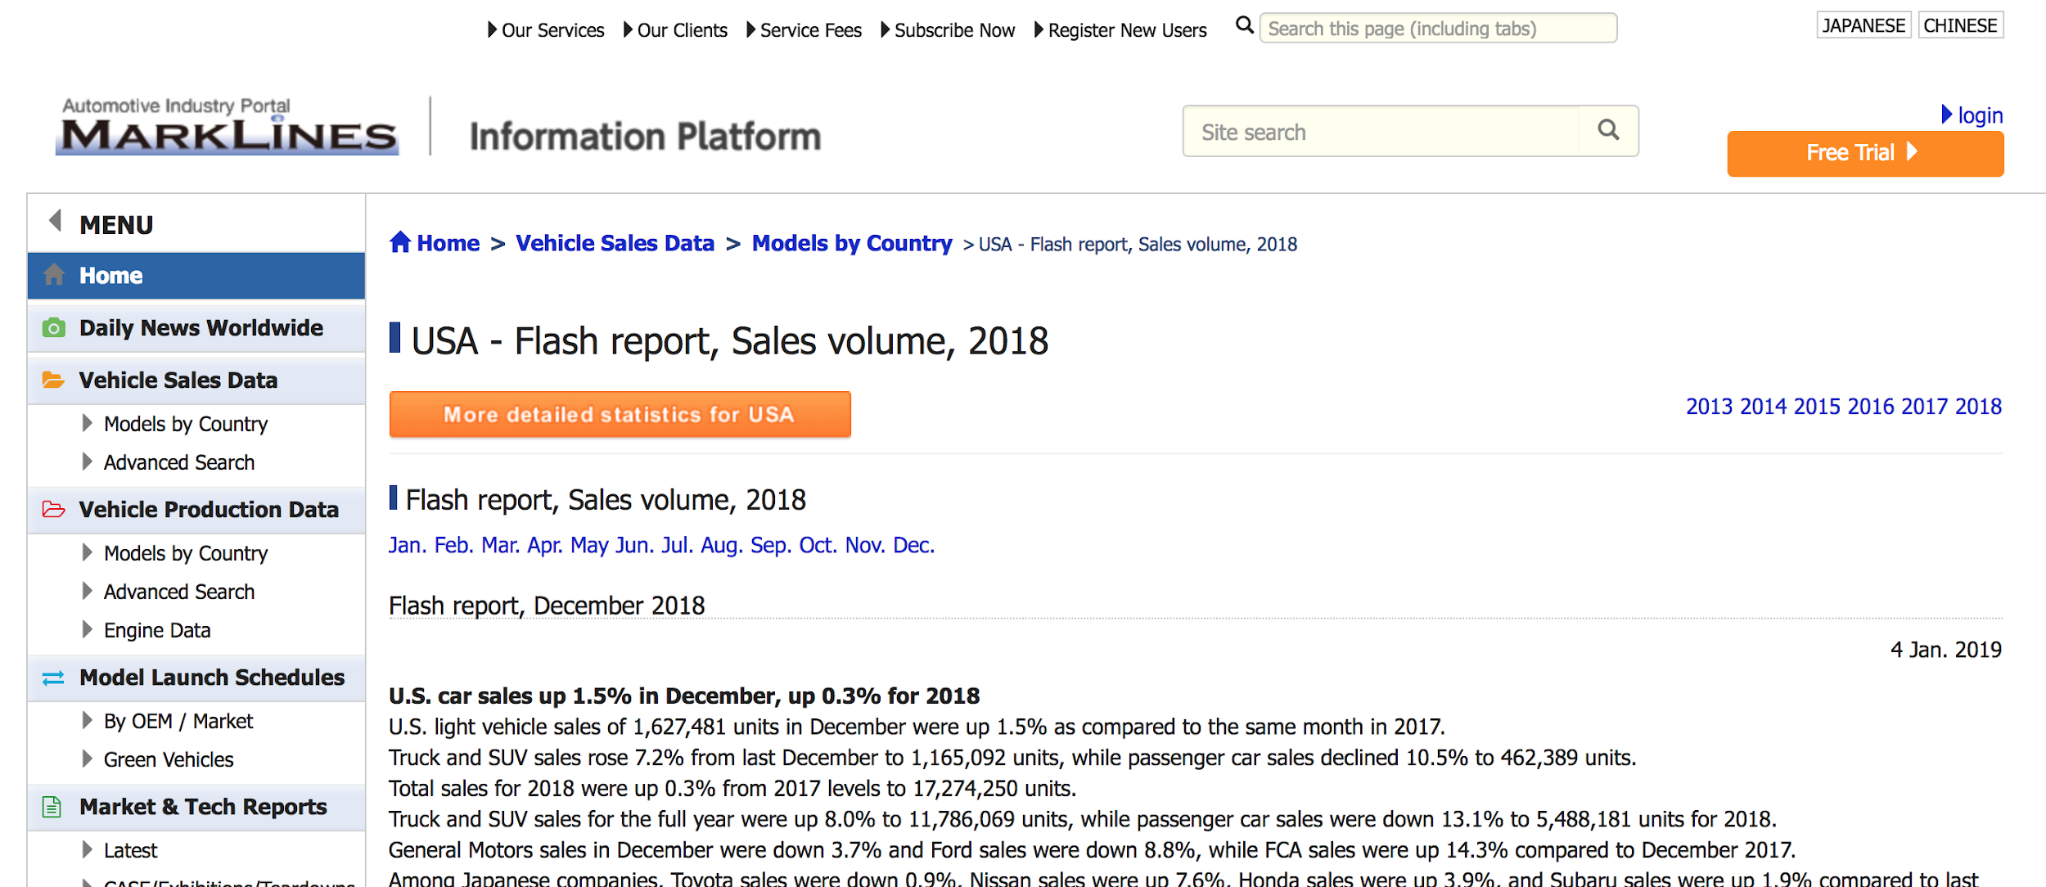
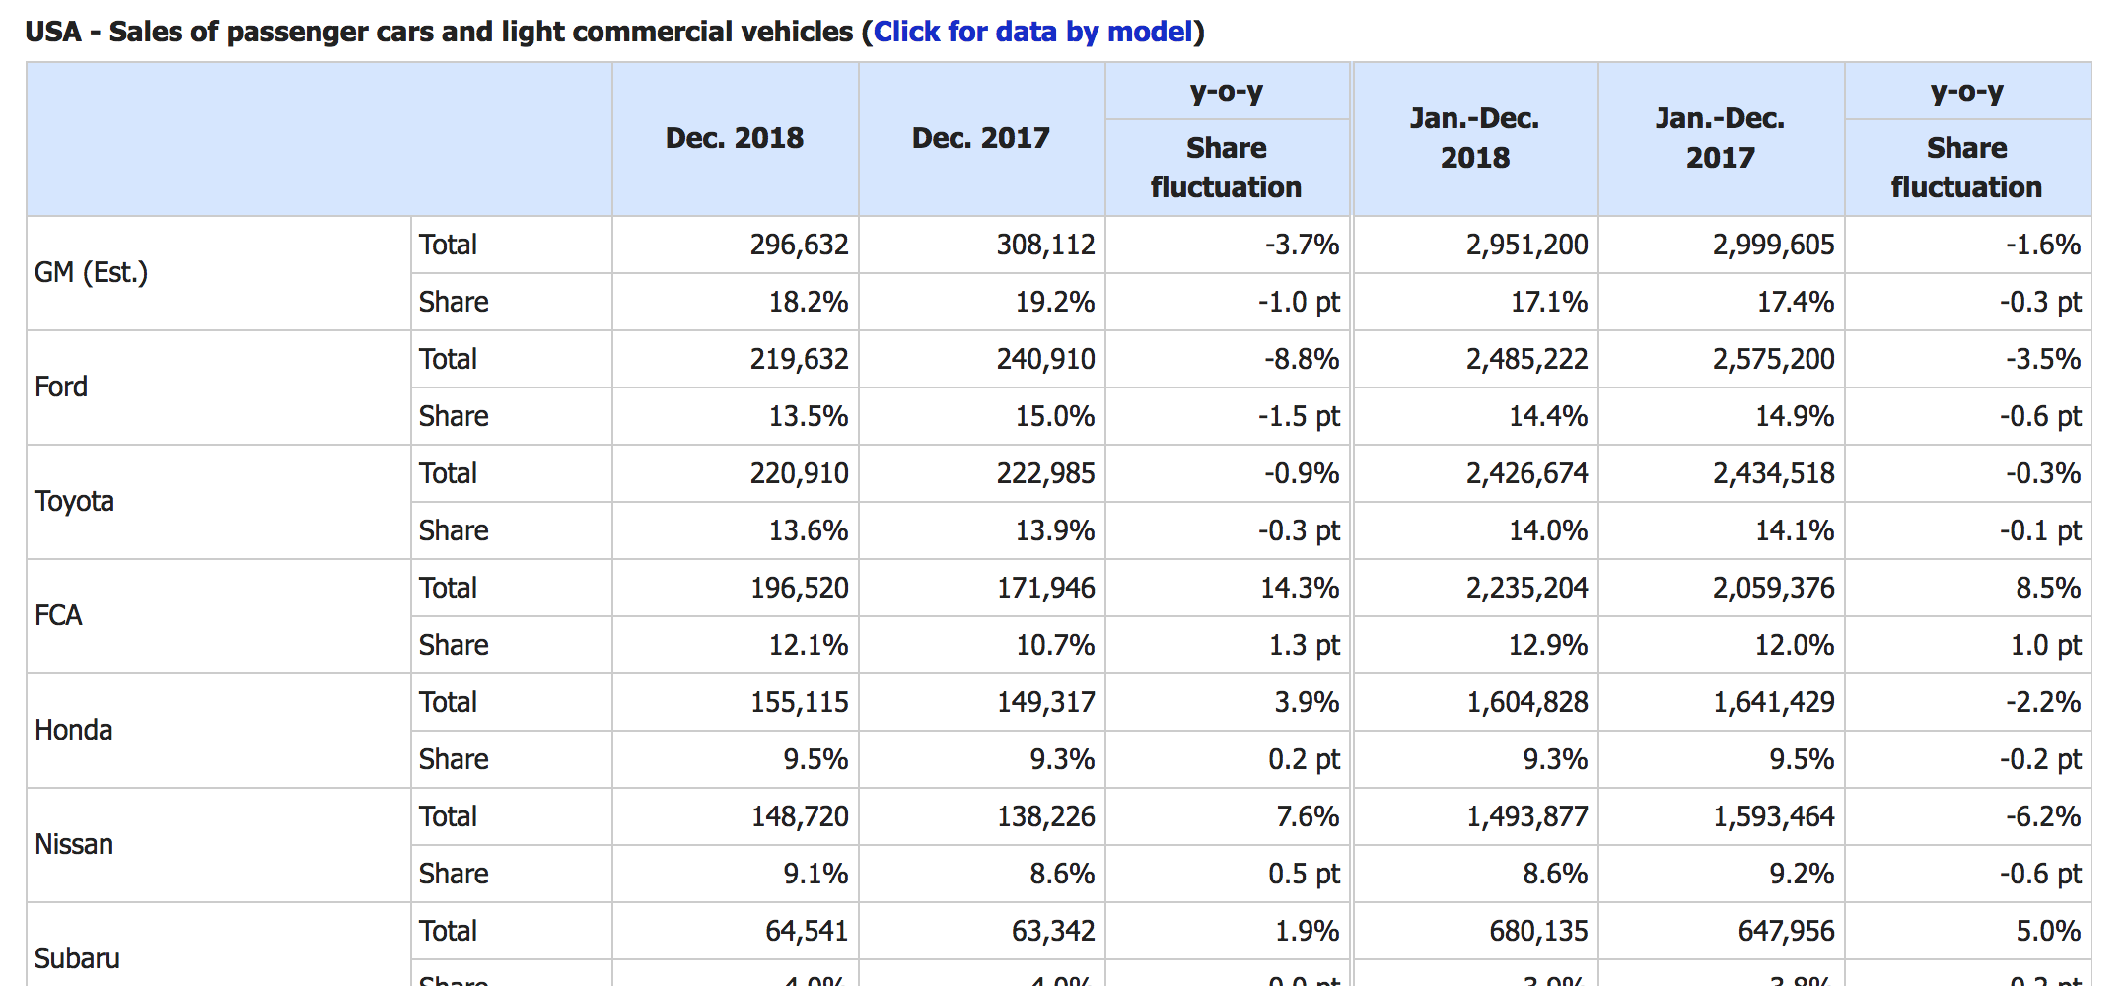

Slide 11
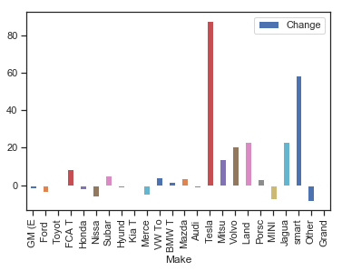
Relative sales in 2018
New car sales have relatively increased in 2018.
This means the rate of used and new car sales are both positive and independent of each other.
% Change

Slide 12
Further research
Gather auto-loan interest rate trends and see if it correlates with rise in auto sales
Characterize and compare vehicles by features (trim, seating, etc.)
Discover trends in the auto industry based on what is more popular/less popular

