Slide 1
Before looking into automatic differentiation backward mode, let’s revisit forward mode.

Slide 2
Evaluation trace
The calculation of a mathematical function can be decomposed into elementary steps. We call the combination of all the elementary steps as the evaluation trace.
Primal and tangent traces:
Forward mode using dual numbers:we can get the primal and tangent trace simultaneously.
Cons: you have to init the number

Slide 3
Forward Mode
Primal Trace
Tangent Trace
Tangent Trace
Tangent Trace
Tangent Trace
x
1
1
1
1
2()
2x
1⋅2
1⋅2
2
()²
(2x)²
2⋅2⋅2x
8x
sin()
sin[(2x)²]
8x ⋅ cos[(2x)²]

Slide 4
Backward Mode
Primal Trace
Tangent Trace
Tangent Trace
Tangent Trace
Tangent Trace
Tangent Trace
x
1
1
2()
2x
()⋅2
()⋅2
2
()²
(2x)²
()⋅2⋅2x
()⋅2⋅2x
()⋅2⋅2x
8x
sin()
sin[(2x)²]
()⋅cos[(2x)²]
()⋅cos[(2x)²]
()⋅cos[(2x)²]
()⋅cos[(2x)²]
(8x)⋅cos[(2x)²]

Slide 5
Backward Mode
Primal Trace
Tangent Trace
Tangent Trace
Tangent Trace
Tangent Trace
Tangent Trace
x
1
1
1
1
1
2()
2x
()⋅2
()⋅2
()⋅2
()⋅2
2
()²
(2x)²
()⋅2⋅2x
()⋅2⋅2x
()⋅2⋅2x
()⋅2⋅2x
8x
sin()
sin[(2x)²]
()⋅cos[(2x)²]
()⋅cos[(2x)²]
()⋅cos[(2x)²]
()⋅cos[(2x)²]
(8x)⋅cos[(2x)²]

Slide 6
Evaluation trace: z = sinx + xy The values of the intermediate variables are sometimes called the primal trace, and the derivative values the tangent trace.
x
y
sin
×
sinx
xy
+
z=sinx+xy

Slide 7
z = sinx + xy, tangent trace dz/dx = cosx + y
x
y
forward
backward
sinx/dx = cosx
xy/dx = y
cosx
y
+
Duplicated visit in forward mode
dz/dx=cosx+y

Slide 8
z = sinx + xy, tangent trace dz/dy = 0 + x
x
y
sinx/dy = 0
xy/dy = x
0
x
+
dz/dy = x

Slide 9
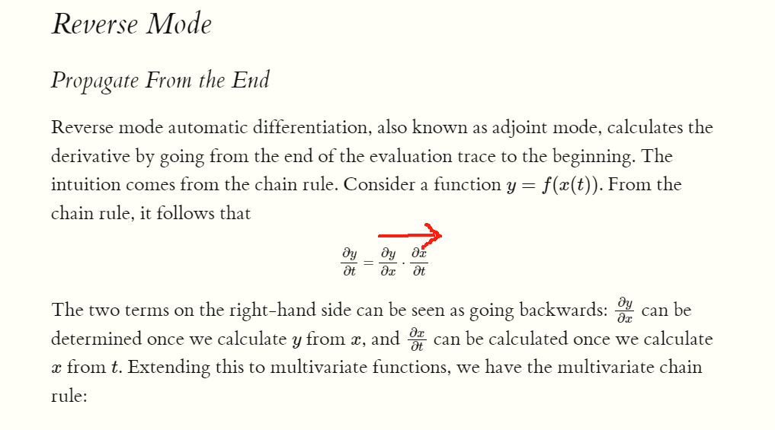
backward

Slide 10
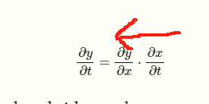
forward

