Slide 1
Forget to order from seamless?
Tired of placing same orders in seamless everyday?

Slide 2
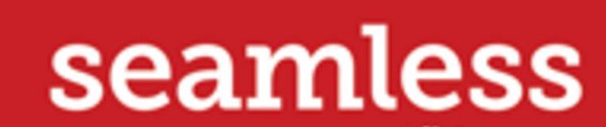

SeamsGood

Slide 3
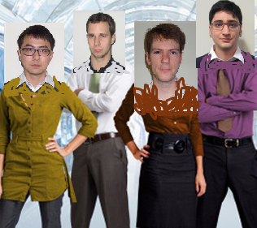
We can help you to forget
the painful ordering from seamless!

Slide 4
SeamsGood:
Scripts to automatically place your seamless order with your preferred order.

Slide 5
Demo

Slide 6
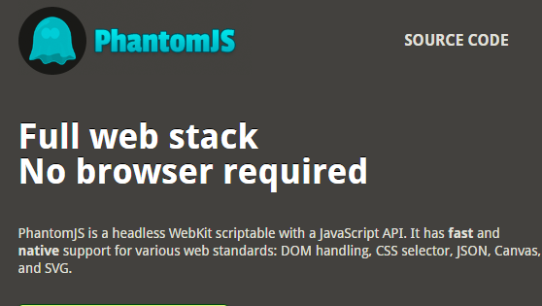
Page Automation:

Slide 7
Cracking Seamless
In code level:
Figure out how to login, place order, submit order

Slide 8
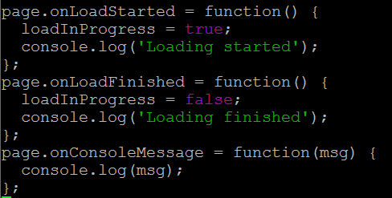
Hack 1:
Async: wait until a page is fully loaded

Slide 9
Hack 2:
Avoid placing order in a usual way:
loads of JS, hard to do automation e.g. popup window
Work around:
add to favorites, get ids, place the order

Slide 10
Hack 3:
Working on Thursday:
When ordering is closed!
Reorder from favourites

Slide 11
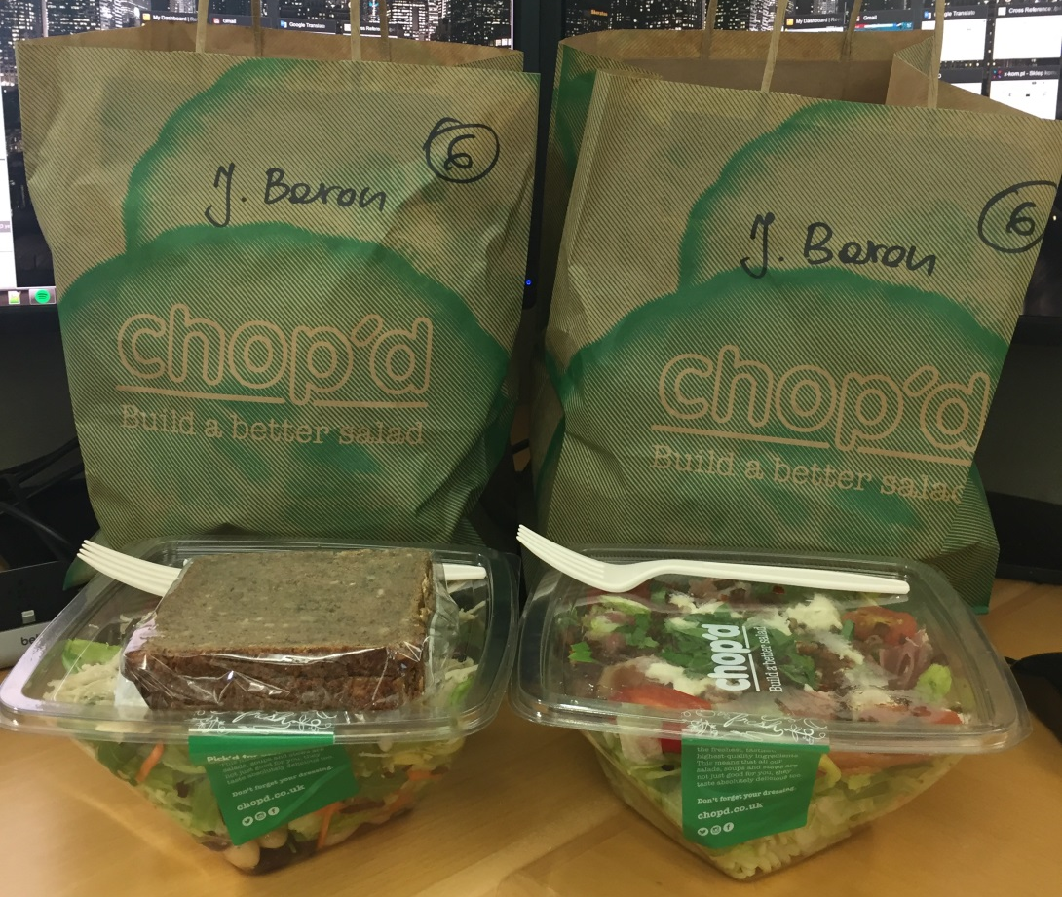

Hack 4:
Get double lunches?

