Slide 1
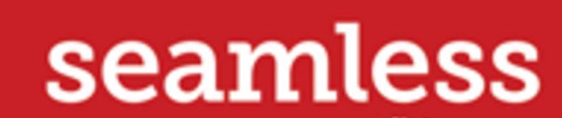

SeamsGood

Slide 2
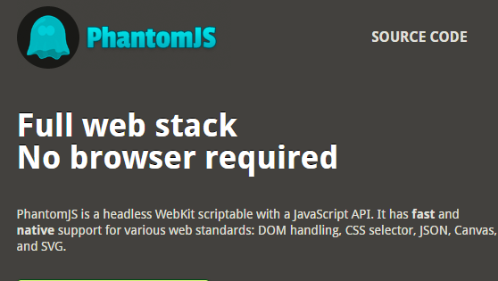
Page Automation

Slide 3
Cracking Seamless
In code level:
Figure out how to login, place order, submit order

Slide 4
Hack 1:
Async: wait until a page is fully loaded

Slide 5
Hack 2:
Avoid placing order in a usual way:
loads of JS ,hard to do automation e.g. popup window
Tried Seamless mobile:
all links, not so many JS interactions
Final solution:
add to favourites,get ids,place the order

Slide 6
Hack 3:
Working on Thursday:
When ordering is closed!

Slide 7
Demo

