Slide 1

제목 : MKL (blas and lapack)
2006. 1. 15 나성권

Slide 2
내용
MKL 소개
MKL 이름 규칙
RMCP의 상속구조

Slide 3
MKL
Intel Math Kernel Library
  Intel chip에 최적화된 수학 라이브러리
  기존의 유명 라이브러리 포팅 + 새로운 라이브러리
  Fortran과 C로 제공.
구성
  BLAS
  Sparse BLAS
  LAPACK
  Fast Fourier Transforms
  VML (Vector Math Library)
  VSL (Vector Statistical Library)

Slide 4
MKL : 이름규칙
BLAS 와 LAPACK과 동일
Fortran에서 영향을 받았다.
Type name : 4가지 제공
s : real, single precision = float
d : real, double precision = double
c : complex, single precision = MKL_Complex8
z : complex, double precision = MKL_Complex16
typedef
struct _MKL_Complex8 {
float real;
float imag;
} MKL_Complex8;
typedef
struct _MKL_Complex16 {
double real;
double imag;
} MKL_Complex16;

Slide 5
MKL : 이름규칙
Matrix Type name
ge general
gb general band
gt general tridiagonal
po symmetric or Hermitian positive-definite
pp symmetric or Hermitian positive-definite (packed storage)
sy symmetric indefinite
sp symmetric indefinite (packed storage)
he Hermitian indefinite
hp Hermitian indefinite (packed storage)
or (real) orthogonal matrix
op (real) orthogonal matrix (packed storage)
un (complex) unitary matrix
up (complex) unitary matrix (packed storage)

Slide 6
MKL : 이름규칙
함수들이 각 Type별로 존재 : ?gecon, ?gbcon..
  ? = s, d, c, z
void sgecon(char *norm,int *n,float *a,int *lda,float *anorm,float *rcond,float *work,int *iwork,int *info);
void dgecon(char *norm,int *n,double *a,int *lda,double *anorm,double *rcond,double *work,int *iwork,int *info);
void cgecon(char *norm,int *n, MKL_Complex8 *a,int *lda,float *anorm,float *rcond, MKL_Complex8 *work,float *rwork,int *info);
void zgecon(char *norm,int *n, MKL_Complex16 *a,int *lda,double *anorm,double *rcond, MKL_Complex16 *work,double *rwork,int *info);
void sgbcon(char *norm,int *n,int *kl,int *ku,float *ab,int *ldab,int *ipiv,float *anorm,float *rcond,float *work,int *iwork,int *info)

Slide 7
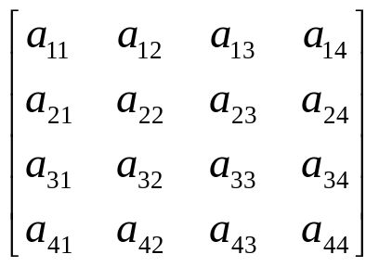
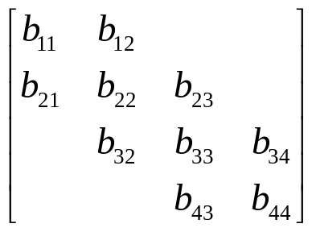
MKL : Storage Scheme
Full storage
  m = 4, n = 4, size = 16
Packed storage : symmetric, triangular
  m = 4, n = 4, size = 10
Band storage : band matrix
  m = 4, n = 4, kl = 1, ku = 1, size = 12
Symmetric 등은 full과 packed 의 두가지 다 제공
a₁₁ | a₂₁ | a₃₁ | a₄₁ | a₁₂ | a₂₂ | a₂₃ | a₂₄ | … | a₄₄
a₁₁ | a₁₂ | a₂₂ | a₁₃ | a₂₃ | a₃₃ | a₁₄ | a₂₄ | … | a₄₄
* | b₁₁ | b₂₁ | b₁₂ | b₂₂ | b₃₂ | … | b₃₄ | b₄₄ | *

Slide 8
BLAS and LAPACK
Basic Linear Algebra Subroutines
  3 종류
    Level 1 : vector-vector operations
    Level 2 : vector-matrix operations
    Level 3 : matrix-matrix operations
  곱, 내적, norm, swap, largest value…
  Lapack의 base를 이룬다.
Linear Algebra Package
  LU decomposition, factorization, condition number, eigenvalue/vector, SVD

Slide 9
Double type, full storage matrix
full storage
dmatrix
(general)
dromatrix
(a.k.a dmMat3)
dhtmatrix
(a.k.a dmHMat)
dgqmatrix
(general square)
dssmatrix
(skew-symmetric)
dormatrix
(orthogonal)
dtrmatrix
(triangular)
dsymatrix
(symmatric indefinite)
donmatrix
(orthonormal)
dpomatrix
(symmetric positive-definit)

Slide 10
Double type, packed storage
packed storage
dtpmatrix
(triangular)
dspmatrix
(symmatric indefinite)
dppmatrix
(symmetric positive-definit)

Slide 11
Double type, band storage
band storage
dgbmatrix
(general band)
dbqmatrix
(general band square)
dpbmatrix
(symmetric positive-definite band)
dtbmatrix
(triangular band)

Slide 12
Double type, vector
vector storage
sparse vector storage
dvector
(general)
dspvector
(general sparse)
d3dvector
(a.k.a dmVec3)

