Slide 1
MIND for YottaDB
MUMPS RPC FRAMEWORK
DnaSoft B.V.

Slide 2
Private comment
Practically every database in the market has a remote access through sockets
One of the main reasons is the growing amount of processed data, leaving horizontal back-end scalability (multiple servers behind a load balancer) accessing a monolithic database a good compromise.
At the same time, executing only pure data API running on the server and moving all the business-tiers to external machines increase the power of the database server allowing a monolithic system to handle more traffic.
GTm and YottaDB don’t have remote access, but I can understand that it is not easy to find the right compromise talking to remote servers with foreign programming languages

Slide 3
Private comment
That’s why Mind fill all the gaps:
Talks M to M programmers and js / java / Go to remote programmers
Expose data in back-end “standard” formats (data-types, Objects) for smoother integration
It is the natural “remote extension” of the multi-language packages YottaDB already offers…
It removes the need to have ALL the client’s code running on the database server, which is now the case (and, in some situation, a limitation for potential customers)

Slide 4
Streamline MUMPS API development with no worries
Isolate you back-end server(s) from the database​
Execute MUMPS procedure remotely using sockets using your preferred programming language.
This will isolate your database server from your back-end server(s), allowing horizontal scalability with no worries…
Focus M development on database procedures
By removing the need to write extra code for communication and data conversion, MUMPS programmers can focus on data.
We natively support JSON / Objects in and out.
Execute your MUMPS code remotely from multiple languages
Your MUMPS code can be remotely executed from several programming languages.
Currently nodejs is fully supported.
Soon Java, Go and .NET drivers will be available

Slide 5
Distributed architecture
Allow you to execute ONLY database related code on the MUMPS server
Allow you to have multiple back-end servers, sharing the same database, to cope with increasing traffic
Keep the power and speed of the M language for pure database access
Use your preferred language for the back-end

Slide 6
Architecture
Back-end
API
new API
Your existing code
Client
(nodejs)
RESP3
M code
Client
(Go)
RESP3
MIND server
Client
(Python)
RESP3
YottaDB
database

Slide 7
Up and running in no time
Easy to install,
Simple to run…
MIND Server gets installed as standard YottaDB plugin on top of your YottaDB installation with a one-liner command.
You can then either run it directly of configure it using the .conf file or command line switches.
Designed putting both MUMPS and back-end developers first
Keeping in mind that back-end languages use data-types and Objects, we created data translators to move data to and from YottaDB.
And, of course, we support JSON in both directions.
ZERO coding needed in the client (back-end) driver.
Once you describe your MUMPS functions / procedure in a JSON file, they will “magically” appear in the client driver and ready to use.
Additionally, automatic validation of the supplied parameters is performed with no code needed.
Support your existing M code right away
You can call your existing code directly, specifying parameters and (eventual) return value.
Once you describe your code in the JSON file, it is available in the client right away

Slide 8
Create and execute M code in 3 minutes
DESCRIBE
Describe your method in a JSON file and restart the Mind server.
CODE
Write M code or simply re-use your Legacy code.
EXECUTE
You can call the method right away, which will execute the M code and return data

Slide 9
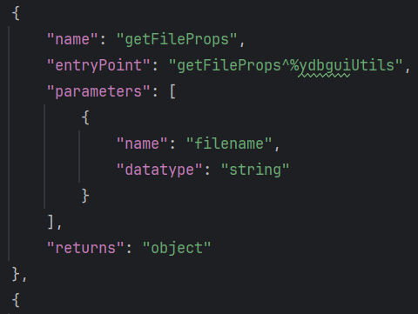
All you need is JSON to describe your API
Create a hierarchical tree structure to group your methods and properties
Describe your procedures / functions with parameters name and data-types
Describe your (optional) return value data-type
Optionally, add M shared variables names to keep process-context in place
Optionally, add read-only values (available in several data-types) that will appear as “properties” in the tree structure

Slide 10
Can still have full remote access to YDB and server / process resources
Built-in objects in the client allow direct access to the following:
Globals
Vars
File system
Process
Server
The client-side methods follow the client language naming, syntax and conventions, making the life easy to back-end programmers

Slide 11
Designed for programmers
We expose a wide range of tools to help you debug problems and improve performances:
Dump the request
Dump the response
Dump the timing in microseconds
Add custom log messages in the server console, also in colors (to stand out) for debugging purposes
Auto-generated methods description and signature on the client, to speed up development and debugging
RESP3 libraries in both client and server, to bypass the framework and make manual calls to the framework
Built-in objects, to perform pre-compiled disk, variables, globals and process utilities

Slide 12
What’s in for the future
The DBMS class
will expose a JSON / Object database
It will allow tables linking in a similar way Fileman does
It will support deep-indexing (indexes of fields deep into object props and arrays)
It will use the client-side to execute commands directly
The DB class:
Will expose an advanced global search (using the ZWRITE call from the GUI that allows:
Ranges on subscripts
Search backwards (still using ranges)
Directly supports lazy-fetching (needed for large global)

Slide 13
RESP3 as network protocol
Introduced by the REDIS storage
Simple and easy to parse protocol
Solid, fast and safe
RESP3 is better than RESP2
It supports more data types than RESP2
It supports async transfers
It supports Verbatim binary strings

