Slide 1
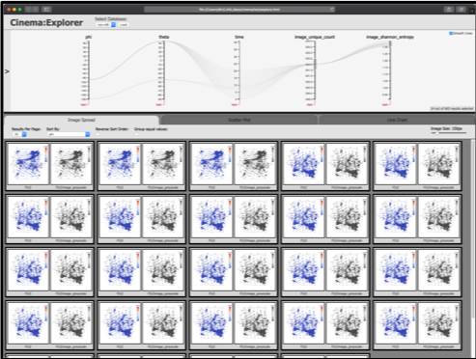
Coupled Nyx/ALPINE
Nyx
Simulation code
ALPINE
Sampling
Algorithm
Cinema DB on disk

Slide 2
Coupled Nyx/ALPINE
ALPINE
Sampling
Algorithm
Cinema DB on disk
Nyx
Simulation code
ALPINE
Isocontour
Algorithm
Cinema DB on disk

