Slide 1
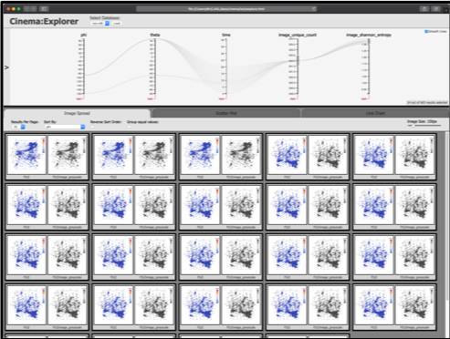
Nyx
Simulation code
Sampling
Algorithm
Cinema DB on disk

