Slide 1
MathTools Lab 9
Bootstrapping, overfitting, cross-validation, model comparison, AIC/BIC
Fangfang Hong

Slide 2
Outline
Part 1: Bootstrapping
Exercise 1: Computing a confidence interval Given empirical data
Part 2: Overfitting and cross-validation
Exercise 2: Fitting polynomial linear models and use cross-validation to find the ‘best’ model
Part 3: Model comparison (AIC, BIC)
Exercise 3: Computing AIC and BIC given log likelihood of models
Part 4: Cross-validation vs. AIC, BIC
Exercise 4: Fitting a psychometric function, computing the likelihood ratio, and comparing the model comparison result obtained from these methods

Slide 3

Bootstrapping
Draw samples with replacement
Sampled dataset1:
Sampled dataset2:
…

Slide 4
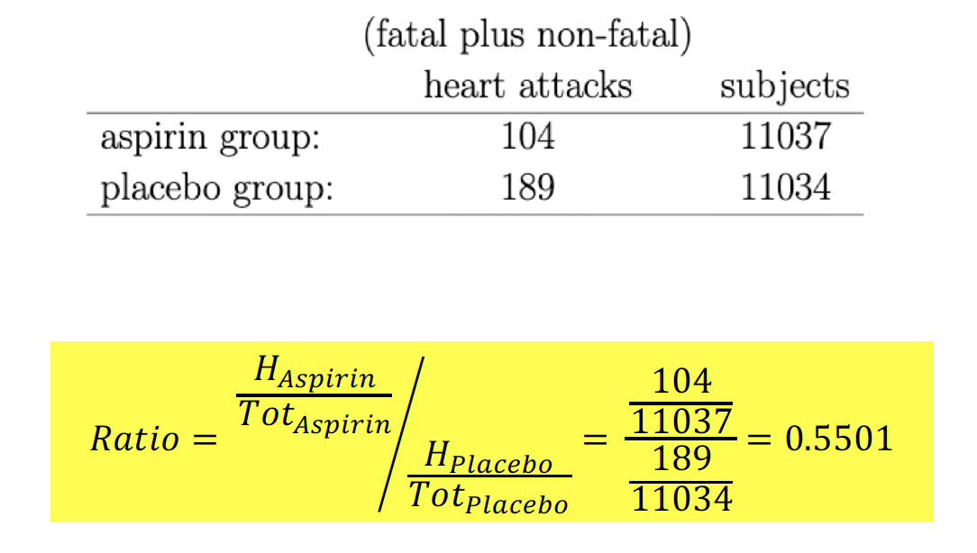
Bootstrapping
Bootstrapping
Exercise 1:
Aspirin group had 55% the number of heart attacks compared to the placebo group
How sure are we of this estimate? – Does the 95% confidence interval include 1?

Slide 5
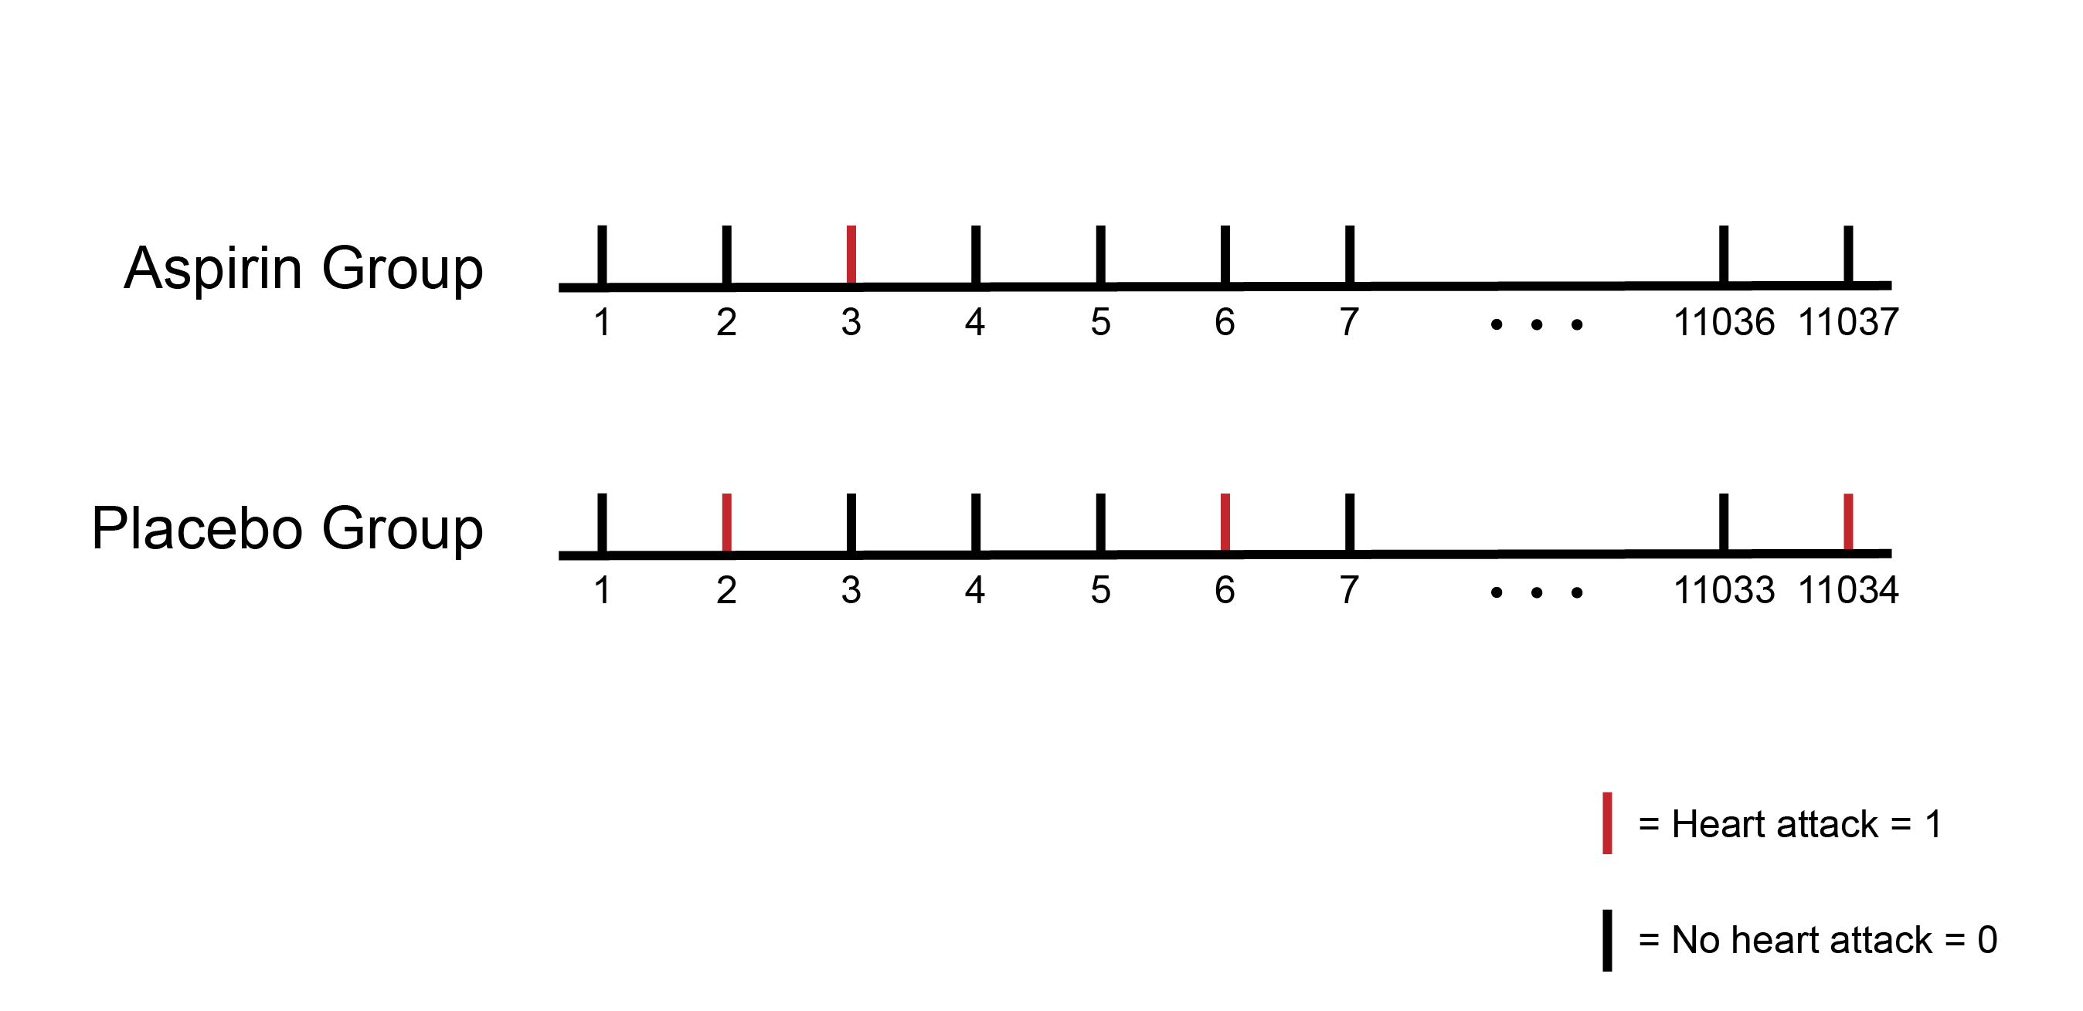
Bootstrapping
Exercise 1:

Slide 6
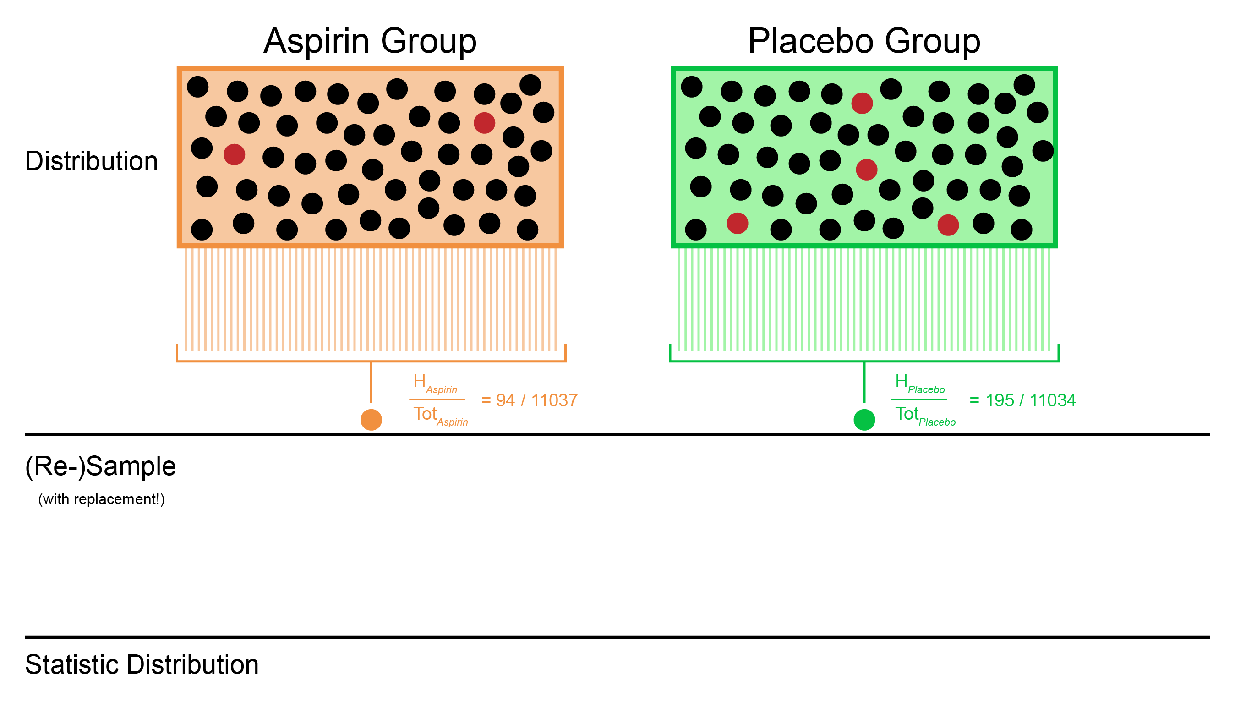

Slide 7
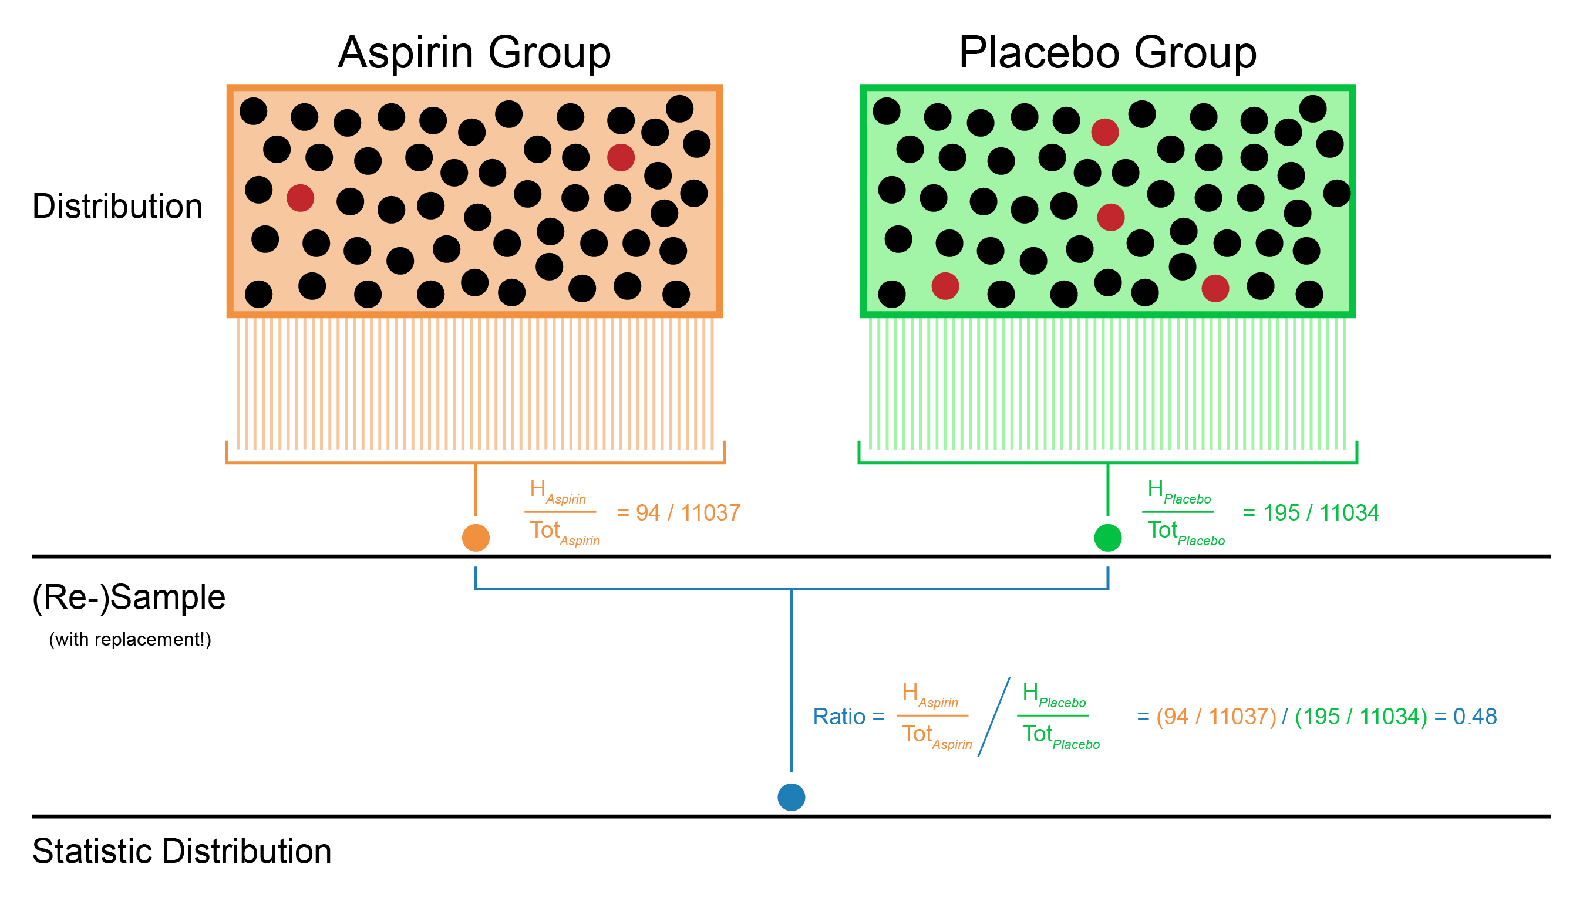

Slide 8
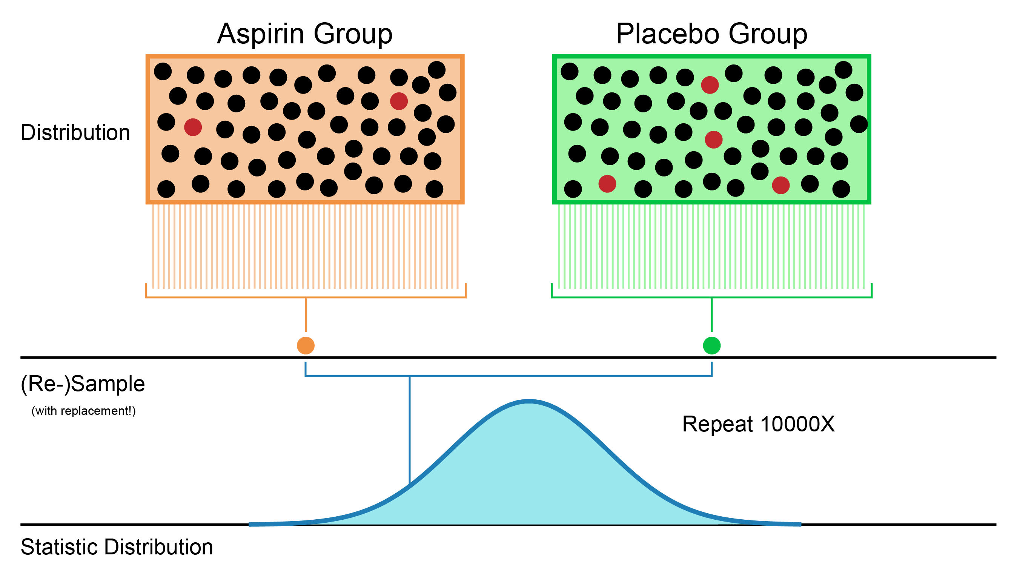

Slide 9
Bootstrapping
Exercise 1:

Slide 10
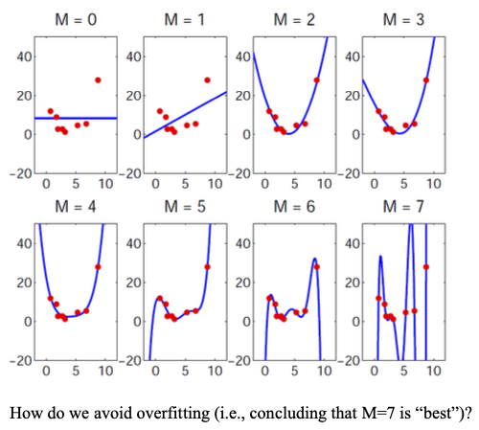
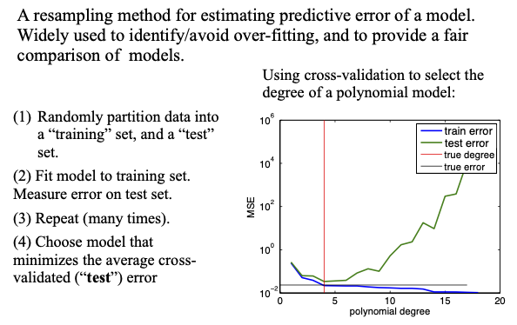
Cross validation

Slide 11
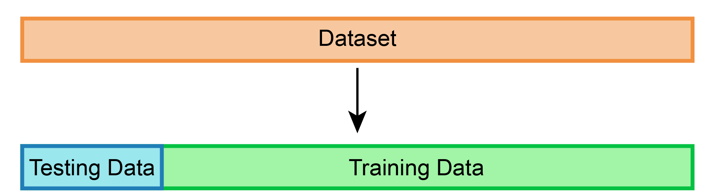
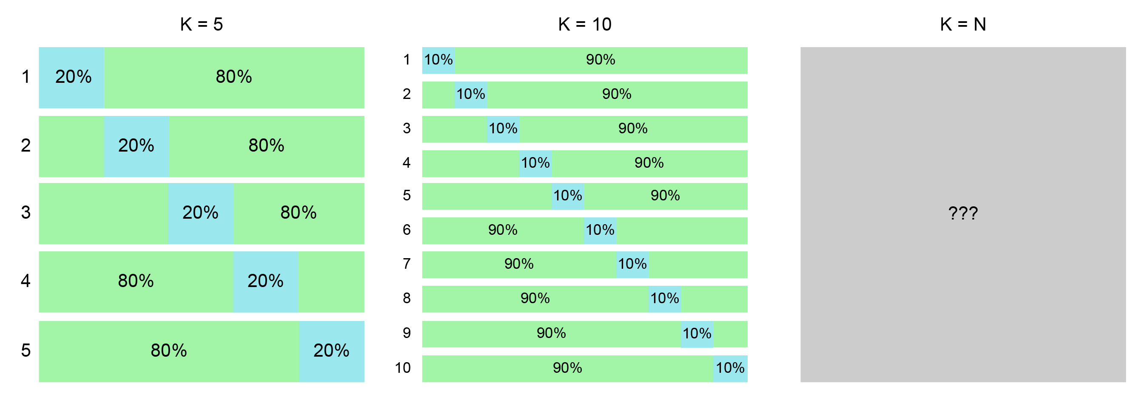
Cross Validation
Cross validation (K-folds)

Slide 12
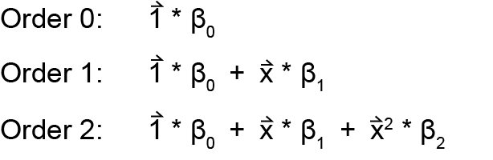
Cross validation (leave-one-out)
Exercise 2:
…

Slide 13
Cross validation (leave-one-out)
Exercise 2:

Slide 14
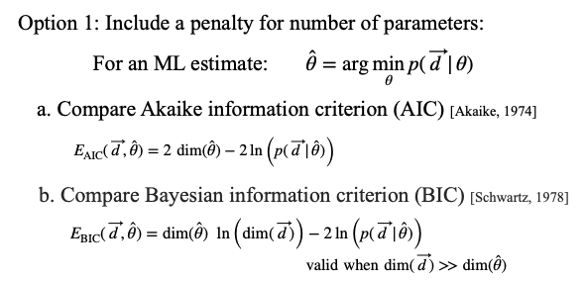
Model comparison (AIC, BIC)

Slide 15


Model comparison (AIC, BIC)
Exercise 3:
Stimulus:
Stimulus onset asynchrony (SOA)
Task:
Report whether V comes first or A comes first
‘V-first’ responses are coded as 1
‘A-first’ responses are coded as 0

Slide 16

Model comparison (AIC, BIC)
Exercise 3:
Model 1:
Model 2:
Model 3:

Slide 17
Model comparison (AIC, BIC)
Exercise 3 & 4:

