Slide 1
The Entity-Relationship Model
Notes:
1

Slide 2
Databases Model the Real World
“Data Model” allows us to translate real world things into structures computers can store
Many models: Relational, E-R, O-O, Network, Hierarchical, etc.
Relational
Rows & Columns
Keys & Foreign Keys to link Relations
Enrolled
Students
sid
cid
grade
53666
Carnatic101
C
sid
name
login
age
gpa
53666
Reggae203
B
53666
Jones
jones@cs
18
3.4
53650
Topology112
A
53688
Smith
smith@eecs
18
3.2
53666
History105
B
53650
Smith
smith@math
19
3.8

Slide 3
Steps in Database Design
Requirements Analysis
user needs; what must database do?
Conceptual Design
high level descr (often done w/ER model)
Logical Design
translate ER into DBMS data model
Schema Refinement
consistency, normalization
Physical Design - indexes, disk layout
Security Design - who accesses what, and how

Slide 4
Conceptual Design
What are the entities and relationships in the enterprise?
What information about these entities and relationships should we store in the database?
What are the integrity constraints or business rules that hold?
A database `schema’ in the ER Model can be represented pictorially (ER diagrams).
Can map an ER diagram into a relational schema.
Notes:
2

Slide 5
ER Model Basics
name
ssn
lot
Employees
Entity: Real-world object, distinguishable from other objects. An entity is described using a set of attributes.
Entity Set: A collection of similar entities. E.g., all employees.
All entities in an entity set have the same set of attributes. (Until we consider hierarchies, anyway!)
Each entity set has a key (underlined).
Each attribute has a domain.
Notes:
3
The slides for this text are organized into several modules. Each lecture contains about enough material for a 1.25 hour class period. (The time estimate is very approximate--it will vary with the instructor, and lectures also differ in length; so use this as a rough guideline.) This covers Lectures 1 and 2 (of 6) in Module (5).
Module (1): Introduction (DBMS, Relational Model)
Module (2): Storage and File Organizations (Disks, Buffering, Indexes)
Module (3): Database Concepts (Relational Queries, DDL/ICs, Views and Security)
Module (4): Relational Implementation (Query Evaluation, Optimization)
Module (5): Database Design (ER Model, Normalization, Physical Design, Tuning)
Module (6): Transaction Processing (Concurrency Control, Recovery)
Module (7): Advanced Topics

Slide 6
ER Model Basics (Contd.)
since
name
dname
ssn
lot
did
budget
Employees
Works_In
Departments
Relationship: Association among two or more entities. E.g., Attishoo works in Pharmacy department.
relationships can have their own attributes.
Relationship Set: Collection of similar relationships.
An n-ary relationship set R relates n entity sets E₁ ... E_{n} ; each relationship in R involves entities e₁ ∈ E₁, ..., e_{n} ∈ E_{n}
Notes:
4

Slide 7
ER Model Basics (Cont.)
name
ssn
lot
Employees
since
dname
super-visor
subor-dinate
did
budget
Reports_To
Departments
Works_In
Same entity set can participate in different relationship sets, or in different “roles” in the same set.
Notes:
4

Slide 8
Key Constraints
name
since
dname
ssn
lot
did
budget
Employees
Manages
Departments
An employee can work in many departments; a dept can have many employees.
Works_In
since
In contrast, each dept has at most one manager, according to the key constraint on Manages.
Many-to-Many
1-to Many
1-to-1
Notes:
6

Slide 9
Participation Constraints
Does every employee work in a department?
If so, this is a participation constraint
the participation of Employees in Works_In is said to be total (vs. partial)
What if every department has an employee working in it?
Basically means “at least one”
since
since
name
name
dname
dname
ssn
did
did
budget
lot
budget
Employees
Manages
Departments
Works_In
Means: “exactly one”
since
Notes:
8

Slide 10
Weak Entities
A weak entity can be identified uniquely only by considering the primary key of another (owner) entity.
Owner entity set and weak entity set must participate in a one-to-many relationship set (one owner, many weak entities).
Weak entity set must have total participation in this identifying relationship set.
name
ssn
lot
cost
pname
age
Employees
Policy
Dependents
Weak entities have only a “partial key” (dashed underline)
Notes:
10

Slide 11
Binary vs. Ternary Relationships
name
ssn
lot
pname
age
Employees
Covers
Dependents
If each policy is owned by just 1 employee:
Bad design
Policies
Key constraint on Policies would mean policy can only cover 1 dependent!
policyid
cost
name
pname
age
ssn
lot
Dependents
Employees
Think through all the constraints in the 2nd diagram!
Purchaser
Beneficiary
Better design
Policies
policyid
cost
Notes:
7

Slide 12
Binary vs. Ternary Relationships (Contd.)
Previous example illustrated a case when two binary relationships were better than one ternary relationship.
An example in the other direction: a ternary relation Contracts relates entity sets Parts, Departments and Suppliers, and has descriptive attribute qty. No combination of binary relationships is an adequate substitute.
Notes:
9

Slide 13
Binary vs. Ternary Relationships (Contd.)
qty
Parts
Contract
Departments
VS.
Suppliers
Parts
needs
Departments
can-supply
Suppliers
deals-with
S “can-supply” P, D “needs” P, and D “deals-with” S does not imply that D has agreed to buy P from S.
How do we record qty?
Notes:
9

Slide 14
Summary so far
Entities and Entity Set (boxes)
Relationships and Relationship sets (diamonds)
binary
n-ary
Key constraints (1-1,1-M, M-M, arrows on 1 side)
Participation constraints (bold for Total)
Weak entities - require strong entity for key
Next, a couple more “advanced” concepts…

Slide 15
Aggregation
name
ssn
lot
Used to model a relationship involving a relationship set.
Allows us to treat a relationship set as an entity set for purposes of participation in (other) relationships.
Employees
Monitors
until
started_on
since
dname
pid
pbudget
did
budget
Projects
Sponsors
Departments
Aggregation vs. ternary relationship?
Monitors is a distinct relationship, with a descriptive attribute.
Also, can say that each sponsorship is monitored by at most one employee.
Notes:
2

Slide 16
Conceptual Design Using the ER Model
ER modeling can get tricky!
Design choices:
Should a concept be modeled as an entity or an attribute?
Should a concept be modeled as an entity or a relationship?
Identifying relationships: Binary or ternary? Aggregation?
Note constraints of the ER Model:
A lot of data semantics can (and should) be captured.
But some constraints cannot be captured in ER diagrams.
We’ll refine things in our logical (relational) design
Notes:
3

Slide 17
Entity vs. Attribute
Should address be an attribute of Employees or an entity (related to Employees)?
Depends upon how we want to use address information, and the semantics of the data:
If we have several addresses per employee, address must be an entity (since attributes cannot be set-valued).
If the structure (city, street, etc.) is important, address must be modeled as an entity (since attribute values are atomic).

Slide 18
Entity vs. Attribute (Cont.)
from
to
name
dname
ssn
lot
did
budget
Works_In2 does not allow an employee to work in a department for two or more periods.
Similar to the problem of wanting to record several addresses for an employee: we want to record several values of the descriptive attributes for each instance of this relationship.
Employees
Works_In2
Departments
name
dname
ssn
lot
did
budget
Employees
Works_In3
Departments
from
Duration
to
Notes:
5

Slide 19
Entity vs. Relationship
OK as long as a manager gets a separate discretionary budget (dbudget) for each dept.
What if manager’s dbudget covers all managed depts?
(can repeat value, but such redundancy is problematic)
since
dbudget
name
dname
ssn
lot
did
budget
Employees
Manages2
Departments
name
ssn
lot
dname
Employees
did
budget
Departments
is_manager
managed_by
since
apptnum
Mgr_Appts
dbudget
Notes:
6

Slide 20
Now you try it
Try this at home - Courses database:
Courses, Students, Teachers
Courses have ids, titles, credits, …
Courses have multiple sections that have time/rm and exactly one teacher
Must track students’ course schedules and transcripts including grades, semester taken, etc.
Must track which classes a professor has taught
Database should work over multiple semesters

Slide 21
These things get pretty hairy!
Many E-R diagrams cover entire walls!
A modest example:

Slide 22
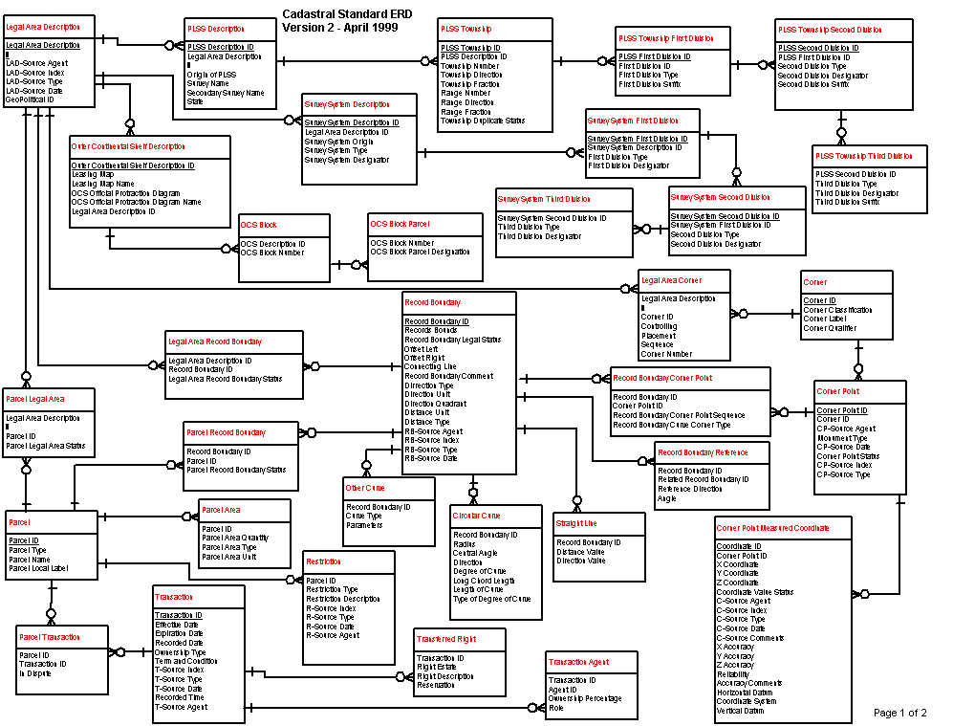
A Cadastral E-R Diagram
cadastral: showing or recording property boundaries, subdivision lines, buildings, and related details
Source: US Dept. Interior Bureau of Land Management, Federal Geographic Data Committee Cadastral Subcommittee
http://www.fairview-industries.com/standardmodule/cad-erd.htm

Slide 23
Converting ER to Relational
Fairly analogous structure
But many simple concepts in ER are subtle to specify in relations

Slide 24
Logical DB Design: ER to Relational
Entity sets to tables.
ssn
name
lot
123-22-3666
Attishoo
48
name
231-31-5368
Smiley
22
ssn
lot
131-24-3650
Smethurst
35
Employees
CREATE TABLE Employees
(ssn CHAR(11),
name CHAR(20),
lot INTEGER,
PRIMARY KEY (ssn))
Notes:
3
The slides for this text are organized into several modules. Each lecture contains about enough material for a 1.25 hour class period. (The time estimate is very approximate--it will vary with the instructor, and lectures also differ in length; so use this as a rough guideline.) This covers Lectures 1 and 2 (of 6) in Module (5).
Module (1): Introduction (DBMS, Relational Model)
Module (2): Storage and File Organizations (Disks, Buffering, Indexes)
Module (3): Database Concepts (Relational Queries, DDL/ICs, Views and Security)
Module (4): Relational Implementation (Query Evaluation, Optimization)
Module (5): Database Design (ER Model, Normalization, Physical Design, Tuning)
Module (6): Transaction Processing (Concurrency Control, Recovery)
Module (7): Advanced Topics

Slide 25
Relationship Sets to Tables
CREATE TABLE Works_In(
ssn CHAR(1),
did INTEGER,
since DATE,
PRIMARY KEY (ssn, did),
FOREIGN KEY (ssn)
REFERENCES Employees,
FOREIGN KEY (did)
REFERENCES Departments)
In translating a many-to-many relationship set to a relation, attributes of the relation must include:
1) Keys for each participating entity set (as foreign keys). This set of attributes forms a superkey for the relation.
2) All descriptive attributes.
ssn
did
since
123-22-3666
51
1/1/91
123-22-3666
56
3/3/93
231-31-5368
51
2/2/92
Notes:
5

Slide 26
Review: Key Constraints
Each dept has at most one manager, according to the key constraint on Manages.
since
name
dname
ssn
lot
did
budget
Employees
Manages
Departments
Translation to
relational model?
1-to-1
1-to Many
Many-to-1
Many-to-Many
Notes:
6

Slide 27
Translating ER with Key Constraints
since
Since each department has a unique manager, we could instead combine Manages and Departments.
name
dname
ssn
lot
did
budget
Employees
Manages
Departments
CREATE TABLE Manages(
ssn CHAR(11),
did INTEGER,
since DATE,
PRIMARY KEY (did),
FOREIGN KEY (ssn) REFERENCES Employees,
FOREIGN KEY (did) REFERENCES Departments)
CREATE TABLE Dept_Mgr(
did INTEGER,
dname CHAR(20),
budget REAL,
ssn CHAR(11),
since DATE,
PRIMARY KEY (did),
FOREIGN KEY (ssn)
REFERENCES Employees)
Vs.
Notes:
7

Slide 28
Review: Participation Constraints
Does every department have a manager?
If so, this is a participation constraint: the participation of Departments in Manages is said to be total (vs. partial).
Every did value in Departments table must appear in a row of the Manages table (with a non-null ssn value!)
since
since
name
name
dname
dname
ssn
did
did
budget
lot
budget
Employees
Manages
Departments
Works_In
since
Notes:
8

Slide 29
Participation Constraints in SQL
We can capture participation constraints involving one entity set in a binary relationship, but little else (without resorting to CHECK constraints which we’ll learn later).
CREATE TABLE Dept_Mgr(
did INTEGER,
dname CHAR(20),
budget REAL,
ssn CHAR(11) NOT NULL,
since DATE,
PRIMARY KEY (did),
FOREIGN KEY (ssn) REFERENCES Employees,
ON DELETE NO ACTION)
Notes:
9

Slide 30
Review: Weak Entities
A weak entity can be identified uniquely only by considering the primary key of another (owner) entity.
Owner entity set and weak entity set must participate in a one-to-many relationship set (1 owner, many weak entities).
Weak entity set must have total participation in this identifying relationship set.
name
ssn
lot
cost
pname
age
Employees
Policy
Dependents
Notes:
10

Slide 31
Translating Weak Entity Sets
Weak entity set and identifying relationship set are translated into a single table.
When the owner entity is deleted, all owned weak entities must also be deleted.
CREATE TABLE Dep_Policy (
pname CHAR(20),
age INTEGER,
cost REAL,
ssn CHAR(11) NOT NULL,
PRIMARY KEY (pname, ssn),
FOREIGN KEY (ssn) REFERENCES Employees,
ON DELETE CASCADE)
Notes:
11

Slide 32
Summary of Conceptual Design
Conceptual design follows requirements analysis,
Yields a high-level description of data to be stored
ER model popular for conceptual design
Constructs are expressive, close to the way people think about their applications.
Note: There are many variations on ER model
Both graphically and conceptually
Basic constructs: entities, relationships, and attributes (of entities and relationships).
Some additional constructs: weak entities, ISA hierarchies (see text if you’re curious), and aggregation.
Notes:
11

Slide 33
Summary of ER (Cont.)
Several kinds of integrity constraints:
key constraints
participation constraints
Some foreign key constraints are also implicit in the definition of a relationship set.
Many other constraints (notably, functional dependencies) cannot be expressed.
Constraints play an important role in determining the best database design for an enterprise.
Notes:
12

Slide 34
Summary of ER (Cont.)
ER design is subjective. There are often many ways to model a given scenario!
Analyzing alternatives can be tricky, especially for a large enterprise. Common choices include:
Entity vs. attribute, entity vs. relationship, binary or n-ary relationship, whether or not to use ISA hierarchies, aggregation.
Ensuring good database design: resulting relational schema should be analyzed and refined further.
Functional Dependency information and normalization techniques are especially useful.
Notes:
13

