Slide 1
Oracle JET

Slide 2


Slide 3
Contents
Introduction
Installation and Configuration of OJET
First OJET Application

Slide 4







OJET Toolkit

Slide 5
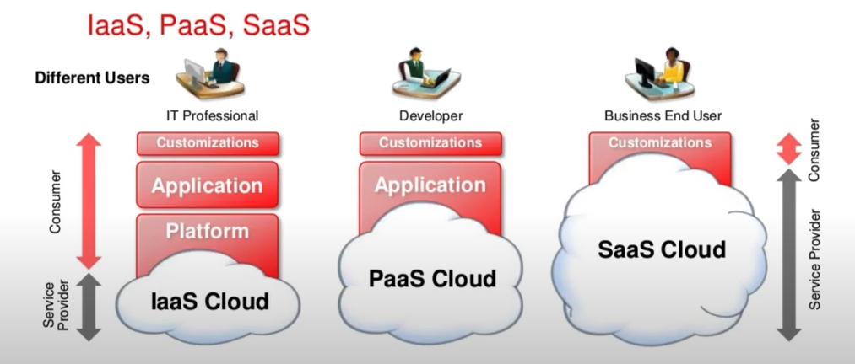
Modern Business Applications and Cloud
JS is the native language of the internet
Research with Cloud architectures
OJET is the resultant of that research
Oracle recommendations and best practices for enterprise JS

Slide 6
Oracle JET
Free and Open Source
github.com/oracle/oraclejet
Javascript Toolkit
Useful Architectures, Patterns, Templates, Techniques, Components
Focussed on Enterprise Applications
Javascript, HTML5 and CSS3
Result of research at Oracle in Javascript enterprise applications

Slide 7
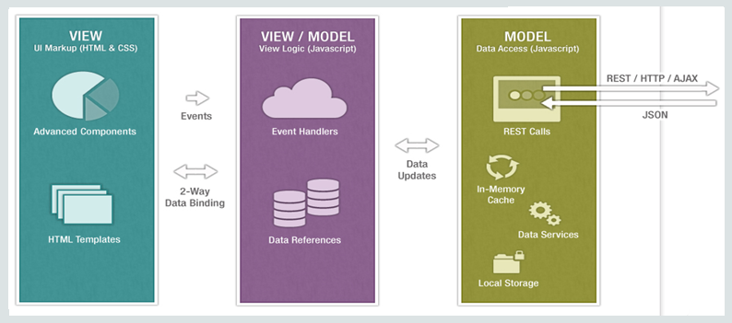
OJET MVVM Concepts
External Server
External Server
User
External Server
External Server

Slide 8
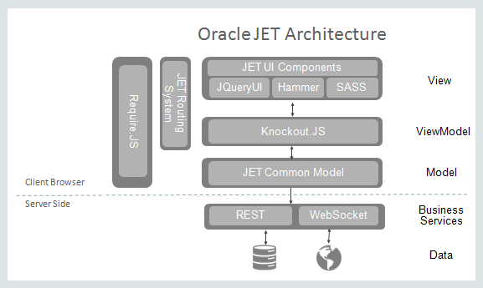
OJET Architecture

Slide 9
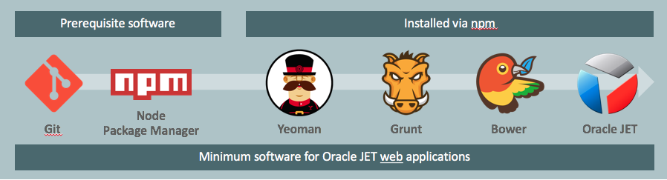
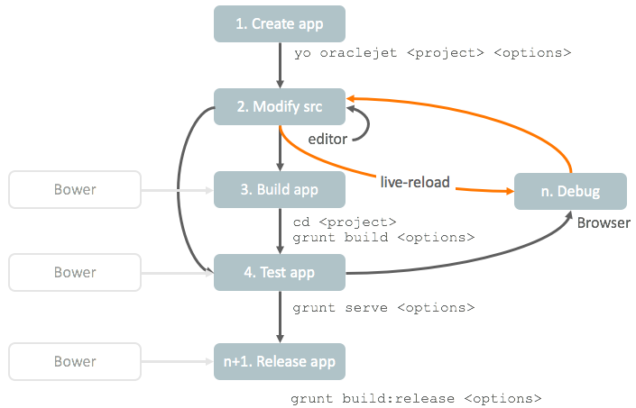
Development Process with OJET

Slide 10
Javascript Ecosystem
Vibrant, innovative ecosystem
Increasing popularity of mobile devices
Expense of native applications
Popularity of hybrid mobile applications
Challenges of a volatile, dynamic, ecosystem
Relevant and Maintainable over a number of years

Slide 11
Installation and Configuration
Download and install node.js
Install OJET Client
Verify the OJET CLI
https://nodejs.org/en/download/
> (sudo) npm install -g @oracle/ojet-cli
> ojet help
> ojet --version

Slide 12
First OJET Web Application
Developing client-side web application with Oracle JET is simple and efficient
Create a starter template
Run the web application
Change the directory to firstwebapp
Execute the command
> ojet create firstwebapp –-template=navdrawer
> ojet serve
LAB #1

Slide 13




Slide 14
Using Require JS and Knockout JS in OJET
Require JS helps in dependency management
Knockout JS helps in data-binding and automatic tracking of value/property changes, it updates all references to that property automatically
LAB #2

Slide 15
Oracle JET Components
Powerful and clean way of organizing UI code into self-contained reusable chunks
Development patterns beneficial for large applications, simplifying by encapsulation
Improve performance by incremental loading of resources
LAB #3

Slide 16
Loading Resources
Require.js Text Plugin is an extension of Require.js
Enables you to load text based resources
Let’s you separate HTML templates from business logic in Javascript files
LAB #4

Slide 17
Creating Modules
OJET applications are inherently modular
An OJET module has its business logic in Javascript and its view in HTML
An OJET module represents a section in your application providing a new feature to the user
LAB #5

Slide 18
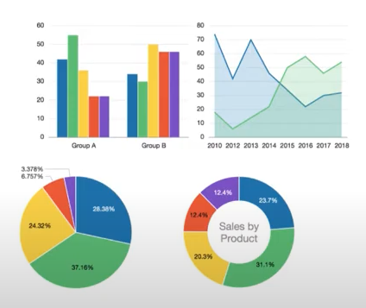
OJET Cookbook Components
Open sourced
Online OJET Cookbook provides recipes for each component
HTML View
JS Business Logic
JSDoc describes each component
Explore Cookbook, Understand Workflow
LAB #6

Slide 19
OJET Flex Layouts
Oracle ALTA UI design systems https://www.oracle.com/webfolder/ux/middleware/alta/index.html
Set of CSS classes used to design modern Oracle applications
Default theme of Oracle JET
Design with mobile first approach
Flex box layout is the standard part
Efficient way to layout, align and distribute space for applications
Helps accommodate variety of device visual spaces
LAB #7

Slide 20
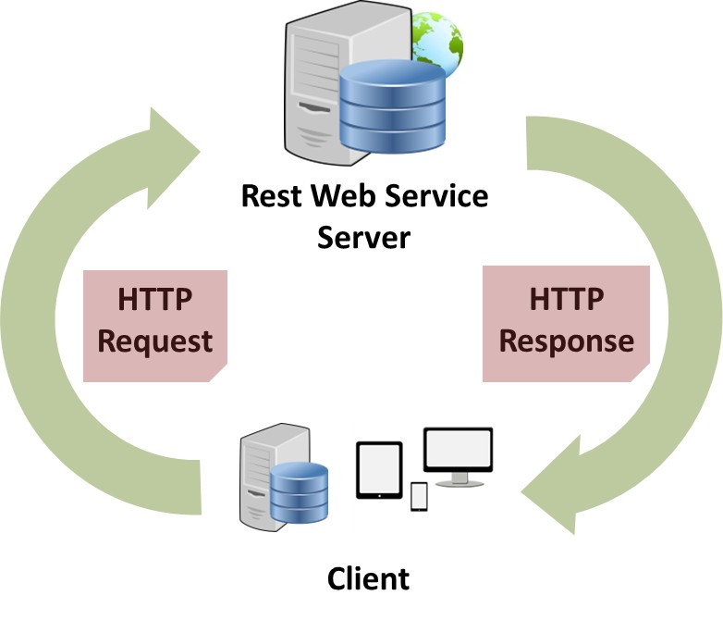
Accessing and Integrating Data
We access data using REST Services
Representation State Transfer
Data and functionality are resources
Resouces are accessed using URI
Benefit: Simplicity and it’s a standard
Can expose data via Java EE, Spring Boot, Node, etc
OJET allows you to create REST clients to integrate REST services
jQuery API can be used for REST calls
Experiment with a REST endpoint

Slide 21
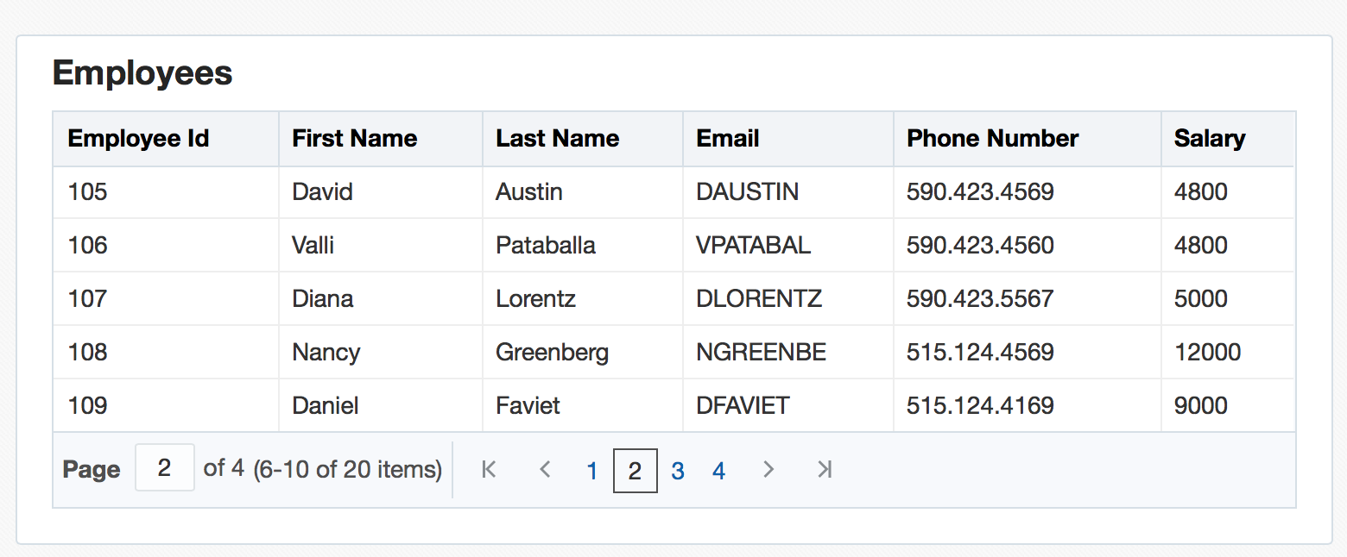
Common Model
Idiomatic alternative to working with data
Inspired by Backbone JS
Model and Collections
CRUD
UI
Model
Data Source
REST
Model
ko
Model
Model
Model
Collection
LAB #8

Slide 22
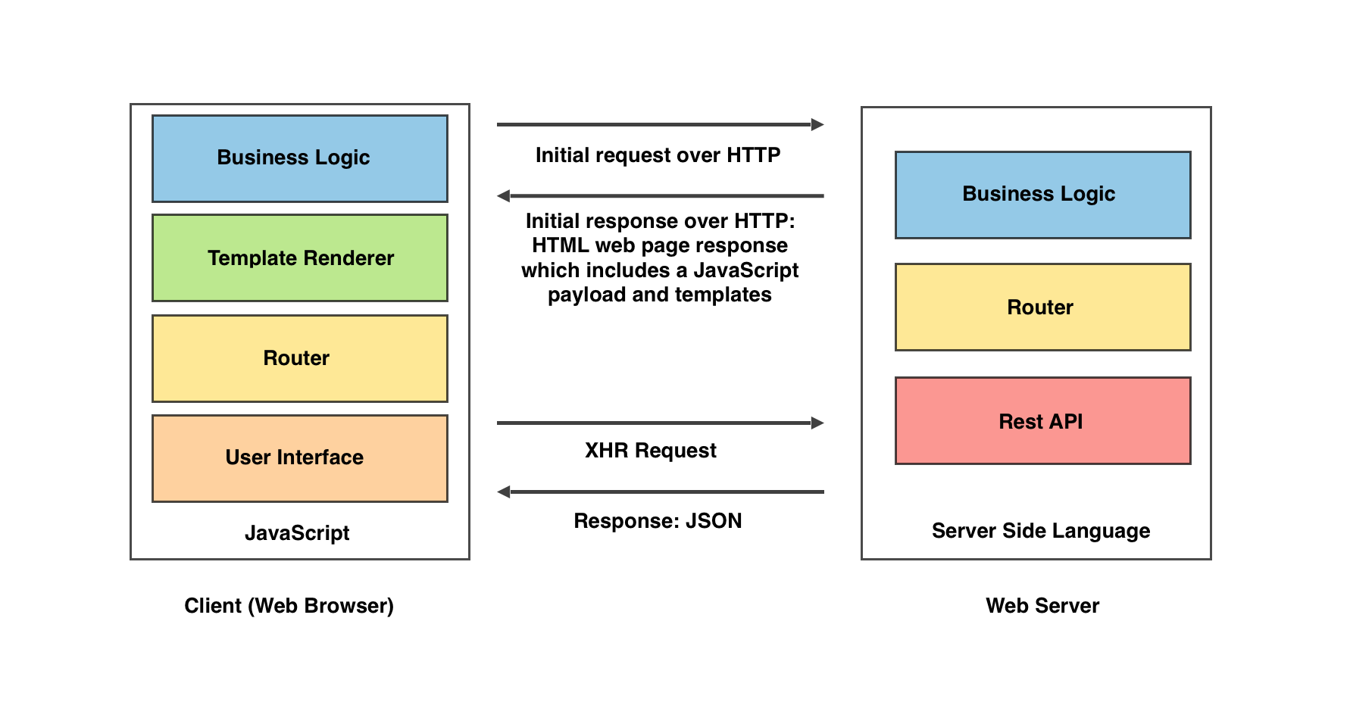

Single Page Applications
A single-page application is a web application or website that interacts with the web browser by dynamically rewriting the current web page with new data from the web server, instead of the default method of the browser loading entire new pages
https://www.excellentwebworld.com/what-is-a-single-page-application/
https://globekit.co/
LAB #9

Slide 23
Building OJET Applications from Scratch
Create a blank or basic application and proceed
> ojet create webapp –template=blank|basic
LAB #10

