Slide 1
Hadoop
Main Concepts

Slide 2
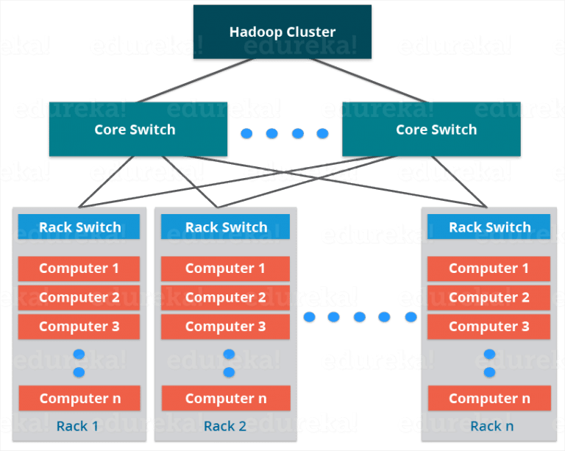

Slide 3
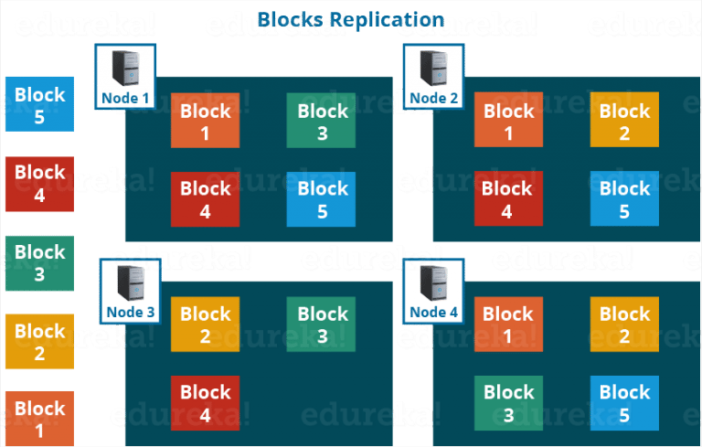

Slide 4
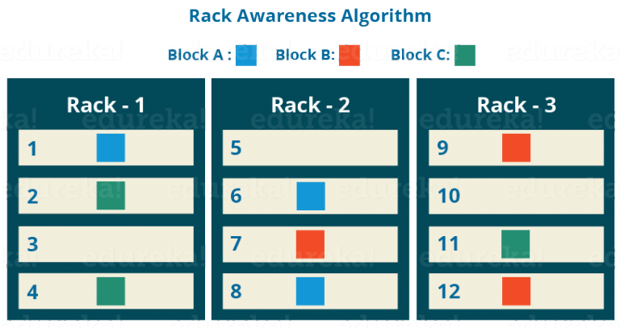
nameNode ensures the blocks are not on the same rack

Slide 5
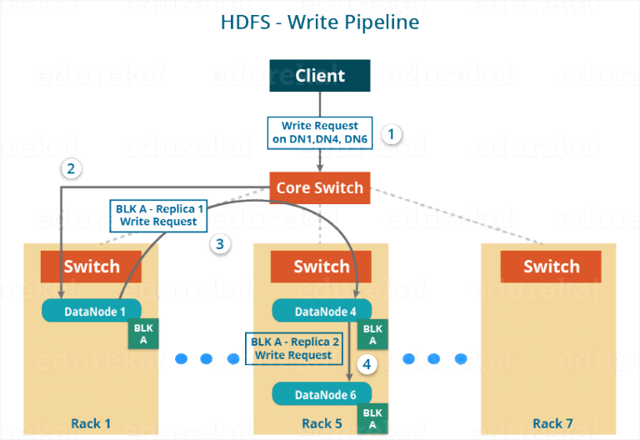

Slide 6
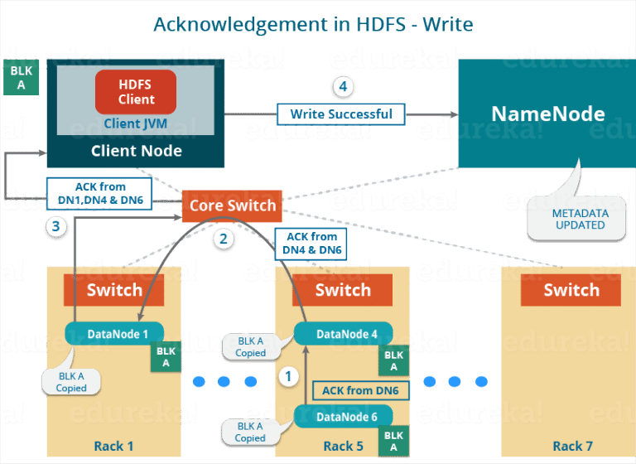

Slide 7
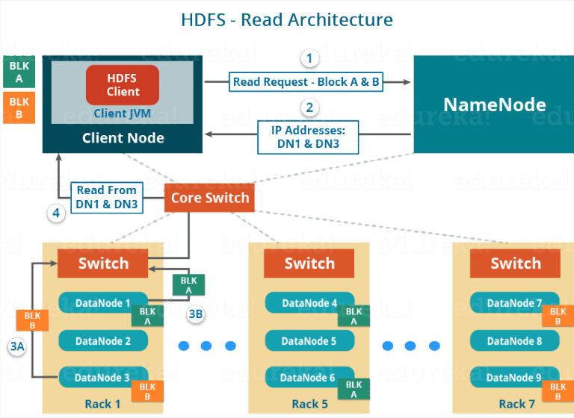

Slide 8
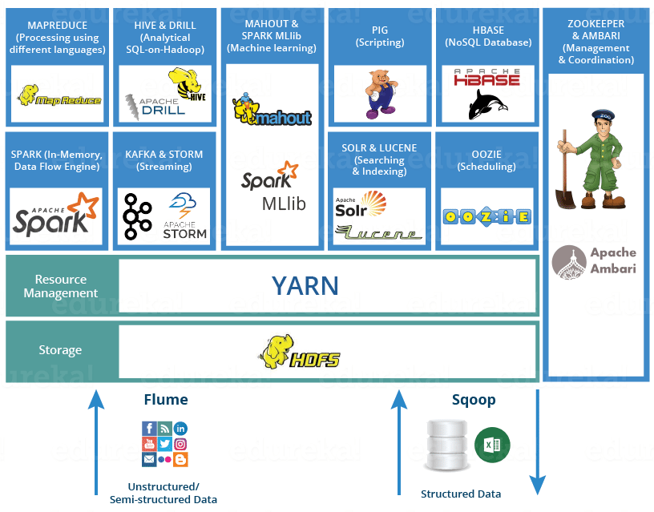

Slide 9
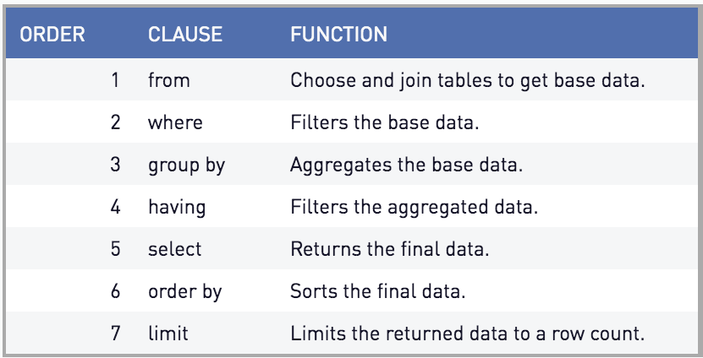

Slide 10
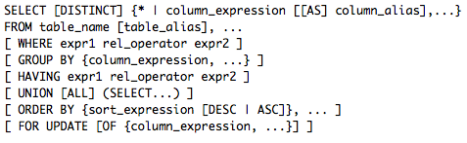

Slide 11
select
count(*)
from
pings
join
signups
on
pings.cookie = signups.cookie
where
pings.url like '%/blog%'

