Slide 1
Selenium

Slide 2
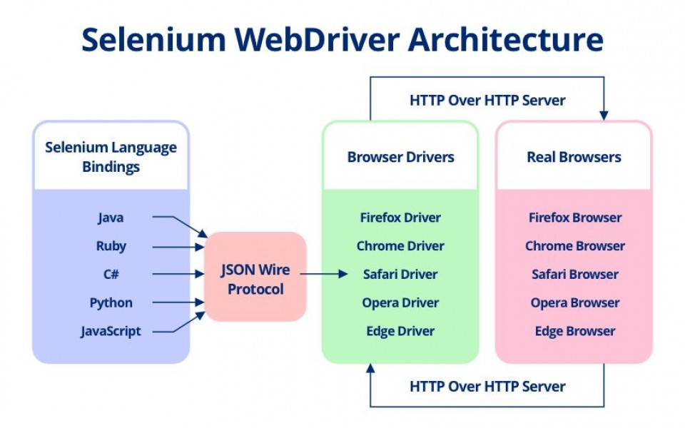

Slide 3
Installing Selenium
pip install Selenium

Slide 4
Install Selenium Webdriver
WebDriver is an open source tool for automated testing of webapps across many browsers.
It provides capabilities for navigating to web pages, user input, JavaScript execution, and more.
ChromeDriver is a standalone server that implements the W3C WebDriver standard.
ChromeDriver is available for Chrome on Android and Chrome on Desktop (Mac, Linux, Windows and ChromeOS).
Download Chromedriver from:
https://chromedriver.chromium.org/

Slide 5
Workshop
>>> from selenium import webdriver
>>> from selenium.webdriver.common.keys import Keys
>>> browser = webdriver.Chrome('chromedriver’)
>>> browser.get('https://www.facebook.com’)
>>> elem = browser.find_element_by_id('email')
>>> elem.send_keys('purushotham')
>>> elem = browser.find_element_by_id('pass')
>>> elem.send_keys('hello')
>>> elem.send_keys(Keys.RETURN)
>>> browser.close()

