Slide 1
Day 05
Flask-Login
Celery
MongoDB

Slide 2
Task Queues
Task queues let applications perform work, called tasks, asynchronously outside of a user request.
If an app needs to execute work in the background, it adds tasks to task queues.
The tasks are executed later, by worker services. The Task Queue service is designed for asynchronous work.
Celery is an asynchronous task queue

Slide 3
Asynchronous Processing
Asynchronous processing helps us reduce the user wait time and improve responsiveness.
The high level concept of asynchronous processing involves two steps;
isolate the time consuming lines of code and place them in separate block
for example a function
ensure that the isolated code from (1) above is executed separately from the main process.

Slide 4
Celery
Task queues are used as a mechanism to distribute work across threads or machines
Celery communicates via messages, usually using a broker to mediate between clients and workers.
To initiate a task the client adds a message to the queue, the broker then delivers that message to a worker
Celery is a nifty python package with features that enable us to implement;
time consuming operations in an asynchronous manner.
periodic operations in a cron-esque (cron-tab) manner.

Slide 5
Installation
pip install celery
celery -A test_celery worker -l info -P eventlet [Consumer]
python -m test_celery.run_tasks [Producer]
Celery 4 not well supported in Windows
Error:
pip install eventlet celery -A worker -l info -P eventlet

Slide 6
RabbitMQ
What Celery needs is a broker, to deal with all the incoming messages
Download from
https://www.rabbitmq.com/install-windows.html

Slide 7
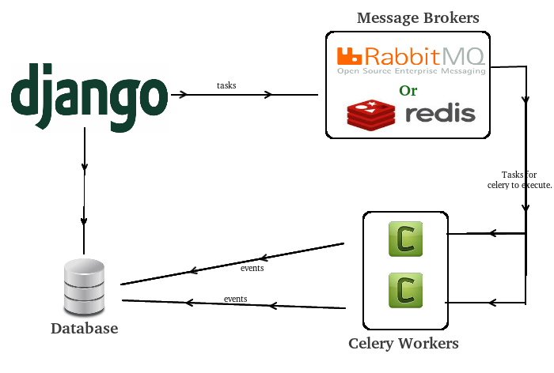
Celery Setup
A Celery application is composed of two parts:
Workers that wait for messages from RabbitMQ and execute the tasks.
Client that submit messages to RabbitMQ to trigger task execution, and eventually retrieve the result at a later time

Slide 8
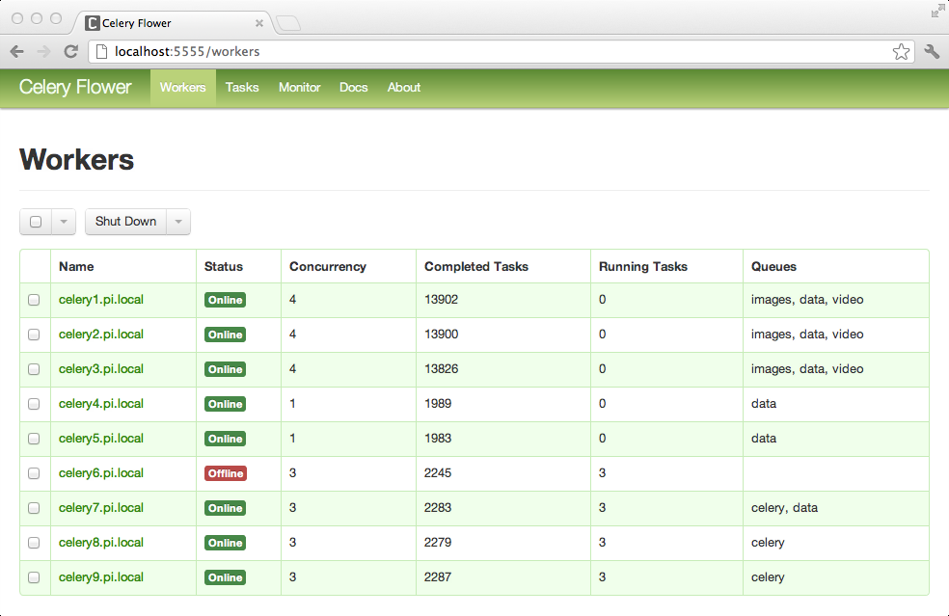
Celery Flower

Slide 9
Installing
pip install pymongo
Assuming you have downloaded and installed MongoDB, you can start it :
$ mongod

Slide 10
MongoDB
Creating a Database
import pymongo myclient = pymongo.MongoClient("mongodb://localhost:27017/") mydb = myclient["mydatabase"]
print(myclient.list_database_names())

Slide 11
MongoDB
Creating and checking collections
import pymongo myclient = pymongo.MongoClient("mongodb://localhost:27017/") mydb = myclient["mydatabase"] mycol = mydb["customers"]
print(mydb.list_collection_names())

Slide 12
Inserting one entry
Insert one entry
import pymongo myclient = pymongo.MongoClient("mongodb://localhost:27017/") mydb = myclient["mydatabase"] mycol = mydb["customers"] mydict = { "name": "John", "address": "Highway 37" } x = mycol.insert_one(mydict)

Slide 13
Inserting many
import pymongo myclient = pymongo.MongoClient("mongodb://localhost:27017/") mydb = myclient["mydatabase"] mycol = mydb["customers"] mylist = [ { "name": "Amy", "address": "Apple st 652"}, { "name": "Hannah", "address": "Mountain 21"}, { "name": "Michael", "address": "Valley 345"}, { "name": "Sandy", "address": "Ocean blvd 2"}, { "name": "Betty", "address": "Green Grass 1"}, { "name": "Richard", "address": "Sky st 331"}, ] x = mycol.insert_many(mylist) #print list of the _id values of the inserted documents: print(x.inserted_ids)

Slide 14
Inserting
myclient = pymongo.MongoClient("mongodb://localhost:27017/") mydb = myclient["mydatabase"] mycol = mydb["customers"] mylist = [ { "_id": 1, "name": "John", "address": "Highway 37"}, { "_id": 2, "name": "Peter", "address": "Lowstreet 27"}, { "_id": 3, "name": "Amy", "address": "Apple st 652"}, { "_id": 4, "name": "Hannah", "address": "Mountain 21"}, { "_id": 5, "name": "Michael", "address": "Valley 345"}, ] x = mycol.insert_many(mylist) #print list of the _id values of the inserted documents: print(x.inserted_ids)

Slide 15
Finding
import pymongo myclient = pymongo.MongoClient("mongodb://localhost:27017/") mydb = myclient["mydatabase"] mycol = mydb["customers"] for x in mycol.find(): print(x)

Slide 16
Finding
import pymongo myclient = pymongo.MongoClient("mongodb://localhost:27017/") mydb = myclient["mydatabase"] mycol = mydb["customers"] for x in mycol.find({},{ "_id": 0, "name": 1, "address": 1 }): print(x)

Slide 17
Query object
import pymongo myclient = pymongo.MongoClient("mongodb://localhost:27017/") mydb = myclient["mydatabase"] mycol = mydb["customers"] myquery = { "address": "Park Lane 38" }
#myquery = { "address": { "$gt": "S" } } mydoc = mycol.find(myquery) for x in mydoc: print(x)

Slide 18
Sorting
import pymongo myclient = pymongo.MongoClient("mongodb://localhost:27017/") mydb = myclient["mydatabase"] mycol = mydb["customers"] mydoc = mycol.find().sort("name") for x in mydoc: print(x)

Slide 19
Deleting
import pymongo myclient = pymongo.MongoClient("mongodb://localhost:27017/") mydb = myclient["mydatabase"] mycol = mydb["customers"] myquery = { "address": "Mountain 21" } mycol.delete_one(myquery)

Slide 20
Deleting
import pymongo myclient = pymongo.MongoClient("mongodb://localhost:27017/") mydb = myclient["mydatabase"] mycol = mydb["customers"] myquery = { "address": {"$regex": "^S"} } x = mycol.delete_many(myquery) print(x.deleted_count, " documents deleted.")

Slide 21
Updating
import pymongo myclient = pymongo.MongoClient("mongodb://localhost:27017/") mydb = myclient["mydatabase"] mycol = mydb["customers"] myquery = { "address": "Valley 345" } newvalues = { "$set": { "address": "Canyon 123" } } mycol.update_one(myquery, newvalues) #print "customers" after the update: for x in mycol.find(): print(x)

Slide 22
Update Many
import pymongo myclient = pymongo.MongoClient("mongodb://localhost:27017/") mydb = myclient["mydatabase"] mycol = mydb["customers"] myquery = { "address": { "$regex": "^S" } } newvalues = { "$set": { "name": "Minnie" } } x = mycol.update_many(myquery, newvalues) print(x.modified_count, "documents updated.")

Slide 23
Drop Collection
import pymongo myclient = pymongo.MongoClient("mongodb://localhost:27017/") mydb = myclient["mydatabase"] mycol = mydb["customers"] mycol.drop()

