Slide 1
Data Science and AI Bootcamp

Slide 2
What is Git?
A Version Control System (VCS) for tracking changes in code.
Works locally on your computer.
Stores code history so you can revert to older versions.
Allows branching & merging to work on multiple features at once.

Slide 3
What is GitHub?
A cloud-based platform for hosting Git repositories.
Acts as a remote backup for your project.
Enables collaboration with other developers.
Supports Pull Requests, Code Reviews, and Issue Tracking
💻 Developer → Push code → ☁ GitHub → Other developers pull code.

Slide 4
Why Use Git & GitHub?
Backup: Keep your code safe in the cloud.
Version History: See who changed what, and when.
Teamwork: Multiple developers can work without overwriting each other’s work.
Branching: Safely test new features without breaking the main code.
Open Source: Contribute to or use public projects.
Safe → ⏳ Track changes → 🤝 Collaborate → 🚀 Deploy faster.

Slide 5
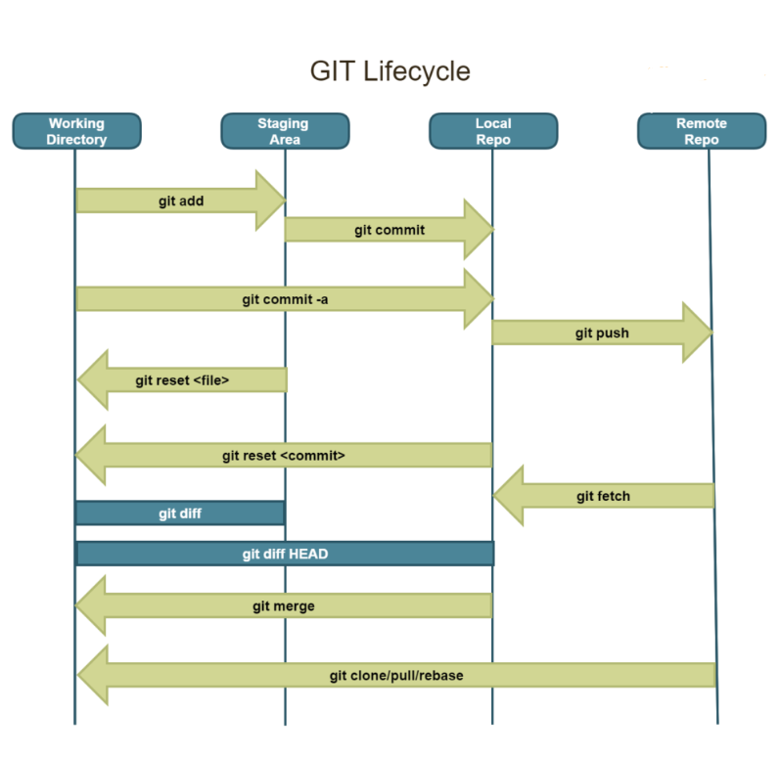
Git Commands

Slide 6
Packaging Python
Organize code for reuse across projects
Simplify distribution to other developers or PyPI
Manage dependencies in a structured way
Enable versioning and change tracking
Ensure consistent installations across environments
Support modular development and team collaboration

Slide 7
Setup Tools
The traditional Python packaging tool (widely used)
Works with a setup.py or setup.cfg file
Handles:
Package metadata (name, version, author, etc.)
Dependencies installation via install_requires
Entry points for CLI scripts
Supports distribution to PyPI with twine
Pros: Mature, stable, well-documented
Cons: More verbose, less modern defaults

Slide 8
Poetry
Modern Python dependency & packaging manager
Uses a single config file: pyproject.toml
Built-in virtual environment management
Dependency resolution is fast & deterministic
Easy publishing to PyPI with one command (poetry publish)
Commands:
poetry init → Start new project
poetry add <package> → Install dependency
poetry build → Create package
Pros: All-in-one solution, clean workflow
Cons: Slightly steeper learning curve for beginners

Slide 9
UV
Next-gen ultra-fast Python packaging tool
Drop-in replacement for pip, pip-tools, and venv
Written in Rust for extreme speed
Manages dependencies & virtual environments together
Compatible with pyproject.toml
Commands:
uv init → Create new project
uv add <package> → Install dependency
uv build → Build package
Pros: Blazing fast, modern defaults, minimal setup
Cons: Newer tool, ecosystem still growing

