Slide 1
Knockout JS

Slide 2
Features
Declarative Bindings
  Easily associate DOM elements with model data using a concise, readable syntax
Automatic UI Refresh
  When your data model's state changes, your UI updates automatically
Dependency Tracking through Observables
  Implicitly set up chains of relationships between model data, to transform and combine it
Templating
  Quickly generate sophisticated, nested UIs as a function of your model data

Slide 3
Additional Benefits
Additional benefits:
  Pure JavaScript library - works with any server or client-side technology
  Can be added on top of your existing web application without requiring major architectural changes
  Compact - around 13kb after gzipping
  Works on any mainstream browser (IE 6+, Firefox 2+, Chrome, Safari, Edge, others)
  Comprehensive suite of specifications (developed BDD-style) means its correct functioning can easily be verified on new browsers and platforms

Slide 4
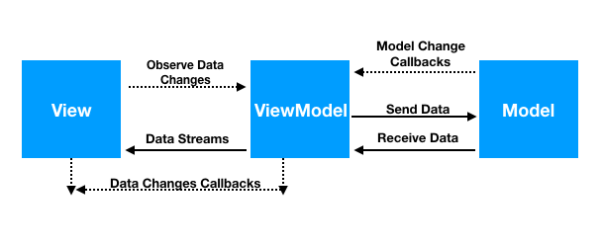
MVVM Architecture
A model: your application’s stored data.
A view model: a pure-code representation of the data and operations on a UI.
A view: a visible, interactive UI representing the state of the view model.

Slide 5
Observables
Variables that can be observed
So that rest of the code is notified of the changes in the observed variable
Achieved through data binding
The name is <span data-bind="text: personName"></span>
ko.applyBindings(myViewModel);
var myViewModel = {
personName: ko.observable('Ram'),
personAge: ko.observable(123)
};

Slide 6
Accessing the Observables
// Reading and writing to an observable
this.x = this.lastName();
this.lastName(x)

Slide 7
Computed Observables
These are functions that are dependent on one or more other observables, and will automatically update whenever any of these dependencies change.
function AppViewModel() {
var self = this;
self.firstName = ko.observable('Ram');
self.lastName = ko.observable('Kumar');
self.fullName = ko.computed(function() {
return self.firstName() + " " + self.lastName();
});
}

Slide 8
Knockout Lab
5
5
The sum of squares of two numbers is 50

Slide 9
Observable Arrays
If you want to detect and respond to changes on one object, you’d use observables. If you want to detect and respond to changes of a collection of things, use an observableArray.
This is useful in many scenarios where you’re displaying or editing multiple values and need repeated sections of UI to appear and disappear as items are added and removed.
var arr = ko.observableArray([
{ name: "Bungle", type: "Bear" },
{ name: "George", type: "Hippo" },
{ name: "Zippy", type: "Unknown" }
]);

