Slide 1

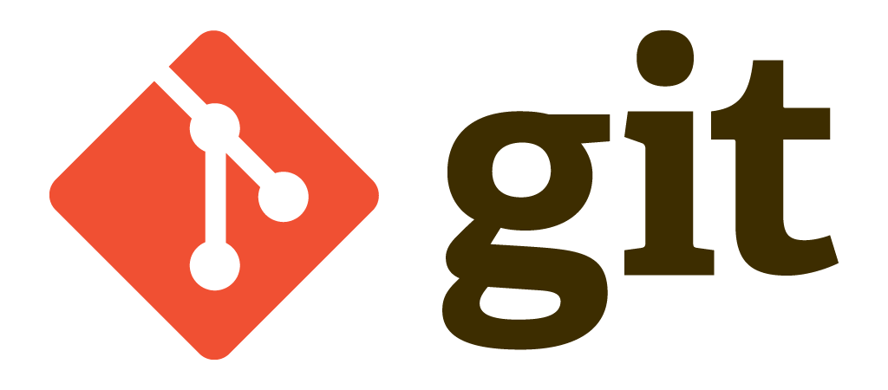

Slide 2
Git
Git is a popular version control system. It was created by Linus Torvalds in 2005, and has been maintained by Junio Hamano since then.
It is used for:
Tracking code changes
Tracking who made changes
Coding collaboration

Slide 3
What does Git do?
Manage projects with Repositories
Clone a project to work on a local copy
Control and track changes with Staging and Committing
Branch and Merge to allow for work on different parts and versions of a project
Pull the latest version of the project to a local copy
Push local updates to the main project

Slide 4
Working with Git
Initialize Git on a folder, making it a Repository
Git now creates a hidden folder to keep track of changes in that folder
When a file is changed, added or deleted, it is considered modified
You select the modified files you want to Stage
The Staged files are Committed, which prompts Git to store a permanent snapshot of the files
Git allows you to see the full history of every commit.
You can revert back to any previous commit.
Git does not store a separate copy of every file in every commit, but keeps track of changes made in each commit!

Slide 5
Advantages of using Git
Over 70% of developers use Git!
Developers can work together from anywhere in the world.
Developers can see the full history of the project.
Developers can revert to earlier versions of a project.

Slide 6
Github
Git is not the same as GitHub.
GitHub makes tools that use Git.
GitHub is the largest host of source code in the world, and has been owned by Microsoft since 2018.
In this tutorial, we will focus on using Git with GitHub.

Slide 7
Getting Started
Install Git
https://www.git-scm.com/
Check if Git is properly installed
git --version
Configure Git, let Git know who you are
git config --global user.name "test"
git config --global user.email "test@mindullearning.com"
Creating a Git folder
mkdir myproject
cd myproject
Initializing Git
git init

Slide 8
Adding Files
Add some files to the newly created Git repository
Check Git status
git status
One of the core functions of Git is the concepts of the Staging Environment, and the Commit.
As you are working, you may be adding, editing and removing files. But whenever you hit a milestone or finish a part of the work, you should add the files to a Staging Environment. You can add multiple files
git add helloworld.py
git status

Slide 9
Adding Files
Files in your Git repository folder can be in one of 2 states:
Tracked - files that Git knows about and are added to the repository
Untracked - files that are in your working directory, but not added to the repository

Slide 10
Staging and Commit
Adding commits keep track of our progress and changes as we work. Git considers each commit change point or "save point". It is a point in the project you can go back to if you find a bug, or want to make a change.
When we commit, we should always include a message.
By adding clear messages to each commit, it is easy for yourself (and others) to see what has changed and when
git commit -m "First release of Hello World!“
To automatically notice any modified (but not new) files, add them to the index, and commit, all in one step.
git commit -a

Slide 11
Git Log and Help
You can get the log of commits
git log
git log --oneline
If you are having trouble remembering commands or options for commands, you can use Git help.
There are a couple of different ways you can use the help command in command line:
git <command> -help - See all the available options for the specific command
git help --all - See all possible commands

Slide 12
Revert
We revert the latest commit using git revert HEAD (revert the latest change, and then commit), adding the option --no-edit to skip the commit message editor (getting the default revert message)
git revert HEAD --no-edit
git log –oneline
To revert to earlier commits, use git revert HEAD~x (x being a number. 1 going back one more, 2 going back two more, etc.)

Slide 13
Reset
The reset is the command we use when we want to move the repository back to a previous commit, discarding any changes made after that commit.
Step 1: Find the previous commit:
git log --oneline
Find the log ID
Step 2: Reset
git reset 9a9add8
git restore helloworld.py
See the log once again

Slide 14
Branching
In Git, a branch is a new/separate version of the main repository.
Let's say you have a large project, and you need to update the design on it.
With Git:
With a new branch called new-design, edit the code directly without impacting the main branch
EMERGENCY! There is an unrelated error somewhere else in the project that needs to be fixed ASAP!
Create a new branch from the main project called small-error-fix
Fix the unrelated error and merge the small-error-fix branch with the main branch
You go back to the new-design branch, and finish the work there
Merge the new-design branch with main (getting alerted to the small error fix that you were missing)

Slide 15
Branching with Git Advantages
Branches allow you to work on different parts of a project without impacting the main branch.
When the work is complete, a branch can be merged with the main project.
You can even switch between branches and work on different projects without them interfering with each other.
Branching in Git is very lightweight and fast!

Slide 16
Branching
Creating a new branch
git branch hello-world-2
Confirm you have created a new branch
git branch
checkout is the command used to check out a branch. Moving us from the current branch, to the one specified at the end of the command
git checkout hello-world-2

Slide 17
Emergency Fixes
Now imagine that we are not yet done with hello-world-1, but we need to fix an error on master. You don't want to mess with master directly, and you do not want to mess with hello-world-2, since it is not done yet.
So we create a new branch from master to deal with the emergency:
git checkout -b emergency-fix
git add index.html
git commit -m "updated index.html with emergency fix"

Slide 18
Branch Merge
We have the emergency fix ready, and so let's merge the master and emergency-fix branches.
git checkout master
git merge emergency-fix
Since the emergency-fix branch came directly from master, and no other changes had been made to master while we were working, Git sees this as a continuation of master. So it can "Fast-forward", just pointing both master and emergency-fix to the same commit.
As master and emergency-fix are essentially the same now, we can delete emergency-fix, as it is no longer needed:
git branch -d emergency-fix

Slide 19
Github
Go to GitHub and sign up for an account
Sign in, and create a new repository
Push Local Repository to GitHub
git remote add origin https://github.com/test/hello-world.git
git push -u origin master

Slide 20
Github: Pull and Push
You can pull all changes from a remote repository into the branch you are working on
git pull origin
We can make changes in the local repository and push it back to github
git push origin

Slide 21
Summary
git init
git commit -m "first commit"
git branch -M main
git remote add origin https://github.com/mindful-ai/test.git
git push -u origin main

Slide 22
Summary
git remote add origin https://github.com/mindful-ai/test.git
git branch -M main
git push -u origin main

Slide 23
Git Clone from GitHub
A clone is a full copy of a repository, including all logging and versions of files.
git clone https://github.com/test/test.io.git
git log

Slide 24
GitHub Fork
At the heart of Git is collaboration. However, Git does not allow you to add code to someone else's repository without access rights.
A fork is a copy of a repository. This is useful when you want to contribute to someone else's project or start your own project based on theirs.
fork is not a command in Git, but something offered in GitHub and other repository hosts. Let's start by logging in to GitHub, and fork our repository

Slide 25
Push Changes to Our GitHub Fork
We have made a lot of changes to our local Git.
Now we push them to our GitHub fork, commit the changes
git push origin
Go to GitHub, and we see that the repository has a new commit. And we can send a Pull Request to the original repository
Now any member with access can see the Pull Request when they see the original repository and they can see proposed changes
You can comment on the changes and merge.

