Slide 1
UART System Design for FPGA

Slide 2
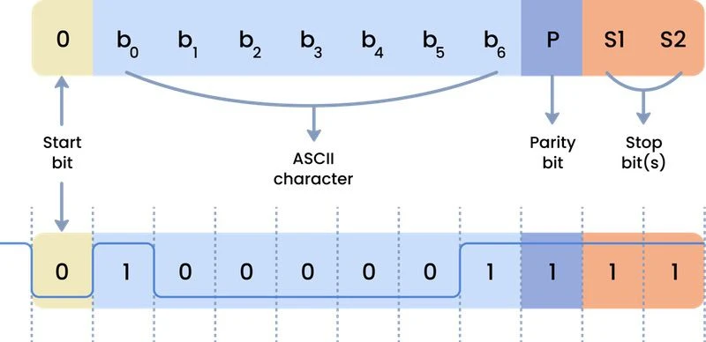
UART

Slide 3
UART Transceiver
Serial communication module
Transmitter and Receiver
Transmits one byte at a time
Start bit and a stop bit
One data line for transmitting and another for receiving and no clock: Asynchronous
Default state of the Tx/Rx line is 1
Start bit = 0
Stop bit = 1

Slide 4
Tx
Rx
Baud rate: Rate at which data is transferred, bits per second
9600 Baud = 9600 bits in one second
start
stop
8 bits
data
Stop bit
Start bit
1/9600 = 104 us
Generate enable pulse ever 104 us
PISO
Shifting operation should be controlled using an enable signal delayed with respect to baud rate
104 us / 20 ns = 5200 (104 us)
Baud rate
Every 5200 clock cycles of 50 MHz clock, generate one enable pulse. By doing this, 104 us is achieved.
Clock = 50MHz

Slide 5
delayCounter
PISO
bitCounter
FSM
Transmitter

Slide 6
Assignment
Calculate the number of clock cycles for 1 bit delay to transfer data at 11500 baud rate. Consider 12 Mhz clock
Use the bk_fsm_demo.v. Create a test bench and generate the enable signal with 104 us delay for the design. Consider 50 MHz clock
Come up with the design for UART receiver
Clue: Use SIPO shift register
2 Hours

Slide 7
5208 Cycles of 50 MHz domain T = 104160 ns +- 100
Source clock = 50 MHz
T = 20 ns
Required Baud Rate = 9600
9600 cycles should be present per second
50000000/9600 = N = 5208
Baud_rate_div = N/2 = 2604
baud_rate_div
always@(posedge baud_clock)
5208 Cycles of 50 MHz domain T = 104160 ns +- 100
20 ns = One clock cycle
always@(posedge baud_pulse)
always@(posedge source_clock)
if(baud_pulse)
Use as an enable signal in source domain

Slide 8
1X
16 X
Source clock = 50 MHz
T = 20 ns
Required Baud Rate = 9600
9600 cycles should be present per second
50000000/9600 = N = 5208
Baud_rate_div = N/2 = 2604
Source clock = 50 MHz
T = 20 ns
Required Baud Rate = 9600 X 16
153600 cycles should be present per second
50000000/153600 = N = 325
Baud_rate_div = N/2 = 162

Slide 9
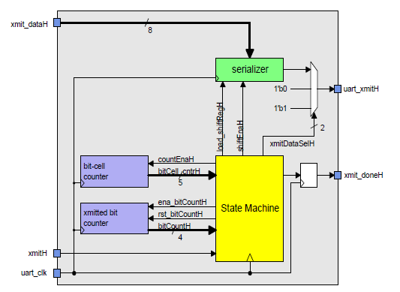
PISO
Data Path
Control Path

Slide 10
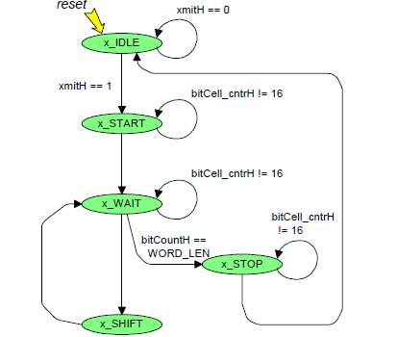
Data to send = 1 byte
Start bit = 0
Stop bit = 1
Default = 1
Sending the start bit and waiting for 16 cycles
Sending the data byte and waiting for 16 cycles every time a bit is transferred
Sending the stop bit and waiting for 16 cycles
One bit shift

Slide 11
UART Transmitter
FIFO
FSM
uart_tx.v

