Slide 1
Ethernet on Zynq

Slide 2
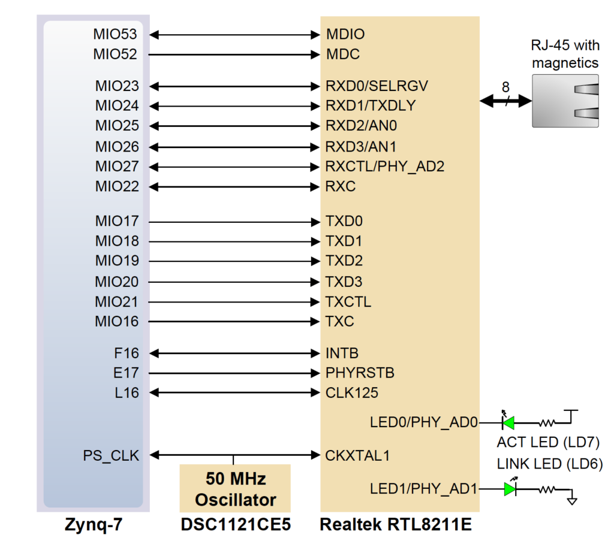

Slide 3
Initialization
Conventionally, Xilinx drivers for Ethernet MAC (EMAC) IPs normally start with functions like the XEmacPs_LookupConfig and XEmacPs_CfgInitialize. The first essentially reads information of the hardware defined in the Vivado project from the xparameters.h file (exported to the SDK project) and returns this information in an organized structure. In the current case, the most important information is the address to which the EMAC is mapped on memory.

Slide 4
Ethernet Tx Clock
After this information is obtained, the second function (XEmacPs_CfgInitialize) initializes a structure of type XEmacPs that contains the EMAC configurations, with all default values and including the particular address obtained from the first function (XEmacPs_LookupConfig). This structure will, then, be used whenever a configuration is to be written to the EMAC.

Slide 5
Ethernet Tx Clock
The next thing that the example application does is to configure the Ethernet Tx clock through the so-called System-Level Control Registers (SLCRs). This is done by configuring the GEM0_CLK_CTRL register such that a 125 MHz clock is provided to the MII, where data is transferred at 8-bit per cycle (125 * 8 gives 1Gbps, as required). And to do so, first the SLCRs have to be unlocked by writing to the ZYNQ register called SLCR_UNLOCK, then, after configuring the two registers, the SLCRs must be locked back. This is a standard procedure every time one of the SCLR registers needs to be configured.

Slide 6
Ethernet MAC Address
Next, the MAC address of the device is set by:
Status = XEmacPs_SetMacAddress(EmacPsInstancePtr, EmacPsMAC, 1);
It defaults to “{0x00, 0x0a, 0x35, 0x01, 0x02, 0x03}”. Pay attention to this address, as it will be useful when debugging frames transmitted by the FPGA on a computer (i.e. on Wireshark). And by the way, note that “0x00, 0x0a, 0x35” (the upper 24 bits of the address) corresponds to the Xilinx organizationally unique identifier (OUI), so if you use Wireshark, you can notice that it interprets the address as pertaining to a Xilinx device and labels the incoming frames like this:

Slide 7
PHY Configuration
MDC Clock
As noted earlier, the external PHY transmits and receives data through the RGMII interface, but it is configured through the dedicated and standardized MDIO interface. This MDIO interface, in turn, is clocked by a clock signal called MDC that must be fed to the PHY by the MAC. Hence, the first thing to do is to generate the appropriate MDC clock (with the appropriate frequency not exceeding 2.5 MHz). Since the MDC is generated by dividing the CPU_1X clock of the ZYNQ PS, it is only necessary to configure the divisor. This is done by the following function call:
XEmacPs_SetMdioDivisor(EmacPsInstancePtr, MDC_DIV_224);
sleep(1);

Slide 8
PHY Configuration
MDIO Registers
The subsequent lines put the PHY in loopback mode (so that frames are not sent over the twisted-pair line), reset the PHY and configure the speed to 1Gbps.
EmacPsUtilEnterLoopback(EmacPsInstancePtr, EMACPS_LOOPBACK_SPEED_1G);
XEmacPs_SetOperatingSpeed(EmacPsInstancePtr, EMACPS_LOOPBACK_SPEED_1G);

Slide 9
PHY Configuration
Every time the MAC needs to configure or read a configuration or status from the PHY, it must do so by the MDIO bus. In the application, this is done by the following functions:
XEmacPs_PhyRead(XEmacPs *InstancePtr, u32 PhyAddress, u32 RegisterNum, u16 *PhyDataPtr)
XEmacPs_PhyWrite(XEmacPs *InstancePtr, u32 PhyAddress, u32 RegisterNum, u16 PhyData)
where PhyAddress is the address corresponding to the PHY that is targeted (there could be multiple PHYs, e.g. in a switch), RegisterNum is the number of the target MDIO register to be read or written and PhyData holds the read value or the value to be written.

Slide 10
ZYNQ/MicroBlaze
PWM Generator
R0
R1
AXI
R3
R4

