Slide 1
MLOPS

Slide 2
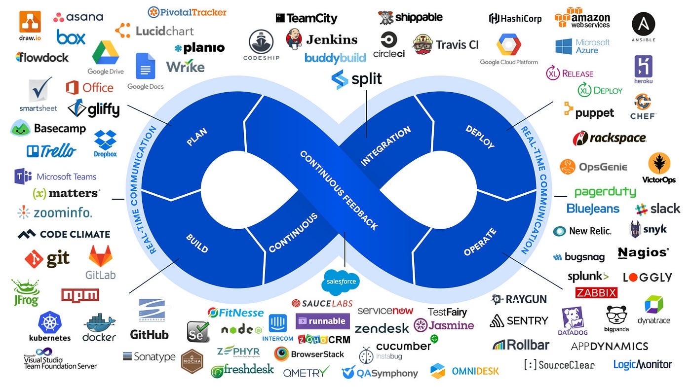

Slide 3
Model Lifecycle Management
MLOps emphasizes managing the full ML lifecycle, including data ingestion, model training, evaluation, deployment, monitoring, and retraining.
A well-structured ML lifecycle with clearly defined stages helps ensure models are developed, deployed, and maintained efficiently and transparently.

Slide 4
Version Control for Code and Models
Just as version control (e.g., Git) is crucial in software development, versioning code and models is fundamental in MLOps.
This involves tracking different versions of datasets, model code, configurations, and trained models, so you can reproduce results, roll back to previous versions, or retrain models with updated data.

Slide 5
Automated Model Training Pipelines
Automated training pipelines make it easy to regularly retrain models, especially when new data becomes available.
These pipelines use tools like Airflow, Kubeflow Pipelines, or MLflow to automate workflows, reduce manual errors, and ensure reproducibility.
CI/CD principles are extended to ML through Continuous Integration (CI) (automating testing and validation) and Continuous Delivery (CD) (automating deployment of models).

Slide 6
Feature Engineering and Feature Stores
Feature engineering is a critical part of ML that involves creating meaningful input variables (features) from raw data.
MLOps uses feature stores to store and manage features for reuse across models and teams. This ensures consistency in feature calculations and speeds up the development process by providing a shared library of features.

Slide 7
Model Deployment and Serving
Deployment involves putting a model into a production environment where it can make real-time predictions or batch predictions.
Model serving is the process of exposing the model so it can be accessed by applications or end users, typically via REST APIs or other interfaces.
Deployment strategies include A/B testing, canary deployments, and blue-green deployments to validate model performance safely before scaling it fully.

Slide 8
Monitoring and Model Drift Detection
MLOps frameworks continuously monitor deployed models to ensure they perform as expected over time.
Model drift happens when the statistical properties of input data or relationships change, causing model accuracy to degrade.
Monitoring tools and dashboards track model accuracy, prediction confidence, latency, and other metrics to detect and address performance degradation or data drift.

Slide 9
Experiment Tracking
MLOps includes tools to track experiments, such as different model versions, hyperparameters, feature selections, and evaluation metrics.
Experiment tracking helps data scientists and ML engineers keep a log of experiments, making it easier to understand which combinations produce the best results.

Slide 10
Data and Model Lineage
Data lineage tracks the origin, transformations, and flow of data through the pipeline to maintain transparency and regulatory compliance.
Model lineage allows tracking of which datasets, features, and hyperparameters were used to train each model version, supporting reproducibility and debugging.

Slide 11
Infrastructure as Code (IaC)
Using Infrastructure as Code (IaC), like Terraform or Kubernetes, allows infrastructure setup for ML pipelines to be defined, managed, and versioned as code.
IaC makes it easier to scale resources up or down, automate setup, and maintain consistency across different environments.

Slide 12
Security and Compliance
MLOps considers data security (e.g., data encryption, access control) and model security (e.g., vulnerability testing) to protect models and data.
Compliance requirements, such as GDPR for data privacy, are also integrated into MLOps practices, especially in regulated industries.

Slide 13
Tools and Technologies in MLOps
MLOps relies on a variety of tools to manage different lifecycle stages:
Data management: Data versioning tools like DVC, Delta Lake, and feature stores like Feast.
Experiment tracking: MLflow, Weights & Biases, or TensorBoard.
Pipeline orchestration: Apache Airflow, Kubeflow Pipelines, and Prefect.
Deployment: Docker, Kubernetes, Seldon Core, and TensorFlow Serving.
Monitoring: Prometheus, Grafana, and monitoring platforms like Arize or Evidently.

Slide 14
Collaborative and Reproducible Workflows
MLOps emphasizes collaborative, reproducible workflows that enable data scientists and ML engineers to work together seamlessly.
Through shared pipelines, experiment tracking, and reproducible environments (e.g., Docker, Conda), MLOps promotes collaboration and reduces dependency on individual team members.

Slide 15
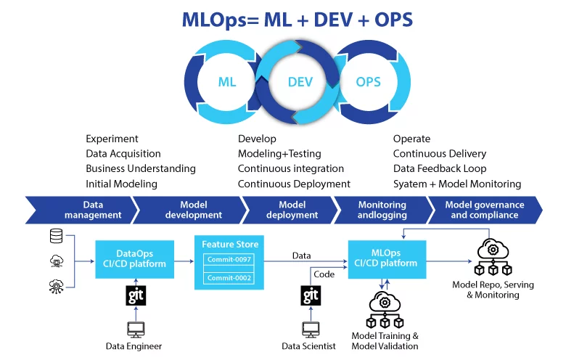

Slide 16
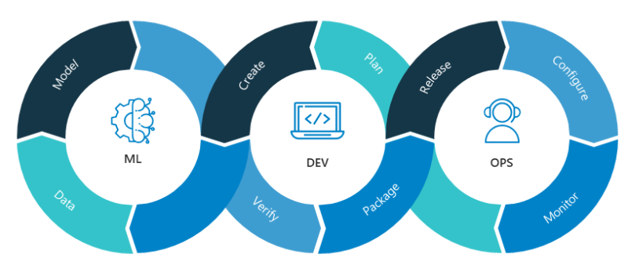
Streamline

