Slide 1
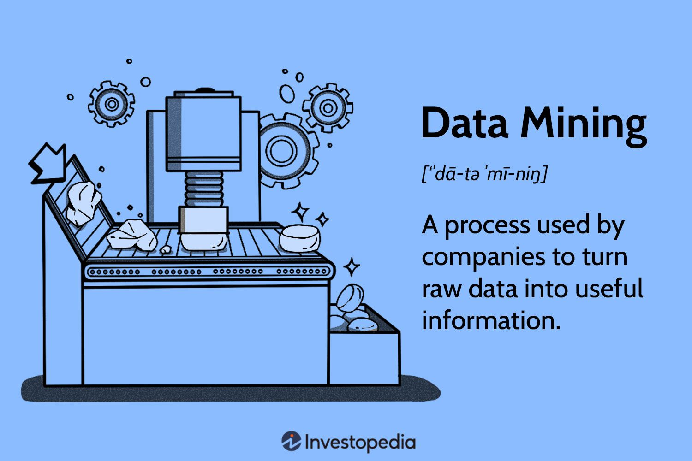
Data cleaning
Name: shakti prasad Nahak
Reg No: 200101120047
Sec: A

Slide 2
Contents
Handling
Missing
Data
Conclusion
Introduction
Why data cleaning matters
Common data quality issues
Steps of Data cleaning

Slide 3
introduction
Data cleaning is the essential process of identifying and rectifying errors, inconsistencies, and inaccuracies in datasets.
Think of it as tidying up your data house to make sure it's in order.

Slide 4
Why data cleaning matters
Misleading Insights: Dirty data can lead to incorrect conclusions and misguided decisions.
Damaged Reputation: Using unclean data can tarnish your organization's credibility.Inefficient Processes: Unreliable data can waste time and resources.
Loss of Credibility: Mistakes in data can undermine your trustworthiness in the eyes of customers and stakeholders.

Slide 5
Common data quality issues
Missing data
Duplicate Records
Inconsistent Formatting
Outliers
Incorrect data types

Slide 6
Handlin Missing data
Data Imputation : Mean, Median, or Mode Imputation: Replace missing values with the mean, median, or mode of the respective attribute. This is suitable for numerical data.
Regression Imputation: Use regression models to predict missing values based on the relationship with other variables.
Machine Learning Imputation: Employ machine learning algorithms, such as k-Nearest Neighbors (k-NN) or Random Forest, to predict missing values.
Consideration of Impact: Evaluate the impact of removing records with missing data on the overall analysis. Remove records only if the missing data significantly affects the results.
Thresholds: Set thresholds for the acceptable level of missing data; if a record exceeds this threshold, it is considered for removal.

Slide 7
Removing duplicates
Unique Identifiers: Identify duplicates using unique identifiers, such as customer IDs or transaction numbers.
Fuzzy Matching: Use fuzzy matching algorithms to identify potential duplicates with slight variations.
Removal: Delete duplicate records, keeping only one instance. This is appropriate when duplicates provide no additional value.
Merging: Combine information from duplicate records into a single representative record. This is suitable when duplicates hold unique information.

Slide 8
Steps of Data cleaning
Data Collection
Data Inspection
Handling Missing Data
Removing Duplicates
Standardizing Formats
Handling Outliers
Validating Data Types
Data Transformation
Data Verification

Slide 9
Handling outliers
Statistical Methods: Use statistical techniques like Z-score or interquartile range (IQR) to identify potential outliers.
Visual Inspection: Plot data and visually inspect for points that deviate significantly from the overall pattern.
Removal: Eliminate outliers if they are genuine errors or anomalies.
Transformation: Apply mathematical transformations (logarithmic, square root) to mitigate the impact of outliers.
Separate Analysis: Consider analyzing outliers separately if they represent a distinct pattern or behavior.

Slide 10
Data smoothing
Moving Averages: Smooth out fluctuations by calculating the average of neighboring data points over a specified window.
Exponential Smoothing: Assign different weights to data points, giving more importance to recent observations.

Slide 11
Conclusion
Data cleaning is an essential step in data preparation for data warehousing and data mining. By addressing data quality problems, organizations can improve the accuracy and reliability of their data mining results, make better decisions, and enhance their reputation

Slide 12


