Slide 1

Animation: Simple Harmonic Motion (SHM)
ELECTRICAL AND COMPUTER ENGINEERING, COLLEGE OF ENGINEERING AND APPLIED SCIENCE

Slide 2
Goals
Illustrate Simple Harmonic Motion by changing the variables involved in the equation:
Amplitude
Frequency
Initial Phase
Damping Constant

Slide 3
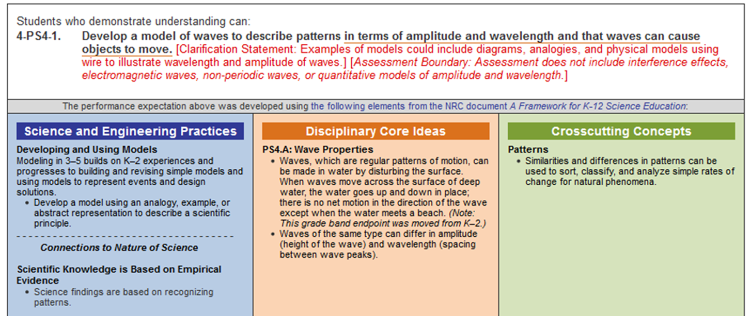
Applicable Education Standards
See page 72 of Next Generation Science Standards:
https://www.nextgenscience.org/sites/default/files/AllTopic.pdf

Slide 4
Abstract
This Module uses the concept of Simple Harmonic Motion to create the graph of a wave. The user can make changes to the amplitude, frequency, and initial phase of the wave to see the changes these cause. There is also an option to add a decay or damping constant

Slide 5
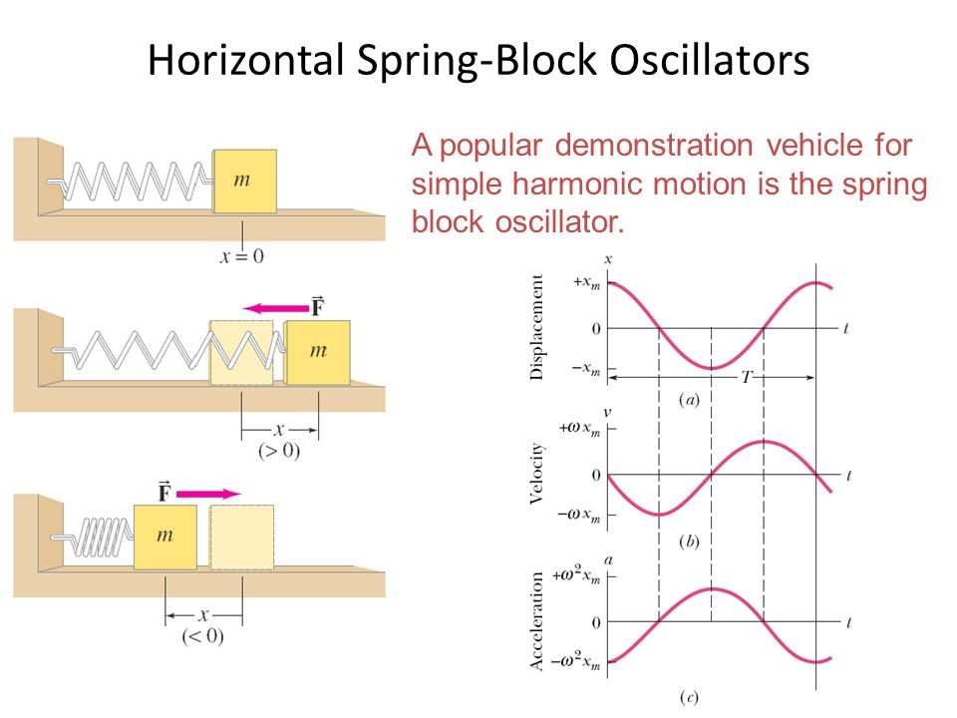
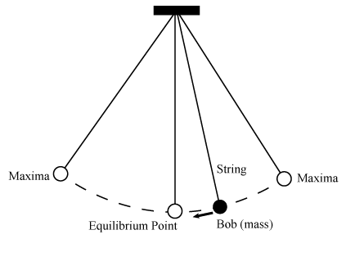
What is SHM?
Repetitive movement back and forth through an equilibrium position, so that the maximum displacement on one side (amplitude) is equal to the maximum displacement position on the other side.
The time interval of each complete vibration (time period) is the same and the force responsible for the motion is always directed toward the equilibrium position and is directly proportional to the distance from it.

Slide 6
Converting Science to Code
Required libraries (in Python3):
numpy (should already be installed)
matplotlib (if not installed, type into a terminal: sudo apt-get install python3-matplotlib)
Forming a math model i.e. modeling the behavior through an equation (In many cases an equation already exists and it is a simple case of coding this in)
Identifying the independent and dependent variables in the equation i.e. what do you have to find vs what can you set from the start

Slide 7
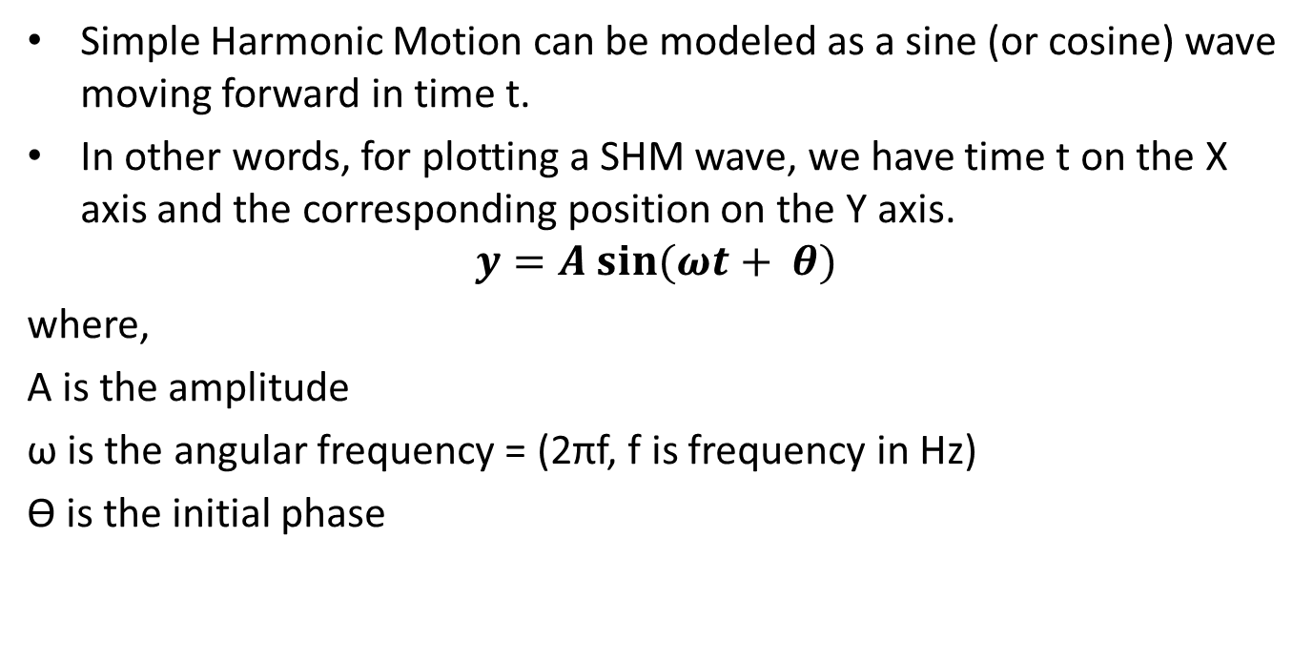
Math Model of SHM
Simple Harmonic Motion can be modeled as a sine (or cosine) wave moving forward in time t.
In other words, for plotting a SHM wave, we have time t on the X axis and the corresponding position on the Y axis.
$$y=A sin⁡(ωt+ θ)$$
where,
A is the amplitude
ω is the angular frequency = (2πf, f is frequency in Hz)
ϴ is the initial phase

Slide 8
Time marching (Discretization)
Marching means the evolution of the main dependent property with respect to the independent dimension i.e. space and time
This is done by iterating or moving along in the time dimension (for example) in a sequential manner from 0 s till a specified stop time in intervals of 0.5 s (or any arbitrary value, called steps)
For example if we want see what happens for the first 5 s of motion in steps of 0.1 s, we will have 50 steps in total
Examples of time marching include,
SHM:
independent dimension is time
dependent property is displacement (Y axis)

Slide 9
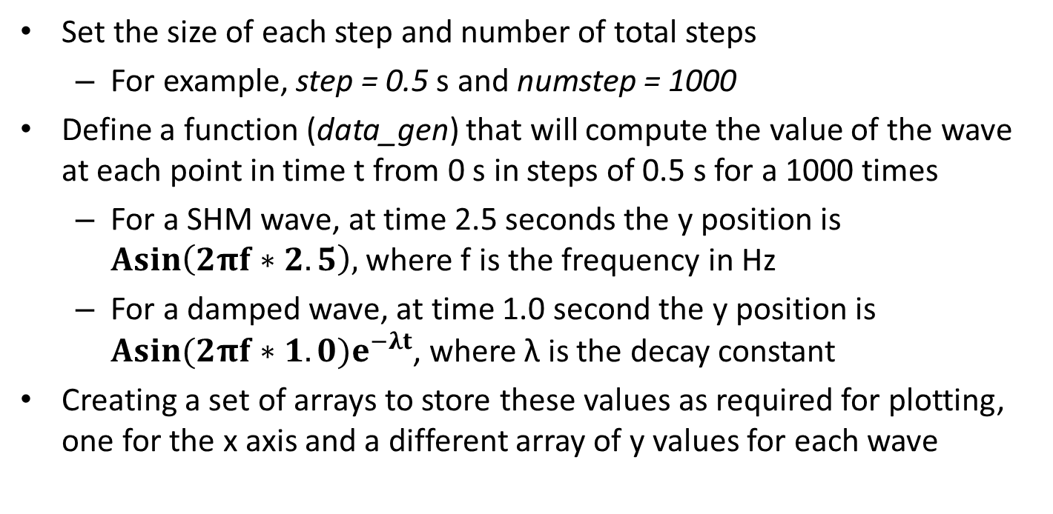
Algorithm/Process
Set the size of each step and number of total steps
For example, step = 0.5 s and numstep = 1000
Define a function (data_gen) that will compute the value of the wave at each point in time t from 0 s in steps of 0.5 s for a 1000 times
For a SHM wave, at time 2.5 seconds the y position is $Asin\left(2πf∗2.5\right),$where f is the frequency in Hz
For a damped wave, at time 1.0 second the y position is $Asin(2πf∗1.0)e^{−λt}$, where λ is the decay constant
Creating a set of arrays to store these values as required for plotting, one for the x axis and a different array of y values for each wave

Slide 10


Bookkeeping
Creating empty arrays to store these sets of points
Creating a figure with three subplots and changing the size of the window
Associating the color and right data sets with each plot, also setting the title

Slide 11
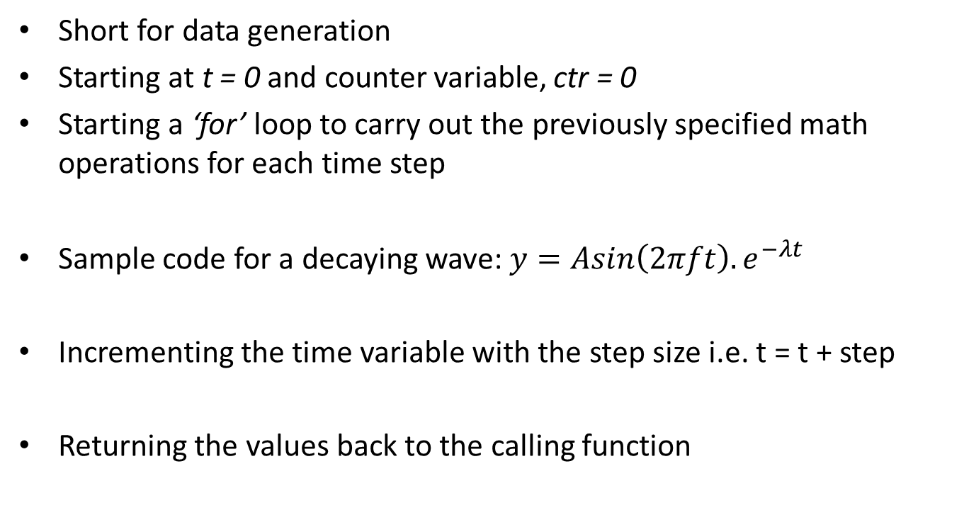
Function: data_gen
Short for data generation
Starting at t = 0 and counter variable, ctr = 0
Starting a ‘for’ loop to carry out the previously specified math operations for each time step
Sample code for a decaying wave: $y=Asin\left(2πft\right).e^{−λt}$
Incrementing the time variable with the step size i.e. t = t + step
Returning the values back to the calling function

Slide 12


Updating and Animating
Update the arrays with the values of each iteration and set it to each line
Animate the lines by calling FuncAnimation with the appropriate function (data_gen)
(increase interval if you want to make it slower)

Slide 13
Code
Open the file: SHM.py
The green comments and the following slides give instructions on how to complete the code to create the animated waves.

Slide 14
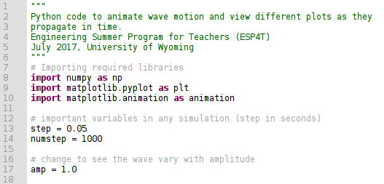
Code

Slide 15
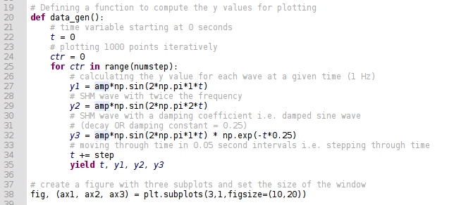
Code

Slide 16
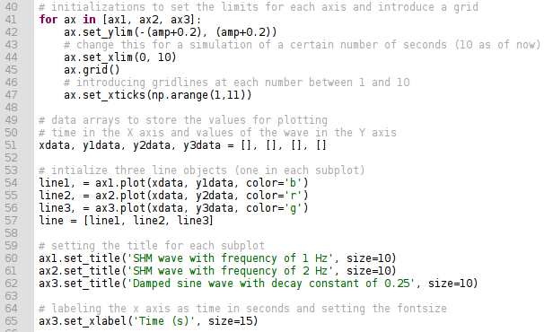
Code

Slide 17
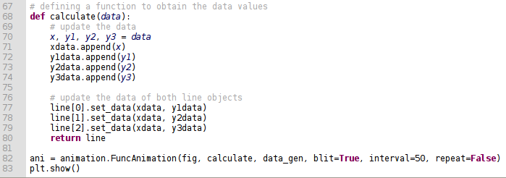
Code

Slide 18
Things to try out
Change the function to print out a different wave instead:
With a frequency of 4 Hz and an amplitude of 2.5
With an initial phase shift of 180º
Extend the X axis to watch the wave fully decay
(P.S. Make sure to change the title to match the corresponding wave)
Use the script to try out other physical animations in 2D using different math formulae with appropriate changes
Best of luck!

