Slide 1
Expect to Win: Predicting Winning (Proportion) in Major League Baseball
Rob Sanchez & Sydney Brougham
STA631 F2018

Slide 2

Goals
1. OLS / Penalized / Dimension-Reducing Regression Models
Lahman’s Baseball Database: Teams table
Response variable: Winning Percentage (proportion)
$\frac{Wins}{Games Played}$
2. Estimate Pythagorean Expectation Exponent
By decade
By year
3. Fit Team Run Data to Weibull distribution
Maximum likelihood

Slide 3
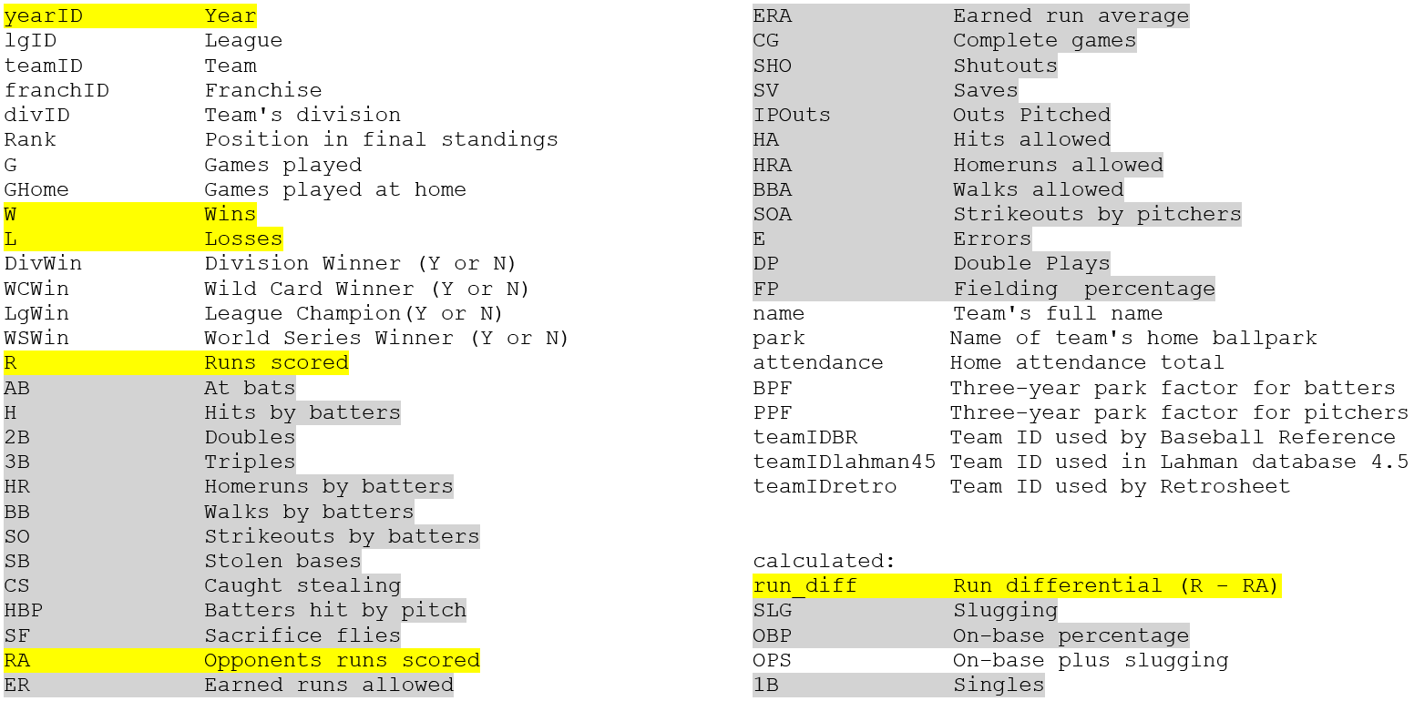
Data
Sean Lahman’s Baseball Database: Teams table

Slide 4
Regression Models
Variable Selection (SAS)
Backward
Forward
Stepwise
Penalized (SAS)
Lasso
Elastic Net
PCR (R)
PLS (R)

Slide 5
Pretty PCR and PLS Plots

Slide 6
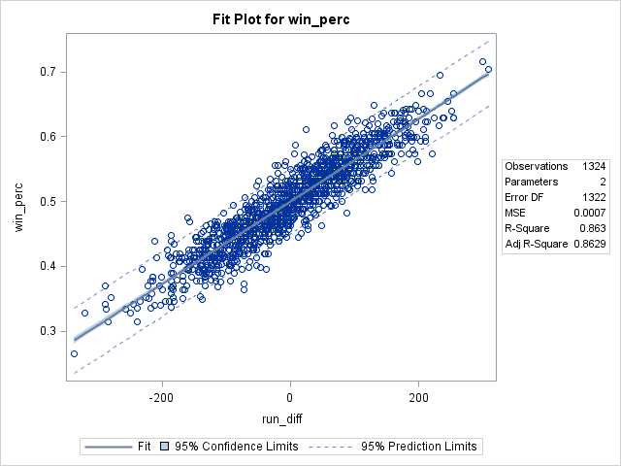
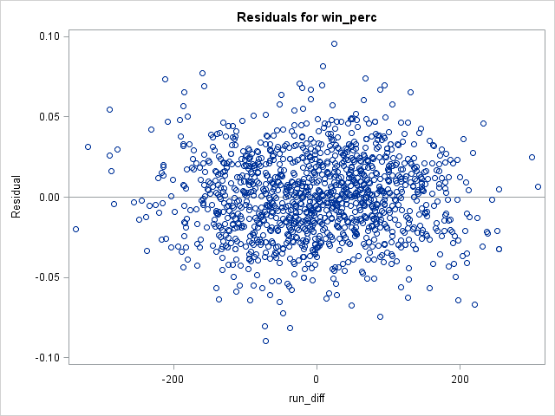
Run Differential
Intercept: 0.5000 When R=RA, W%=0.5
Notes:
P<0.0001 slope and int

Slide 7

Pythagorean Expectation
Derived empirically by Bill James in the 1980s
Original formula:
$W\%=\frac{{RS}^{k}}{{RS}^{k}+{RA}^{k}}=\frac{{RS}^{2}}{{RS}^{2}+{RA}^{2}}$
Recent research suggests the long-term exponent is between 1.8 and 1.9
Estimating k can be formulated as a regression problem:
$log\left(\frac{W}{L}\right)=k∙log\left(\frac{R}{RA}\right)$
Notes:
where RS = runs scored and RA = runs allowed
Research exists adapting the formula for NBA, NHL, and NFL
Model: $logWratio=0+logRratio$ (no intercept)
$k→logRratio$ parameter estimate (exponent)

Slide 8



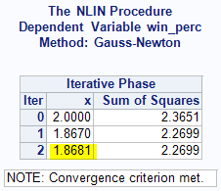


Overall Exponent Estimation
Simple Linear Regression
$log\left(\frac{W}{L}\right)=k∙log\left(\frac{R}{RA}\right)$
Exponent = 1.87752 ± 0.02212
Nonlinear Regression
$Win_perc=\frac{R^{2}}{R^{2}+{RA}^{2}}$
Exponent = 1.8681 ± 0.0234
Notes:
SAS Nonlinear regression is a form of regression analysis in which data is fit to a model and then expressed as a mathematical function.

Slide 9
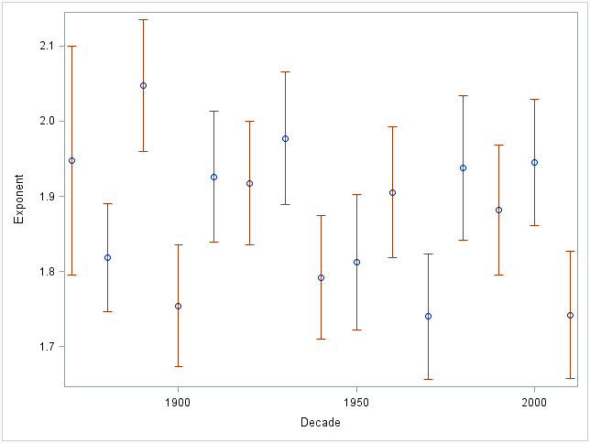
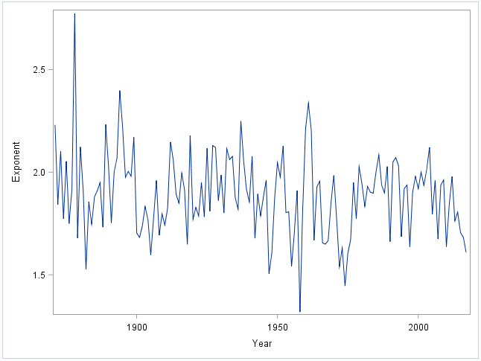
Change in Exponent Over Time
Notes:
Safe to roll with the mean for all years
(need transition to Weibull here)

Slide 10
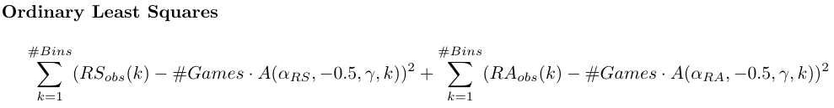
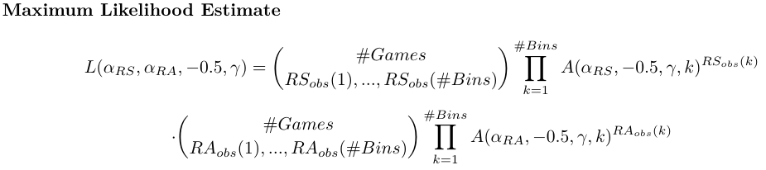
Weibull (1)
Miller, S. J. (2005). A Derivation of the Pythagorean Won-Loss Formula in Baseball.
PE formula from random draws of a Weibull distribution
Daily team runs histogram data – implemented in Julia
OLS – minimize sum-of-squares
MLE – maximum likelihood estimation

Slide 11
Weibull (2)
Table of 2004 MLB exponent estimates: Miller’s and ours, OLS and MLE
Weibull fit images from Miller paper
Pretty pictures from R code
Bookies, Vegas, general managers, team owners, fans

Slide 12
Conclusion
Is the team performing to expectations?
Will the team invest more/less in the off-season
If we had more time
Variable transformations
Interaction effects
Stranded base runners

Slide 13
References
Marchi, M., & Albert, J. (2014). Analyzing Baseball Data with R. Boca Raton, FL: CRC Press, Taylor & Francis Group.
Miller, S. J. (2005). A Derivation of the Pythagorean Won-Loss Formula in Baseball. ArXiv:Math/0509698. Retrieved from http://arxiv.org/abs/math/0509698

