Slide 1
MoE&LLM
稀疏结构⼤模型详解

Slide 2
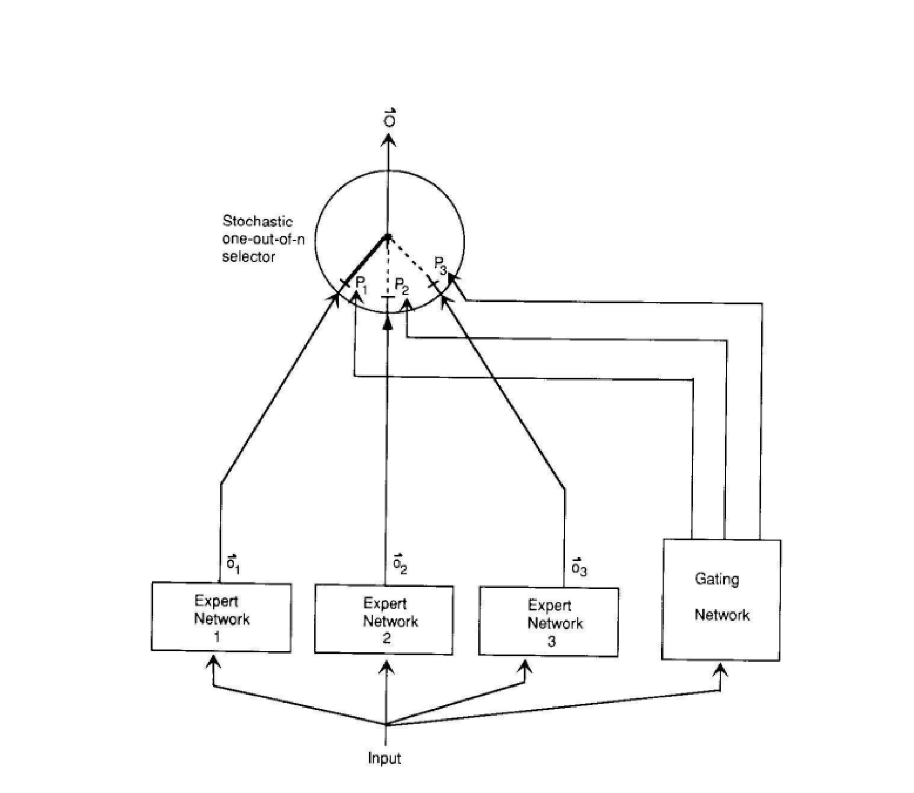
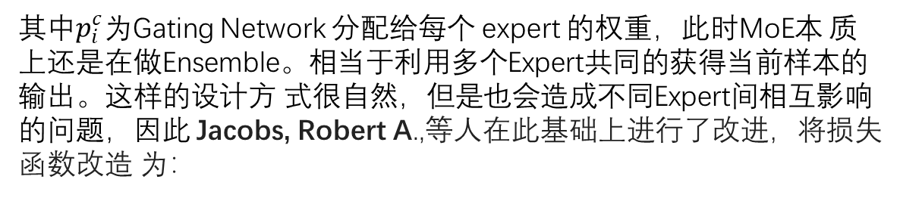
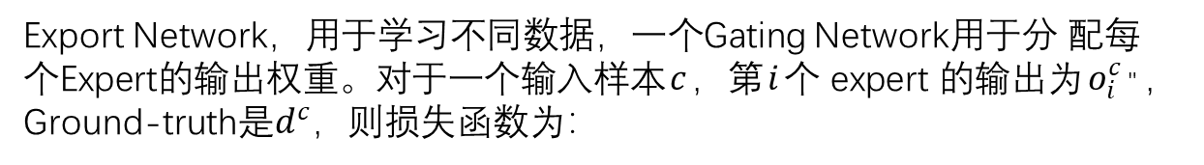
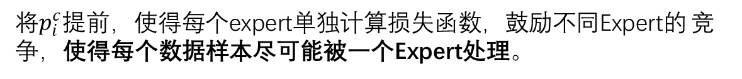
Vanilla MoE
Export Network，⽤于学习不同数据，⼀个Gating Network⽤于分 配每个Expert的输出权重。对于⼀个输⼊样本$c$，第$i$个 expert 的输出为$o_{i}^{c}$" ，Ground-truth是$d^{c}$，则损失函数为：
•
其中$p_{i}^{c}$为Gating Network 分配给每个 expert 的权重，此时MoE本 质上还是在做Ensemble。相当于利⽤多个Expert共同的获得当前样本的输出。这样的设计⽅ 式很⾃然，但是也会造成不同Expert间相互影响的问题，因此 Jacobs, Robert A.,等⼈在此基础上进⾏了改进，将损失函数改造 为：
•
将$p_{i}^{c}$提前，使得每个expert单独计算损失函数，⿎励不同Expert的 竞争，使得每个数据样本尽可能被⼀个Expert处理。
Jacobs, Robert A., et al. "Adaptive mixtures of local experts." Neural computation 3.1 (1991): 79-87.

Slide 3
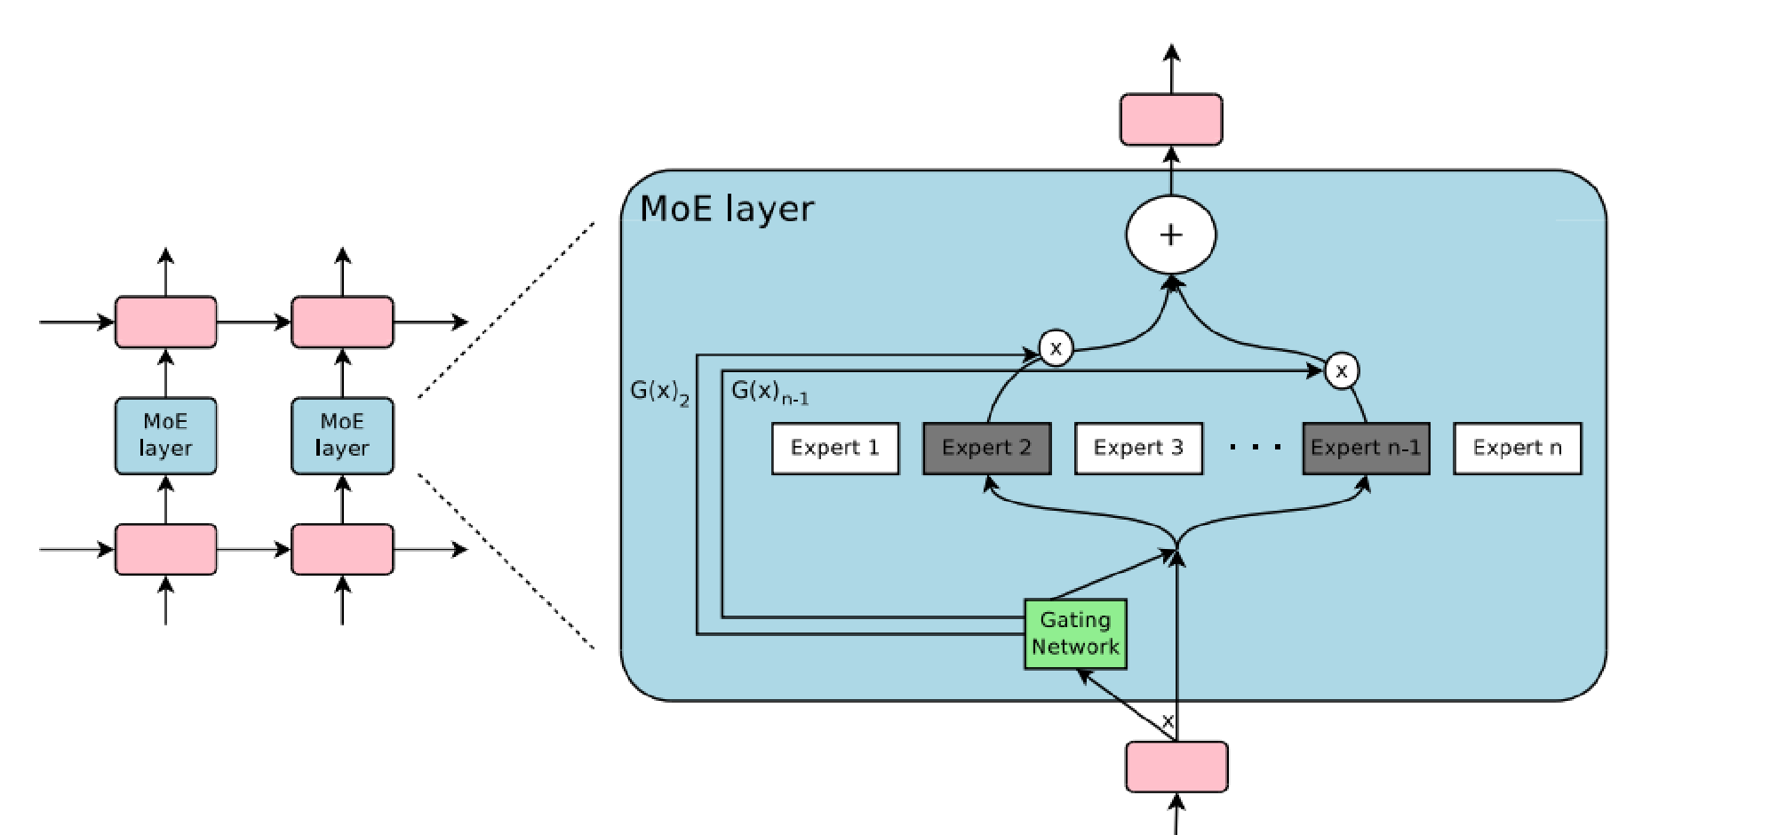
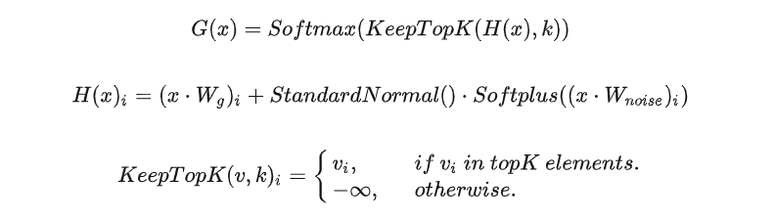
Sparse MoE
设$G\left(x\right)$和$E\left(x\right)$分别是 gating network 和第$i$个 expert 的输出，对于在当前position的输⼊$x$，输出是experts 的加权和：
$G\left(x\right)$的输出是稀疏的，只有部分的 experts 的权重> 0，其余=0 的 expert 直接不参与计算。
Shazeer, Noam, et al. "Outrageously large neural networks: The sparsely-gated mixture-of-experts layer." arXiv preprint arXiv:1701.06538 (2017).

Slide 4
Expert Balancing
作者在实验中发现，不同 experts 在竞争的过程中，会出现“赢者通吃”的现象：前期变现好的 expert 会更容易被 gating network 选择，导致最终只有少数的⼏个 experts 真正起作⽤。因此 作者额外增加了⼀个 loss，来缓解这种不平衡现象，公式如下：
其中 $X$ 代表的是⼀个batch的样本，把⼀个batch所有样本的gating weights加起来，然后计算 变异系数（ coefficient of variation）。
Shazeer, Noam, et al. "Outrageously large neural networks: The sparsely-gated mixture-of-experts layer." arXiv preprint arXiv:1701.06538 (2017).

Slide 5
Transformer MoE
• GShard
• Switch Transformer
• GLaM

Slide 6
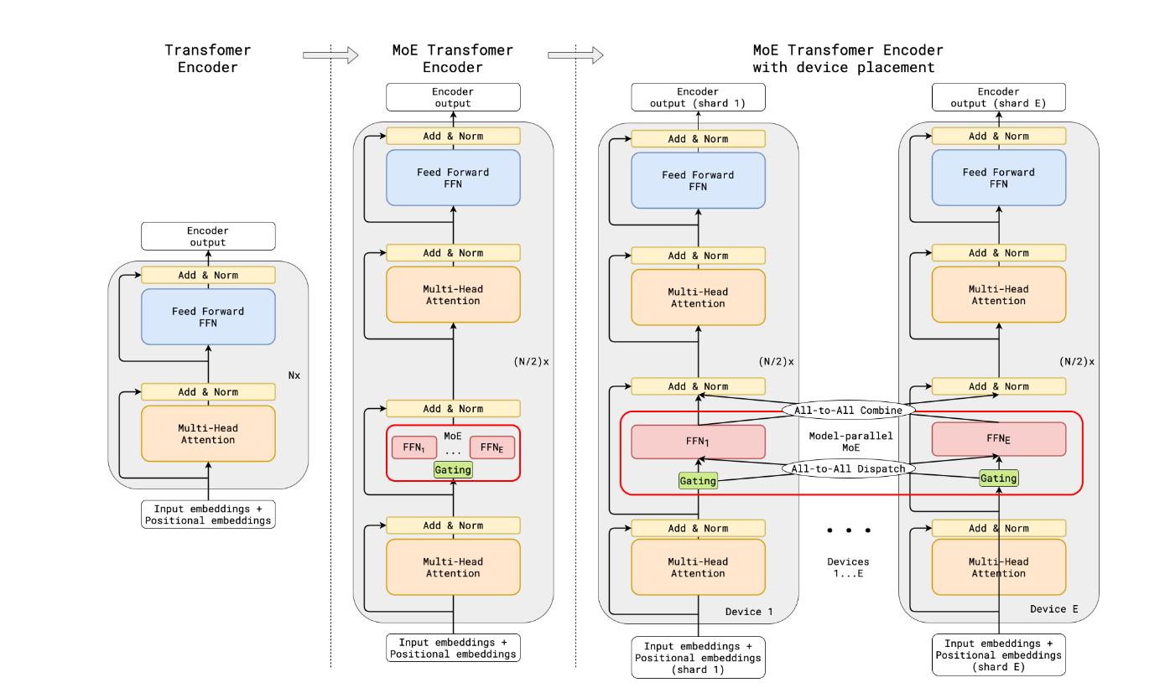
GShard
⾸个MoE+Transformer模型：
• Transformer的encoder和 decoder中，每隔⼀个（every other）FFN层，替 换成position-wise MoE层
• Top-2 gating network

Slide 7
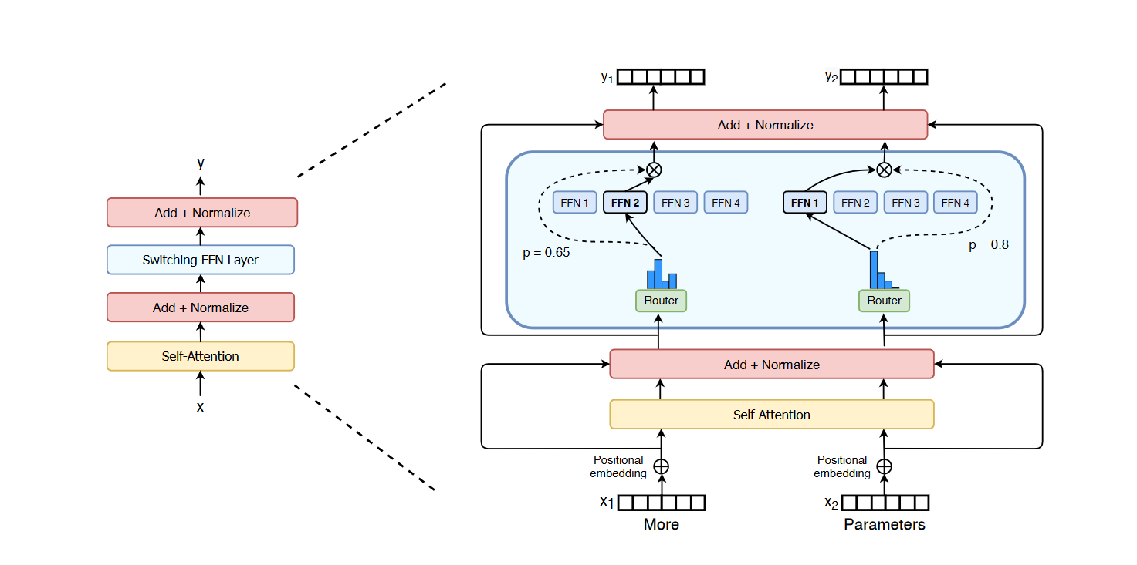
Switch Transformer
• 简化了MoE的routing算法
• gating network 每次只 route 到 1 个 expert
Fedus, William, Barret Zoph, and Noam Shazeer. "Switch transformers: Scaling to trillion parameter models with simple and efficient sparsity." The Journal of Machine Learning Research 23.1 (2022): 5232-5270.

Slide 8
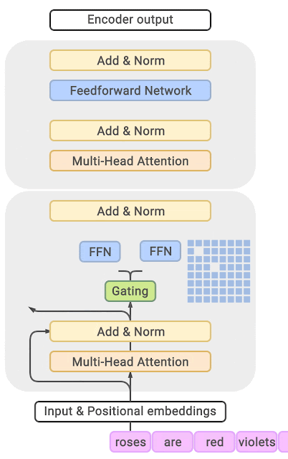
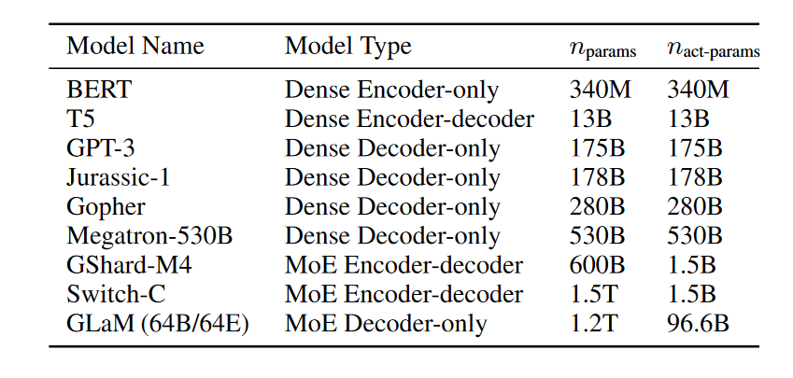
GLaM
• Gshard结构
• Scale参数量
• 降低训练推理成本
Du, Nan, et al. “Glam: Efficient scaling of language models with mixture-of-experts.” ICML, 2022.

Slide 9
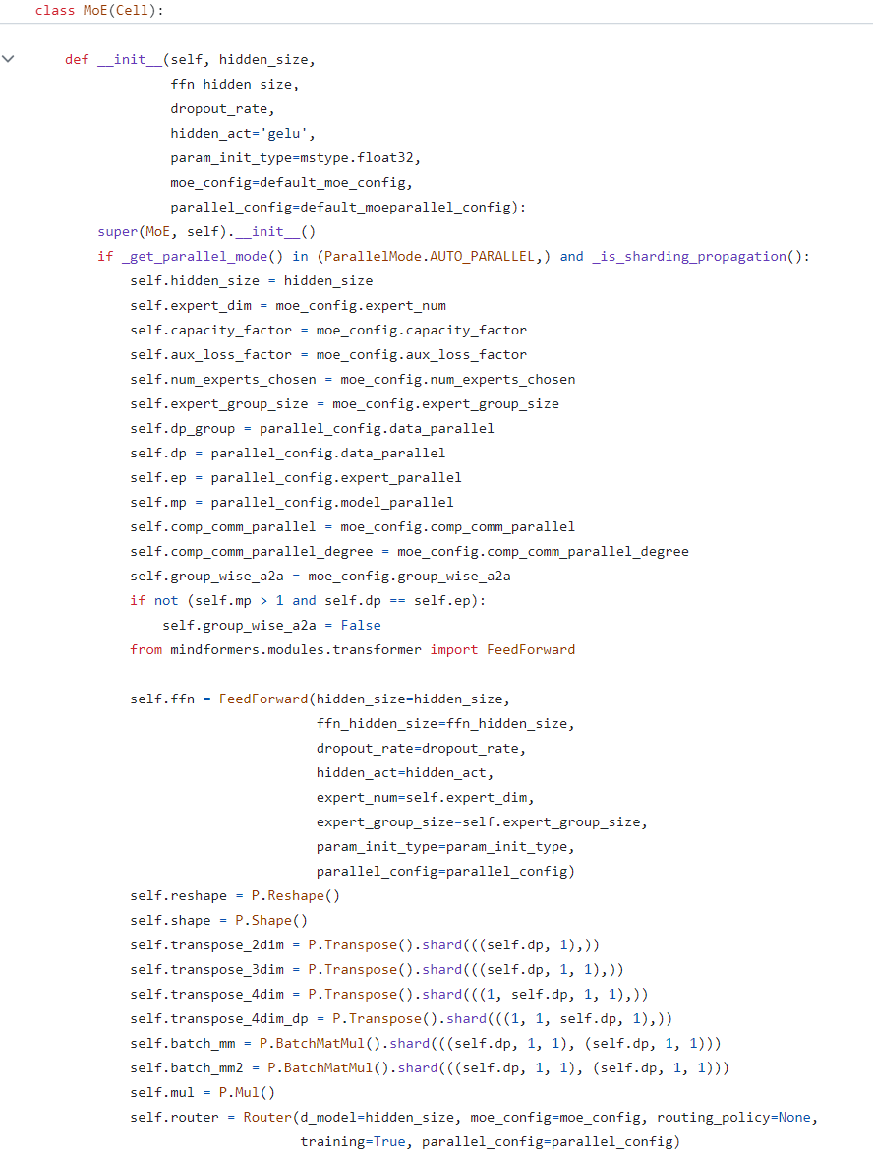
MoE结构复杂度
Transformer的MoE会对FFN层进 ⾏MoE扩展，但是Transformer结 构本⾝还有Multihead Attention 结构，这使得MoE扩展会变成 Transformer结构的侵⼊式改造。

Slide 10
Expert Balancing
• 物理世界规律造成的不均衡。2-8定律在此，总会有⼀部分任务或领域 占据所有数据的⼤部分，也⼀定会有⻓尾数据，使⽤等参数量、随机 Gating的⽅式进⾏强制的均衡分配，实际上也是在伤害模型对现实世 界的拟合。
• 神经⽹络特点决定的赢者通吃。Gating Network可学会很⾃然的朝 着⼏个拟合较好的Expert进⾏数据分配，这⼀点仍需要⼤量的尝试和 研究，也许可以缓解，也许可以解决。

Slide 11
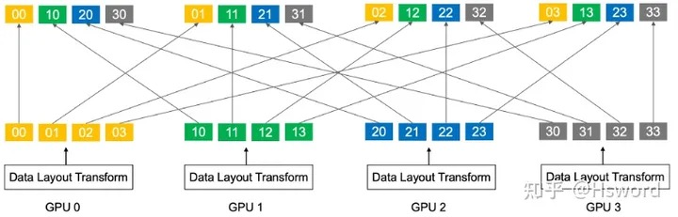
分布式通信问题
MoE结构和普通的Dense模型的差异在于，其需要额外的AllToAll通信，来实现数据的路由 (Gating)和结果的回收。⽽AllToAll通信会跨Node（服务器）、跨pod（路由），进⽽造成⼤ 量的通信阻塞问题

Slide 12
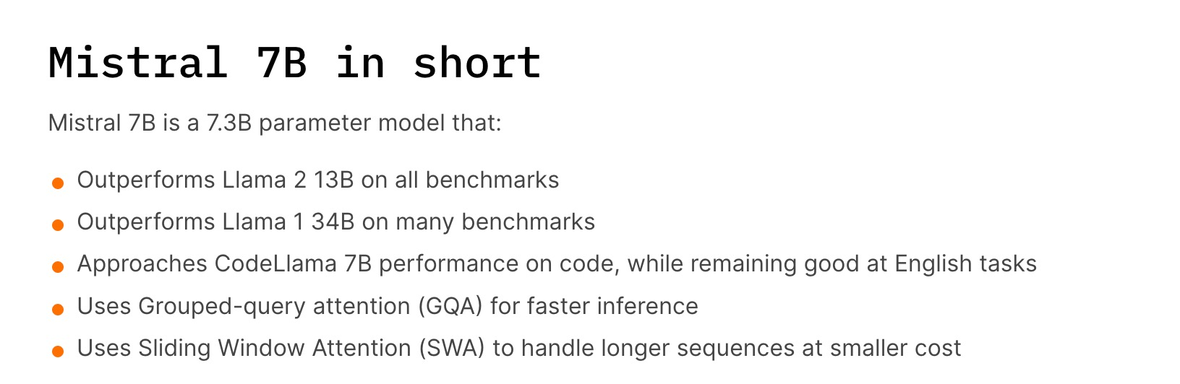
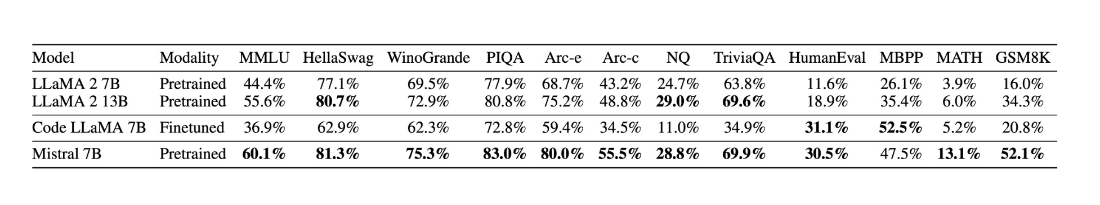
Mistral Model
• RoPE
• RMSNorm
• Transformer decoder

Slide 13
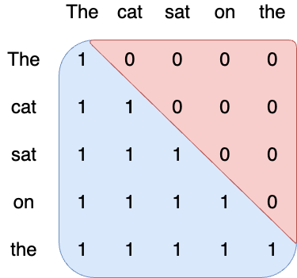
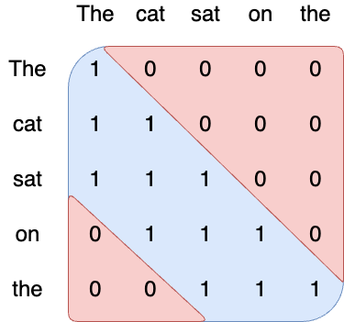
Sliding window attention
Vanilla attention
Sliding window
The number of operations of attention is quadratic in the sequence length, and the memory pressure is linear in the sequence length. At inference time, this incurs higher latency and smaller throughput due to reduced cache availability. To alleviate this issue, we use a sliding window attention :
• each token can attend to at most W tokens in the past (here, W=3).

Slide 14
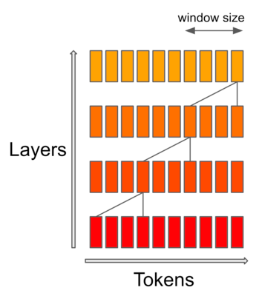
Sliding window attention
Note that tokens outside the sliding window still influence next word prediction. At each attention layer, information can move forward by W tokens at most: after two attention layers, information can move forward by 2W tokens, etc. For instance in a sequence of length 16K and a sliding window of 4K, after 4 layers, information has propagated to the full sequence length.

Slide 15
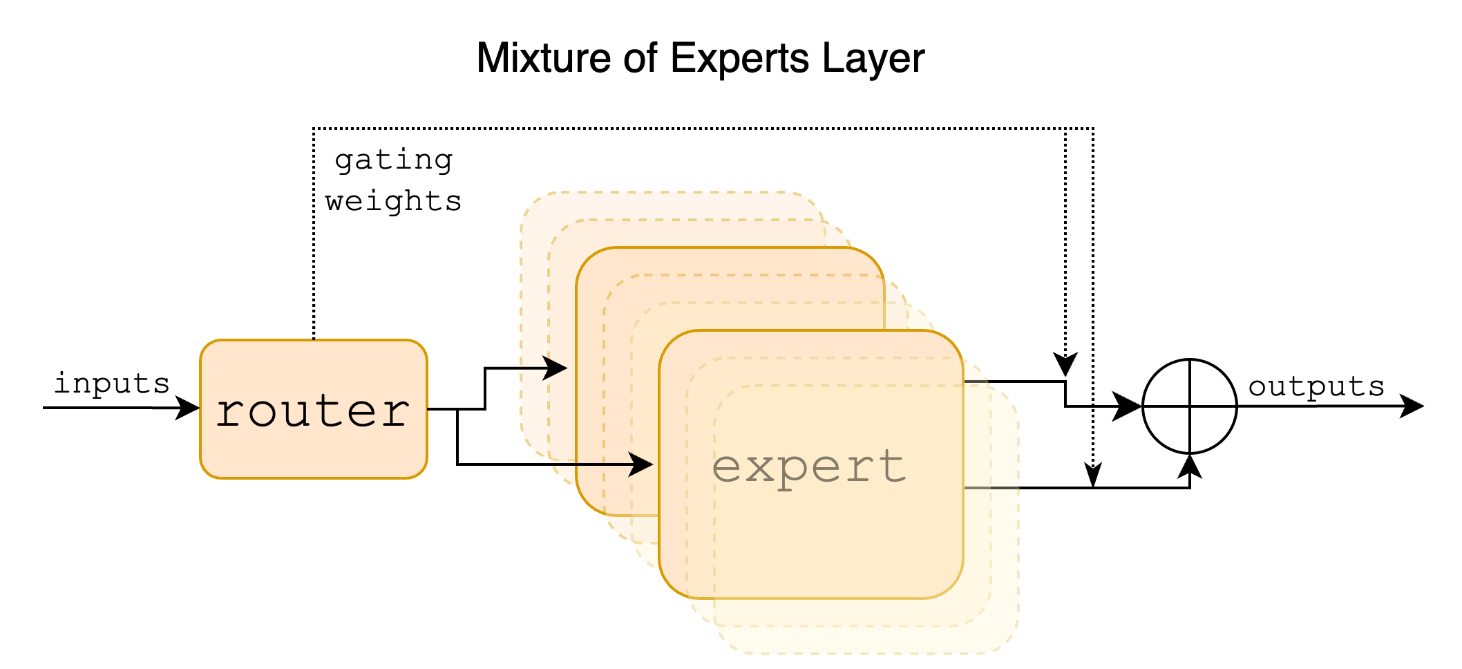
MoE——Mixtral
Sparse Mixture of Experts allows one to decouple throughput from memory costs by only activating subsets of the overall model for each token. In this approach, each token is assigned to one or more "experts" -- a separate set of weights -- and only processed by sunch experts. This division happens at feedforward layers of the model. The expert models specialize in different aspects of the data, allowing them to capture complex patterns and make more accurate predictions.

Slide 16
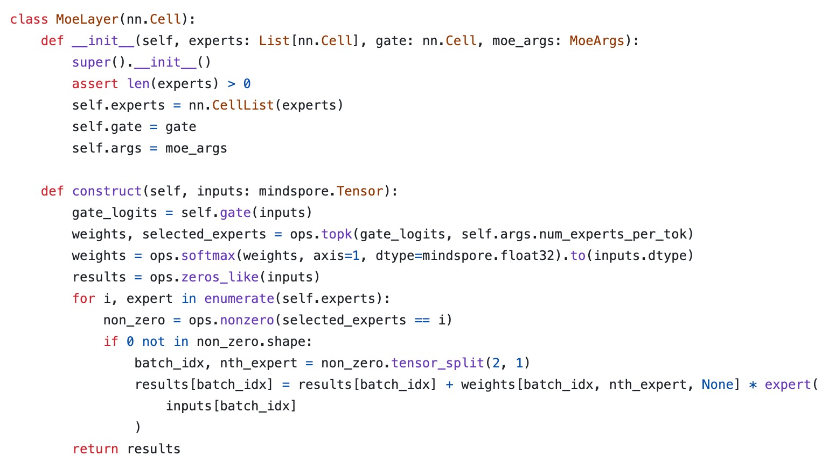
MoE Layer实现

Slide 17
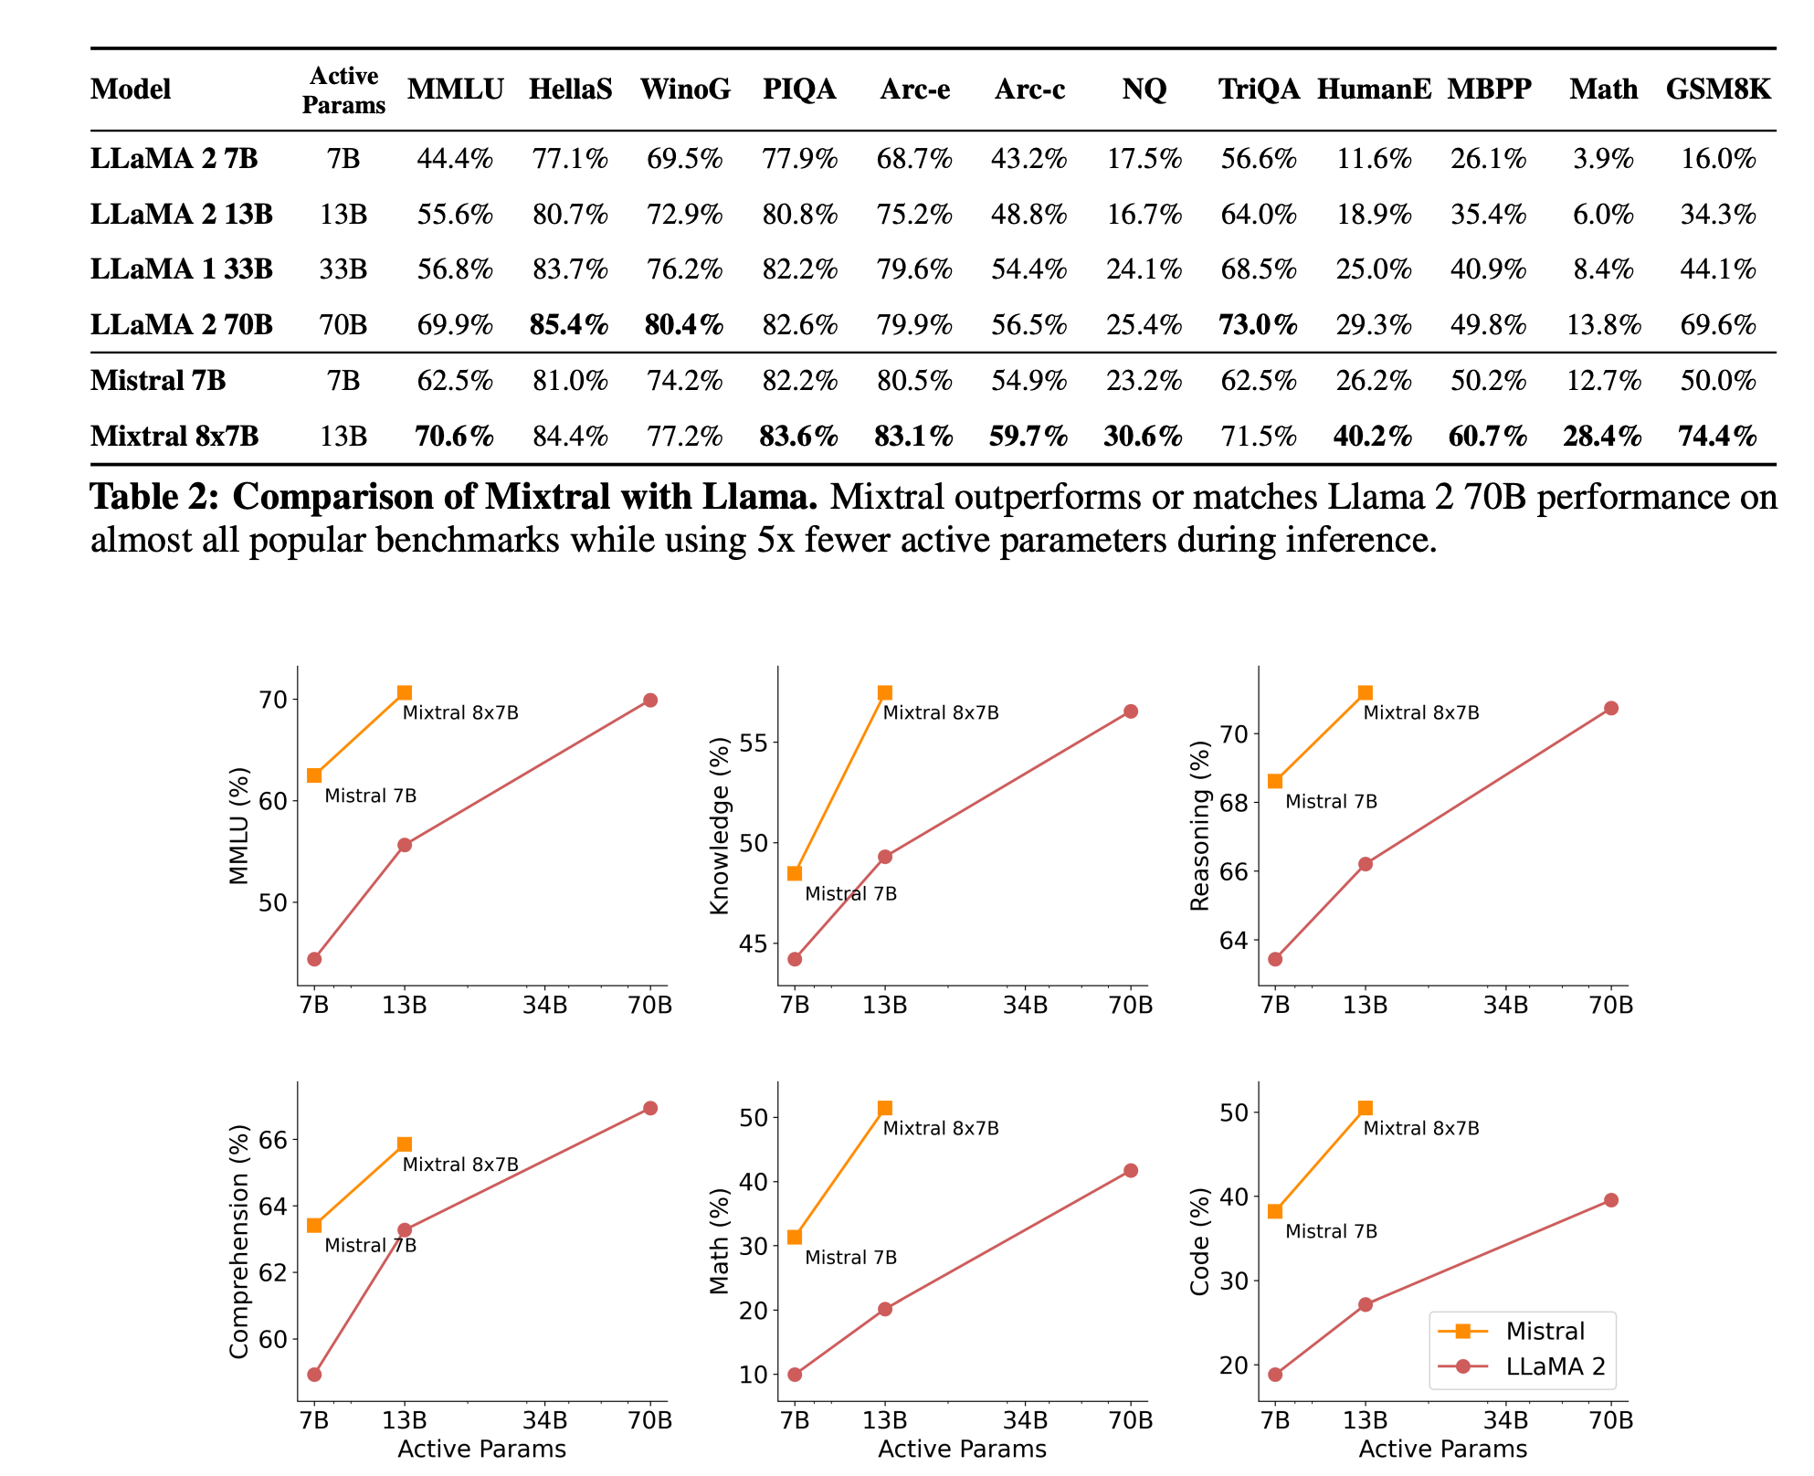
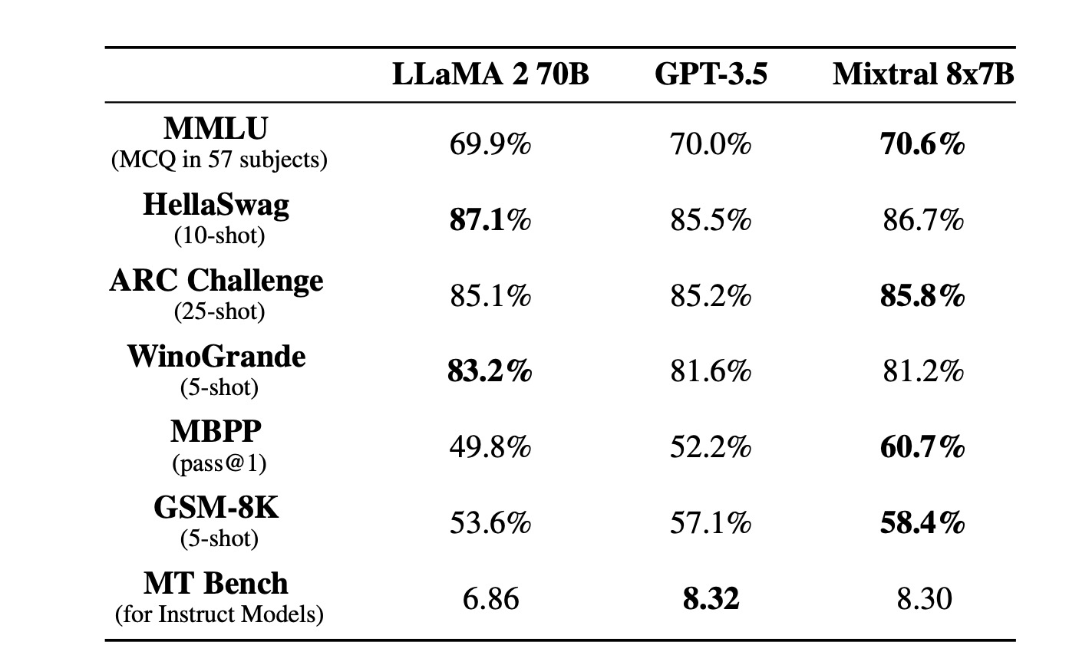

Slide 18
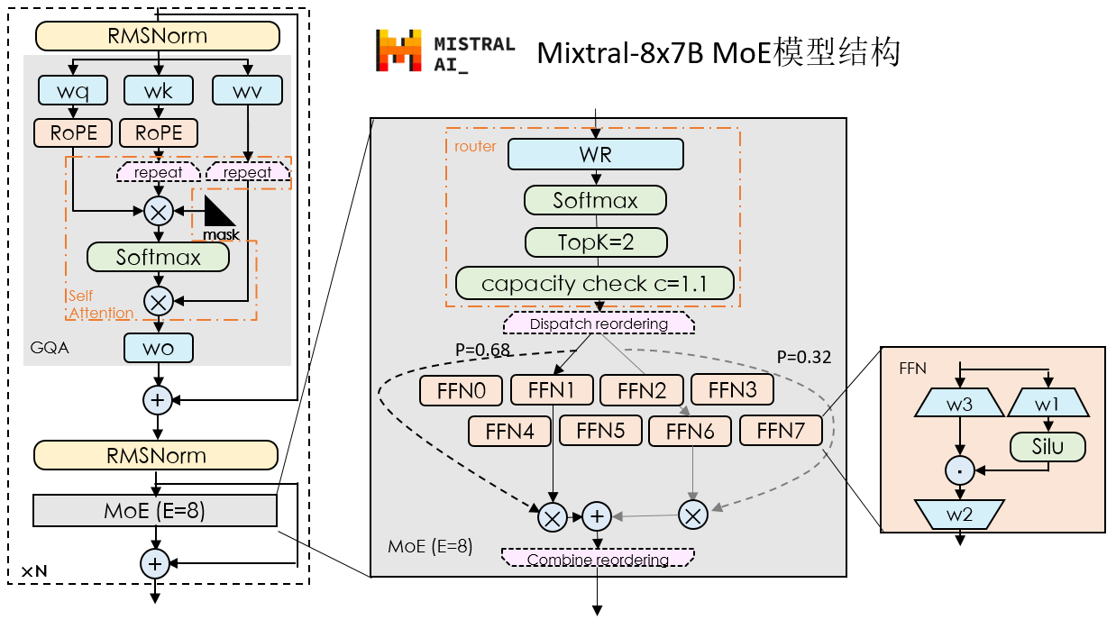
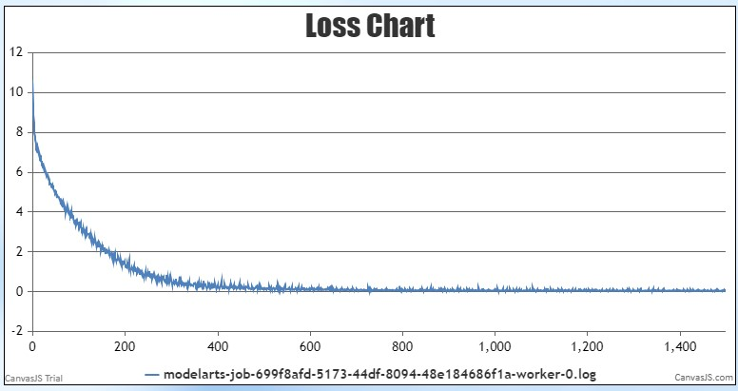
基于MindSpore实现的Mixtral EP-MP等多维混合并行训练
nlaye r | heads | hidden | intermediat e | GQA | vocab | MoE size | MoE topk
32 | 32 | 4096 | 14336 | 8 | 32000 | 8 | 2
• 基于MindFormers实现Mixtral-8x7B MoE模型。
• 关键结构: GQA, RoPE, RMSNorm, Silu
• MoE配置: 8 Experts, TopK=2, capacity c=1.1
• 加载开源的Mixtral权重和tokenizer，推理结果
对⻬HF.
• 4机32卡EP,PP等多维混合并⾏，基于⾃有数据 集试验性训练收敛符合预期。200 epoch loss 10à0.02
4
机
32
卡⼩数据集试验性训练
200
epoch loss
à
10
0.02

Slide 19
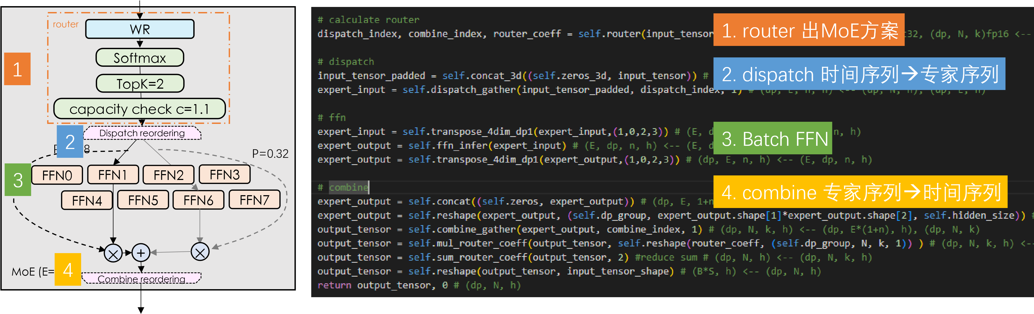
MoE的代码实现

Slide 20
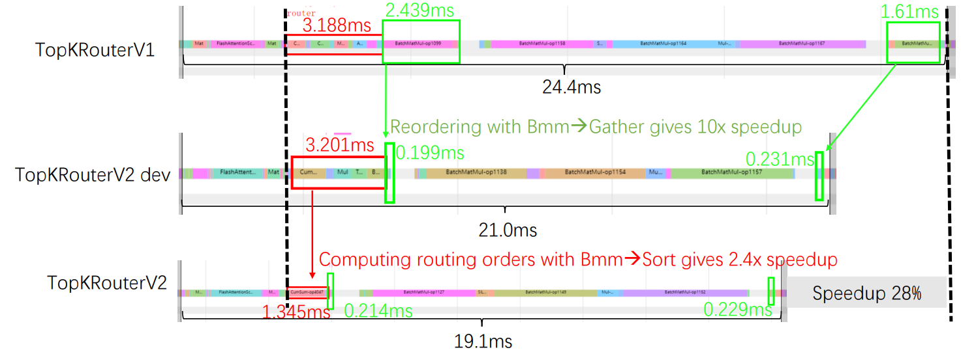
Optimize the implementation of TopKRouter
 | TopK | dispatch/combine | router order computing
TopKRouterV1 | K * argmax | BatchMatMul | ordering matrix = K* (onehot-cumsum-onehot*2)
TopKRouterV2 -dev | 1 * TopK | Gather | ordering index = 1* (onehot-cumsum-bmm)
TopKRouterV2 | 1 * TopK | Gather | ordering index = 1* (onehot-cumsum-sortFP32)

Slide 21
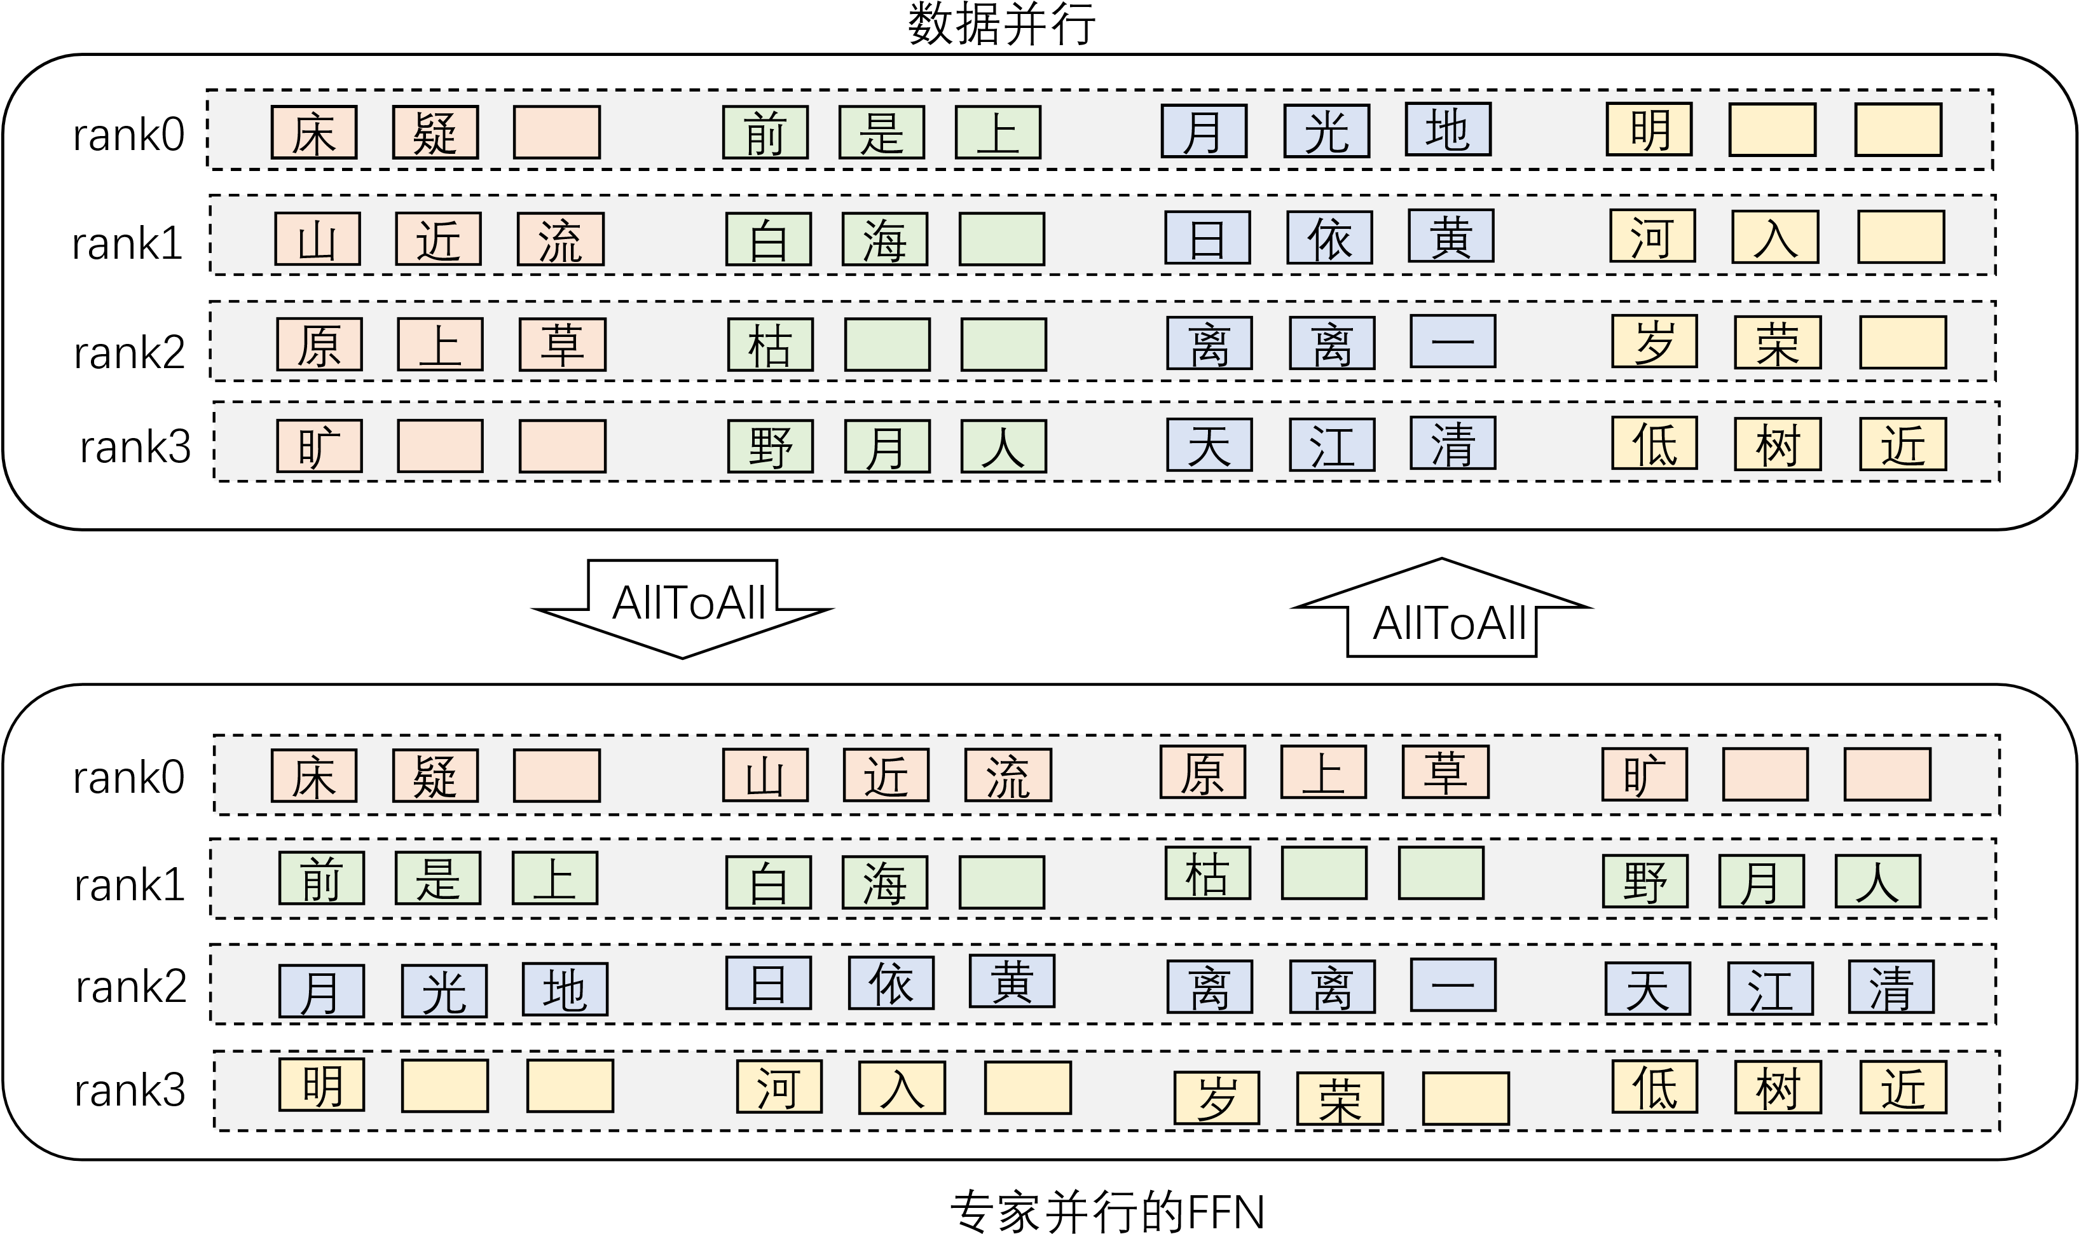
专家并行的示意图

Slide 22
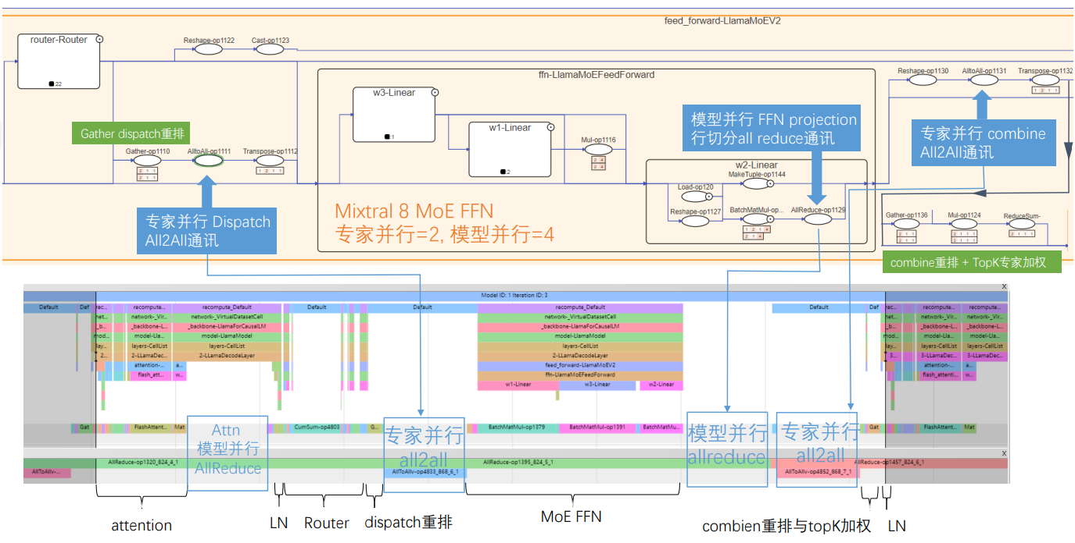
Mixtral 实现EP-MP等多维混合并行训练

Slide 23
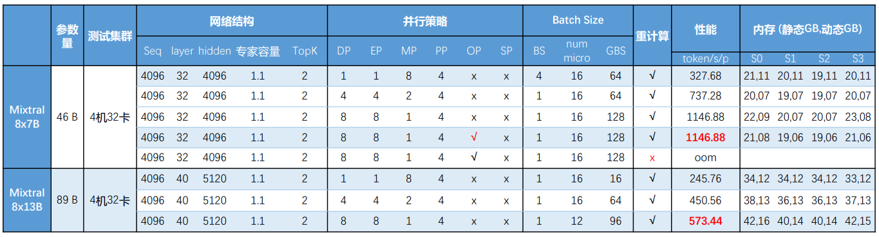
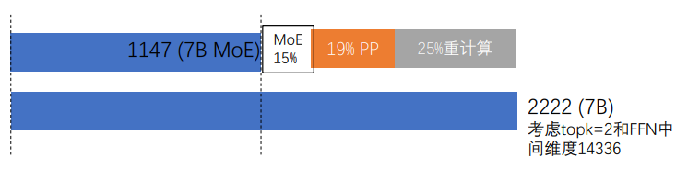
Mixtral 实现EP-MP等多维混合并行训练
• EP=8,MP=1时性能最佳,约1147 tokens/s/p。其中 ：
• MoE相关开销约15%(路由/容量系数/重排/通讯)
• 优化器并⾏在EP的基础上切分QKV优化器参数，静态与动态内存降低约1GB。
• 相⽐8x7B， 8X13B参数量约为2倍，最佳性能下的开销也约为2倍。
• 优化点:
• MP开启时，可以通过Group-wise all2all提⾼a2a性能，通过SP降低allreduce 开销。
• 内存尚有余量，可以考虑选择重计算。

Slide 24
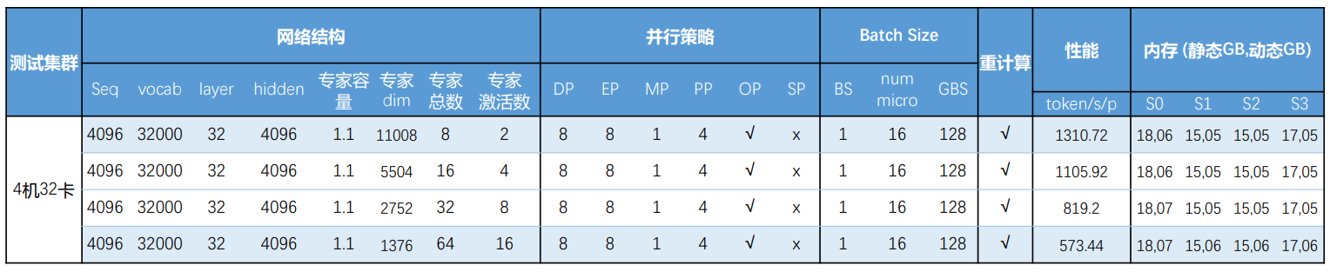
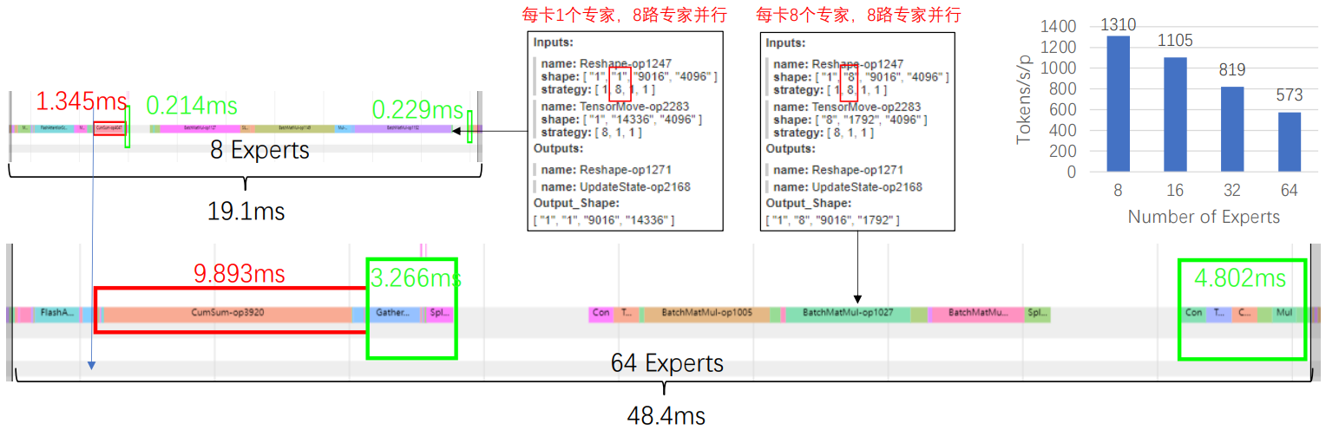
扩展MoE 专家数对性能的影响

Slide 25
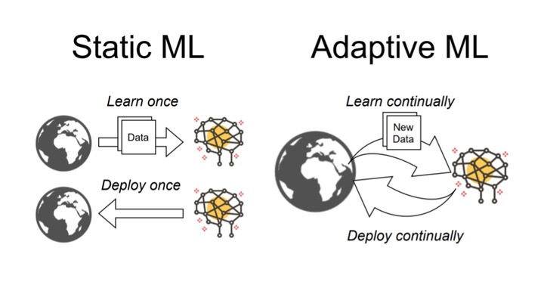
Continual Learning
Continual learning is a machine learning paradigm, whose objective is to adaptively learn across time by leveraging previously learned tasks to improve generalization for future tasks. Hence, CL studies the problem of sequential learning from a continuous stream of data, drawn from a potentially non-stationary distribution, and reusing gained knowledge throughout the lifetime while avoiding catastrophic forgetting.
Biesialska, Magdalena, Katarzyna Biesialska, and Marta R. Costa-Jussa. "Continual lifelong learning in natural language processing: A survey." arXiv preprint arXiv:2012.09823 (2020).

Slide 26
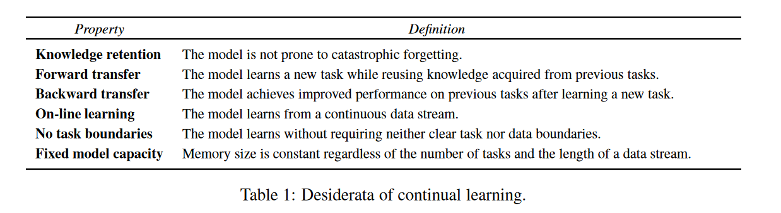
Desiderata of Continual Learning
性质 | 定义
知识记忆(knowledge retention) | 模型不易产⽣遗忘灾难
前向迁移(forward transfer) | 利⽤旧知识学习新任务
后向迁移(backward transfer) | 新任务学习后提升旧任务
在线学习(online learning) | 连续数据流学习
⽆任务边界(No task boudaries) | 不需要明确的任务或数据定义
固定模型容量(Fixed model capacity) | 模型⼤⼩不随任务和数据变化
Biesialska, Magdalena, Katarzyna Biesialska, and Marta R. Costa-Jussa. "Continual lifelong learning in natural language processing: A survey." arXiv preprint arXiv:2012.09823 (2020).

Slide 27
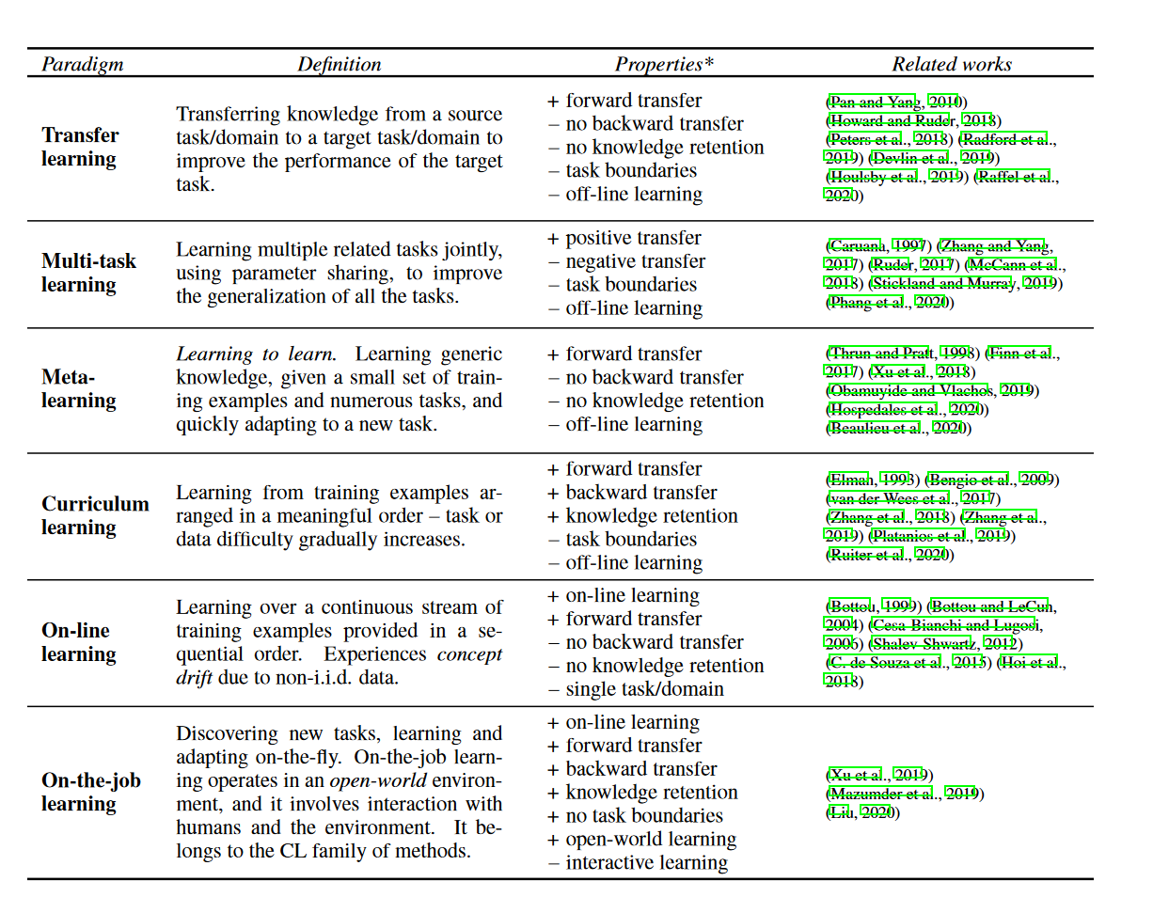
Comparison of related ML paradigms
Biesialska, Magdalena, Katarzyna Biesialska, and Marta R. Costa-Jussa. "Continual lifelong learning in natural language processing: A survey." arXiv preprint arXiv:2012.09823 (2020).

Slide 28
Forgetting
• Distribution of original dataset: A
• Distribution of new samples: B
• Distribution shift A ð B
• Performance on both A & B matter!
• Build general models is the trend.
• “Forgetting issue”: if we only train on B, performance on A will drop

Slide 29
LLM paradigm(Pretrain+SFT)
性质 |  | 说明
知识记忆(knowledge retention) | √ | LLM 预 训 练 后 ， 具 备 世 界 知 识 ， ⼩ 规 模 finetune不易对LLM造成遗忘灾难。但⼤规模数据续训会造成。
前向迁移(forward transfer) | √ | 基 于 世 界 知 识 的 Zero shot 、 few shot 、 finetune。
后向迁移(backward transfer) | - | Finetune后会可能会造成部分任务的性能下降 ⼆次finetune会损失⾸次finetune性能。
在线学习(online learning) | × | 离线预训练、微调。
⽆任务边界(No task boudaries) | √ | Unsupervised预训练、微调，不区分任务。
固定模型容量(Fixed model capacity) | √ | LLM预训练后⼤⼩不变。

Slide 30
MoE和Lifelong learning
MoE的特点：
• 多个Expert分别处理不同分布（domain/topic）的数据
• 推理仅需要部分Expert
LLM的终⾝学习：
• 世界知识底座持续学习
• Expert可插拔
• Gating Network可增删
性质
知识记忆(knowledge retention) | √
前向迁移(forward transfer) | √
后向迁移(backward transfer) | -
在线学习(online learning) | ×
⽆任务边界(No task boudaries) | √
固定模型容量(Fixed model capacity) | √

Slide 31
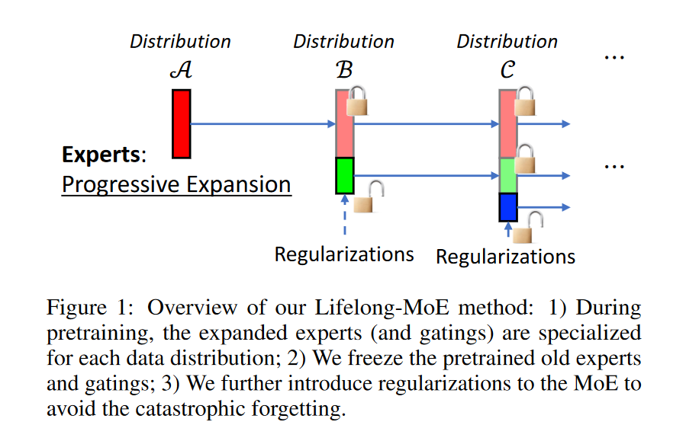
Lifelong Language Pretraining with Distribution-Specialized Experts
• Distribution based MoE
• Progressively add more experts for new data distribution
• Add regularization to mitigate forgetting.
Chen, Wuyang, et al. "Lifelong language pretraining with distribution-specialized experts." ICML, 2023.

Slide 32
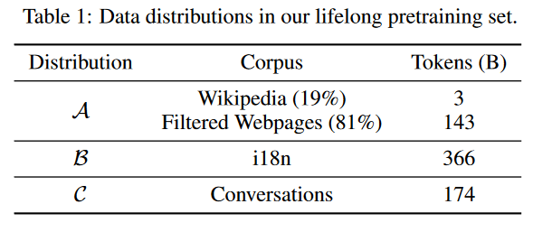
Lifelong Pretraining on MoE
• Distribution A ð B ð C
• Simulation on Tarzan: A=wiki/web, B=non-English, C=dialog
• Regularization
• We don’t want models to overfit B
• We don’t want model weights to be updated too far from A
• Fit B, while regularize model from A
• Expansion
• Allow models to expand layers(experts) when fitting new distributions
Chen, Wuyang, et al. "Lifelong language pretraining with distribution-specialized experts." ICML, 2023.

Slide 33
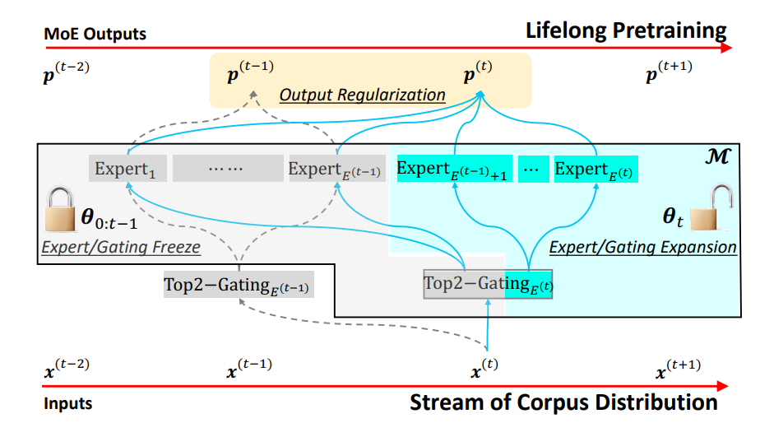
Expansion + Regularization
• Expand experts for new distributions
• Partially freeze old experts/gatings
• Train with “Learning without Forgetting” loss (Regularization)
Chen, Wuyang, et al. "Lifelong language pretraining with distribution-specialized experts." ICML, 2023.

Slide 34
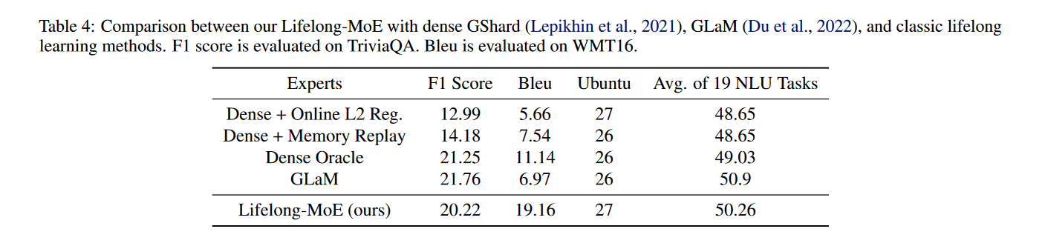
Results
Chen, Wuyang, et al. "Lifelong language pretraining with distribution-specialized experts." ICML, 2023.

Slide 35
Drawback
• Expand dimensions of gating layer with random initialization.
• Need extra regularization
• Not pluggable

Slide 36
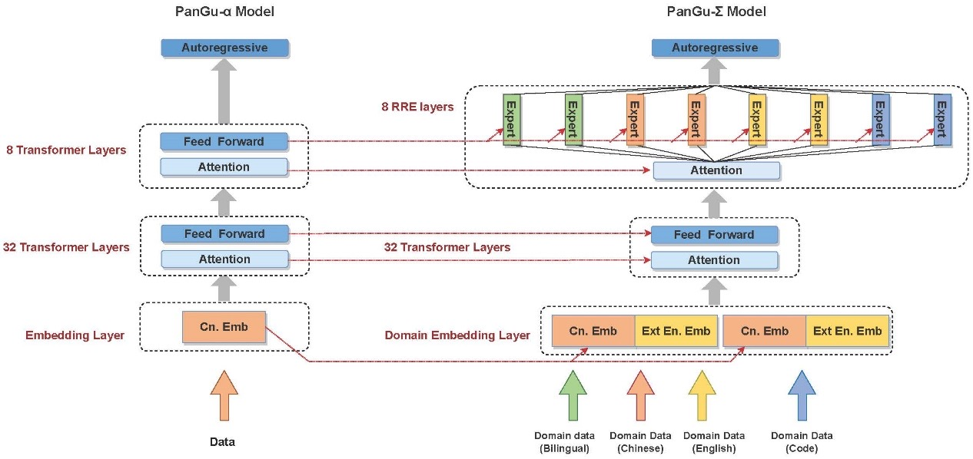
PanGu-Sigma
Ren, Xiaozhe, et al. "PanGu-{\Sigma}: Towards Trillion Parameter Language Model with Sparse Heterogeneous Computing." arXiv preprint arXiv:2303.10845 (2023).

Slide 37
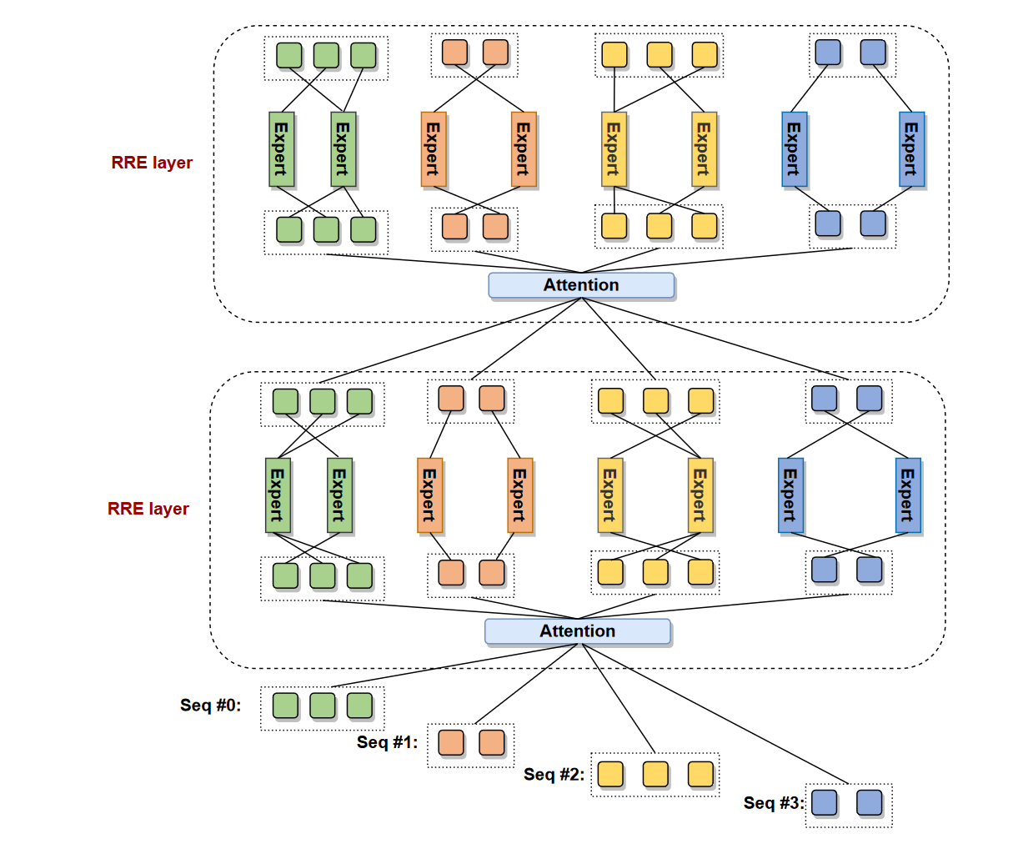
Random Routed Experts
RRE做了双层的设计：
• 第⼀层，根据任务分配给不同 的专家组（多个expert构成⼀个 专家组，供⼀个task/domain使 ⽤）
• 第⼆层，使⽤组内随机Gating， 让专家组的expert可以负载均衡。
Ren, Xiaozhe, et al. "PanGu-{\Sigma}: Towards Trillion Parameter Language Model with Sparse Heterogeneous Computing." arXiv preprint arXiv:2303.10845 (2023).

Slide 38
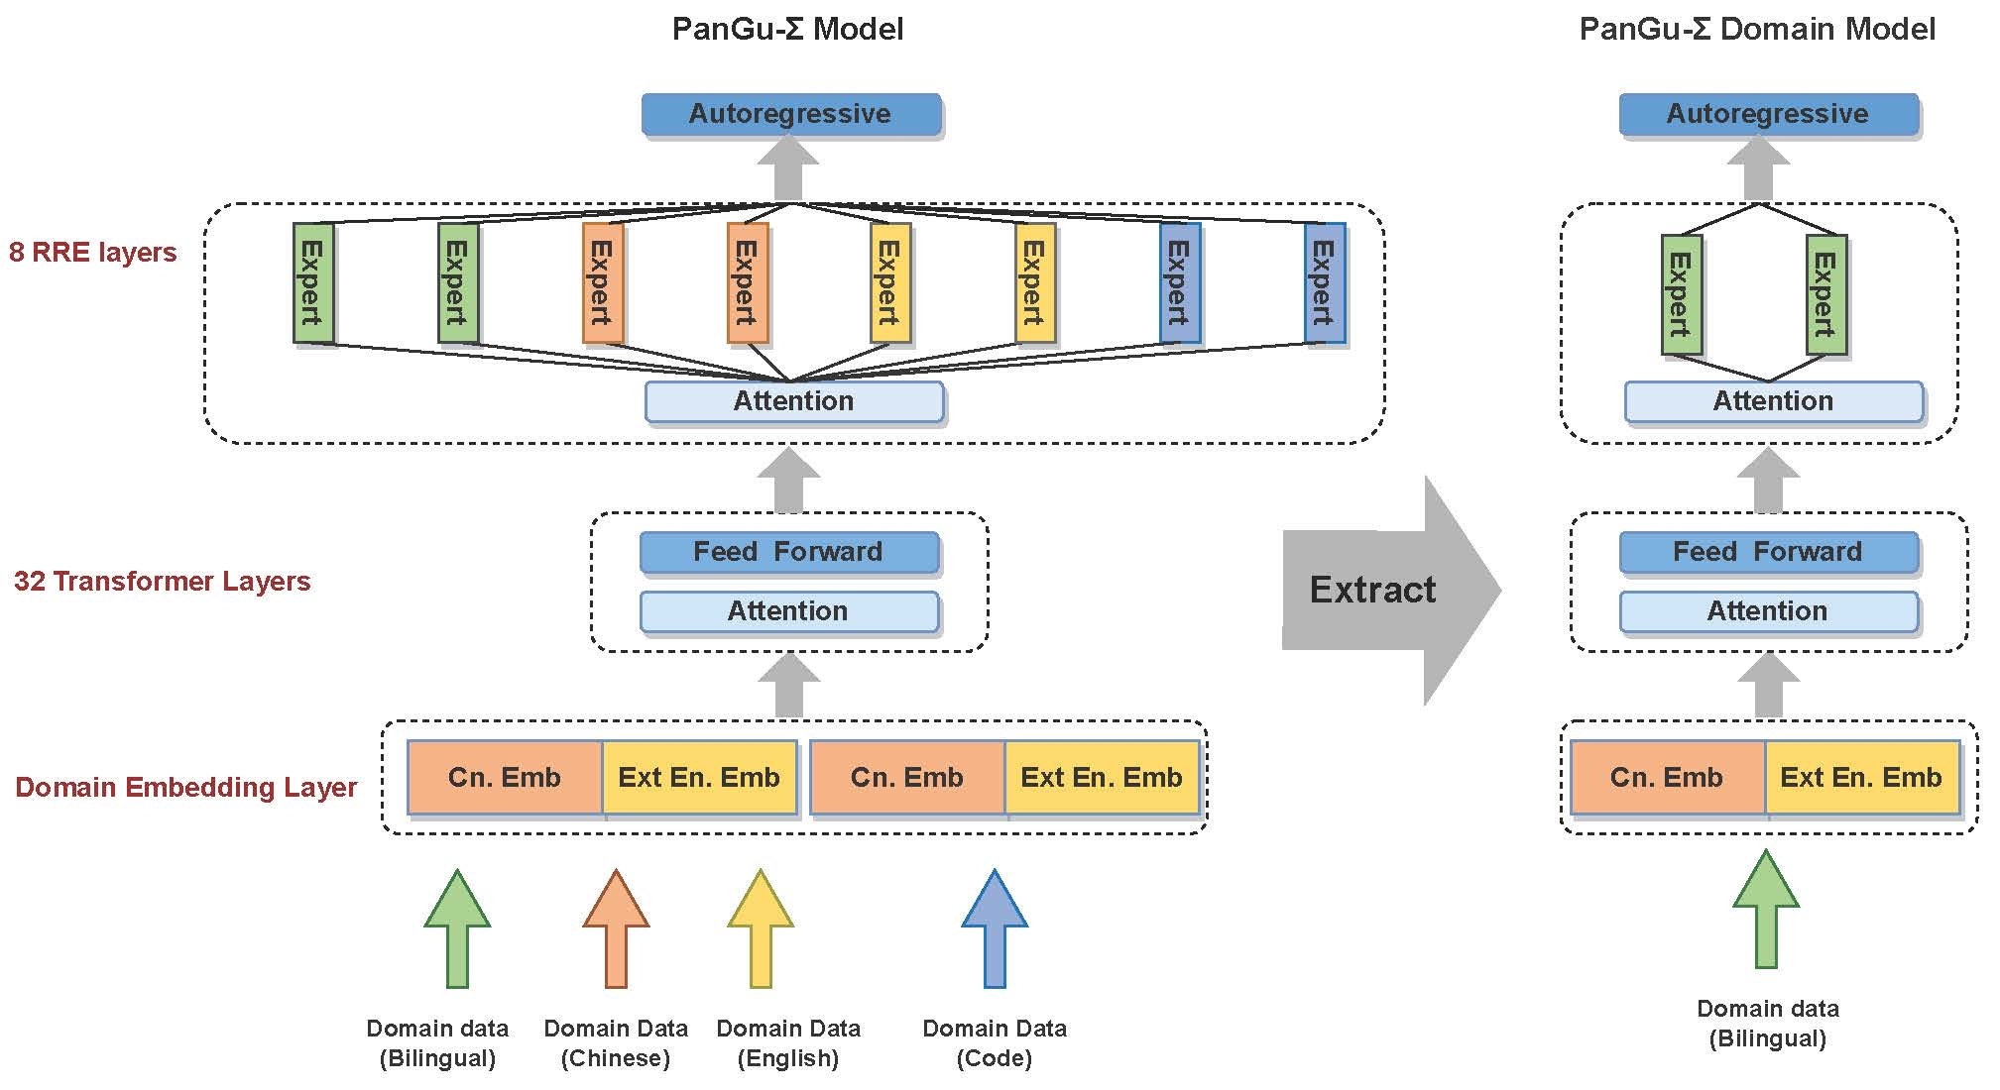
Domain Extract
Ren, Xiaozhe, et al. "PanGu-{\Sigma}: Towards Trillion Parameter Language Model with Sparse Heterogeneous Computing." arXiv preprint arXiv:2303.10845 (2023).

Slide 39
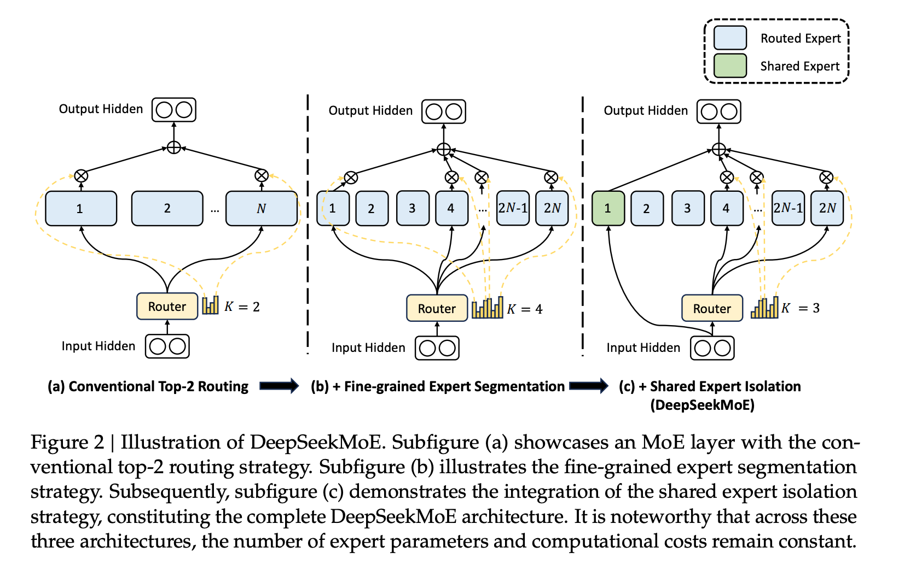
Deepseek

Slide 40
Deepseek
• (1)知识杂交：现有的MoE实践通常采⽤有限数量的专家(例如8或16)， 因此分配给特定专家的标记可能会涵盖不同的知识。因此，指定的专 家将倾向于在其参数中汇集不同类型的知识，这些知识很难同时利⽤。
• (2)知识冗余：分配给不同专家的token可能需要共同知识。因此，多个 专家可能会在各⾃的参数中收敛到共享知识的获取，从⽽导致专家参 数中的冗余。这些问题共同阻碍了现有MoE实践中的专家专业化，使 其⽆法达到MoE模型的理论上限性能。

Slide 41
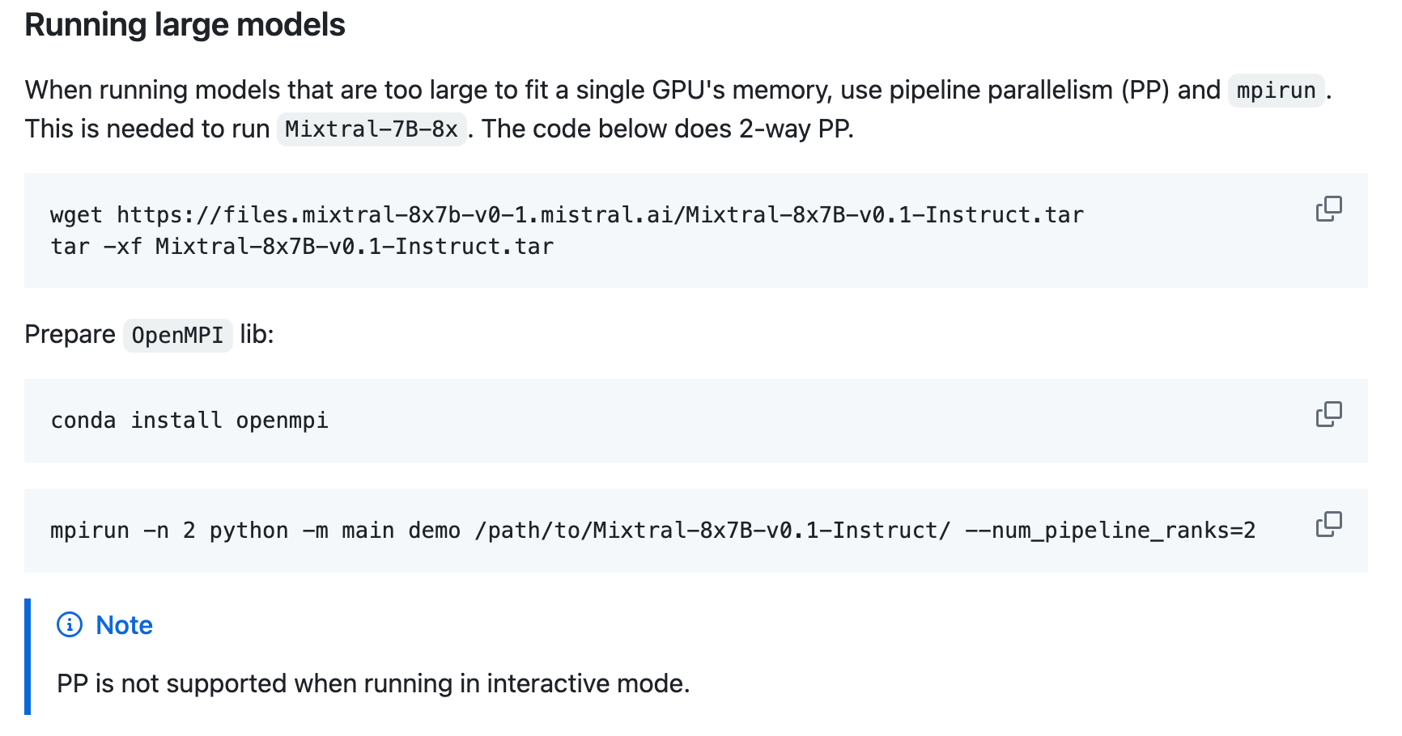
Mixtral 8x7b演示

