Slide 1

Project report
Advanced programming with Python
Group 12

Slide 2
Project topic
Hotel Management System

Slide 3
Hotel Management System
Manage room reservation, check in, check out
Manage service usage
Manage revenue

Slide 4
Project structure Front-end
UI/UX design
Handling user interactions
Handling input and display data
Back-end integration

Slide 5
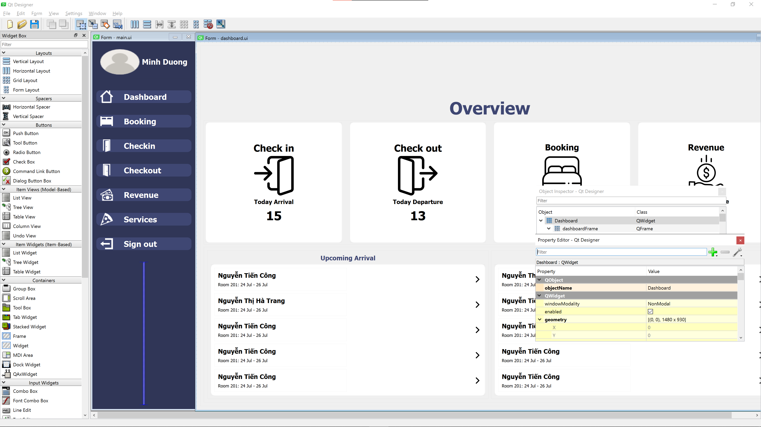
Front-end
Qt Designer is used to design the GUI.

Slide 6
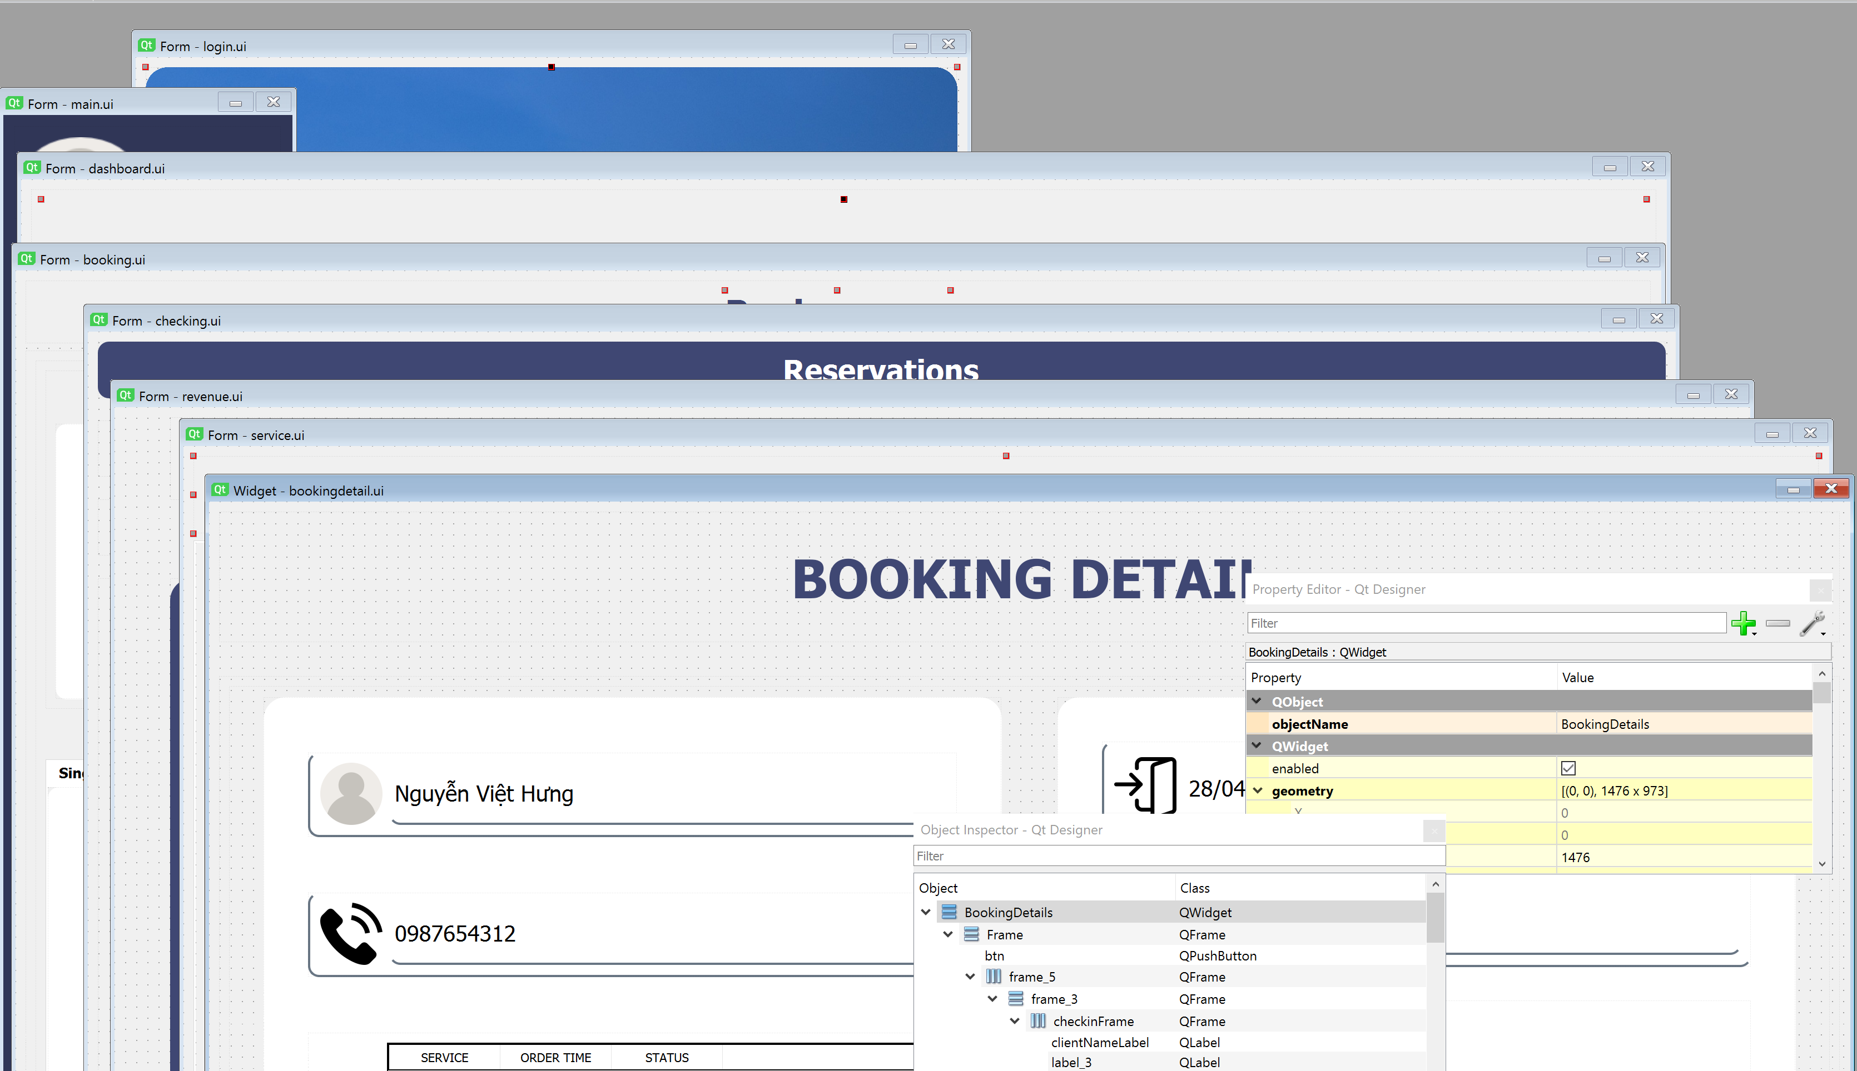
Front-end
The program has multiple pages, each page has its own .ui file.

Slide 7
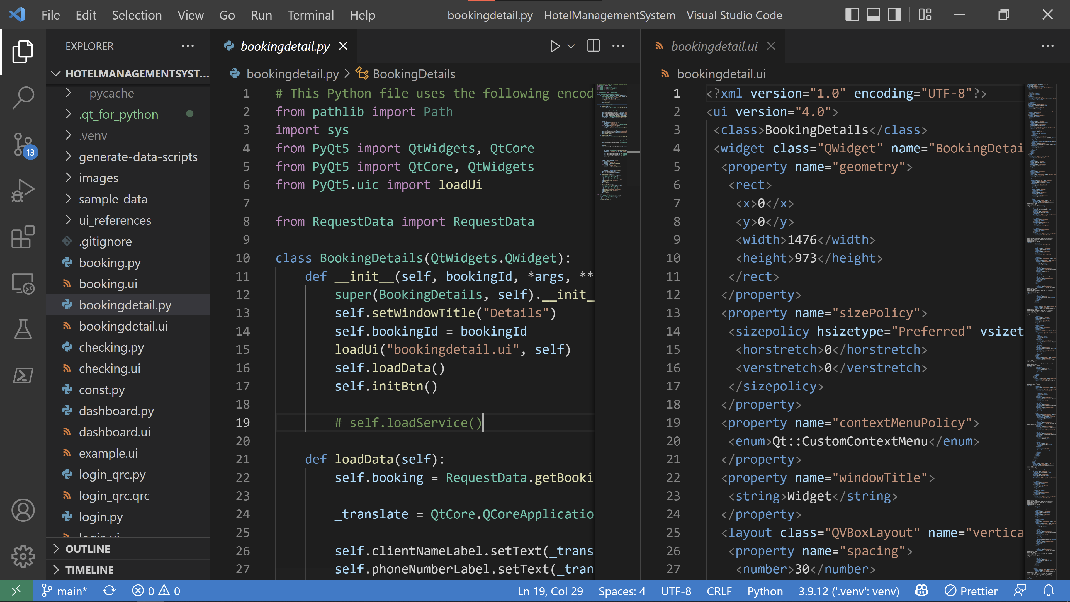
Front-end
Each page has a corresponding .py file to handle the required functions and dynamically display data.

Slide 8
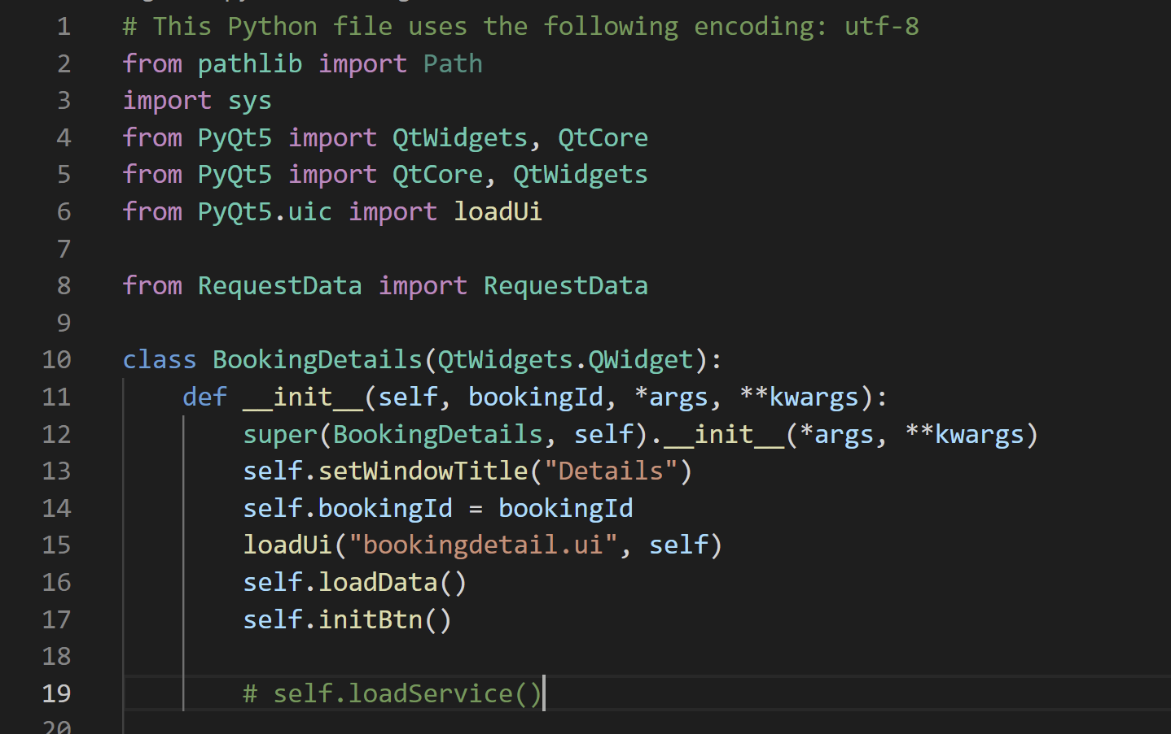
Front-end
Each python file will use the PyQt5 library to create a class inherited from QtWidget that represents a page in our program.

Slide 9
Project structure Back-end
Database design
CRUD handling
Parse and provide data for
front-end
Authentication

Slide 10
Back-end structure
Booking information
Services
Room information
OrderService
User

Slide 11
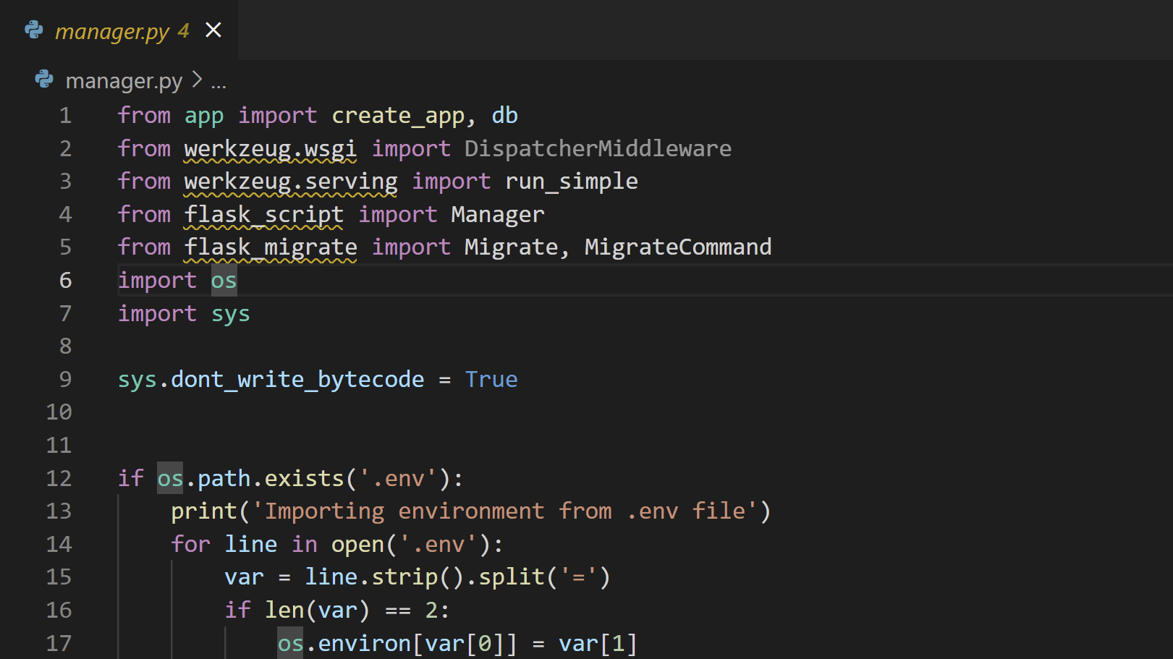

Back-end
The back-end is built using Flask micro web framework

Slide 12
Back-end
The database is SQLite and is handled through SQLAlchemy

Slide 13
Conclusion
All main features are successfully implemented
Manage reservation, check in, check out
Manage service usage
Manage revenue
Improvement ideas:
Add user role and authorization to manage staff
Add restaurant related features

