Slide 1



Building Serverless Applications with Amazon
AWS Lambda

Slide 2
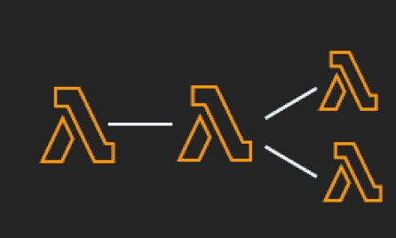
Why Serverless?
Pay By Usage
No Server management
Flexible scaling
Automated High Availability
Ease of getting started
“Build and run applications without thinking about servers”

Slide 3

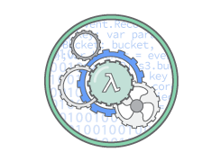
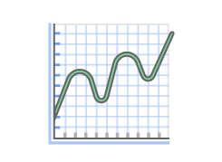
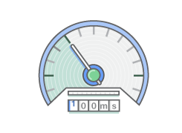
AWS Lambda
No servers to manage
Focus on code
Continuous Scaling
Configure concurrency
Sub Second Metering
Pay for only what you use
“Compute service that lets you run code without managing servers: Scale, monitor, and, trigger on your behalf”

Slide 4




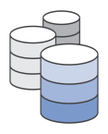





AWS Lambda
Bring your own code
Node.js, Java, Python, C#, Go, Ruby, …
Simple resource model
Select power rating from 128 MB to 1.5 GB
CPU and network allocated proportionately
Stateless
Persist data using external storage
No affinity or access to underlying infrastructure
Flexible use
Synchronous or asynchronous
Integrated with other AWS services

Slide 5

AWS Lambda – Good Practices
Minimize package size to only what is necessary
Separate the Lambda handler from core logic
Leverage container reuse
Use Environment Variables to modify operational behavior
Self-contain dependencies in your function package
Leverage “Max Memory Used” to right-size your functions
Understand, set, and monitor concurrency
Delete large unused functions (75GB limit)
Leverage ecosystem - AWS Serverless Application Model, AWS CodePipeline, AWS CodeDeploy, AWS X-Ray, AWS Cloud9

