Slide 1


VPC Fundamentals and
Your Virtual Data Center:
Connectivity Options
© 2018, Amazon Web Services, Inc. or its affiliates. All rights reserved.

Slide 2
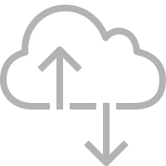


Amazon EC2 Instance

Slide 3
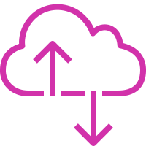
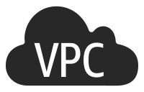


54.4.5.6
172.31.1.24
172.31.0.128
54.2.3.4
172.31.0.129
172.31.1.27
Amazon Virtual Private Cloud (Amazon VPC)

Slide 4
What to expect from this session
Get familiar with VPC concepts
Walk through a basic VPC setup
Learn about the ways in which you can tailor your virtual network to meet your needs
Understand the options for connectivity
Between VPCs
To your own corporate networks
To AWS services

Slide 5


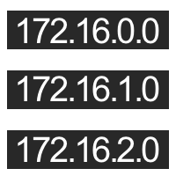



Creating an Internet-connected VPC: Steps
Choosing an
address range
Creating subnets in
Availability Zones
Creating a route
to the Internet
Authorizing traffic
to/from the VPC

Slide 6
Choosing an IP address range

Slide 7

CIDR notation review
CIDR range example:
172.31.0.0/16
1010 1100 0001 1111 0000 0000 0000 0000

Slide 8




Choosing an IP address range for your VPC
Avoid ranges that overlap with other networks to which you might connect
172.31.0.0/16
Recommended:
Recommended: RFC1918 range
/16 (65,536 addresses)

Slide 9
Subnets and Availability Zones

Slide 10
VPC subnets and Availability Zones
172.31.0.0/16
eu-west-1a
eu-west-1b
eu-west-1c
172.31.0.0/24
172.31.1.0/24
172.31.2.0/24
VPC subnet
VPC subnet
VPC subnet
Availability Zone
Availability Zone
Availability Zone

Slide 11




VPC and subnet recommendations
/16 VPC (65,536 addresses)
At least /24 subnets (251 addresses)
Use multiple Availability Zones per VPC through multiple subnets
You can resize your VPC by adding
additional IP address ranges

Slide 12

IPv6 in your VPC
Can have a dual-stack VPC by adding an IPv6 CIDR
Fixed sizes for VPC and subnets:
/56 VPC (4,722,366,482,869,645,213,696 addresses)
/64 subnets (18,446,744,073,709,551,616 addresses)

Slide 13
VPC subnets and Availability Zones
172.31.0.0/16
2600:1f16:14d:6300::/56
eu-west-1a
eu-west-1b
eu-west-1c
172.31.0.0/24
2600:1f16:14d:6300::/64
172.31.1.0/24
2600:1f16:14d:6301::/64
172.31.2.0/24
2600:1f16:14d:6302::/64
VPC subnet
VPC subnet
VPC subnet
Availability Zone
Availability Zone
Availability Zone

Slide 14
Route to the Internet

Slide 15
Routing in your VPC
Route tables contain rules for which packets go where
Your VPC has a default route table
But, you can assign different route tables to different subnets

Slide 16
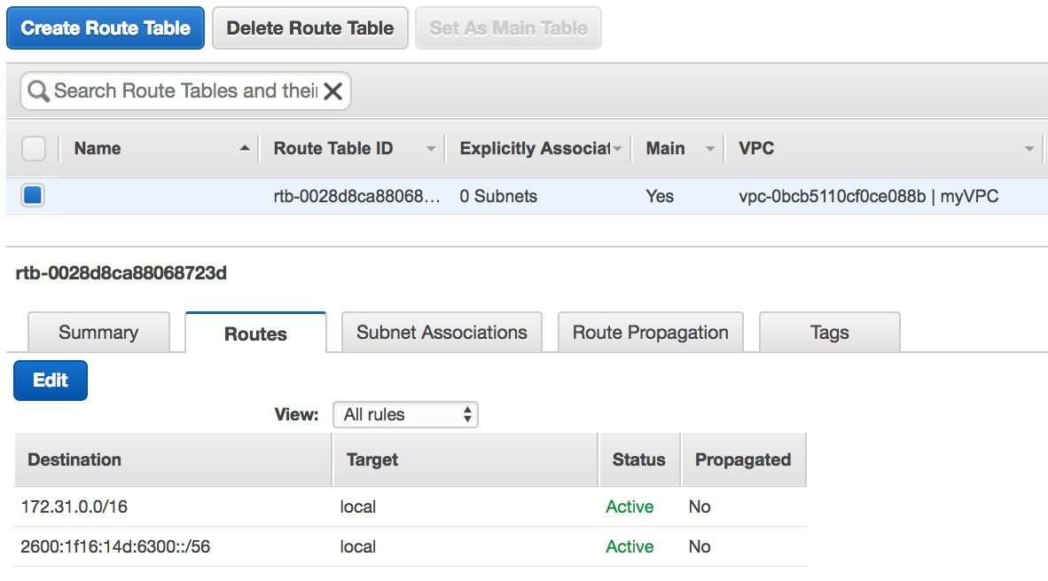

Traffic destined for my VPC stays in my VPC

Slide 17

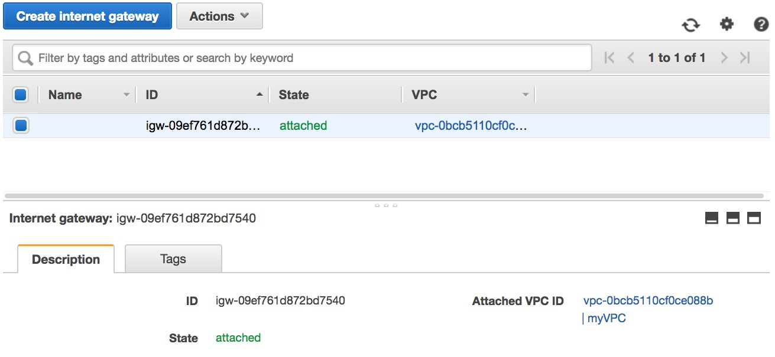
Internet gateway
Send packets here if you want
them to reach the Internet

Slide 18
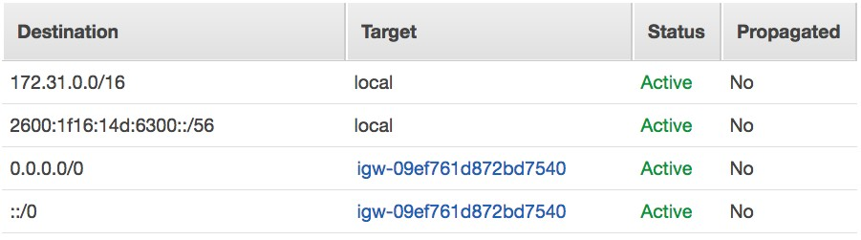
Default routes
Everything that isn’t destined for the VPC:
Send to the Internet

Slide 19
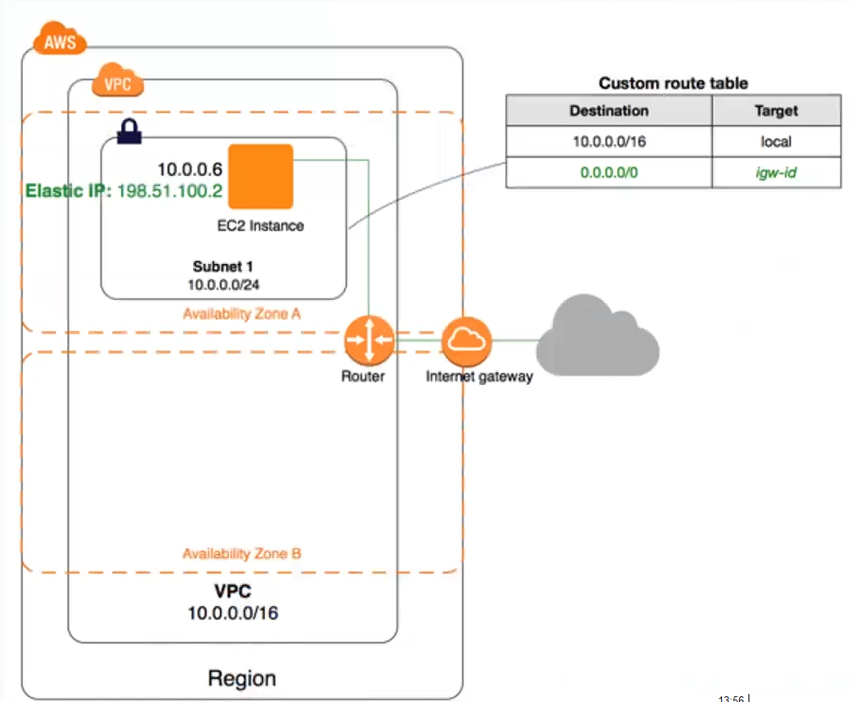

Slide 20
Network security in your VPC: Security groups

Slide 21

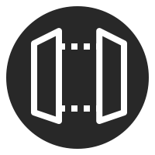
Security groups follow application structure
“MyWebServers” security group
Allow only “MyWebServers”
“MyBackends” security group

Slide 22
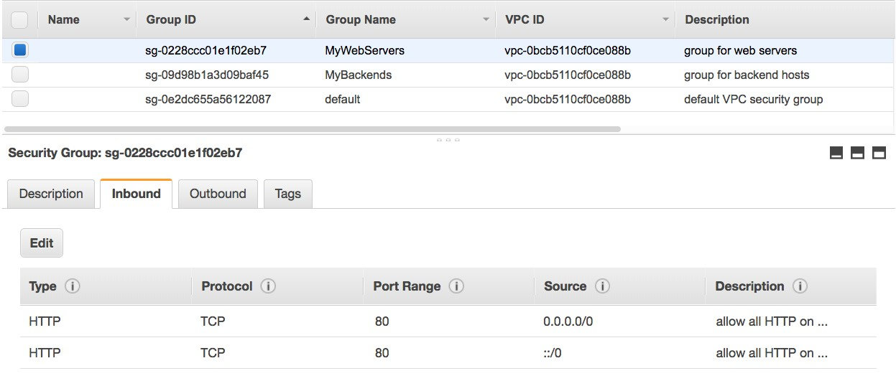
Security groups example: Web servers
Allow HTTP traffic from anywhere

Slide 23
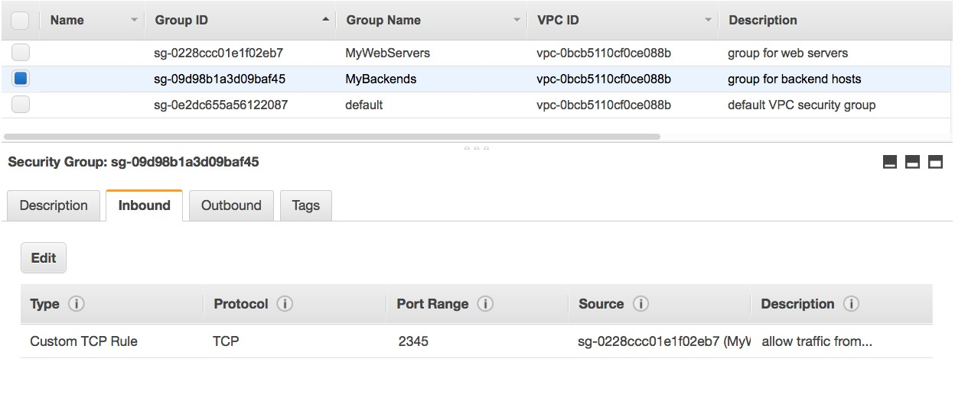
Security groups example: Backends
Allow application traffic from web servers only

Slide 25




Beyond Internet connectivity
Restricting Internet access
Connecting to other VPCs
Connecting to your corporate network

Slide 26
Restricting Internet access: Routing by subnet

Slide 27


Routing by subnet
Has route to Internet
Public subnet
Has no route to Internet
Private subnet

Slide 28



Routing by subnet
Public subnet
Public subnet
Public subnet
Private subnet
Availability Zone
Private subnet
Availability Zone
Private subnet
Availability Zone

Slide 29

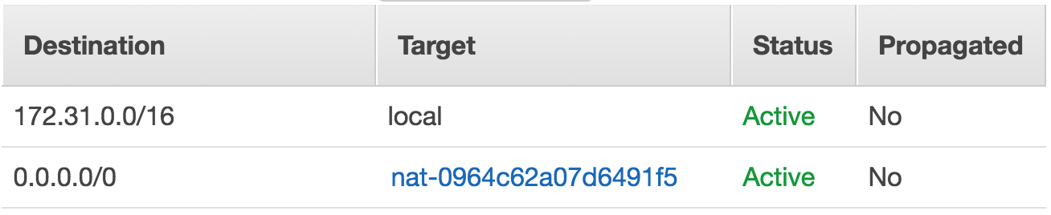



Outbound-only Internet access: NAT gateway
Public IP: 54.161.0.39
0.0.0.0/0
0.0.0.0/0
NAT gateway
Private subnet
Public subnet

Slide 30

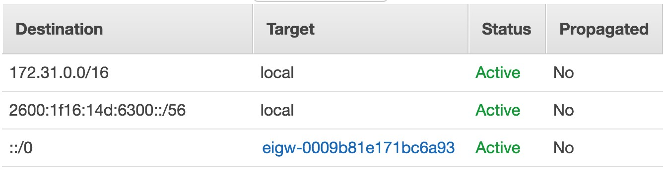
Egress-only Internet gateways for IPv6
Egress-only Internet gateway
::/0
::/0
Private subnet
Public subnet

Slide 31
Inter-VPC connectivity: VPC peering

Slide 32
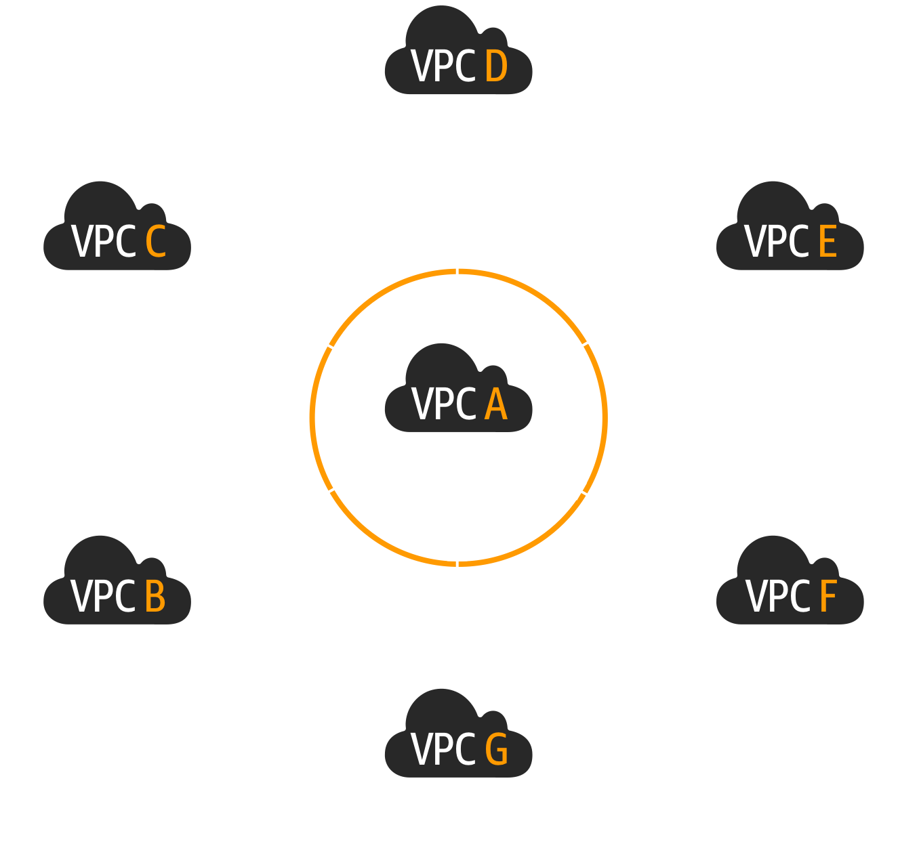
VPC peering
Full private IP connectivity between two VPCs
Can peer VPCs across regions
VPCs can be in different accounts
VPC CIDR ranges must not overlap

Slide 33



Security groups across peered VPCs
172.31.0.0/16
10.55.0.0/16
VPC peering
in the same region
ALLOW
Orange security group
Blue security group

Slide 34
Establish a VPC peering: Initiate request
172.31.0.0/16
Step 1
Initiate peering request
10.55.0.0/16

Slide 35
Establish a VPC peering: Accept request
172.31.0.0/16
Step 1
Initiate peering request
10.55.0.0/16
Step 2
Accept peering request

Slide 36

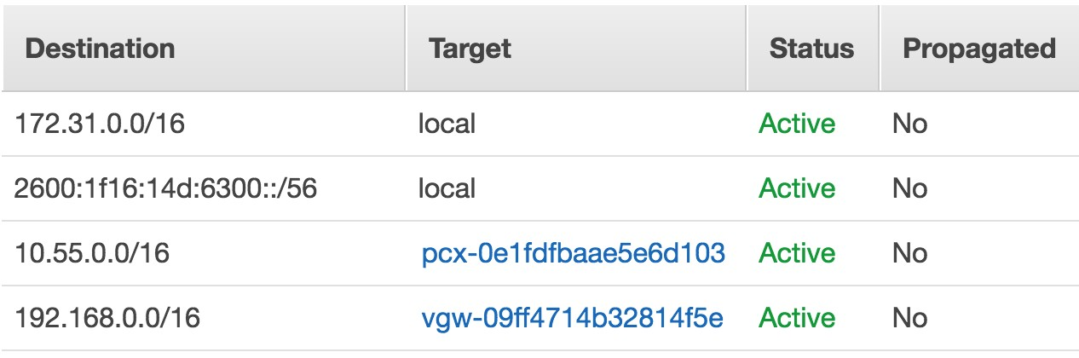

Establish a VPC peering: Create a route
Step 1 10.55.0.0/16
Traffic destined for the peered VPC should go to the peering
172.31.0.0/16
Initiate peering
request
Step 2 Accept peering
request
Step 3

Slide 37
Connecting to on-premises networks:
AWS Virtual Private Network (VPN) and
AWS Direct Connect

Slide 38
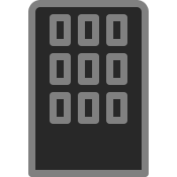



Extend an on-premises network into your VPC
AWS VPN
AWS
Direct Connect

Slide 39


AWS VPN basics
192.168.0.0/16
Two IPSec tunnels
172.31.0.0/16
virtual private gateway
customer
gateway
192.168/16
VPN connection
Your networking device

Slide 40



AWS Direct Connect basics
192.168.0.0/16
172.31.0.0/16
Private virtual interface
virtual private gateway
192.168/16
Customer or
partner cage AWS cage
AWS Direct Connect location
Public virtual interface
AWS services
Customer network

Slide 41
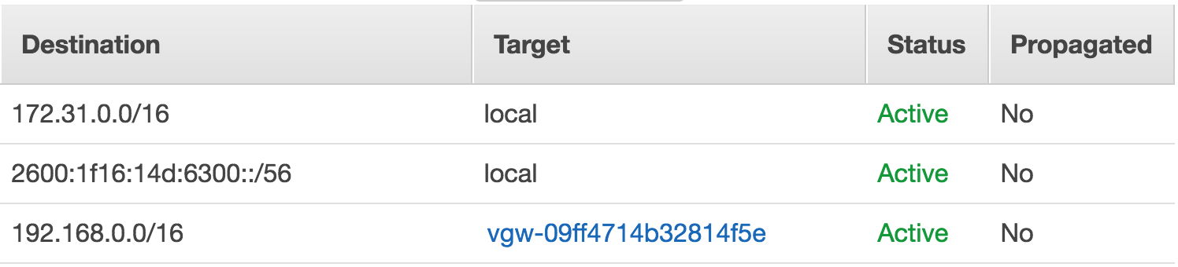

Dynamic route propagation
Static routes (not propagated) as opposed to dynamic routes (propagated)
Propagate using BGP (border gateway protocol)
Routing decisions are based on number of hops
You can influence this by adding extra hops to the
less preferred path

Slide 42
AWS VPN and AWS Direct Connect
Both allow secure connections between your network and your VPC
VPN is a pair of IPSec tunnels over the Internet
AWS Direct Connect is a dedicated line with lower per-GB data transfer rates
For highest availability: Use multiple, dynamically routed AWS Direct Connect connections at multiple locations
https://aws.amazon.com/directconnect/resiliency-recommendation/

Slide 43

Thank you!

