Slide 1
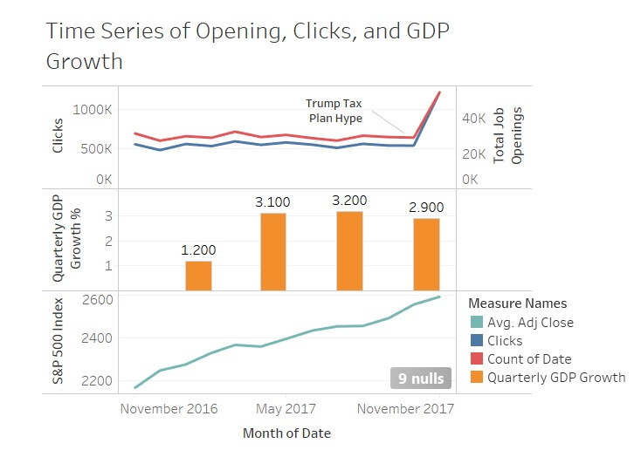
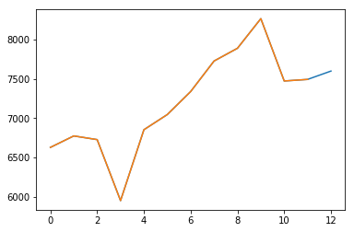
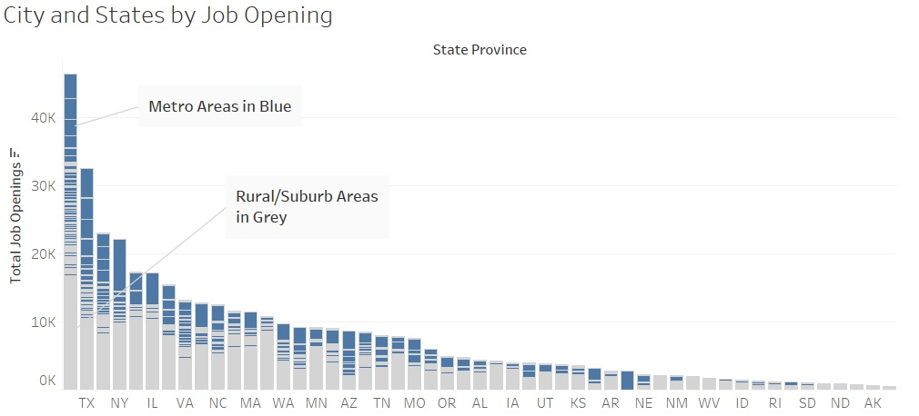
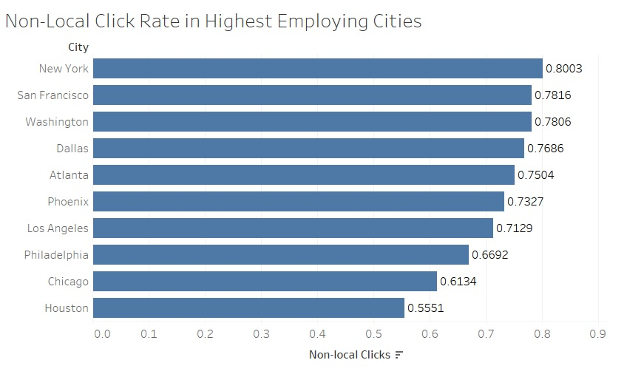
Economy’s Effects on Job Markets
San Francisco Job Openings by Month
Notes:
Job opening varies economic prosperities; but isn’t a perfect indicator
Latencies occur in GDP’s affect on job openings
Large cities lift state job openings; states with large metro areas
New York better for attracting diverse talents; Houston and Chicago have stronger local talent pools
Indeed is much more accessible to white collars than blue collars; so discretion is encouraged

Slide 2
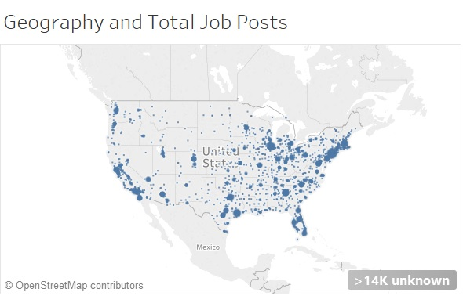
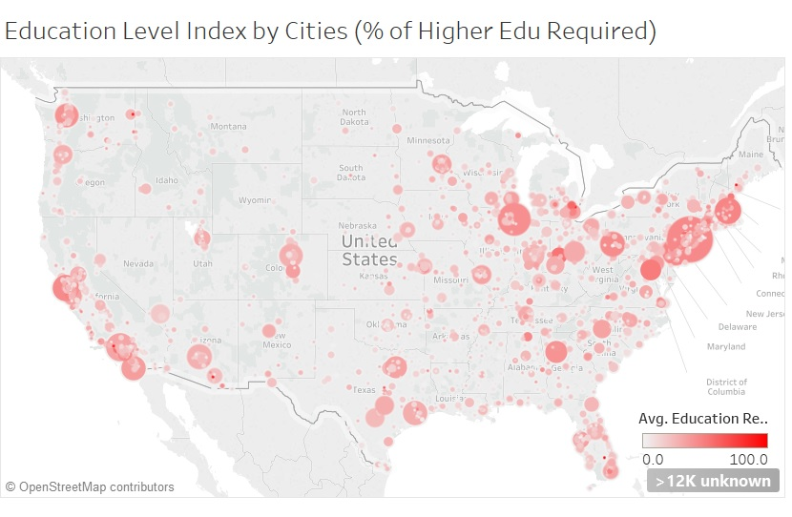
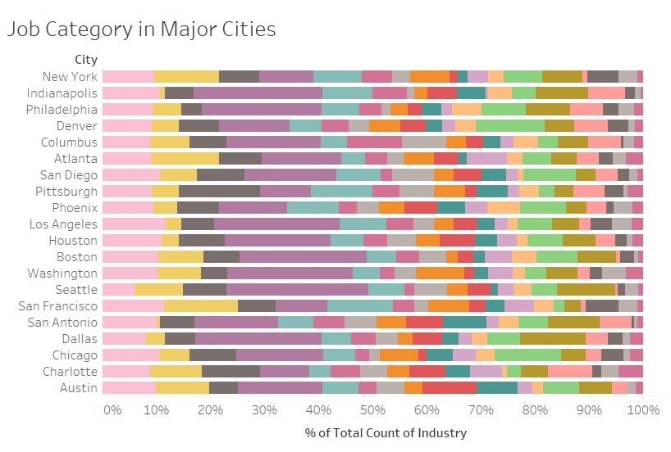
Choosing Location and Industry
Management
Medical
New York
45%
Boston
46%
Washington D.C
50%
Houston
29%
Jacksonville
25%
Los Angeles
33%

Slide 3
