Slide 1


Canadian Women’s Rugby data analysis
By: Joshua Lim, Adam Chodes, Jordan Bethune and Shehreyar Rehman

Slide 2
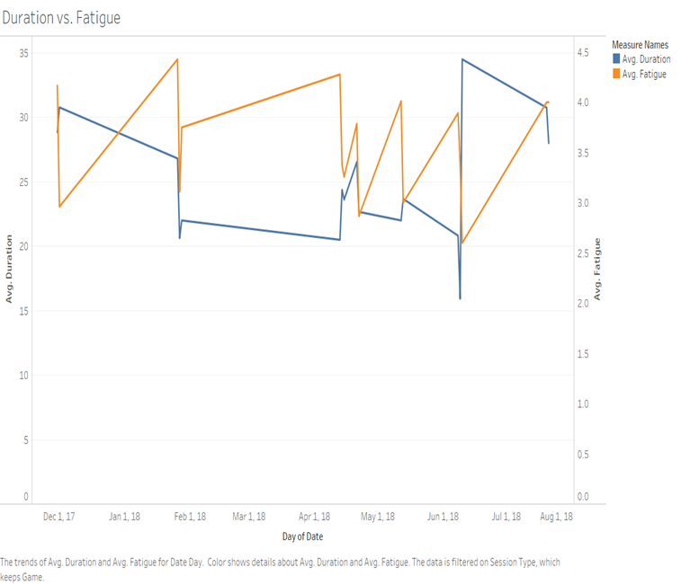
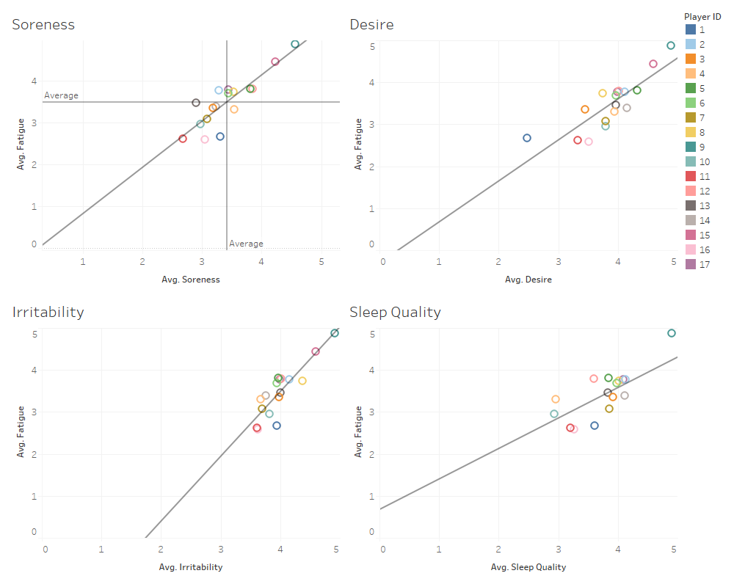
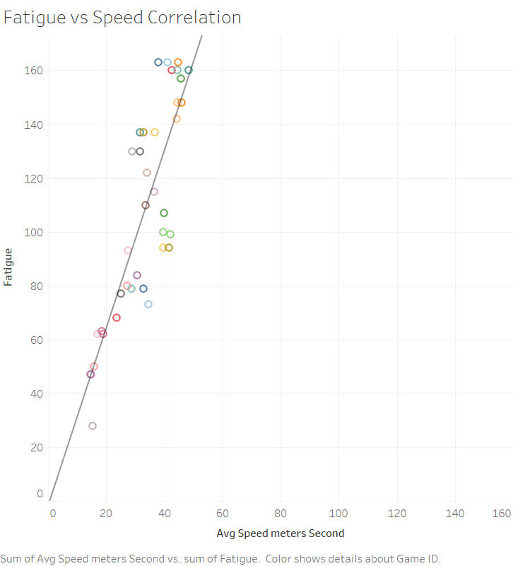
Data visualization

Slide 3
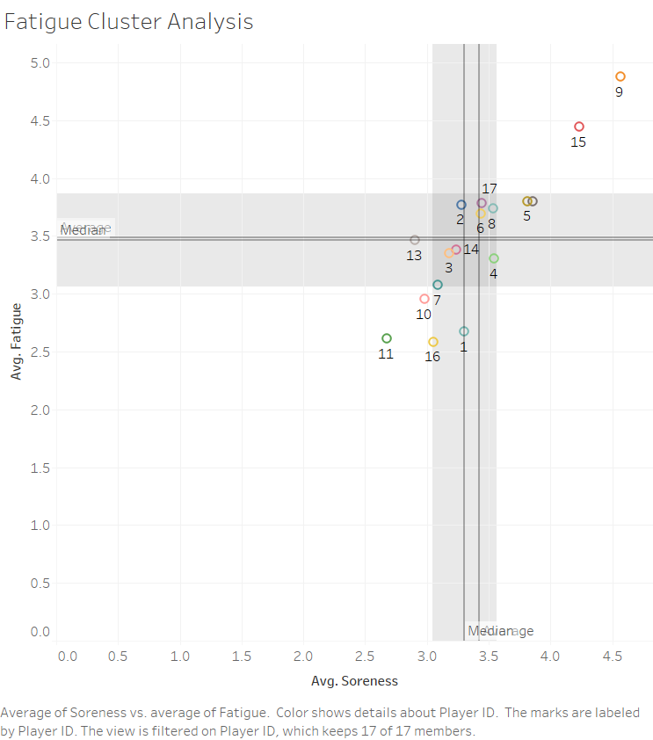
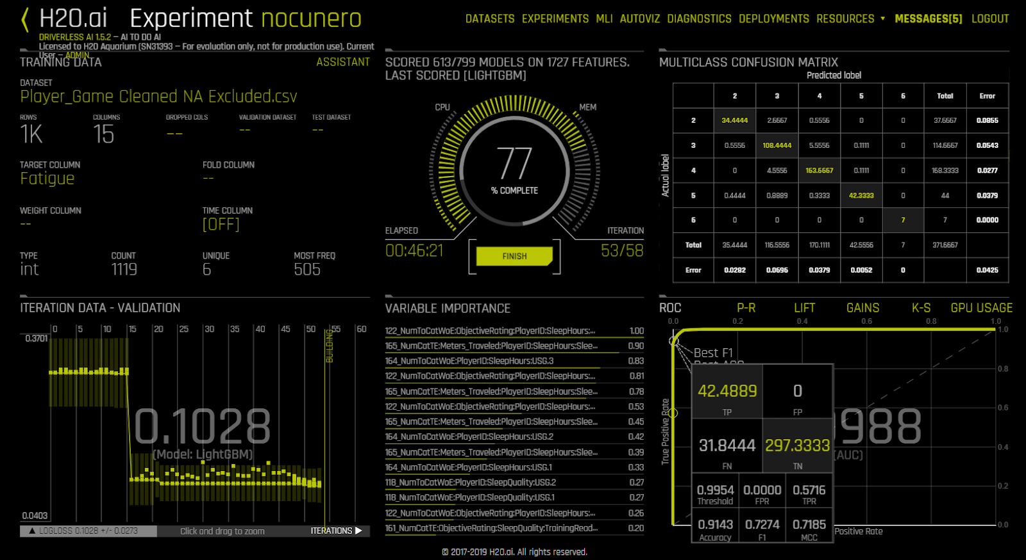
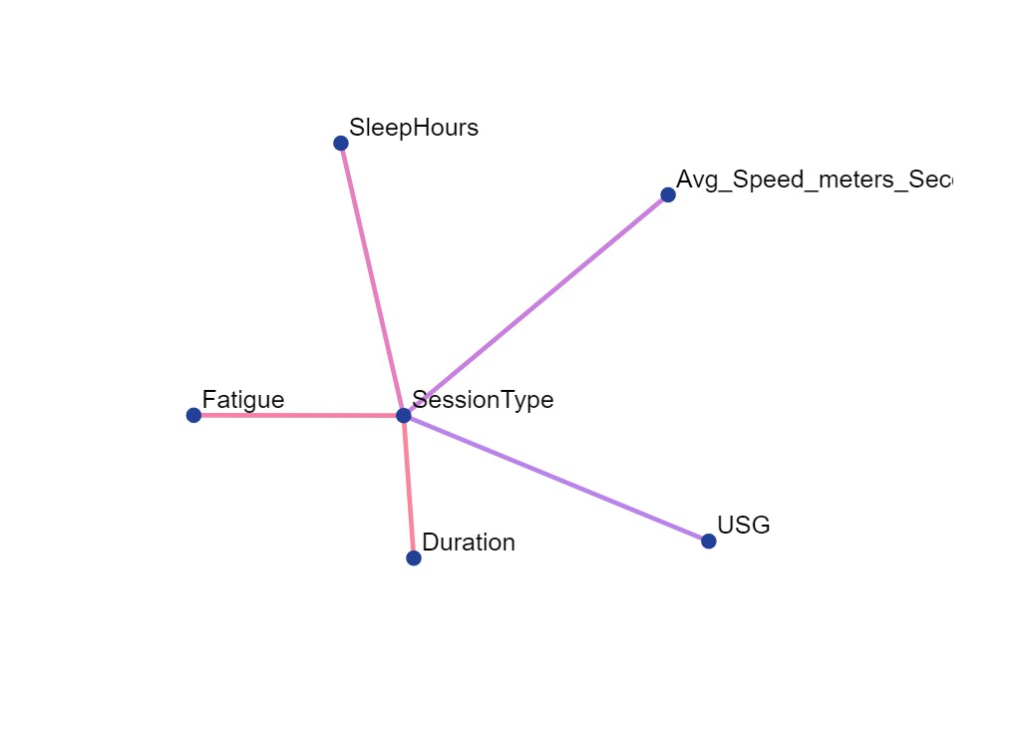

Slide 4
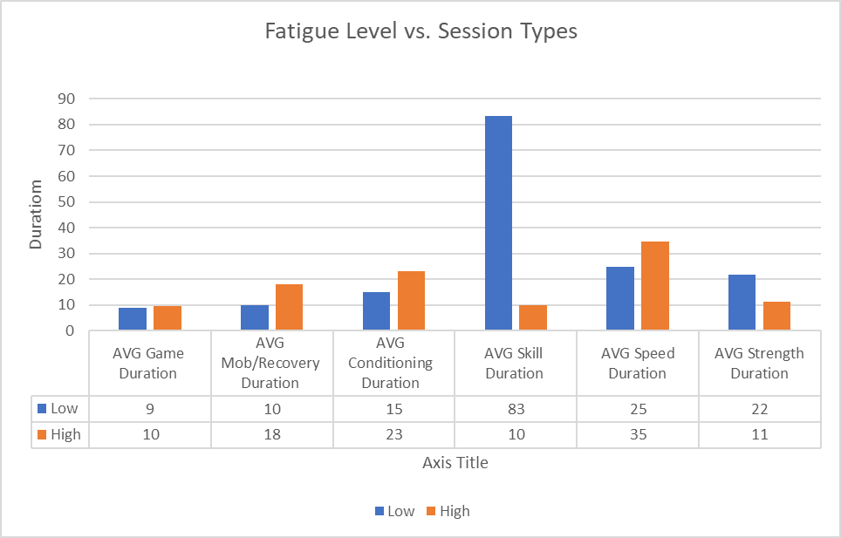
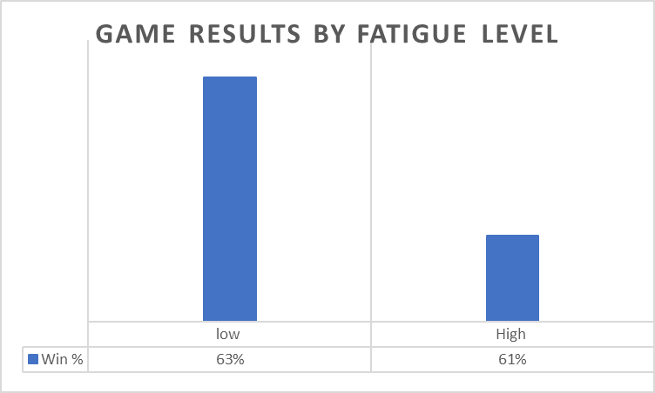
Data visualization

Slide 5
recommendations
Focus training sessions around strength and skill building.
Utilize trainers for stretching, icing/heating, for players with higher fatigue ratings.
Evenly distribute gameplay with players to maximize effectiveness.
Input positions to make position recommendations.
Wear GPS wearables during practices.

Slide 6
recommendations
Soreness leads to negative physiological affects
Irritability leads to negative mental focus/desire.
Skill is a attribute to decision making and understandin how to be the most efficient player.

Slide 7
Research
https://www.ncbi.nlm.nih.gov/pmc/articles/PMC5873345/
An accumulation of fatigue can result in overtraining, which has a significant negative impact on performance
When athletes do not receive adequate time to recover between training and competition, fatigue will accumulate, compromise key aspects of performance and result in an increased risk of injury and illness to the athlete
https://www.ncbi.nlm.nih.gov/pmc/articles/PMC5394138/

