Slide 1
“Figure”-ing Fatigue
By the Best Looking Undergraduate Estimators

Slide 2
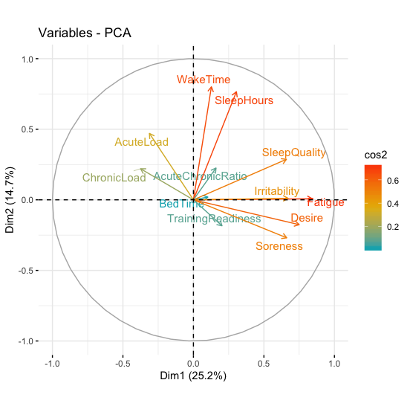
New Fatigue Score
Pre-Game Check
Used PCA
Included:
Wellness
RPE Data
Acute Load
Chronic Load

Slide 3
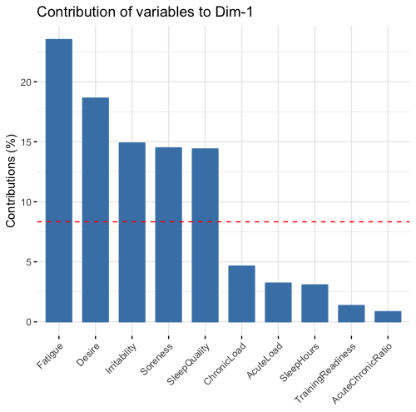
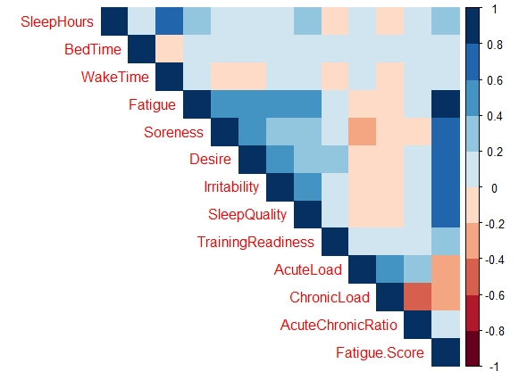
How Fatigue Score Works
Notes:
We grabbed the PC1 scores as our Fatigue.Score
Self-Reporting is the MOST important
The more ready to go you are, the higher your Fatigue.Score is

Slide 4
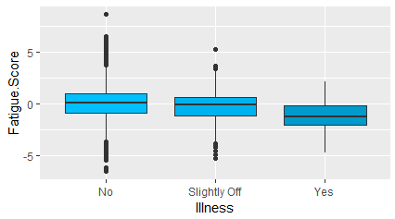
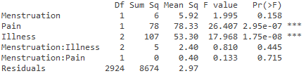
Health and Fatigue
Used ANOVA
Included Categorical Factors
Illness
Pain
Menstruation
Notes:
We grabbed the PC1 scores as our Fatigue.Score
Self-Reporting is the MOST important
The more ready to go you are, the higher your Fatigue.Score is

Slide 5
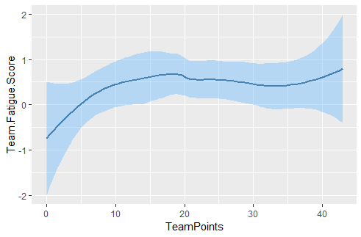
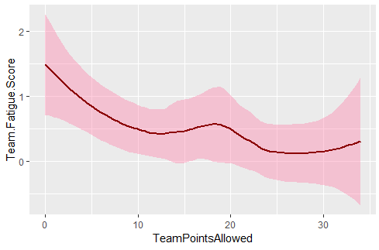
Game Points and Fatigue
Correlational Data
Average Fatigue for Team
Weather and Indv. Fatigue, r = .12
r = .20
r = -.38

Slide 6


Conclusions
Developed Effective Pre-Game Check
Fatigue is still most important
Verified self-reported data
Fatigue impacts game results
By strategically reducing Fatigue, Rugby Canada will have peak performance

