Slide 1

Fatigue and Rugby
Amelia Coyne, Daniel Gernander, Kai Murphy, Jason Odom

Slide 2
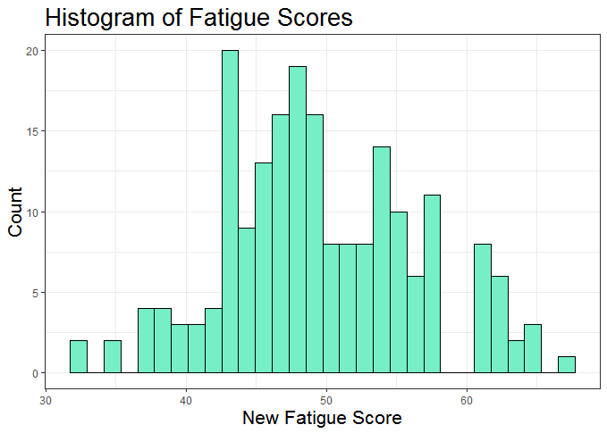
Our New “Fatigue Score”
Two halves of Score:
Lifestyle Variables: -Focus Rating -Sleep Quality -Irritability
Training Variables: -Daily Load -Acute-Chronic Ratio
High Fatigue Score = More Fatigued

Slide 3
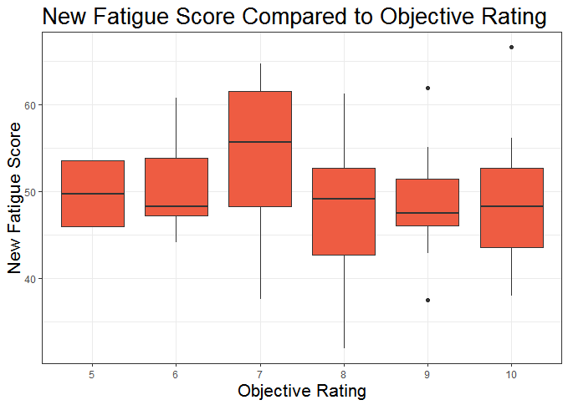
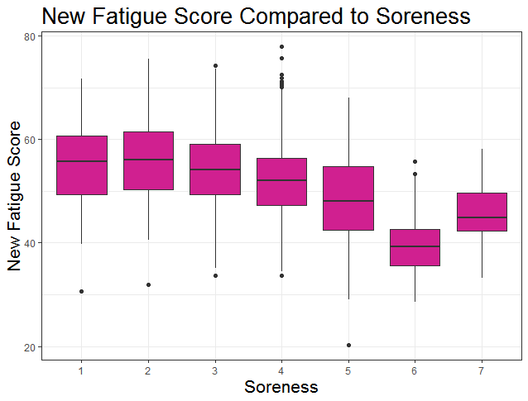
Random Forest
A model predicting the new fatigue score based on decision trees
Variables of Importance:
Duration, Objective Rating, Pain,
Wake Time, etc.
Mean of squared residuals: 24.32567
% Var explained (R-squared): 39.51
OOB: 4.932

Slide 4


Slide 5
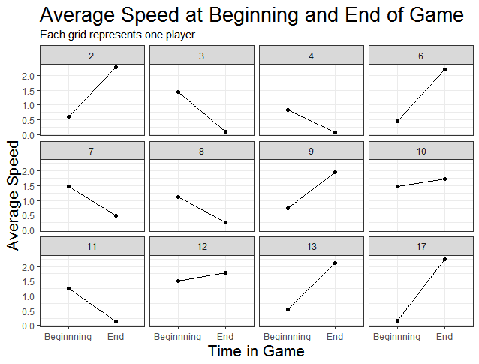
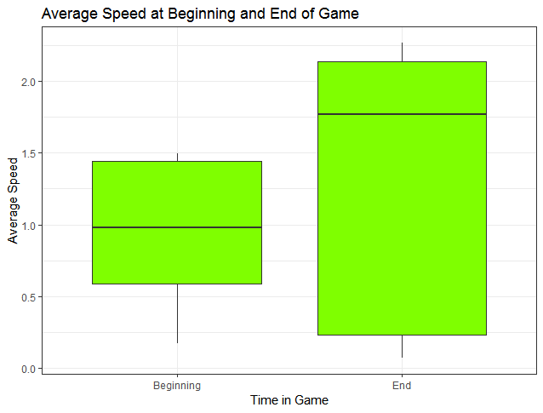

Slide 6
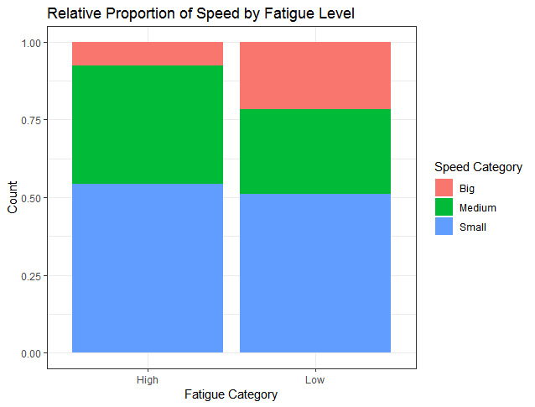
Conclusions
Fatigue Score:
Useful in other contexts?
Improvements
Beginning/End Speed:
Athletic Performance
If fatigue impacts speed/endurance, how can athletes lower their fatigue?

