Slide 1
INCIT 2026 · BANGKOK, THAILAND
Deep Reinforcement Learning
Vulnerability Scanner for
Web Applications
An Extended D3QN agent that learns to find what static and rule-based scanners miss.
Hein Htet Zaw
Karn Yongsiriwit
Rangsit University
01

Slide 2
MOTIVATION
Pentesting doesn't scale with how fast web apps ship
1
2
3
Manual pentesting is slow
Static / rule-based scanners plateau
IDOR-class bugs are the blind spot
Skilled testers are expensive and scarce; release cycles now measured in days, not quarters.
They catch signature-shaped bugs but miss logic flaws that only appear across multi-step workflows.
Broken object-level authorization needs context and state -- exactly what stateless scanners lack.
The gap isn't tooling volume -- it's tools that can't reason across multi-step application state.
02

Slide 3
RELATED WORK
Prior DRL scanners solve one vulnerability class at a time
Single-vulnerability agents
DRL fuzzers tuned for one bug class (e.g. XSS-only or SQLi-only) -- retraining needed per class.
X
Narrow state representations
Many use raw HTTP text or fixed payload lists instead of a structured, transferable state encoding.
X
No systematic ground-truth check
Detections reported without an independent confirmation step, so false positives inflate reported gains.
X
Extended D3QN targets all three gaps in one agent, evaluated with an independent ground-truth confirmation step.
03

Slide 4
OUR APPROACH
Extended D3QN: four Rainbow components, one agent
1
2
3
4
Double DQN
Dueling Networks
Prioritized Experience Replay
Noisy Nets
Decouples action selection from evaluation to curb Q-value overestimation.
Splits state-value and advantage streams for more stable policy learning.
Replays rare, high-signal transitions (e.g. confirmed vuln hits) more often.
Learned, parametric exploration -- no manual epsilon-decay schedule to tune.
Plus multi-step returns for longer-horizon credit assignment across multi-request attack chains.
04

Slide 5
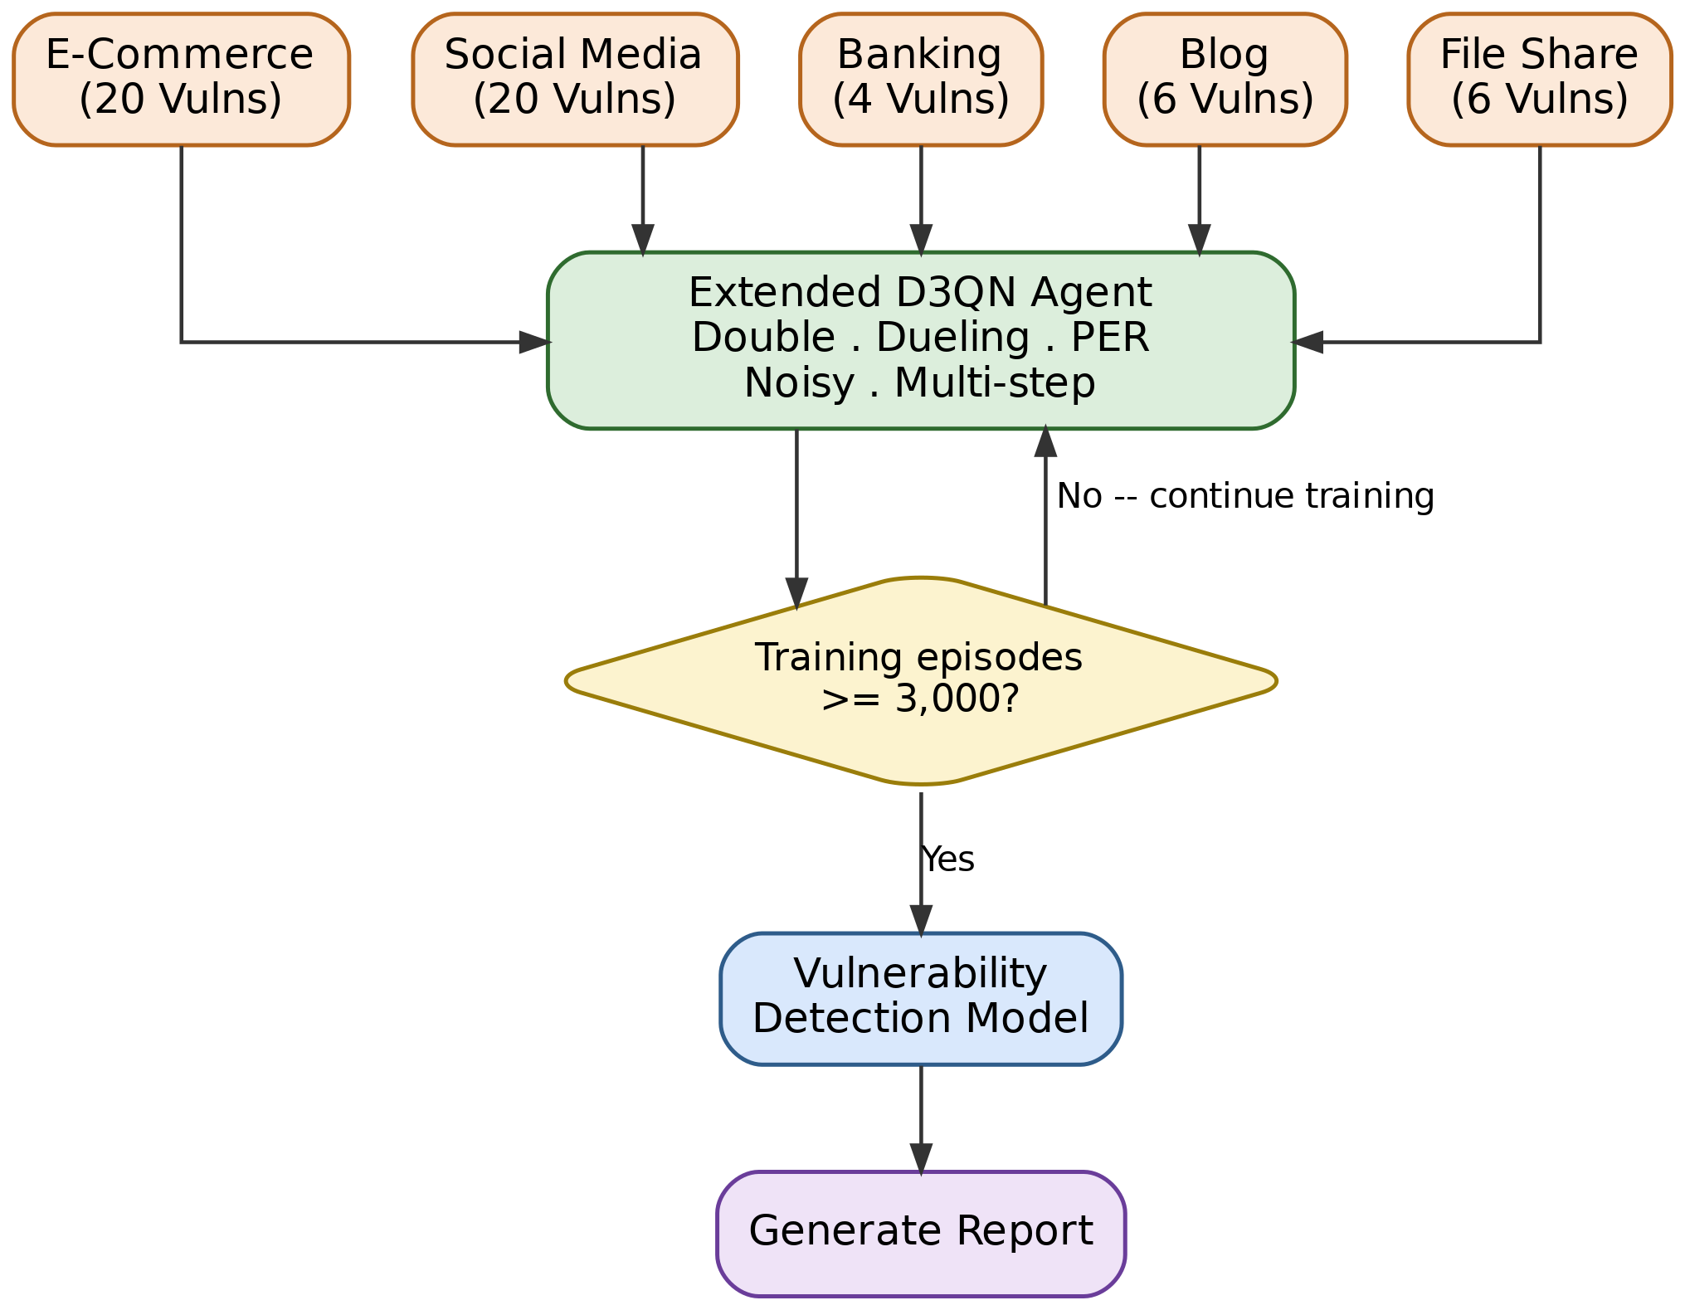
SYSTEM ARCHITECTURE
Five mock targets, one agent, one report
How it flows
5 mock apps: e-commerce, social media, banking, blog, file share
15-D state vector encodes HTTP + DOM signal per step
Episode budget gate: default 3,000 episodes to convergence
Confirmed findings only reach the report -- unconfirmed activity is logged separately
05

Slide 6
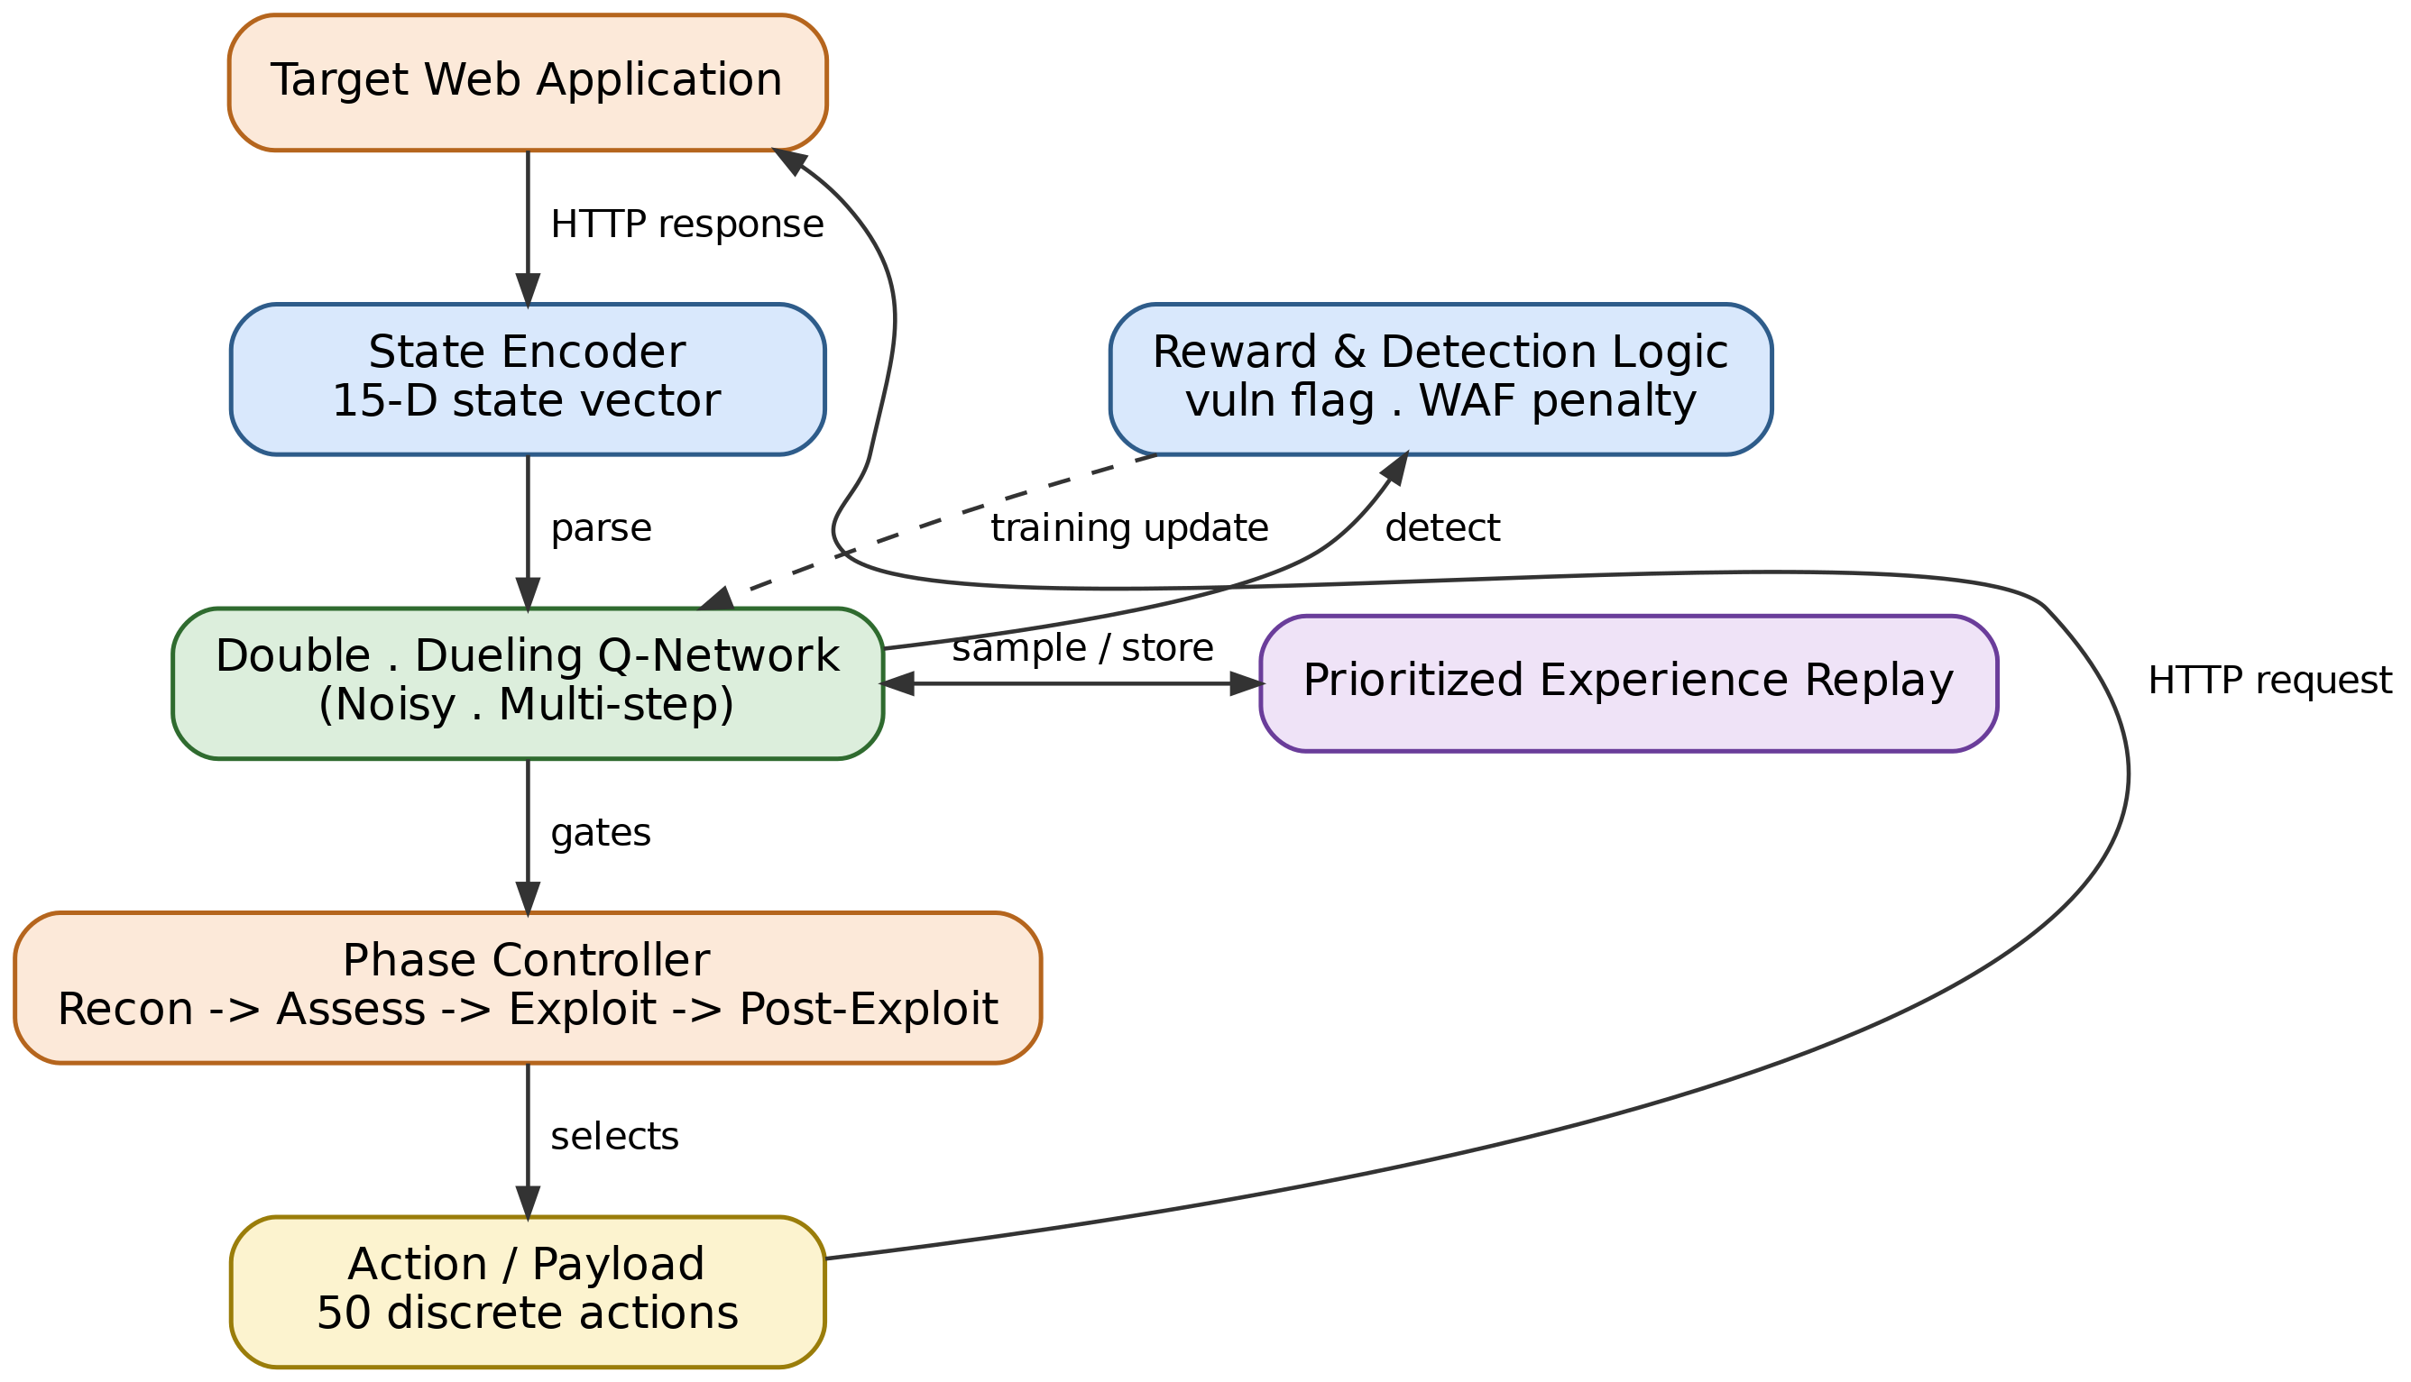
END-TO-END PIPELINE
From HTTP response to phase-gated action
State encoder -> Double-Dueling Q-Network -> PER -> reward & detection logic -> phase controller -> action
06

Slide 7
METHODOLOGY
The scan as a Markov Decision Process
15-D
50
4
State vector
per HTTP step
Discrete
payload actions
Curriculum
phases
Reward shaping
Bellman target uses the Double-DQN correction:
y = r + gamma * Q(s', argmax Q(s',a';theta); theta')
Confirmed vulnerability flag
+1.0
WAF / defensive block triggered
-0.1
Wasted / redundant request
-0.01
07

Slide 8
CURRICULUM DESIGN
Attacks unlock in phases, like a real engagement
Recon
>
Assess
>
Exploit
>
Post-Exploit
Map endpoints, auth boundaries, and app surface before touching payloads.
Probe for weak points -- input validation, session handling, access control.
Fire targeted payloads once the agent has earned access to that phase.
Chain confirmed footholds into deeper, multi-step impact.
Phase gates are earned, not scripted -- the agent must demonstrate signal before advancing.
08

Slide 9
EXPERIMENTAL SETUP
Five deliberately vulnerable mock applications
20
20
4
6
6
planted vulns
planted vulns
planted vulns
planted vulns
planted vulns
E-Commerce
Social Media
Banking
Blog
File Share
Ground truth for every target is enumerated in code (run_ground_truth_scan) -- not estimated -- so detection rate has an exact denominator.
A finding only counts as "confirmed" when both the ground-truth response header and an independent local validator agree.
09

Slide 10
RESULTS
Confirmed detection rate, per target
IDOR: the one class we confirm
E-Commerce: 1/4 IDOR findings confirmed (25%)
Social Media: 1/6 IDOR findings confirmed (16.7%)
Banking, Blog, File Share: 0 confirmed
Every other planted class: 0% across all 5 targets
We report this as-is -- the contribution is the honest measurement pipeline, not an inflated win.
10

Slide 11
ROBUSTNESS CHECK
More scanning didn't move the needle -- and that's the finding
5x
0
increase in crawl depth & attack intensity
(depth 150 / intensity 100 vs. 20 / 5)
change in confirmed detections
Same single IDOR finding reconfirmed on E-Commerce and Social Media; Banking, Blog, and File Share stayed at zero.
~3x
more unconfirmed activity flagged
Ground-truth confirmation resists false-positive inflation from more aggressive scanning.
Conclusion: the detection gap is structural, not a symptom of under-scanning.
11

Slide 12
WHERE THIS LEAVES US
Limitations, honestly stated -- and what's next
Limitations
Future Work
Confirmed detection is narrow -- IDOR only, on 2 of 5 targets
Scale past n=5 seeds -- current Wilcoxon floor (p=0.0625) blocks pairwise significance even on a clean sweep
Single-agent architecture; no multi-agent or transfer study yet
Multi-seed, multi-run replication of the live Table I scan (currently single-seed, unlike the 5-seed ablation study)
Reward shaping is hand-tuned, not learned or ablated per-term
Expand curriculum to auth-bypass and SSRF-style multi-step chains
Contribution: a reproducible, ground-truth-verified DRL pipeline for web vulnerability discovery -- built to be extended, not overclaimed.
12

Slide 13
Thank you
Questions welcome.
Hein Htet Zaw · Karn Yongsiriwit
Rangsit University
InCIT 2026, Bangkok
13

