Slide 1
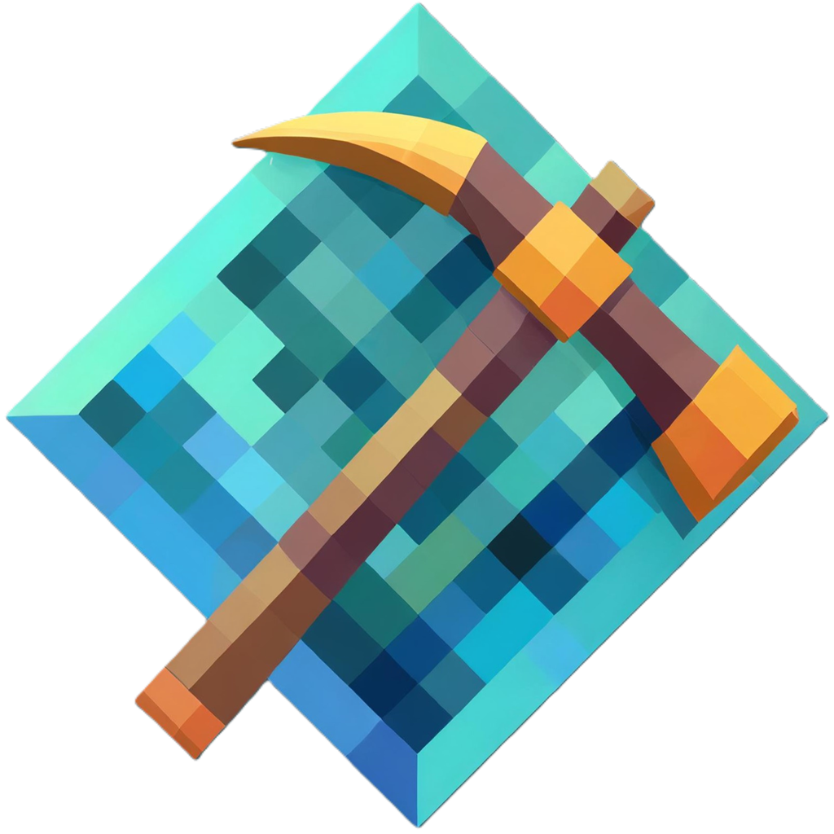
MineChain
Build your own world
With the resources your have.

