Slide 1
Data Analysis, Statistics and Probability
To accompany Helping Children Learn Mathematics 11e, Reys et al.
©2015 John Wiley & Sons

Slide 2
(For Data Analysis) Instructional programs from pre-k through grade 12 should enable all students to:
Formulate questions that can be addressed with data and collect, organize, and display relevant data to answer them.
Select and use appropriate statistical methods to analyze data.
Develop and evaluate inferences and predictions that are based on data.
Reys, Lindquist, Lamdin, & Smith, Helping Children Learn Mathematics,
11th^{th} Edition, © 2015
Notes:
2
Master 17-1: The Data Analysis and Probability Standard

Slide 3
Why Teach Statistics and Probability?
Children encounter ideas of statistics and probability outside of school every day.
Data analysis, statistics and probability provide connections to other mathematics topics or school subjects.
Data analysis, statistics and probability provide opportunities for computational activity in a meaningful context.
Data analysis, statistics, and probability provide opportunities for developing critical thinking skills.
Reys, Lindquist, Lamdin, & Smith, Helping Children Learn Mathematics,
11th^{th} Edition, © 2015
Notes:
3
Master 17-2: Why Teach Statistics and Probability?

Slide 4
Three Steps of Data Analysis
1. Pose a question and collect data.
1.2. Display collected data.
3. Analyze data and communicate results.
Reys, Lindquist, Lamdin, & Smith, Helping Children Learn Mathematics,
11th^{th} Edition, © 2015
Notes:
4
Master 17-3: Steps of Data Analysis

Slide 5
Surveys
Survey data result from collecting information.
These data may range from a national public opinion poll or observing cars pass the window, to simply tallying the ages of students in a class.
Many different sets of real world data are available the U.S. Census Bureau Web site http://www.census.gov. These data can be used for formulating questions, exploring trends, and statistical analysis.
Reys, Lindquist, Lamdin, & Smith, Helping Children Learn Mathematics,
11th^{th} Edition, © 2015

Slide 6
Experiments
Experiments may be somewhat more advanced than surveys.
When students conduct experiments, in addition to using observation and recording skills, they often incorporate the use of the scientiﬁc method
Reys, Lindquist, Lamdin, & Smith, Helping Children Learn Mathematics,
11th^{th} Edition, © 2015

Slide 7
Simulations
Although a simulation is similar to an experiment, random number tables or devices such as coins, dice, spinners, or computer programs are also used to model real-world occurrences.
Reys, Lindquist, Lamdin, & Smith, Helping Children Learn Mathematics,
11th^{th} Edition, © 2015

Slide 8
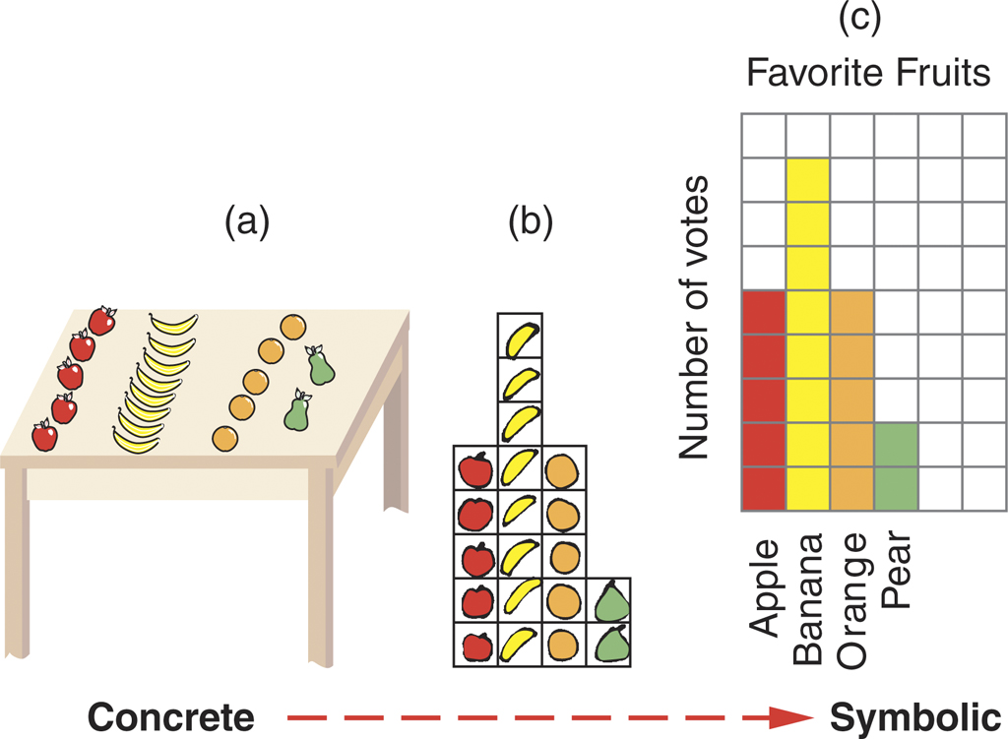
Analyzing Data: Graphical Organization
What do you notice about the graph?
How many children prefer apples?
What is the favorite fruit?
How many different fruits are shown?
How many children contributed to the graph?
Reys, Lindquist, Lamdin, & Smith, Helping Children Learn Mathematics,
11th^{th} Edition, © 2015

Slide 9
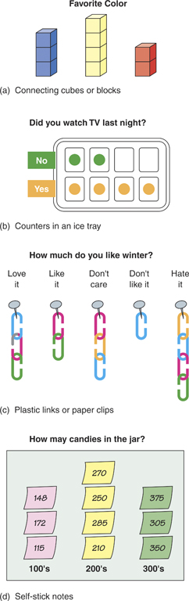
Quick and Easy Graphing Methods
Reys, Lindquist, Lamdin, & Smith, Helping Children Learn Mathematics,
11th^{th} Edition, © 2015

Slide 10
Plots
A plot is another type of graph used to visually display data.
Line plots A line plot may be used to quickly display numerical data with a small range.
Stem-and-leaf plots A stem-and-leaf plot is another quick way to display data and provides a quite different representation than when the data are arranged in a line plot or bar graph.
Box plots A box plot (also called a box-and-whisker plot) summarizes data and provides a visual means of showing variability—the spread of the data. T
Reys, Lindquist, Lamdin, & Smith, Helping Children Learn Mathematics,
11th^{th} Edition, © 2015

Slide 11
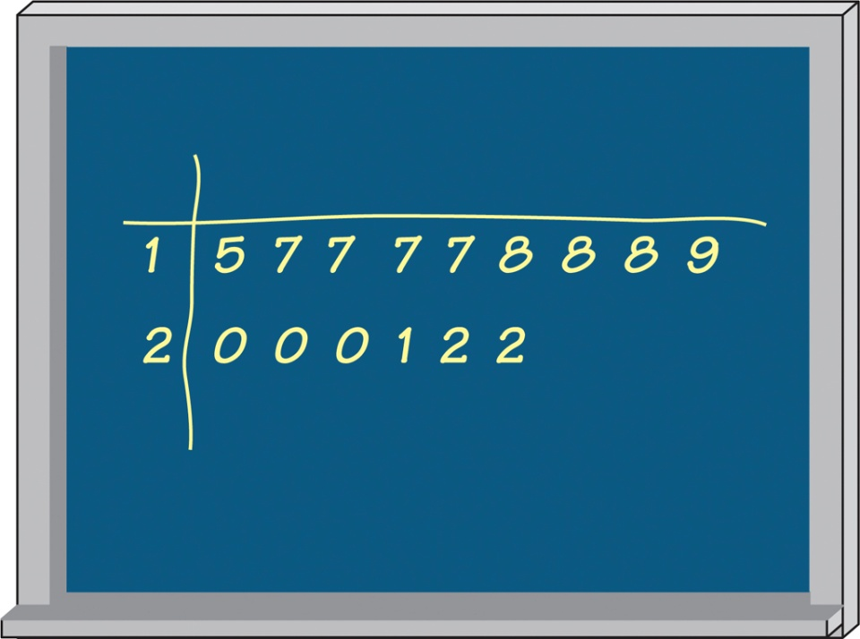
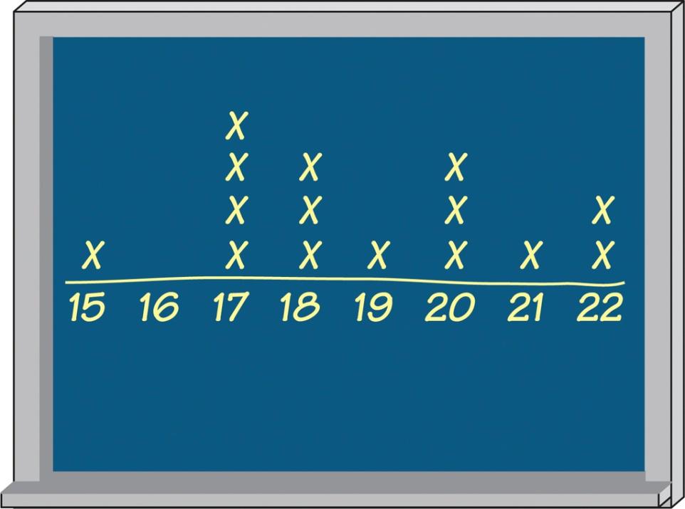
Plots
Reys, Lindquist, Lamdin, & Smith, Helping Children Learn Mathematics,
11th^{th} Edition, © 2015

Slide 12
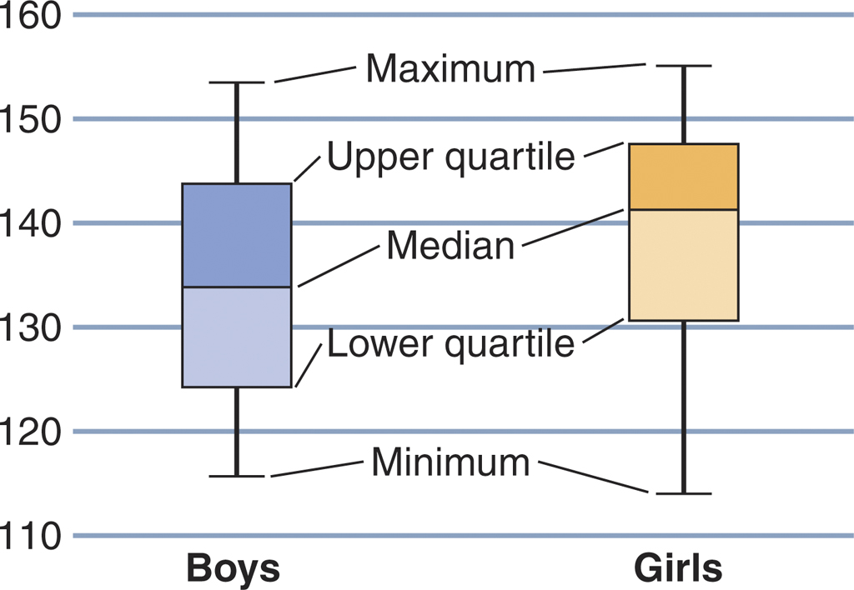
Box Plots
Reys, Lindquist, Lamdin, & Smith, Helping Children Learn Mathematics,
11th^{th} Edition, © 2015

Slide 13
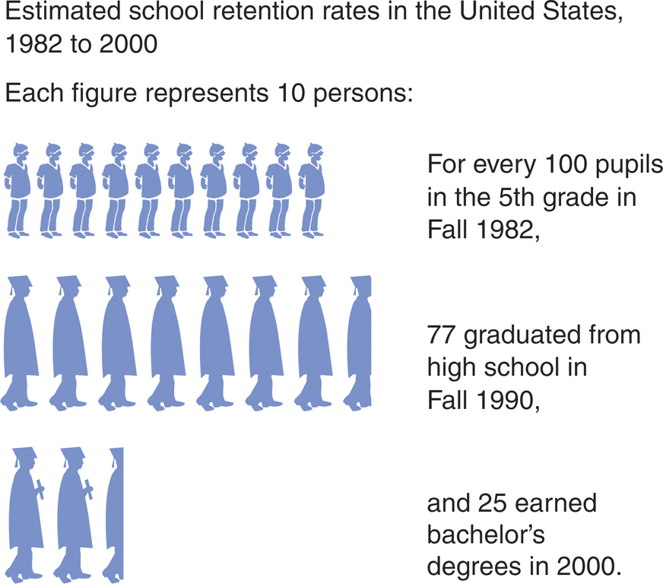
Picture Graphs
Reys, Lindquist, Lamdin, & Smith, Helping Children Learn Mathematics,
11th^{th} Edition, © 2015

Slide 14
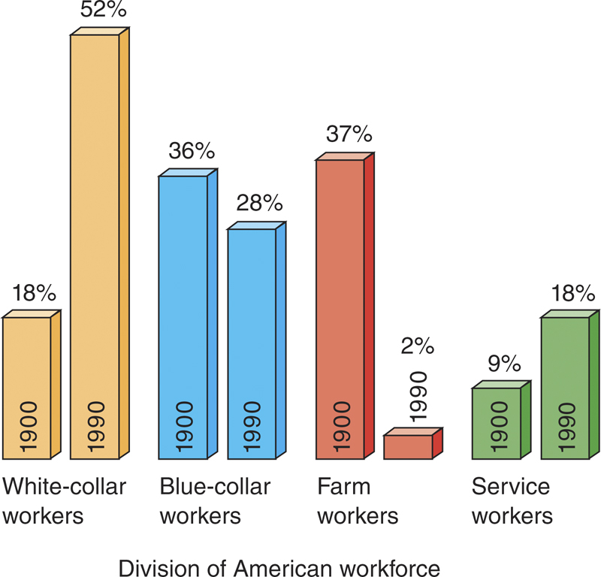
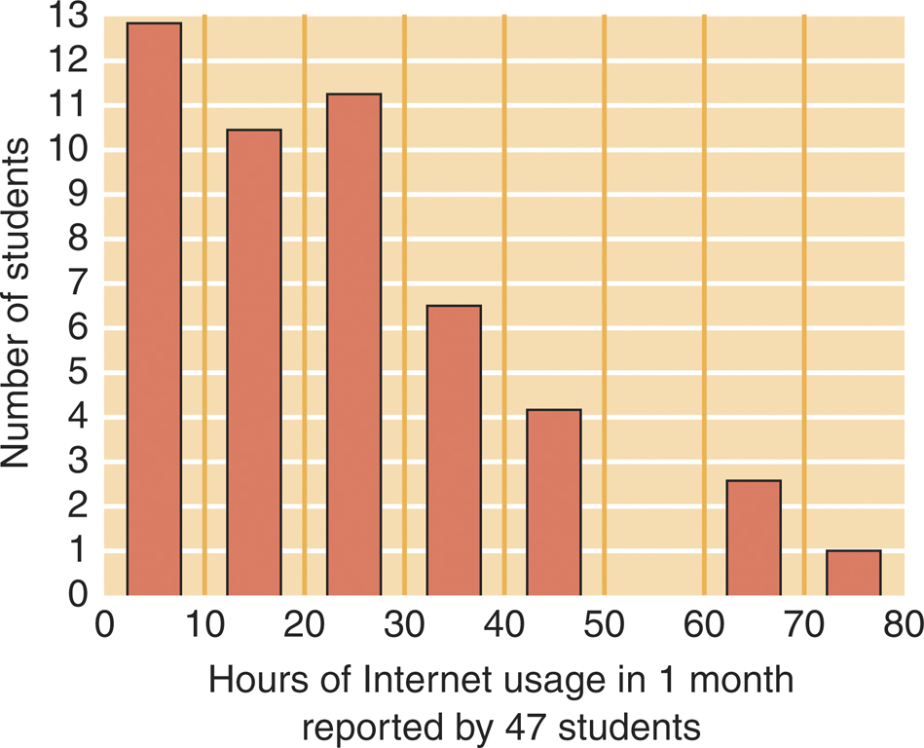
Bar Graphs and Histograms
Reys, Lindquist, Lamdin, & Smith, Helping Children Learn Mathematics,
11th^{th} Edition, © 2015

Slide 15
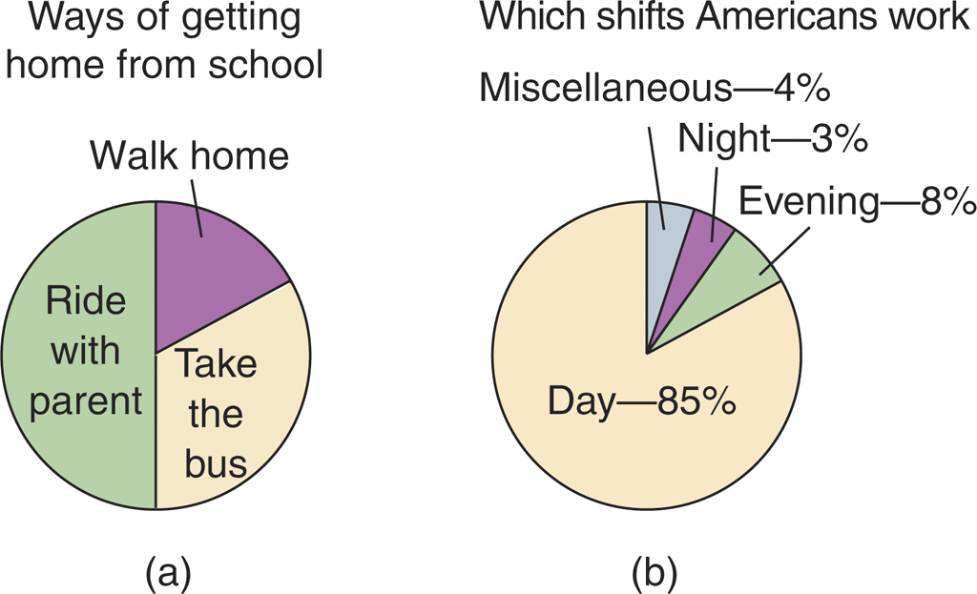
Pie Graphs
Reys, Lindquist, Lamdin, & Smith, Helping Children Learn Mathematics,
11th^{th} Edition, © 2015

Slide 16
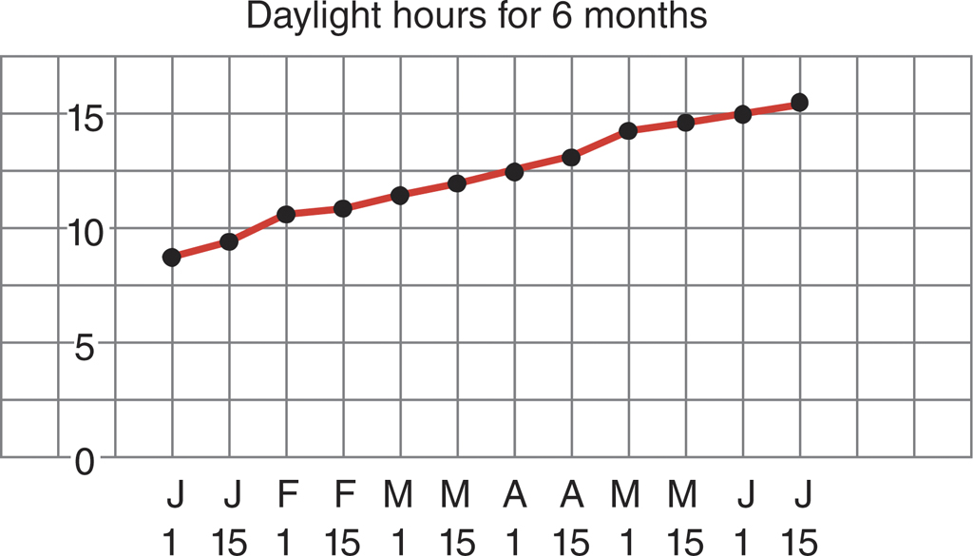
Line Graphs
Line graphs are effective for showing trends over time.
Reys, Lindquist, Lamdin, & Smith, Helping Children Learn Mathematics,
11th^{th} Edition, © 2015

Slide 17
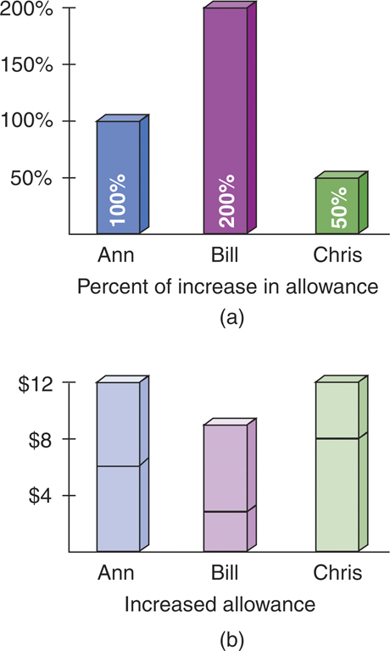
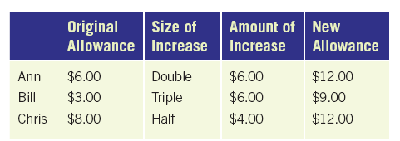
Misleading Graphs
These different graphs of the same data demonstrate how graphs can distort and sometimes misrepresent information.
Reys, Lindquist, Lamdin, & Smith, Helping Children Learn Mathematics,
11th^{th} Edition, © 2015

Slide 18
Analyzing Data: Descriptive Statistics
Measure of Variation
Range - the variation or spread or a set of data
Measures of Central Tendency or Averages
Mode-the value that occurs most frequently
Median-the middle value in a set of data
Mean-the arithmetic average
Reys, Lindquist, Lamdin, & Smith, Helping Children Learn Mathematics,
11th^{th} Edition, © 2015
Notes:
18
Master 17-4: Descriptive Statistics

Slide 19
Data Sense
Reading the data. The student is able to answer specific questions for which the answer is prominently displayed. For example, “Which player averaged the most points?”
Reading between the data. The student is able to find relationships in the data such as comparison, and is able to operate on the data. For example, “How many players had a median less than their mean?”
Reading beyond the data. The student is able to predict or make inferences. For example, “Which player had the greatest range? The smallest range? What do these numbers tell you about the player?”
Reys, Lindquist, Lamdin, & Smith, Helping Children Learn Mathematics,
11th^{th} Edition, © 2015

Slide 20
Communicating Results
Once data have been collected, analyzed, and interpreted it is appropriate for students to communicate their ﬁndings.
Just as in problem solving, students should be encouraged to look back at their results.
Communication can help students clarify their ideas during this process.
Reys, Lindquist, Lamdin, & Smith, Helping Children Learn Mathematics,
11th^{th} Edition, © 2015

