Slide 1

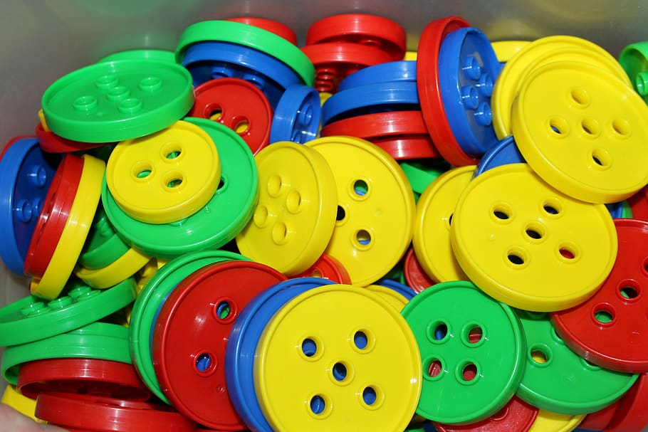

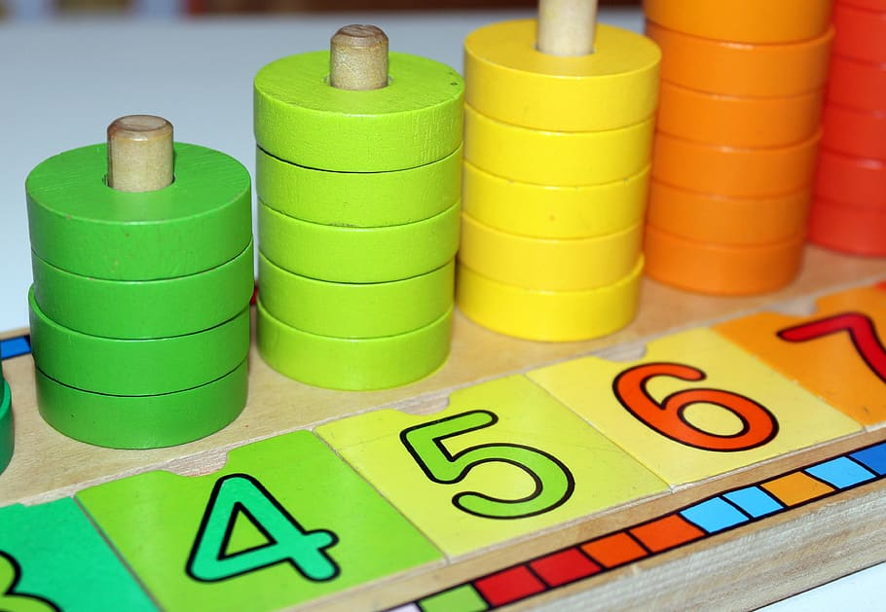
Developing Counting and Number Sense

Slide 2
What is Number Sense?
An understanding of number concepts and operations on these numbers.
The development of useful strategies for handling numbers and operations.
The facility to compute accurately and efficiently, to detect errors and to recognize results as reasonable.
The ability and inclination to use this understanding in flexible ways to make mathematical judgments.
An expectation that numbers are useful and that work with numbers is meaningful and makes sense.

Slide 3

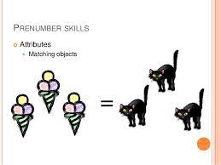
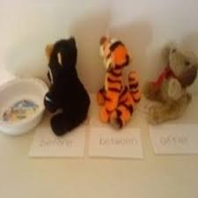
Stages of Number Sense
Number sense is not a finite entity that a student either has or does not have. Its development is a lifelong process, and in early childhood and elementary school number sense development involves several stages:
Prenumber Development
Early Number Development
Number Development

Slide 4
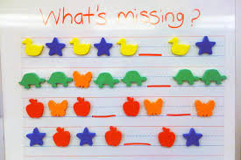
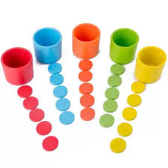
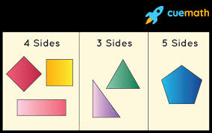
Prenumber Development
Basis for building number sense without the actual use of numbers.
Classification
Patterns

Slide 5

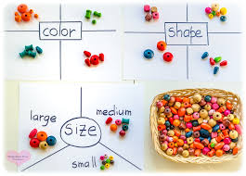
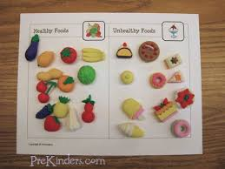
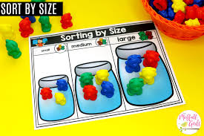
CLASSIFICATION
Classifying objects in different ways fosters the development of reasoning and thinking skills.
Helps the child to become a flexible thinker

Slide 6
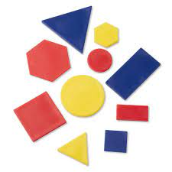
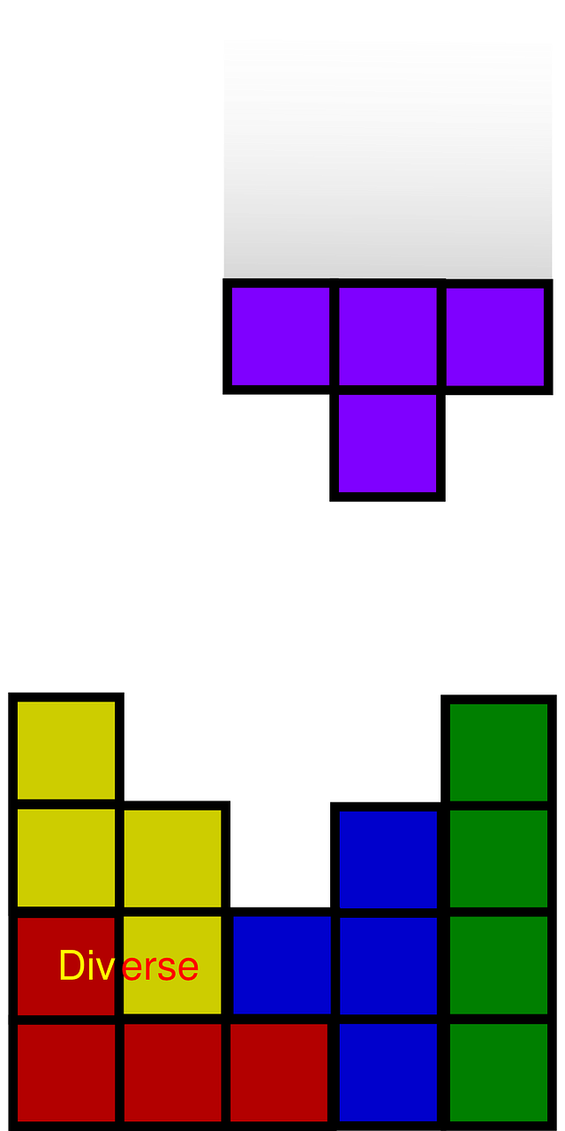
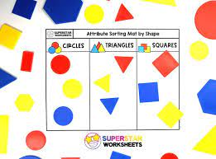
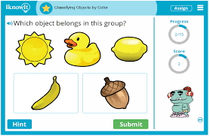
Classification
Attribute blocks provide an excellent model for classification activities and help develop logical thinking.

Slide 7
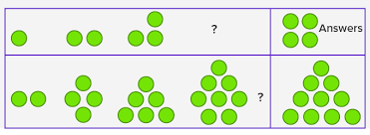
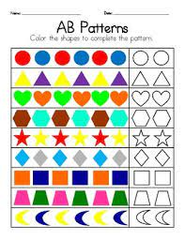
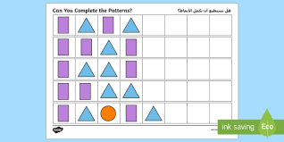
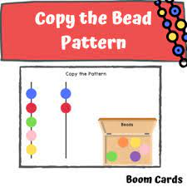
PATTERNS
Creating, constructing, and describing patterns require problem-solving skills and constitute an important part of mathematics learning. Copying, finding and extending patterns are important to building number sense.

Slide 8

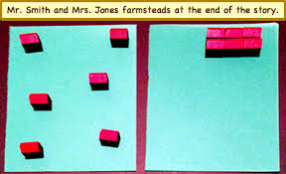
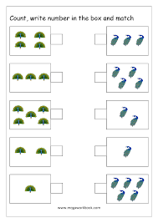
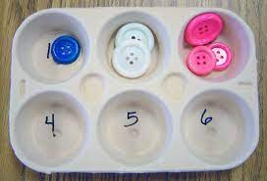
EARLY NUMBER DEVELOPMENT
Making comparisons and recognizing more and less of quantities may be done without counting, and may also provide opportunities for counting.
Conservation
Group Recognition
Comparisons & One to One Correspondence

Slide 9

CONSERVATION OF NUMBERS
A given number does not vary!
Groups of 3 stars are arranged in four different ways. There are always 3 in each circle regardless of arrangement.

Slide 10



GROUP RECOGNITION
The skill to “instantly see how many” in a group is called subitizing. It is an important skill to develop. Recognizing groups of up to five or six is important for:
Saves time
Forerunner of number ideas (different ways to represent a number)
Develops more sophisticated counting skills (counting up)
Accelerates the development of addition and subtraction

Slide 11
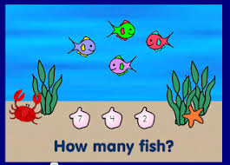
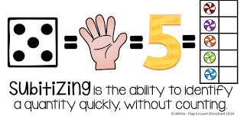

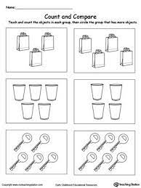
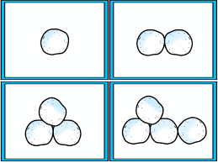
GROUP RECOGNITION/SUBITIZING

Slide 12
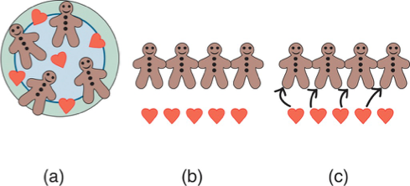
COMPARISONS & ONE TO ONE CORRESPONDENCE
Models for making comparisons by (a) counting; (b) physically comparing without counting; and (c) one-to-one correspondence
Reys/ Lindquist/ Lamdin/ Smith, Helping Children Learn Math,
10th Edition

Slide 13
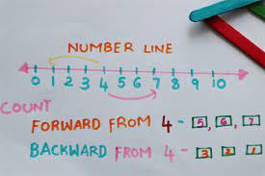
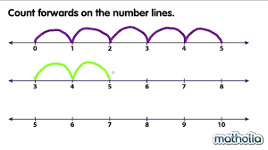
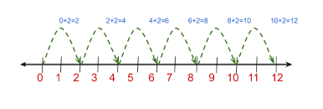
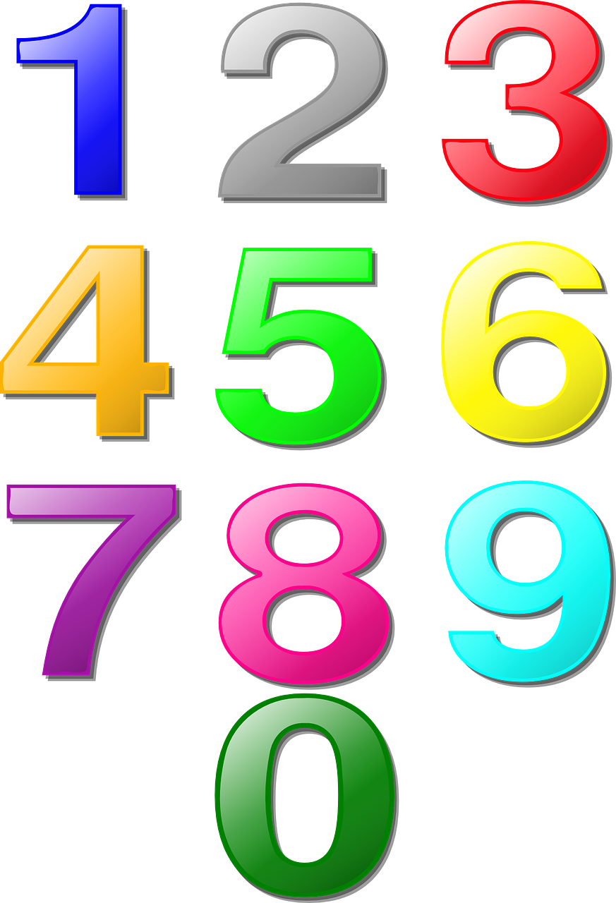
NUMBER DEVELOPMENT
-Connecting groups with number names, including oral and written cardinal and ordinal numbers
- Group recognition
- Counting forward and backward
- Skip counting
- Establishing benchmarks of quantities, such as 5 or 10

Slide 14

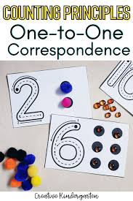



COUNTING PRINCIPLES
One-to-One Rule each object assigned one number
Stable-Order Rule the order for counting objects is done in a fixed order
Order Irrelevance Rule the order with which that objects are counted doesn’t matter
Cardinality Rule last numbered object is the number given for the amount of objects

Slide 15
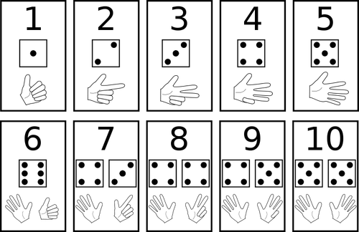
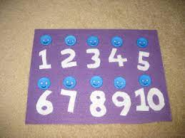
COUNTING STAGES
•Rote Counters may know the proper counting sequence, but they may not always be able to maintain a correct correspondence between the objects being counted and the number names.
•Rational Counters not only uses one-to-one
correspondence but also are able to answer
the question about the number of objects
being counted.

Slide 16

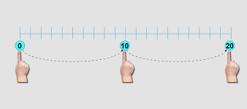
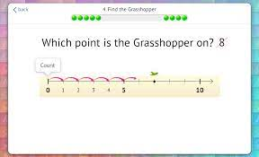
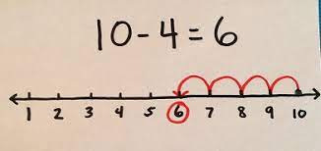
COUNTING STRATEGIES
-Counting on
-Counting back
-Skip counting

Slide 17
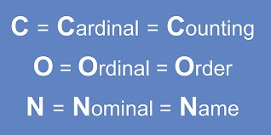
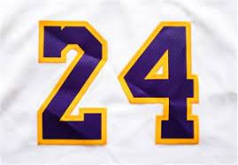
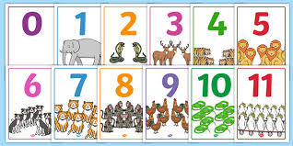
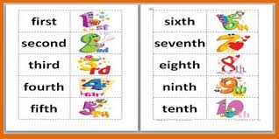
CARDINAL, ORDINAL AND NOMINAL
NUMBERS
Cardinal- “How many?”
Ordinal- “Which one?” (i.e. first, second, third)
Nominal- “Name” (i.e. phone number or address)

