Slide 1



Other Aspects of Measuring
Estimating, Referents, Chunking, Unitizing
Exploring ideas for grade 3 on continuous attributes like length, area, and volume.
Helps without formal tools
Connects to practices, applications, standards, assessments
Develops unit sense
Supports flexible measurement skills

Slide 2

Estimating: What It Is & Why It Matters
Defining Estimation
Estimating is the mental process of arriving at a measurement without using a tool, helping students develop a sense of the size of common units.
"About/almost/between" thinking
Two types:
Estimate known object
Select match for given measurement
Strengthens measurement benchmarks

Slide 3

Referents: Using What You Already Know
What is a Referent?
A referent is a familiar, personal point of reference used to estimate the measurement of something new (e.g., height, foot, desk).
Improves confidence and accuracy
Connects new measurements to meaningful, consistent benchmarks
Supports cross-unit reasoning (e.g., meter is slightly longer than a yard)

Slide 4

Chunking & Unitizing
Breaking Measurements Into Parts
Chunking breaks an object into smaller, manageable subparts (e.g., a door as yard chunks). Unitizing counts how many times one chosen unit fits into an object (e.g., blocks for a wall).
Supports understanding of repeated lengths
Allows for flexible subdivision when more precision is needed
Helps visualize measurement as a process of iteration

Slide 5


Instructional Practices
Developmentally Appropriate Approaches
The teacher will gather objects from around the room.
She will show the students how we measure items.
The teacher will then read the book “Inch by Inch” by Leo Lionni.
After reading the book, the teacher will estimate how big the items are that she gathered.
She will then show the students how to check their estimation by actually measuring the item

Slide 6

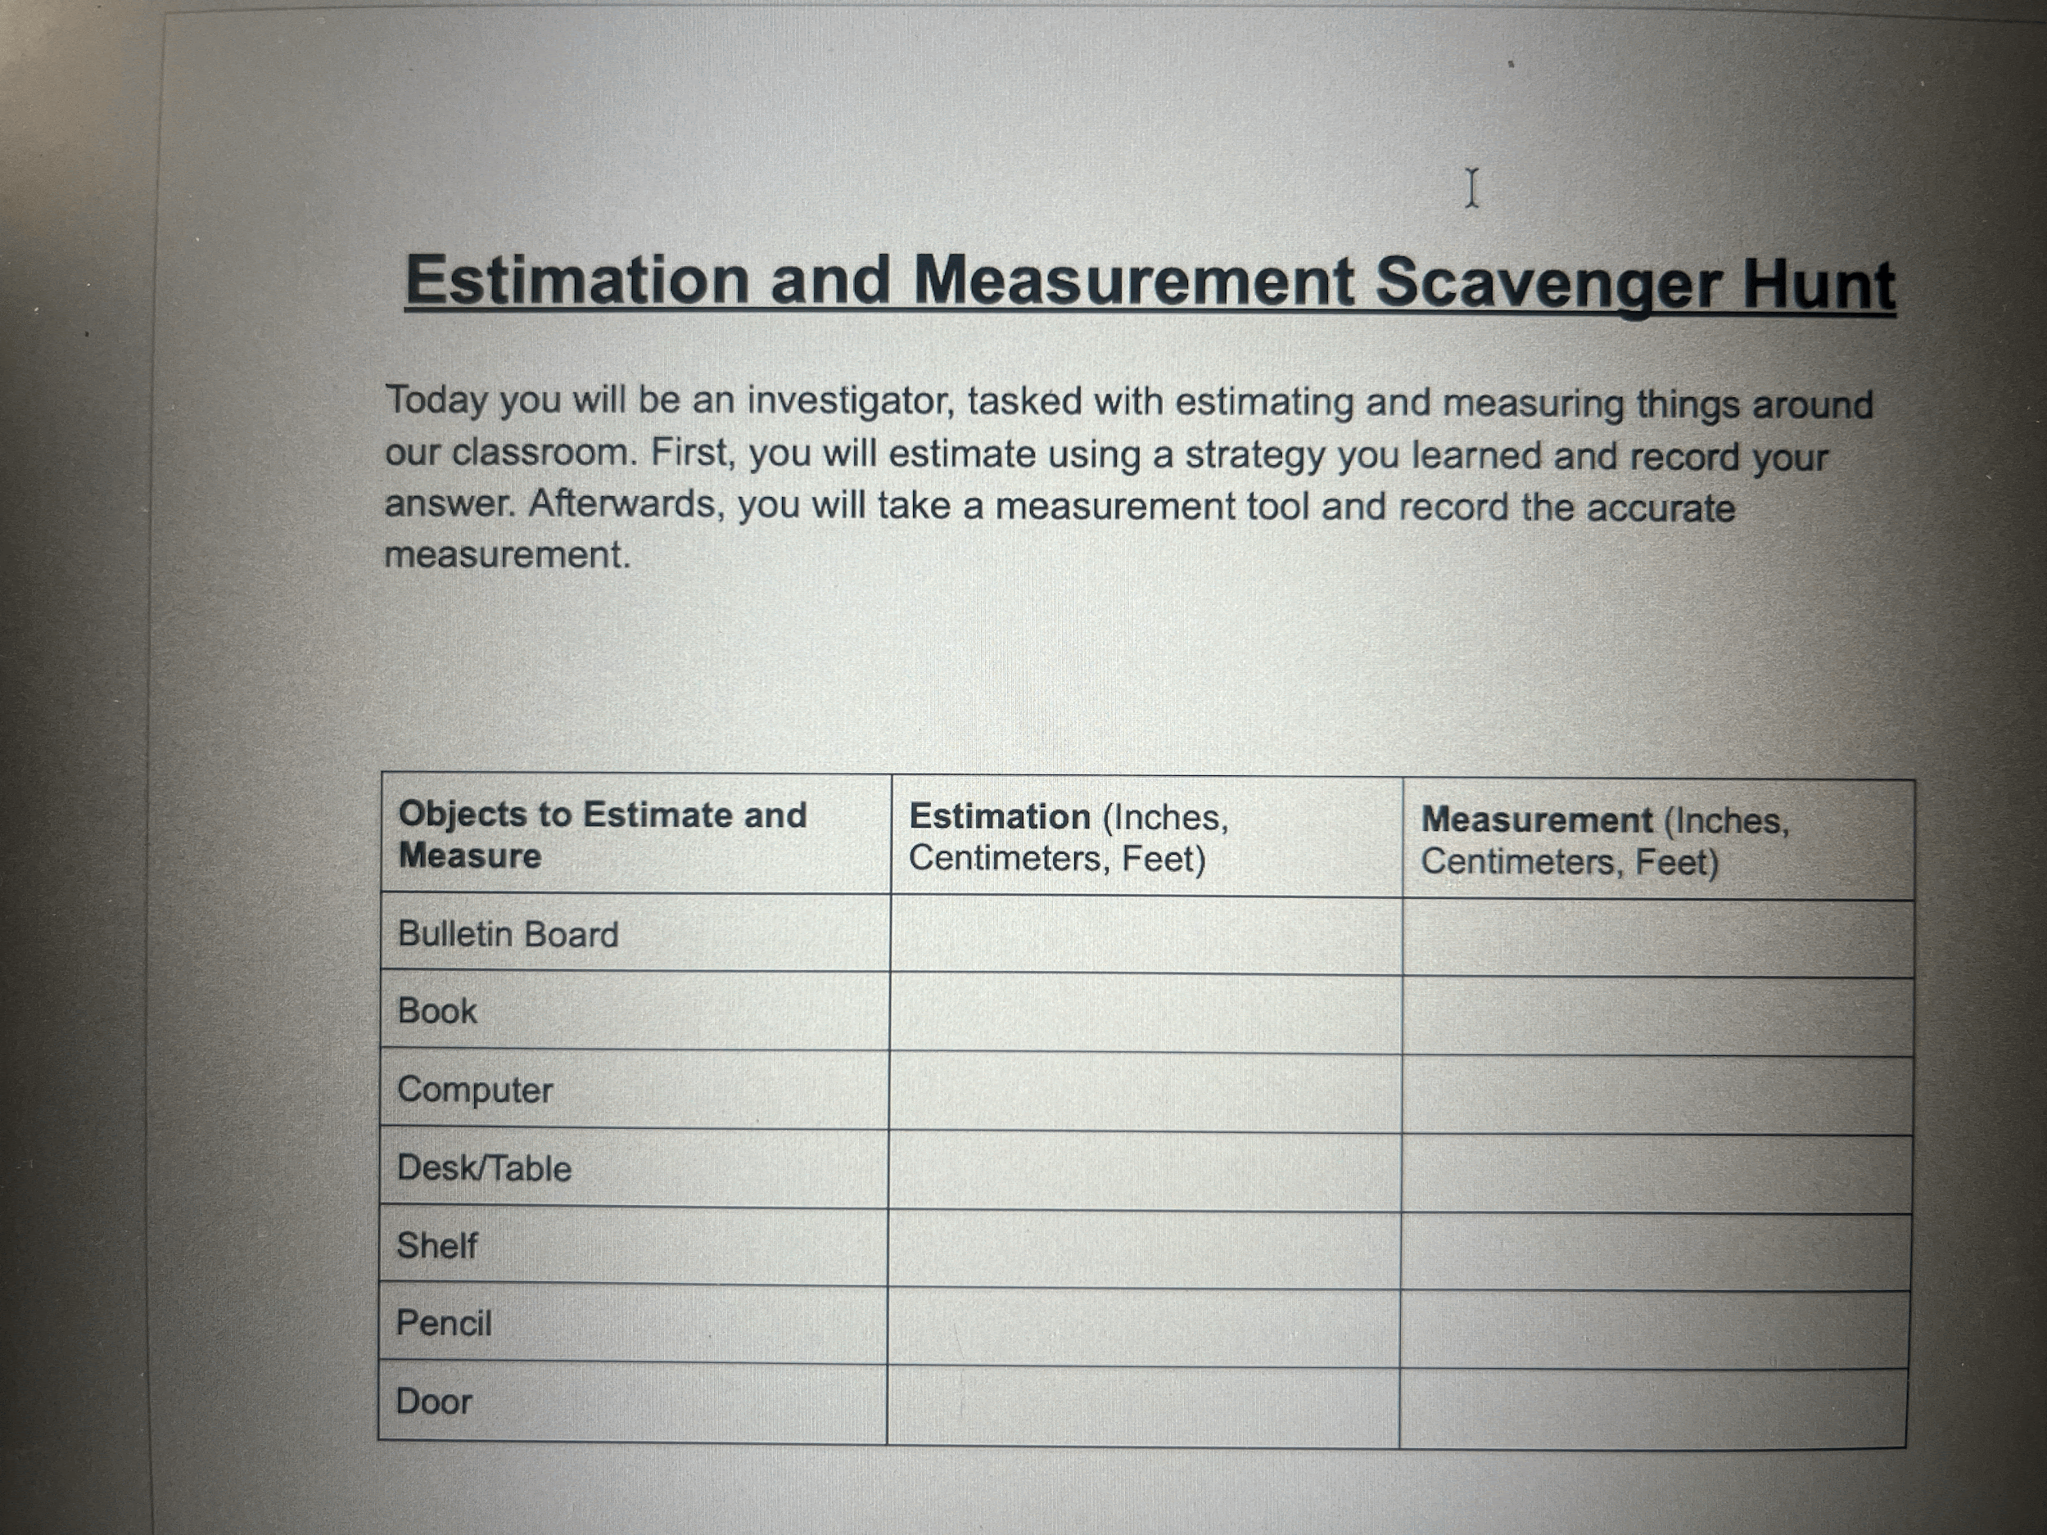
Assessment Practices
Evaluating Understanding
The students would be working individually to complete an estimation and measurement scavenger hunt around the room.
Students would have a worksheet with things around the room (bulletin board, desk, computer, blocks, books…) that students would estimate their length.
After estimating the length, students would use measuring materials such as a ruler and/or measuring tape to accurately and precisely measure the objects.

Slide 7

Video Summary: Measuring Volume by the displacement of water and the volume of objects (peas)
First Video: Hands-on experience with volume through water displacement.
https://platform-teachingchannel-com.eu1.proxy.openathens.net/TeachingChannel/Detail/5791?search=Measurement
2nd video: Estimation and Measurement of peas in the classroom. This video talks about volume
https://platform-teachingchannel-com.eu1.proxy.openathens.net/TeachingChannel/Detail/4796?search=Measurement

Slide 8

PA Standards Alignment
CC.2.4.3.A.1: Solves problems involving volume, mass, length, temperature (supports referents, estimation).
CC.2.4.4.A.1: Converts between larger and smaller units (connects to chunking, unitizing).
CC.2.4.4.A.6W: Measures angles and solves problems (reinforces precise units, estimation).

Slide 9

Connections to Children's Lives
Making Measurement Meaningful
Book: "How Tall, How Short" (historical units)
Book: "Inch by Inch" (story estimation)
Funbrain "Measure It" game
Games link link
YouTube videos
Link
link

Slide 10

Discussion Questions
Reflecting on Key Concepts
Describe one developmentally appropriate way to teach a classroom of third graders how to find the area, length, width, or volume of a given shape or space.
To scaffold student learning when introducing a new unit, such as millimeters, you should relate it back to
Inches
Centimeters
Meters
Micrometer

