Slide 1
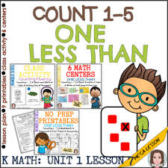
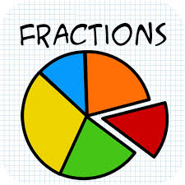
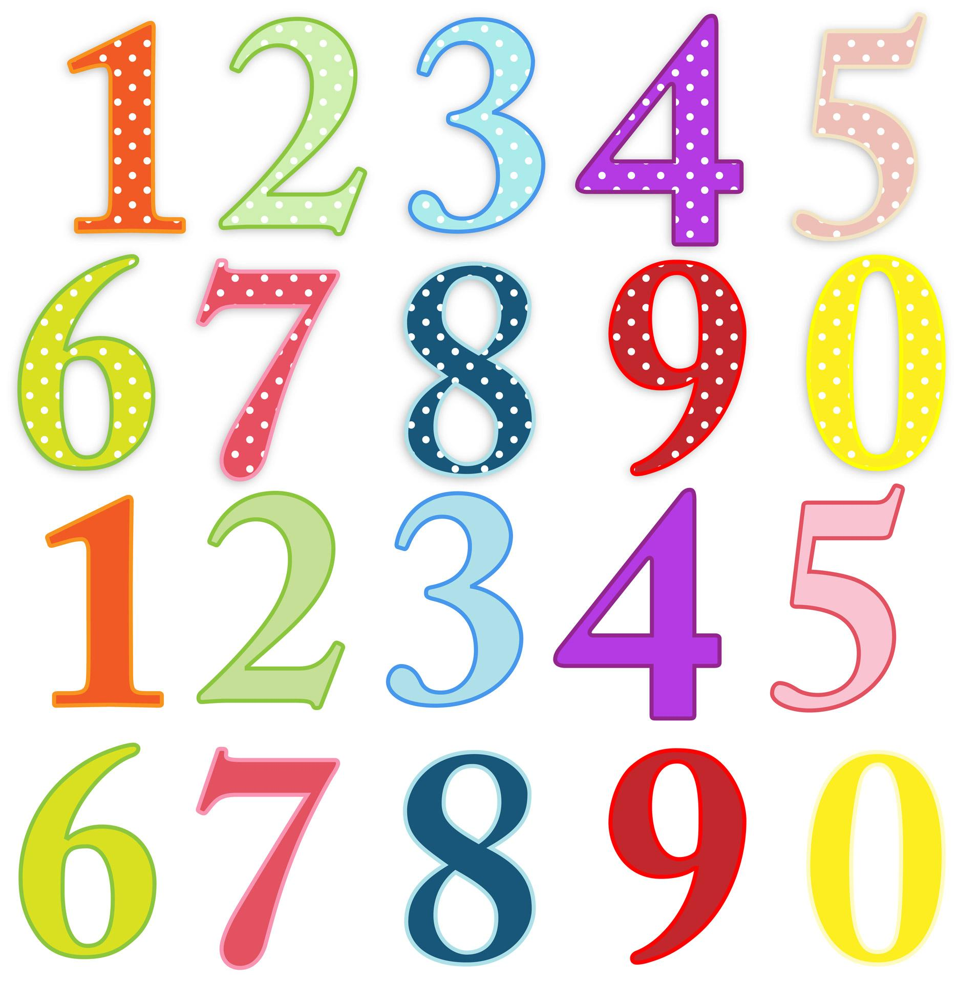
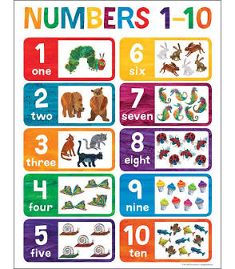

PLACE VALUE AND FRACTIONS
Whole Numbers & Fractions
EDEC 303

Slide 2
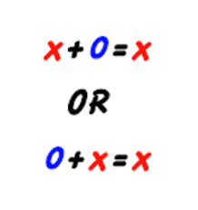
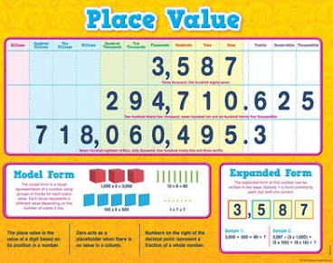
Understanding Whole Numbers: Place Value (PV)
We use the Hindu-Arabic Numeration System.
4 Important Characteristics:
Place Value: The position of a digit represents its value.
Base of 10: Collection of 10. Our digits are 0-9.
Use of 0 (zero): Zero (0) can show the absence of something.
Additive Property: Numbers can be written in expanded notation.

Slide 3
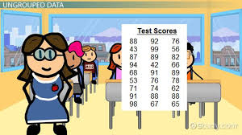
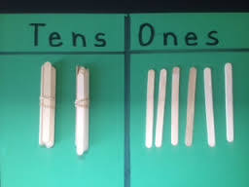
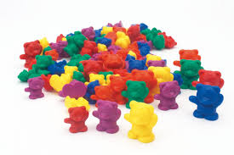
Models for Developing PV Understanding
-Whole numbers are part of a learning trajectory.
-Young children begin understanding of numbers as “counting by ones.”
A 24 year old will have 24 candles on a birthday cake.
-Ungrouped models can be formed into collections of 10.
-Pregrouped models are already grouped into groups of 10.
-Children need experiences with concrete models supported by oral
descriptions and symbolic representations of the models.

Slide 4
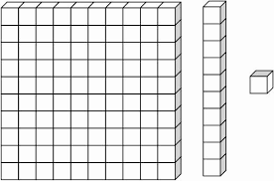
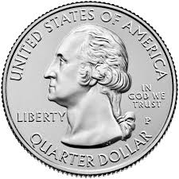
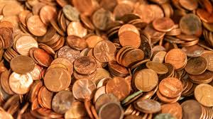
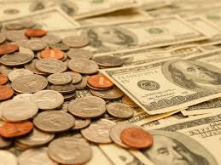
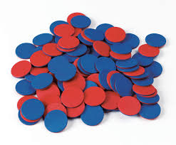
More Models for Developing PV Understanding
Proportional Models: The material for 10 is 10 times bigger than the 1.
Examples: Base 10 blocks; Interlocking blocks grouped as 10 & singles
Non-Proportional Models: There is no size relationship between the models of place value (1, 10, 100, etc.)
Examples: Money, Counters where the color indicates the value (1, 10, 100)
Children need experiences with concrete models supported by oral descriptions and symbolic representations of the models.

Slide 5
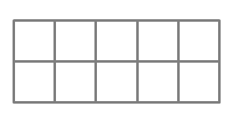
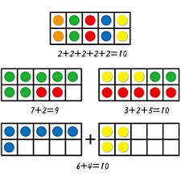
Teaching Place Value: Beginning
IMPORTANT: 11-19 are the hardest 2-digit numbers. There is no consistency between the oral (spoken) and the written forms of 11-19. Start with larger numbers (20 - 99) to help establish PV concepts and naming numbers. Return to 11-19 later.
10 Frames allow children to see a value as ones and also as groups of 10.

Slide 6
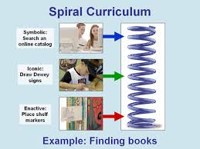
Representing Numbers using Place Value
Bruner’s Instructional Sequence
Enactive (Concrete Models)
Iconic (Pictures - 100-chart)
Symbolic (Numbers)
Real life examples & contexts
Language: Spoken and Written

Slide 7

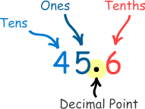

Extending Place Value
The Hindu Arabic Number System extends to large numbers by periods:
Hundreds(ones, tens, hundreds)
Thousands (thousands, ten thousands, hundred thousands)
Millions (millions, ten millions, hundred millions)
Billions (billions, ten billions, hundred billions)
The system also extends to place values less than 1.
(Tenths, Hundredths, Thousandths

Slide 8


Standards - Objectives - Assessments
Grade 2:
CC.2.1.2.B.1
Use place value concepts to represent amounts of tens and ones and to compare three digit numbers.
Notes:
Class Discussion: Possible Objectives & Assessments
Break out rooms

Slide 9
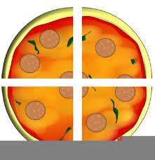
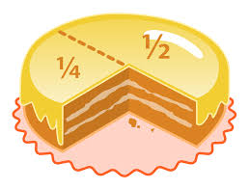
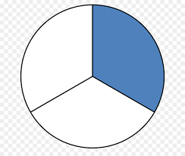
What is a fraction?
Big Fraction Ideas:
A whole may consist of many parts.
If a whole is partitioned into equal parts, the parts can be represented by fractions.
a/b, where a and b are integers and b ≠ 0.

Slide 10
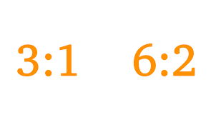
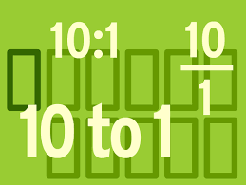
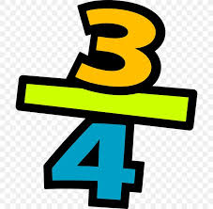
Meanings of Fractions
Part-whole: Most Common. A whole has been partitioned into equal parts. Shade ½ ⊖.
Quotient: (Division): ⅗ Sharing 3 big cookies equally between 5 people
Ratio: 1/10 or 1:10. There is 1 pre-school teacher for every 10 children

Slide 11
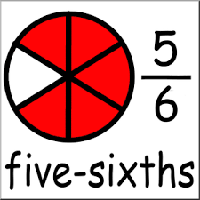
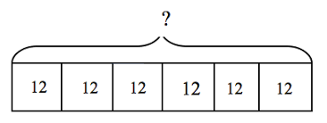
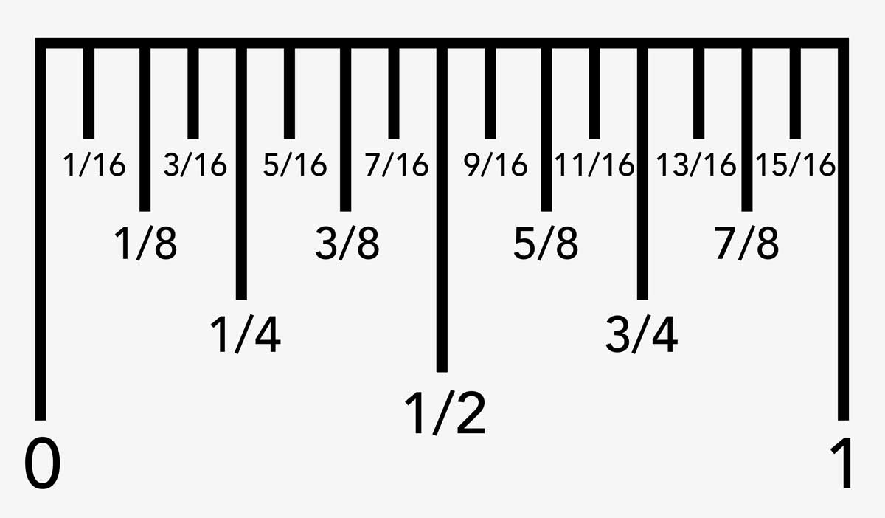

Models of Fractions
Region Model: The region is the whole (the unit) and the
parts are congruent (same size & shape)
Rectangles are easy to draw and partition easily. Some books call this a “bar model.”
Length or Measurement Model: (Length measurement are a most common. ) Any unit of length can be partitioned into fractional parts of equal length. (Notice that rulers are long rectangles.)

Slide 12
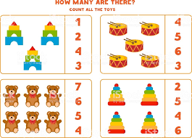
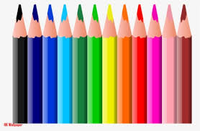


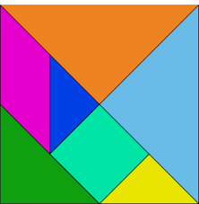
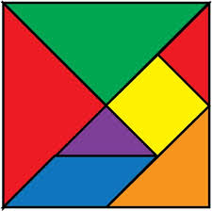
Models of Fractions
Set Model: The set is the whole. Children do not often have much experience in partitioning objects in a set. (A case of soda is a set. A classroom of children is a set)
Area Model is least common. (Tangrams) Notice the square piece, and parallelogram piece have the same area, however they don’t look alike.

Slide 13
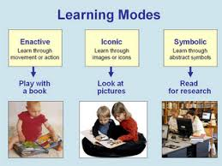
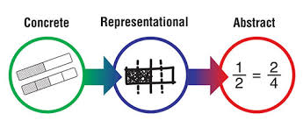
Teaching Fractions
Bruner’s Instructional Sequence
Enactive (Concrete Models)
Iconic (Pictures - 100-chart)
Symbolic (Numbers)
Real life examples & contexts
Language: Spoken and Written

Slide 14
Developing Fraction Ideas (PDESAS Standards)
Grade 1: Fractions in Geometry
Standard - CC.2.3.1.A.2
Use the understanding of fractions to partition shapes into halves and quarters.
Grade 2: Fractions in Geometry
Standard - CC.2.3.2.A.2
Use the understanding of fractions to partition shapes into halves, quarters, and thirds.

Slide 15
Developing Fraction Ideas (PDESAS Standards)
Grade 3: Fractions in Geometry and Fractions as Numbers
Standard - CC.2.1.3.C.1 Explore and develop an understanding of fractions as numbers.
Standard - CC.2.3.3.A.2 Use the understanding of fractions to partition shapes into parts with equal areas and express the area of each part as a unit fraction of the whole.
Standard - 11.3.3.F Identify components of a basic recipe (e.g., volume, weight, fractions, recipe ingredients, recipe directions, safety techniques).

Slide 16
Developing Fraction Ideas (PDESAS Standards)
Grade 4: Fractions as Numbers
Standard - CC.2.1.4.C.1
Extend the understanding of fractions to show equivalence and ordering.
Standard - CC.2.1.4.C.2
Build fractions from unit fractions by applying and extending previous understandings of operations on whole numbers.
Standard - CC.2.1.4.C.3
Connect decimal notation to fractions, and compare decimal fractions (base 10 denominator, e.g, 19/100).

Slide 17
Standards - Objectives - Assessments
Grade 3:
CC.2.3.3.A.2 Use the understanding of fractions to partition shapes into parts with equal areas and express the area of each part as a unit fraction of the whole.
Check this Standard.
What is the Eligible Content?
Notes:
Class Discussion: Possible Objectives & Assessments
Break out rooms

