Slide 1
Section 3 Internet, DNS, Routers

Slide 2
Agenda
The Internet
Routers
DNS

Slide 3

The Internet

Slide 4

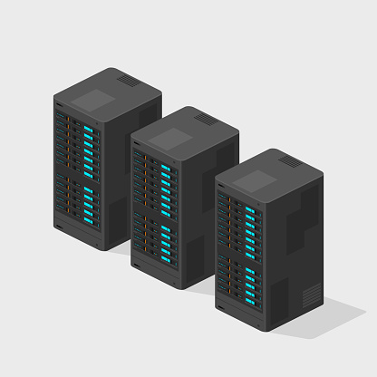
The Internet
Client
Facebook’s Server
Request

Slide 5
The Internet
Client
Facebook’s Server
Request
Response

Slide 6
The Internet
Client
Facebook’s Server
Facebook.com -> 173.10.10.34
30.89.20.30

Slide 7
DNS (Domain Name System)
Acts as a phonebook for IP Addresses
Allows us to not have to remember every website’s IP
Usually exists on port 53

Slide 8
Routers
Connects two or more networks
Acts as an air traffic controller
Routing tables are the guide to direct packets effectively

Slide 9
Thank you

