Slide 1
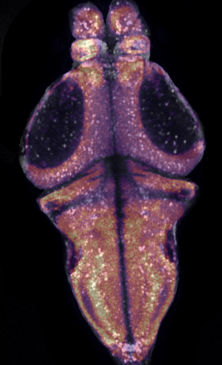
Oblique registration
Mapping tilted functional planes
into the mapZebrain atlas
without pretending the brain is flat
Elysia Ye · larval zebrafish whole-brain imaging
Notes:
This is a plane from fish 32 with the atlas overlaid. It looks decent — hold that thought, because 'the overlay looks good' turns out to be exactly what a wrong depth model also produces. Today: why our planes don't match any single atlas slice, what everyone does about it, why that's not good enough, and the method I've built instead.

Slide 2
1
THE PROBLEM
A neuron with no address is not a data point
Raw movie
Motion correction
ROI extraction
Registration
Region-wise FC
per plane, over time
mcorr → STD projection
CaImAn → traces + COMs
← we are here
DOI vs eggwater
The atlas is what makes one fish comparable to another. Registration is the only place that correspondence gets established — and the only place it can be quietly lost.
Nothing crashes when it is wrong. The numbers just quietly describe the wrong tissue.
Every region-level result rests on this one step.
Notes:
Everything downstream — region-wise functional connectivity, comparing DOI vs eggwater by anatomy — needs each ROI to carry an anatomical label. Registration is the step that turns pixel coordinates into region identity. If it is wrong, every region-level result inherits the error silently: nothing crashes, the numbers just quietly describe the wrong tissue.

Slide 3
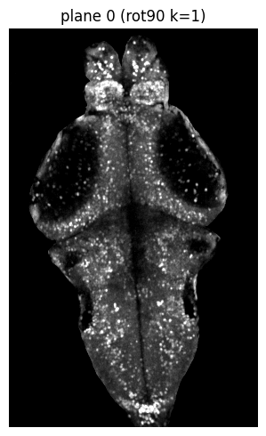
1
THE PROBLEM
The scope is fixed. The fish is not.
The imaging plane is horizontal in scope coordinates and never tilts.
The fish is mounted in agarose at whatever angle it lands at.
The atlas axes were defined by a different animal entirely.
So the plane enters dorsal tissue at one end and ventral tissue at the other.
This is not a mounting error to be fixed. It is the normal condition of every recording we have.
fish 32, plane 0 — STD projection
The tilt is a property of the experiment, not a defect in it.
Notes:
The imaging plane is set by the objective and the piezo — it is horizontal in scope coordinates and it never moves. The fish, mounted in agarose, sits at whatever angle it sits at. Nobody mounts a fish perfectly level, and even if you did, the atlas's own axes are defined by a different animal. So the plane cuts the brain obliquely. This isn't a mounting failure to be fixed — it's the normal condition of every recording we have.

Slide 4
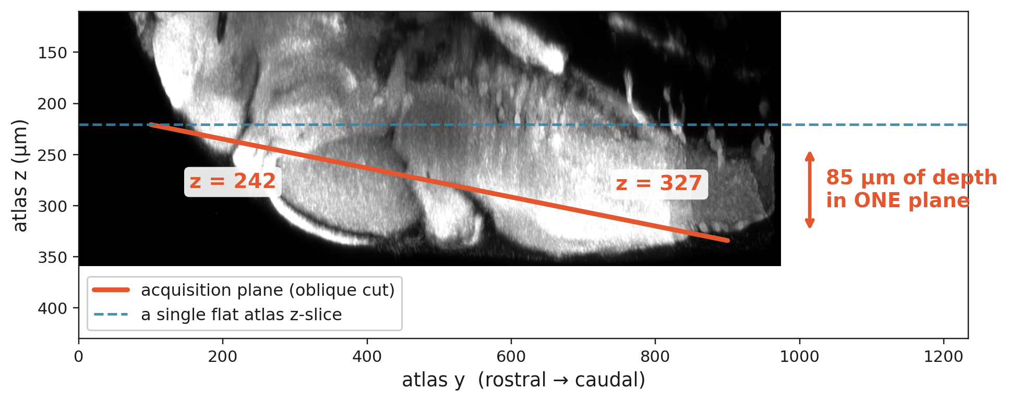
1
THE PROBLEM
One plane spans 85 µm of atlas depth
Sagittal projection of mapZebrain, with the fish-32 acquisition plane drawn through it.
85 µm of depth ≈ 12 somata stacked, end to end, inside one image
No single atlas z-slice can be the right target for this plane.
Notes:
Here is the actual measurement for fish 32, drawn on a sagittal projection of mapZebrain. The orange line is where our acquisition plane really sits. The dashed blue line is what a flat atlas z-slice would be. Rostrally the plane is at z=242; caudally it has descended to z=327. That's 85 microns of depth inside a single 2D image. For scale, a soma is about 7 microns — so the two ends of one plane are separated by roughly twelve cell bodies of depth.

Slide 5
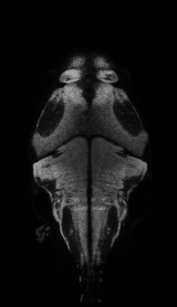
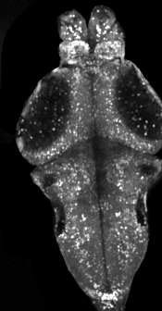
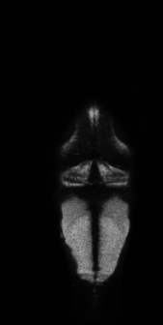
1
THE PROBLEM
Pick a slice — either end matches, never both
atlas z = 242
our plane
atlas z = 327
matches the rostral end
what we actually recorded
matches the caudal end
The mismatch is not a shift you can translate away — the target itself is tilted.
Notes:
Left and right are the two atlas slices at the ends of that range. Centre is our actual data. The z=242 slice has the right forebrain but the wrong hindbrain. The z=327 slice has the right hindbrain and almost no forebrain left. There is no slice in between that fixes it, because the mismatch isn't a translation — it's that the target should be tilted.

Slide 6
2
THE STANDARD WORKAROUND
Chop the plane into bands
one functional plane
rostral band
atlas z ≈ 250
each band registered
independently to its own
flat atlas slice, then
stitched back together
middle band
atlas z ≈ 285
caudal band
atlas z ≈ 320
Sensible, widely used — and genuinely better than one flat slice.
Notes:
The standard response, and what I did first: mask the plane into two or three bands, register each band to its own atlas slice, and stitch the results. Each band gets a depth that is closer to correct than one global slice was. This is a real improvement and it is what the field does.

Slide 7
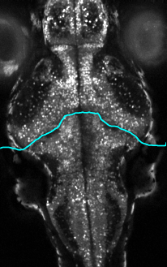
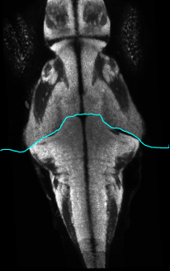
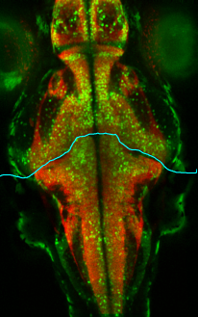
2
THE STANDARD WORKAROUND
And it does help
top band, masked
composite of both bands
merge (R = atlas, G = data)
Each band is closer to its true depth than one global slice was.
Edges sharpen; the smearing from averaging across depth drops.
It is cheap: same registration call, run more times.
plane 2 — masked patch registration, fish 32
The question isn't whether masking helps. It's what the leftover error looks like.
Notes:
Be fair to the method. Masked registration visibly sharpens the fit — here the masked patch recovers the top of the plane that a full-frame fit was smearing. I'm not about to tell you this doesn't work. I'm going to tell you what it costs.

Slide 8
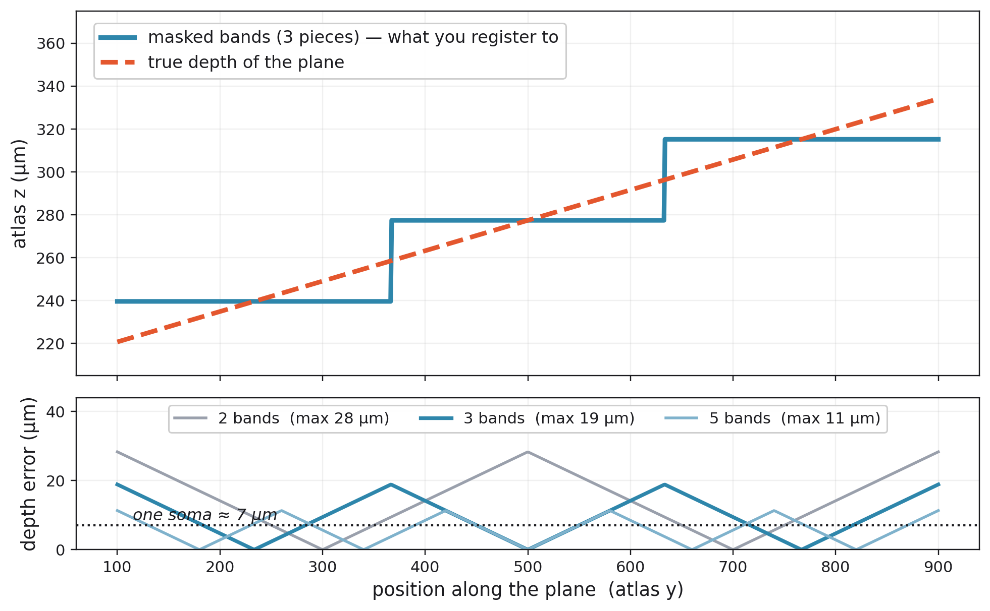
2
THE STANDARD WORKAROUND
But the depth model is a staircase
The error is largest in the middle of each band — where the neurons are.
Notes:
This is the whole argument on one plot. Orange dashed is the true depth of the plane as you walk along it — a straight ramp. Blue is what a three-band mask actually gives you: piecewise constant. You are approximating a continuous ramp with a step function. Bottom panel is the residual. Three bands leaves you 19 microns of depth error at its worst, and crucially the error is worst in the MIDDLE of each band — where the tissue is, not at the edges where you were looking.

Slide 9
2
THE STANDARD WORKAROUND
What the staircase costs
19 µm
9 bands
8 seams
worst-case depth error with 3 bands — nearly 3 cell bodies
needed to push that error under a single soma
…and each one is an independent registration
Bands are registered independently, so in-plane pose drifts between neighbours — the stitched plane is no longer one rigid object.
At a seam, two neurons a few microns apart get depths that differ by a whole step. That discontinuity is an artefact you introduced.
More bands is not convergence: you buy depth resolution with pose instability and more seams.
Refining the staircase does not approach the ramp. It trades one error for another.
Notes:
Three numbers. Three bands leaves 19 microns of residual depth error. To push that under one soma you'd need about nine bands. But bands aren't free — each one is an independent registration, so the in-plane pose is free to drift between neighbours, and every boundary is a seam where two solutions meet. More bands buys depth accuracy with pose instability and more seams. It does not converge on the truth; it trades one error for another.

Slide 10
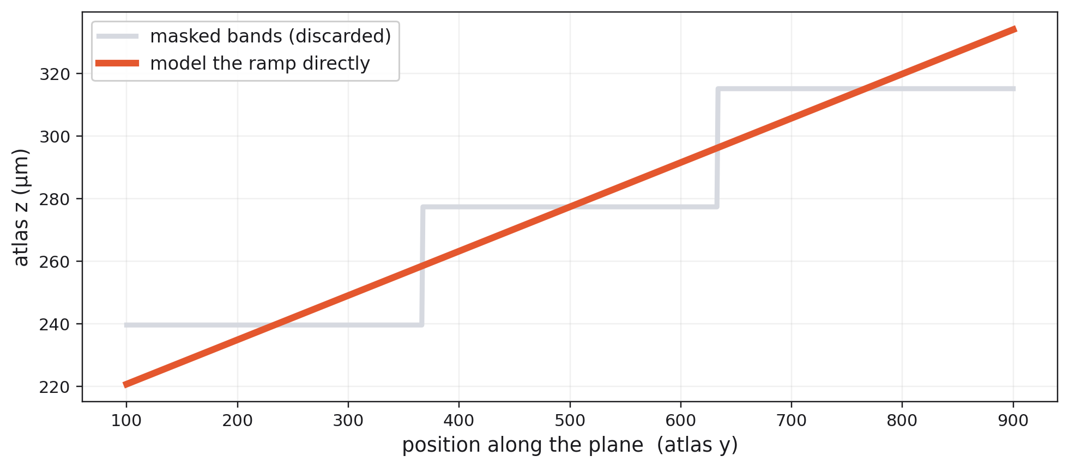
3
THE OBLIQUE METHOD
Don't approximate the ramp — model it
The depth of the plane is a smooth linear function of position. So write that function down and use it.
One continuous depth model instead of N independent registrations.
Notes:
Same axes as the last plot. The staircase goes away. If the depth of the plane is a smooth linear function of position, then write down that function and use it. That's the entire idea. Everything from here is the bookkeeping needed to make it work.

Slide 11
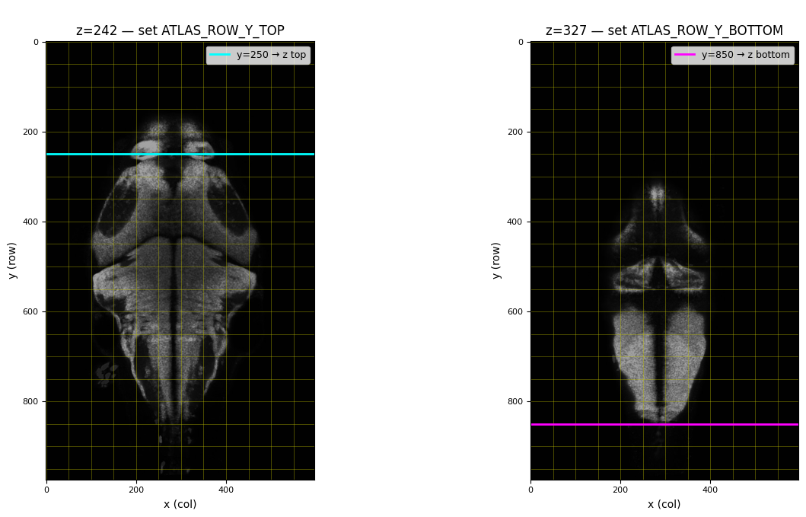
3
THE OBLIQUE METHOD
Two numbers define the cut
The two anchors
y = 250 → z = 242
y = 850 → z = 327
Read off the atlas, not off your data — which is why the same two numbers serve every plane in the fish.
This is the only place a human is in the loop — and everything inherits its error.
Notes:
The only manual step in the whole pipeline. Look at the atlas at the shallow end of your plane and note the y-row where tissue starts. Look at the deep end and note the y-row where it ends. That's it — two (y, z) anchor pairs. Everything downstream is derived. Note these are read off the ATLAS, not off your data, which is why they're stable across all the planes of a fish.

Slide 12
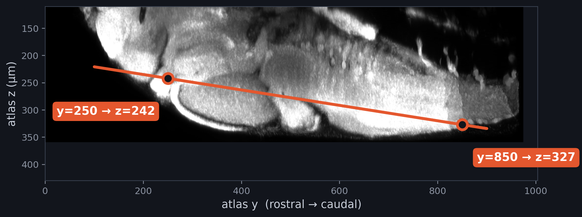
3
THE OBLIQUE METHOD
Depth is a function of atlas y
z = z_top + ( y − y_top ) / ( y_bot − y_top ) × ( z_bot − z_top )
y is the atlas y
obtained after the affine — not your image row index
Anchors live in atlas space
so the same pair serves every plane in the fish
The line does not stop
unclamped: one flat tilted plane through the volume
Every pixel gets its own depth. Continuously.
Notes:
THE slide. Every pixel in the functional plane gets its own atlas depth, interpolated linearly between the two anchors. Continuous, not stepped. Three things people get wrong. One: y is the ATLAS y — obtained after the affine — not the row index in your image. If you index depth by image row, the tilt rotates whenever the affine changes and you get a different plane every time you register. Two: the anchors describe where the cut sits in the atlas, which is what makes them reusable across planes. Three: the line does not stop at the anchors — t is unclamped, so the cut stays one flat tilted plane through the whole volume. Clamping would give you a bent surface, which is physically wrong.

Slide 13
3
THE OBLIQUE METHOD
The affine and the anchors do different jobs
3D affine registration
The two anchors
The affine's z output is discarded
solves in-plane pose
solve depth
x, y position
rotation in plane
scale
atlas z per pixel
the tilt
shared by all planes
This is the single line that separates the method from sitk.Resample, which would use that z and hand you one depth for the whole plane.
Mattes MI, 500 iterations, against the atlas z-slab
y → z, linear, unclamped
Pose and depth are solved separately, so they cannot trade off against each other.
Notes:
This is the part that surprises people, so I want to be explicit. We do run a 3D affine registration — but we use only its in-plane output. The affine tells us where the plane sits in x and y. Its z output is computed and then thrown away, replaced by the anchor rule. That separation is deliberate: pose and depth are solved by different mechanisms, so they can't trade off against each other. An optimiser that can move in z will happily buy metric improvement by sliding to the wrong depth. This one can't.

Slide 14
3
THE OBLIQUE METHOD
Build a synthetic atlas image that matches your geometry
1
Take every pixel
(col, row) on the functional grid
The result
A 2D atlas image that has never existed as a slice — cut along exactly the surface your microscope cut.
The problem is now 2D-to-2D, and ordinary Elastix (affine + B-spline) finishes the job on residual deformation only.
2
Push through the affine
→ atlas x, atlas y
3
Apply the anchor rule
atlas y → atlas z, per pixel
4
Sample the volume
trilinear, at (x, y, z)
The geometry is solved before the deformable step ever runs.
Notes:
Mechanically: take the grid of pixels in your functional plane. Push each one through the affine to get atlas x and y. Use the anchor rule to get that pixel's atlas z. Sample the atlas volume there, trilinearly. The result is a 2D image — an atlas view that has never existed as a slice, cut along exactly the surface your microscope cut. Now the problem is 2D-to-2D and ordinary Elastix can finish the job.

Slide 15
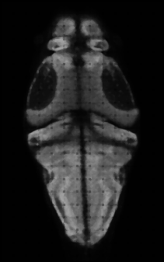
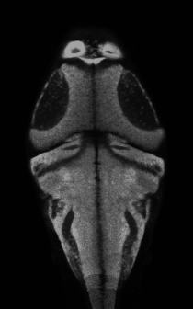
3
THE OBLIQUE METHOD
Oblique reslice vs. what SimpleITK would give you
oblique reslice
axis-aligned resample
our data
z varies with atlas y
one z ≈ 246 for the whole frame
what we actually recorded
Same affine, same atlas, same fish — the only difference is where z comes from.
Forebrain and hindbrain in register at the same time — the axis-aligned cut can't do that.
Notes:
Proof it does something. Same affine, same atlas, same fish. Left is the oblique reslice. Middle is what a standard axis-aligned resample produces — essentially one atlas z for the whole frame. Right is our data. Look at the forebrain and the hindbrain simultaneously: the oblique version has both in register, the axis-aligned version can only ever have one.

Slide 16
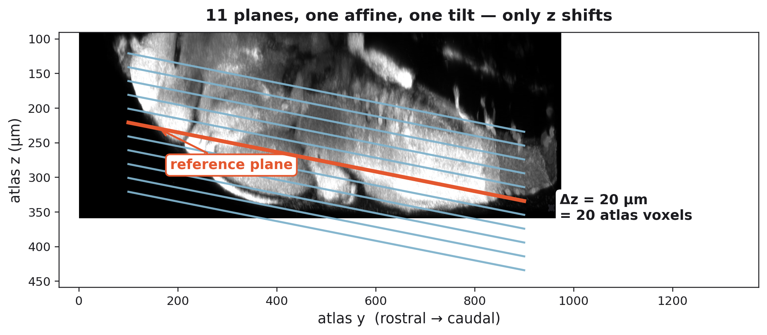
3
THE OBLIQUE METHOD
One affine for the whole stack, shifted in z
Stepped by the piezo along one axis — parallel by construction.
Same in-plane pose, same tilt, different depth.
So: register once, shift N times.
Independent per-plane fits would let the tilt drift — a stack no microscope could have produced.
The arithmetic is exact
20 µm / plane
÷ 1 µm / voxel
= 20 voxels
11 planes, one registration.
Notes:
The planes are acquired by stepping the piezo along the imaging axis, so they are parallel by construction: same in-plane pose, same tilt, different depth. So we register once and shift. The arithmetic is clean — functional z spacing is 20 microns, mapZebrain is 1 micron isotropic, so one plane step is exactly 20 atlas voxels. Re-registering each plane independently would let the tilt drift plane to plane and produce a stack that no physical microscope could have acquired. Only the sign is empirical: which end of the stack is deeper.

Slide 17
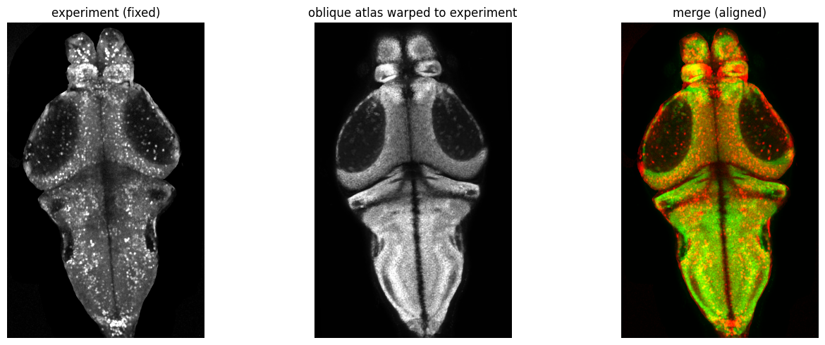
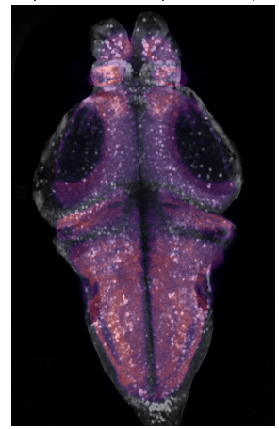
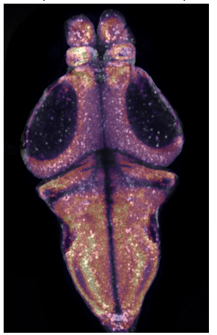
4
DOES IT WORK
Residual deformation is small
before deformable
after deformable
Before the deformable step vs. after — the correction is small because the geometry was already right when Elastix started.
experiment | atlas warped to it | merge (R = atlas, G = data)
A hard-working B-spline is a symptom, not a success.
Notes:
Left: experiment. Middle: the atlas after the deformable step. Right: merged, red atlas green data. The point isn't that the merge looks yellow — it's that the B-spline barely had to do anything, because the geometry was already right when it started. When the deformable step is working hard, that's a sign the depth model is wrong and the warp is compensating for it.

Slide 18
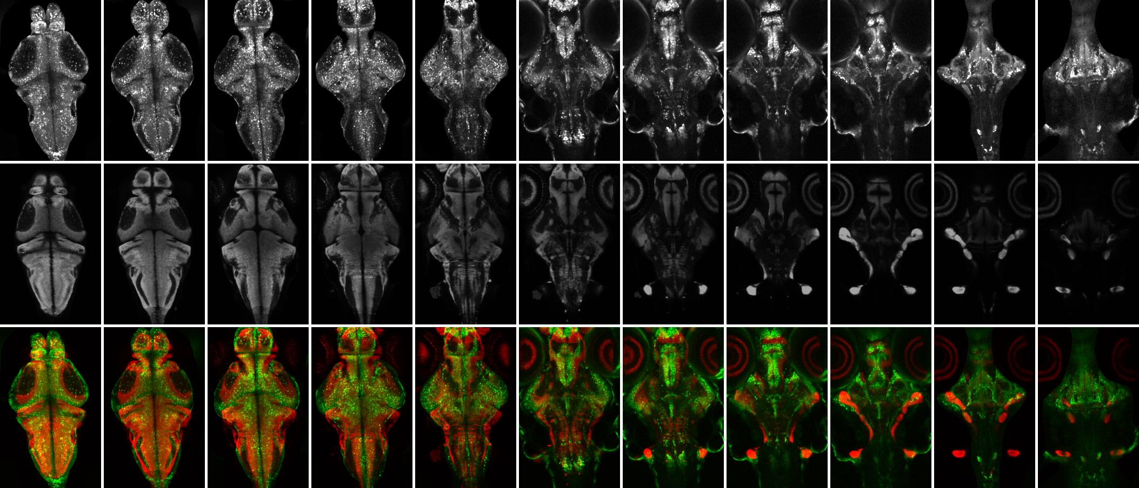
4
DOES IT WORK
Consistent across the whole stack
All 11 planes, fish 32.
One affine. One pair of anchors.
z stepped by 20 voxels per plane.
Nothing tuned per plane.
Deep planes thin out because there is less tissue there — not because the registration degraded.
rows: experiment | oblique atlas reslice | overlay columns: plane 0 (dorsal) → plane 10 (ventral)
Same parameters top to bottom.
Notes:
All 11 planes of fish 32. One affine, one pair of anchors, z stepped by 20 voxels per plane. Nothing here is tuned per plane. The deep planes get sparse because there's genuinely less tissue there, not because the registration degraded.

Slide 19
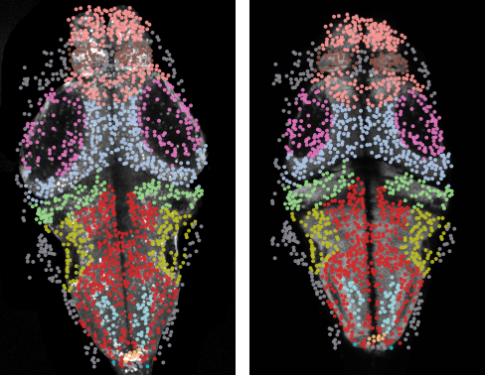
4
DOES IT WORK
The check that isn't just an overlay
A wrong depth model plus a flexible B-spline also produces an overlay that looks good.
plane 0 — 1616 ROIs, coloured by the mapZebrain region they landed in
Take compact regions with unambiguous centres — habenula, epiphysis.
Compute the centre of mass of the atlas region mask.
Compare against the centre of mass of the ROIs we mapped into it.
2–3 voxels
agreement between mask CoM and mapped-ROI CoM, at 1 µm isotropic — sub-somatic
experiment | oblique atlas reslice
That is a measurement, not an impression.
Notes:
This is the slide that matters. Everything before this was 'the overlay looks good' — and I want to be blunt: a wrong depth model plus a flexible enough B-spline ALSO produces an overlay that looks good. It will warp the atlas to match intensity while sampling the wrong tissue, and you will never see it in a merge. So: independent check. Take compact regions with unambiguous centres — habenula, epiphysis — compute the centre of mass of the atlas mask, and compare it to the centre of mass of the ROIs we mapped there. Those agree to within two or three voxels, which at 1 micron isotropic is sub-somatic. That is a measurement, not an impression.

Slide 20
4
DOES IT WORK
Masks didn't disappear — they got demoted
Before — masks as depth model
Now — masks as clean-up
carried the entire depth model
seam = a jump of tens of µm in anatomy
more bands → more pose drift
handles residual local deformation only
seam = a small intensity discontinuity
eroded overlap band, discarded at composite
The mask survived. It just stopped being the geometry.
Notes:
Honesty slide. I still use masked, piecewise registration. But it is no longer carrying the depth model — it handles residual local deformation, mostly where the agarose or the eye distorts one corner of the frame. And because the depth is already right everywhere, the seam is a small intensity discontinuity rather than a jump of tens of microns in anatomy. I erode the mask by an overlap band and discard that band when compositing, rather than registering the sharp complement, which is what produces the visible seam.

Slide 21
5
LIMITS
What this does not do
Linear tilt, one axis
The plane is assumed flat
Roll about the other axis isn't modelled; the residual grows toward the frame edges.
Genuine optical curvature is not captured — the B-spline absorbs it.
The anchors are manual
Intensity-based throughout
Everything downstream inherits the error in those two numbers.
A good-looking merge is necessary, not sufficient — hence the CoM check.
Everything inherits the two anchors — which is why validation can't be an overlay.
Notes:
Naming the limits before anyone asks. It models a linear tilt about one axis. Roll about the other axis isn't in the model — if the fish is also rolled left-right, that residual grows toward the frame edges and the B-spline absorbs it. The plane is assumed flat; genuine optical curvature isn't captured. And the anchors are set by eye, so the whole pipeline inherits whatever error is in those two numbers — which is why the region centre-of-mass check matters more than any overlay.

Slide 22
5
STATUS
Where this goes next
Running
Applied across the DOI cohort; aligned ROIs written back to the temporal pack with atlas voxels + region labels.
Building on it
Region-wise functional connectivity — the DOI vs eggwater difference-in-differences analysis.
Next
Extract the oblique functions into a standalone package with a written guide, so it's reproducible outside my notebooks.
Thank you — questions?
Notes:
Status. The method is running across the DOI cohort and the aligned ROIs are written back into the temporal pack with mapZebrain voxel coordinates and region labels, which is what the region-wise functional connectivity work is now built on. Next: pulling the oblique functions out into a standalone package with a written guide, so this is reproducible outside my notebooks. Happy to take questions — especially on the anchor selection, since that's the part I'd most like to automate.

