Slide 1
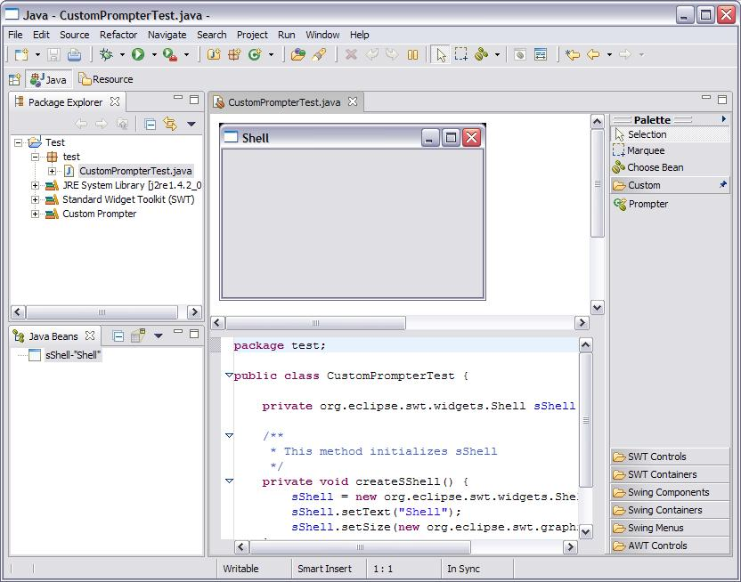
eclipse.exe JVM
plugin side
Visual Editor target JVM
runtime side
Eclipse workbench
containing plugins
org.eclipse.ve.examples.customwidget
plugin contributes
customwidgetplugin.jar
Test.Java openWith Visual Editor
Target VM includes
customwidgets.jar
based on the build path
of the Java project

