Slide 1

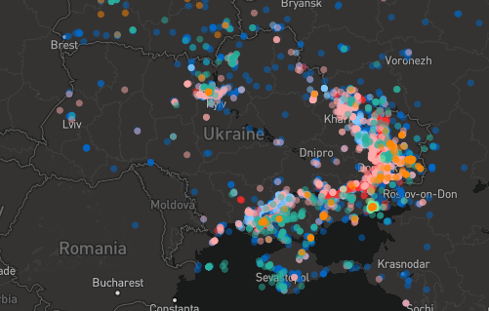
Covering the Ukraine - Russia Conflict
Data driven, social-media oriented, and keeping you safe
Adam Miner
Data scientist for the Associated Press

Slide 2
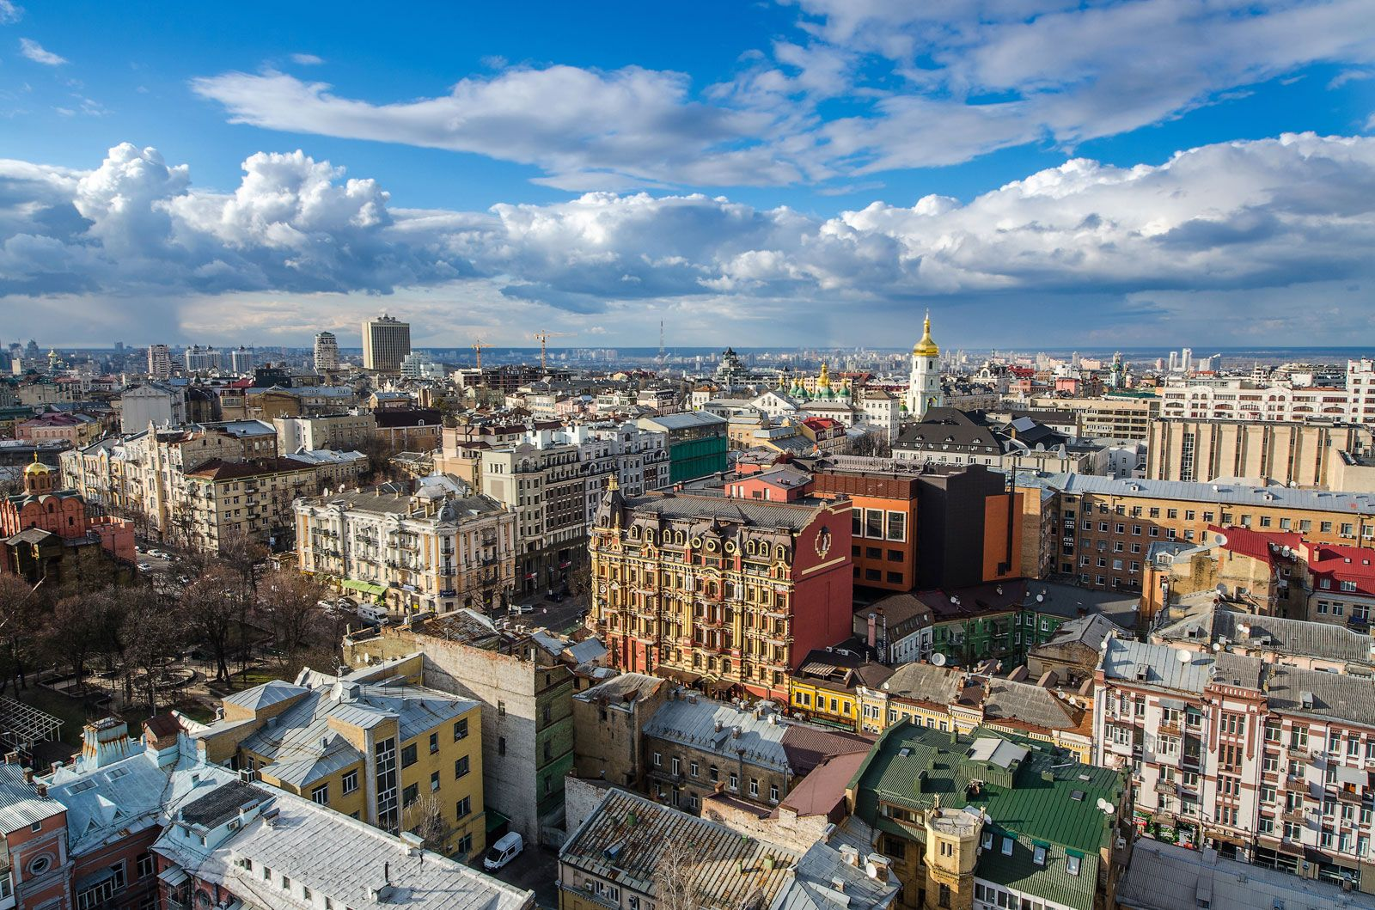
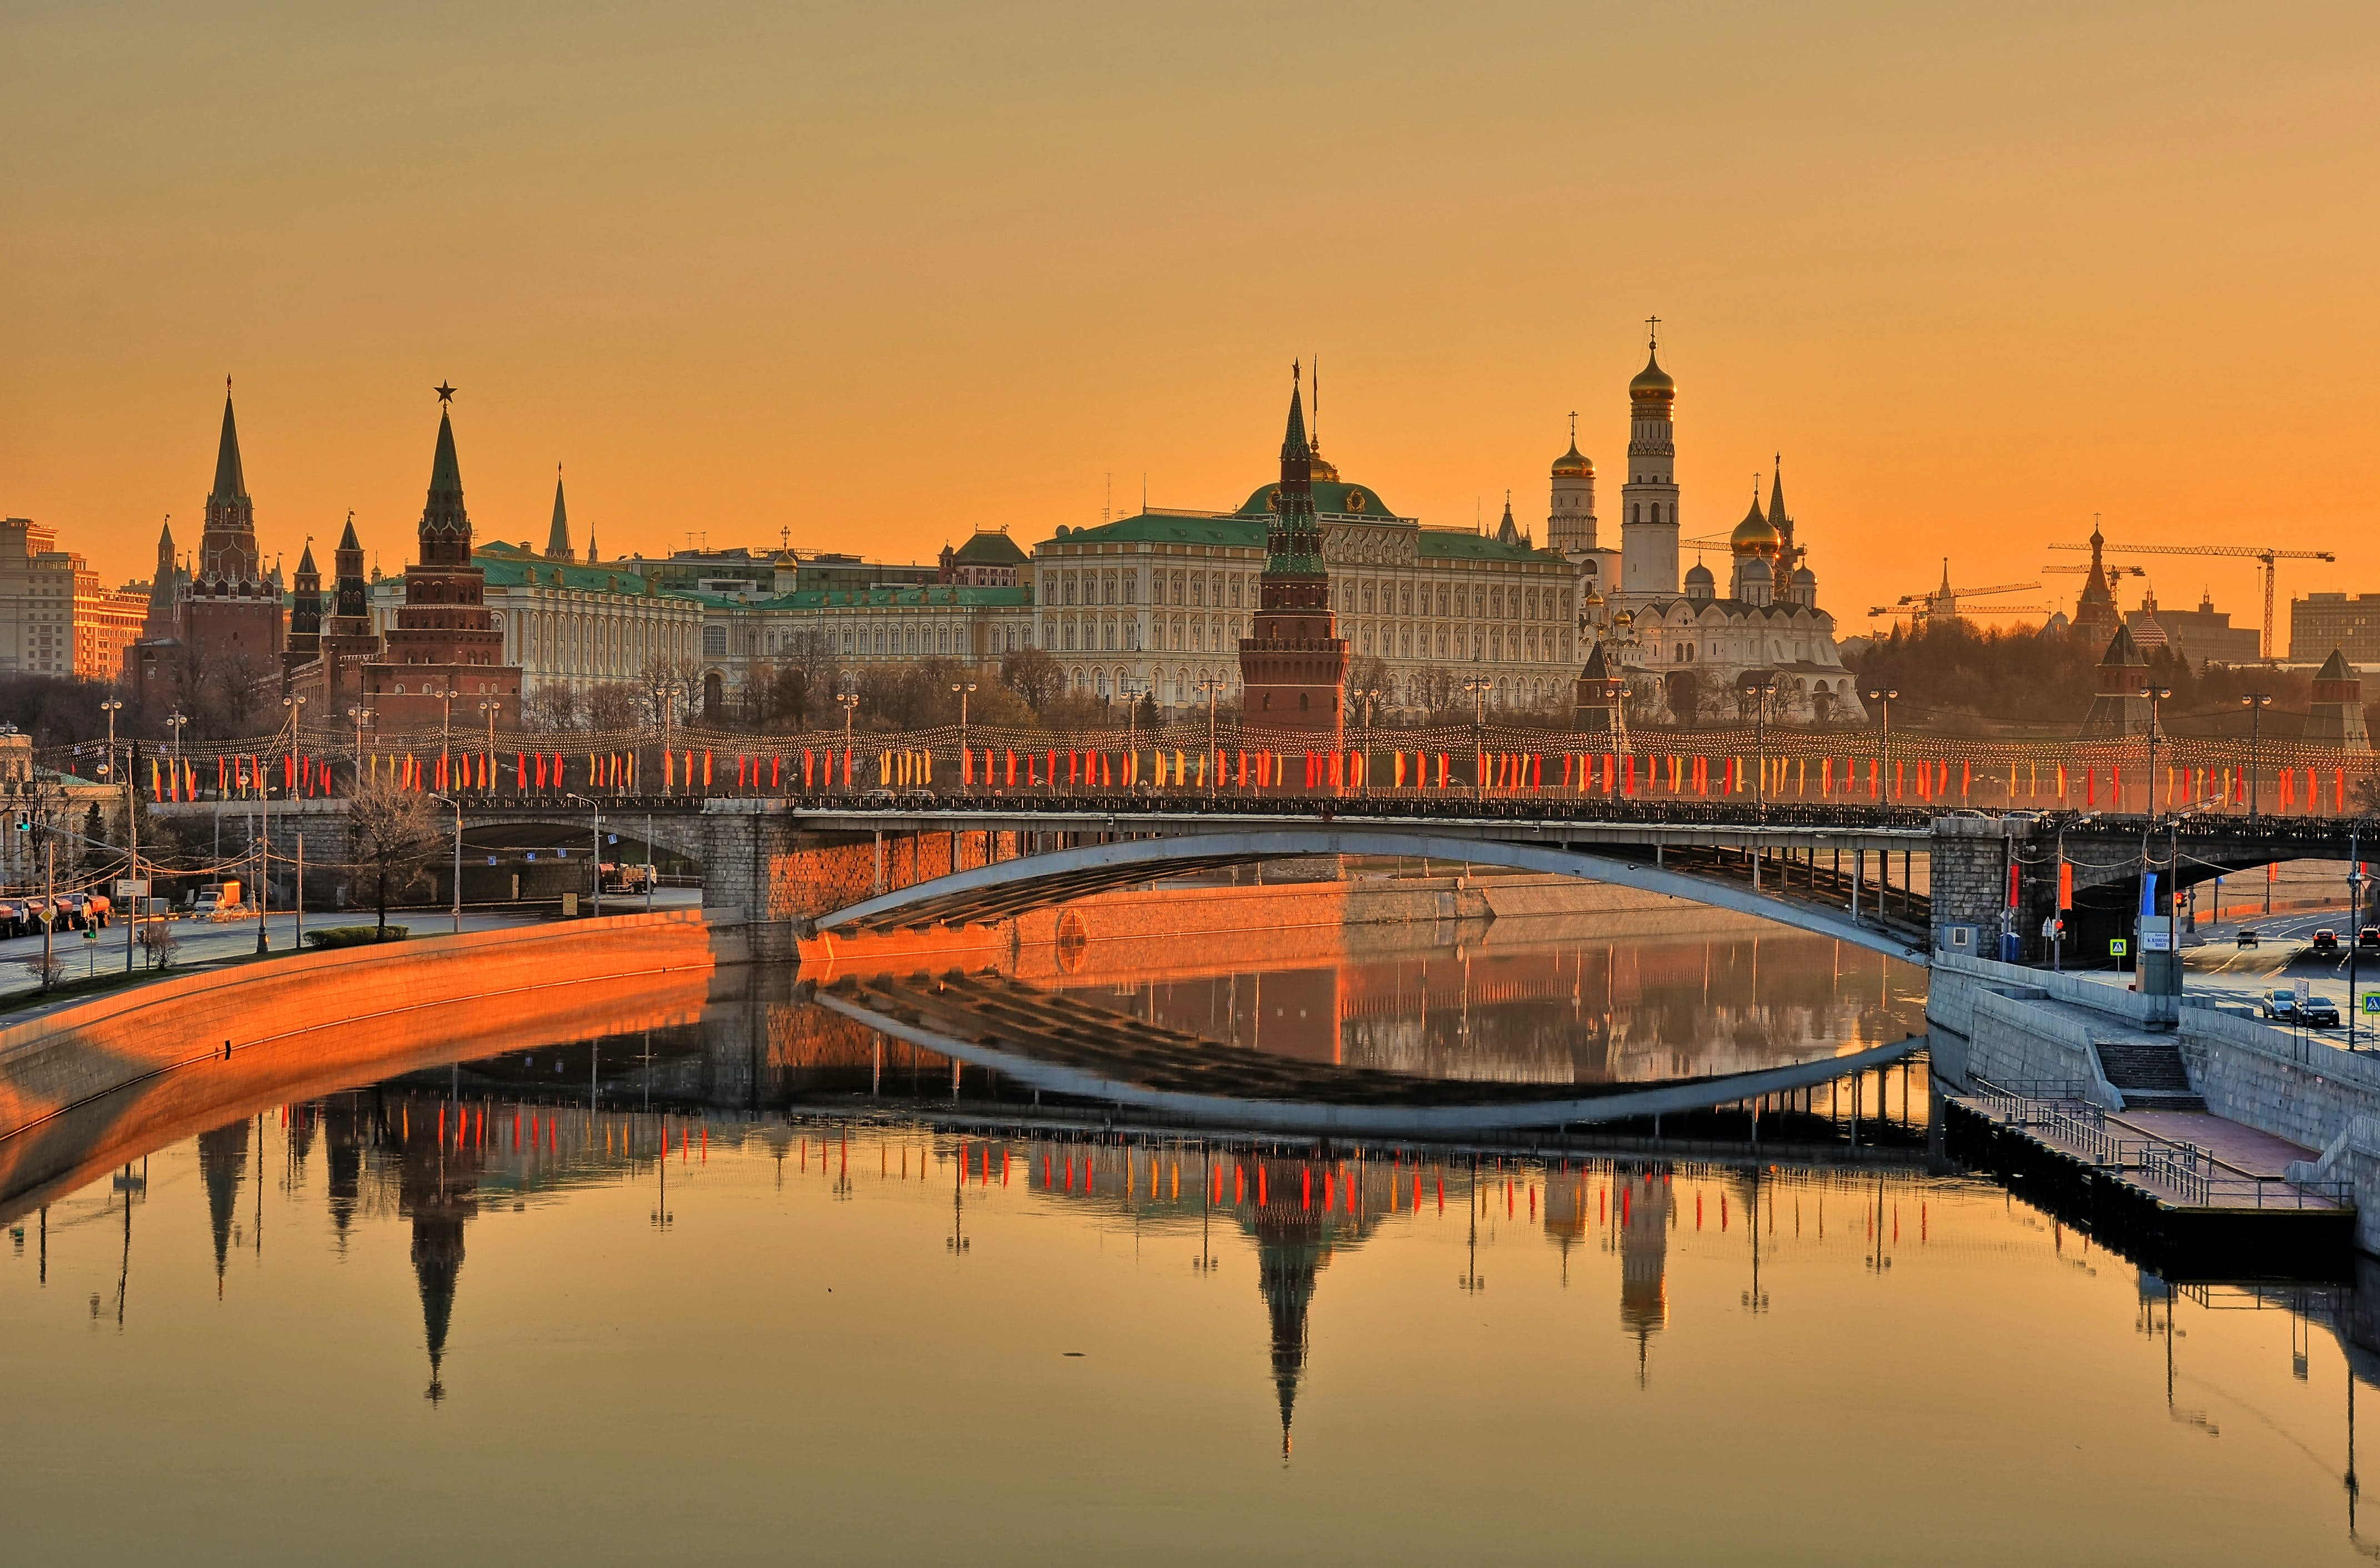
Russia-Ukraine Conflict Problem at hand
Immense amount of social media data:
60,000 useful Tweets and Telegrams since the start of conflict
Exponentially more raw social media out there
Dangerous situations for journalists in Ukraine and Russia
Recently jailed Wall Street Journal reporter in Moscow¹
1 https://www.cnn.com/2023/03/30/business/wsj-journalist-arrested-russia/index.html
https://cdn.britannica.com/18/194818-050-E7A7A993/view-Kiev-Ukraine.jpg
https://lp-cms-production.imgix.net/2023-03/500pxRF_61786861.jpg

Slide 3

A Helpful Solution
Built a Machine Learning model that:
Takes vetted, located social media posts
Clusters them into seven unique clusters
Displays via an interactive web app
Repeatable and customizable
Help your coverage:
Saves time by filtering relevant social media posts for you
Narratives for each cluster have already been generated and analyzed
Worldwide focused, regularly updating and robust dataset

Slide 4
How the Model Works (generally)
Gathers the data from five non-profit geolocation groups (Bellingcat, Ceninfores, Texty.ua, Defmon, Geoconfirmed)
Analyzes the text of the social media posts for relevance and importance of words within the entire dataset
Creates seven unique clusters to assign the social media posts to
Classifies new posts into one of these seven clusters
https://ukraine.bellingcat.com/
https://texty.org.ua/projects/107577/under-attack-what-and-when-russia-shelled-ukraine/
https://eyesonrussia.org/
ttps://geoconfirmed.azurewebsites.net/
https://www.scribblemaps.com/maps/view/2022051301800/nBT8ffpeGH
https://pypi.org/project/osint-geo-extractor/

Slide 5
Clusters
Russian Movements and Activities
Global Russian and Ukrainian Activities
The Siege of Mariupol
The Destruction Cluster
Ukrainian Positions and Activities
Battle for Bakhmut
Satellite Imagery
Learn more about the clusters at this site here!
Successful
Saving Throw!
Failed
Saving Throw
https://extracting-and-clustering-posts-webapp.onrender.com/

Slide 6
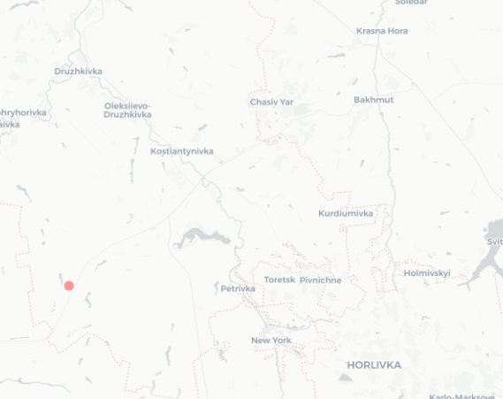
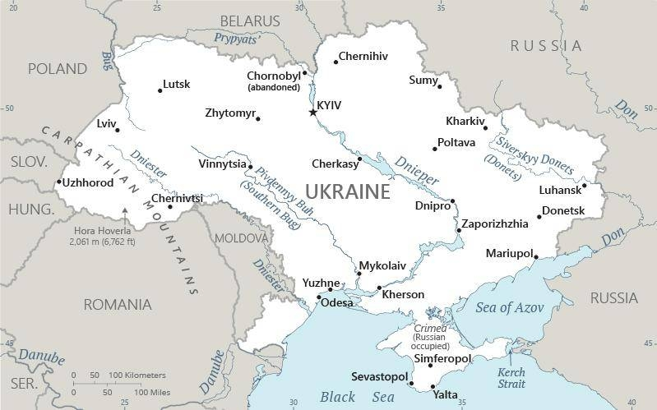
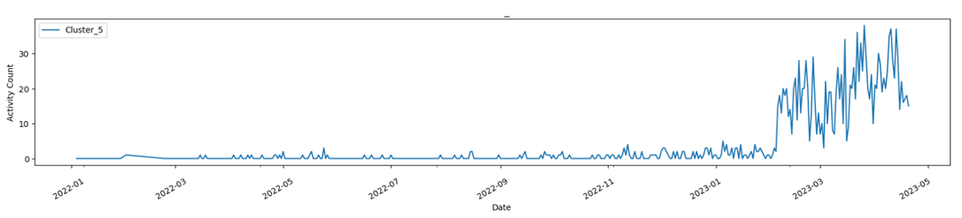
An Example: Battle for Bakhmut
Bakhmut, Donetsk Oblast, Ukraine
Not much coverage from social media, until Russia focused on taking the city in January 2023
Social media activity may be indicative of a spike in conflict
Tipping you off for stories, with an already extracted, vetted social media dataset to use
Potential time saver while still allowing for good journalism coverage
Average geolocation
of social media post
Battle for Bakhmut
Mapbox CartoDB basemap
https://www.cia.gov/the-world-factbook/static/18b651e66c4b2afa661be723ebd65029/9eab2/UP-map.jpg

Slide 7
Application Demo
Live site: https://extracting-and-clustering-posts-webapp.onrender.com/
Prototype Prediction model for local demonstration

Slide 8
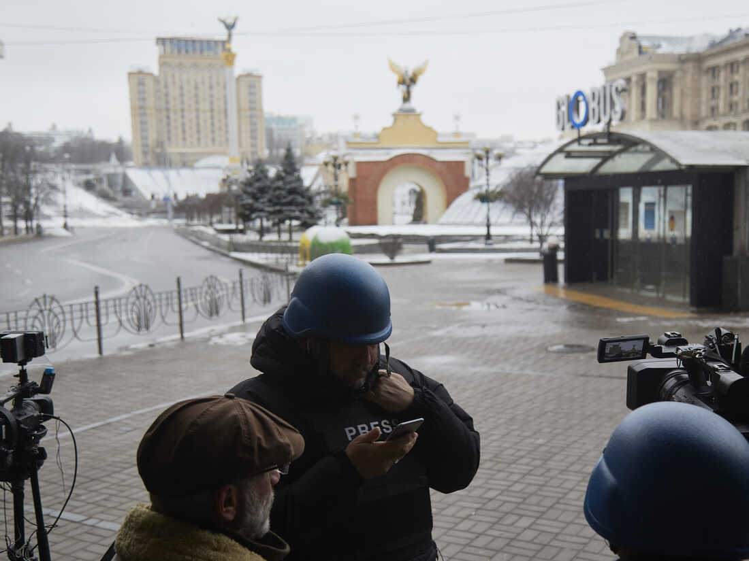
Future Work for AP
With a partnership opportunity:
Collect more social media data from sources
Fine tune model using your requested inputs
Provide method to upload file of tweet texts, for batch classification
Generate readouts of social media activity for each cluster on a recurring basis
https://media.npr.org/assets/img/2022/05/10/gettyimages-1238853212-74df85ecc2ac5c1e2d312cf9b79d54c79d43899e-s1100-c50.jpg

Slide 9
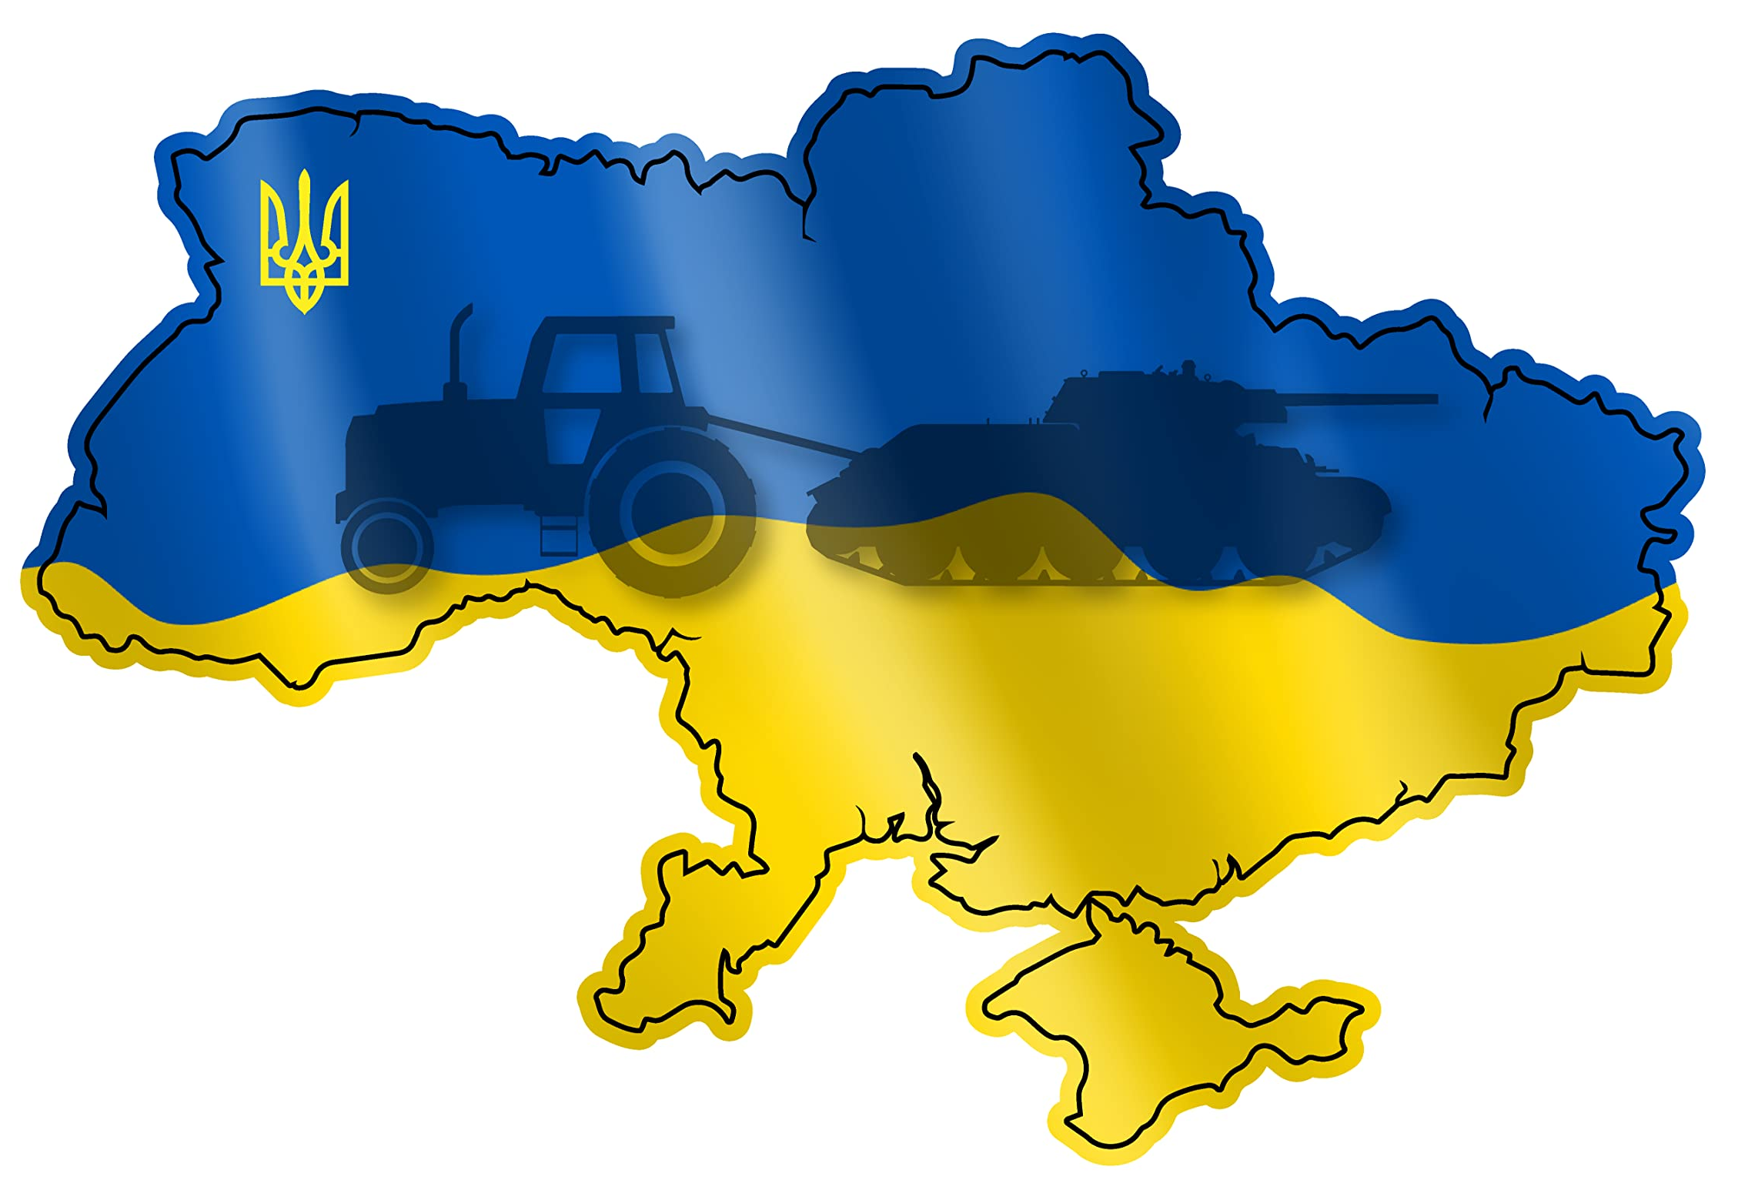
Thank You
Adam Miner
https://m.media-amazon.com/images/I/71Ip6ODc70L.jpg

