Slide 1

DAB – 103: Project Submission- part 1
Section: 0001
Windsor Miners – Let's dig some Data...

Slide 2
Project Proposal

Slide 3
Counter Strike: Global Offensive
The Game:
Counter-strike is a FPS (First-Person Shooter) game in which two teams of 5 players face each other in a matchup. The game include a Terrorist side (T) that is tasked to plant a bomb and have it detonate, and a Counter-Terrorist side (CT) that is tasked to defuse the bomb or prevent it from being planted. The game of Counter-Strike is a best of 30 rounds, the winning team being the first to win 16 rounds. The 30 rounds are played in two halves of 15 on each side of the map. There are 7 maps in the map pool that are available to be played competitively at any given time. Matches are normally played as a 'bo3' (Best of 3) maps, with finals often played as 'bo5’s. Counter-strike has an economic system that governs the acquisitions of armour, weapons and grenades by the players.
Motivation:
Online gaming world is full of FPS games, with CS:GO being one of the most sorted out game by online players. Most players (old or new) try to get along on the platform and try to hone their skills (both offensive and defensive) by playing competitive matches. But the other side of the story is that CS:GO platform has the highest drop out rate for new online gamers. With the game and maps becoming more and more competitive and complex it becomes extremely difficult for a new gamers to keep on going on the platform after certain time on the platform.
Problem Statement:
New online gamers need upfront guidance and insights for starting their online game journey. These insights can help the gamers to choose better maps, learn from top players/teams and use strategies (economic) that can raise their own interest in this complex gameplay. Eventually the gamer can perfect his own style of gameplay (offensive or defensive) by learning or copying from the very best around on the circuit.

Slide 4
Counter Strike: Global Offensive – contd.…
Project Proposal:
The team will take a descriptive analysis approach in which team will try to develop an analytic product to examine the data related to Players, Teams, Maps and Matches of the old CS:GO data. This data can help out new online gamers to gain insights related to the past trends of the game which can help them to gain strategic edge while starting their new online journey. The new gamers will be direct beneficiaries of the analytic trend data along game creators who will be benefitted indirectly by getting the benefits of better retention percentage of new gamers.
The analysis will try to give answers to some of the below few questions:-
Which map get the most picked with high number of kills per round?
Which are the top players in an event and can decided awards for MVP?
How to save economy in game to maintain a good inventory?
Where to start and what approach to take on a certain map?
Dataset Description:
Analysis is based on the dataset of CS:GO data between 2015 and 2020.
Base data is collected from Link and some new data will be added related to inventory and economic.

Slide 5
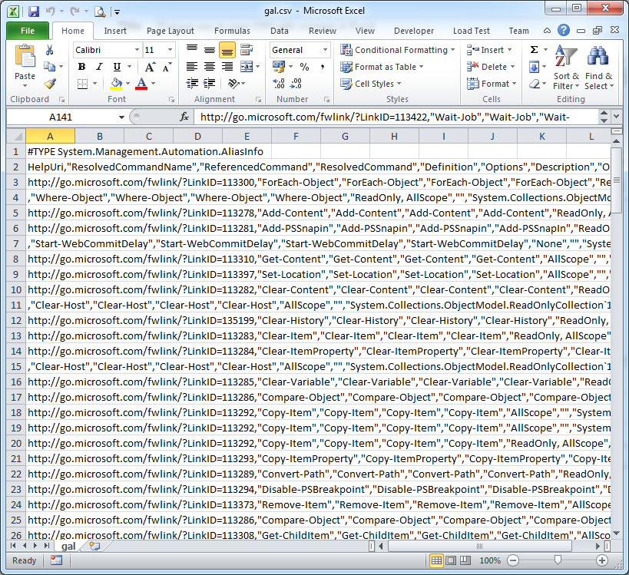

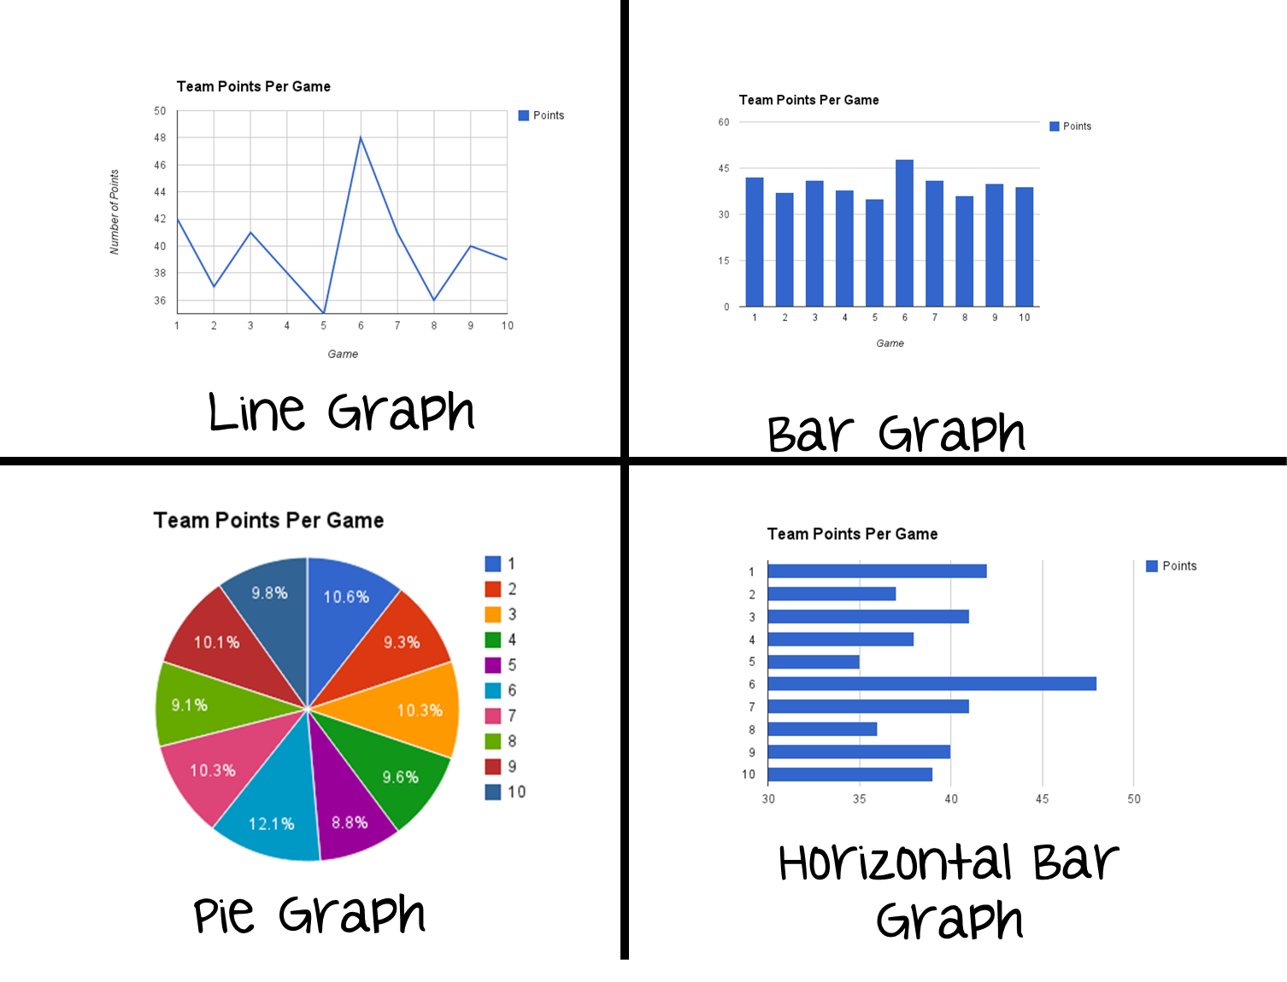

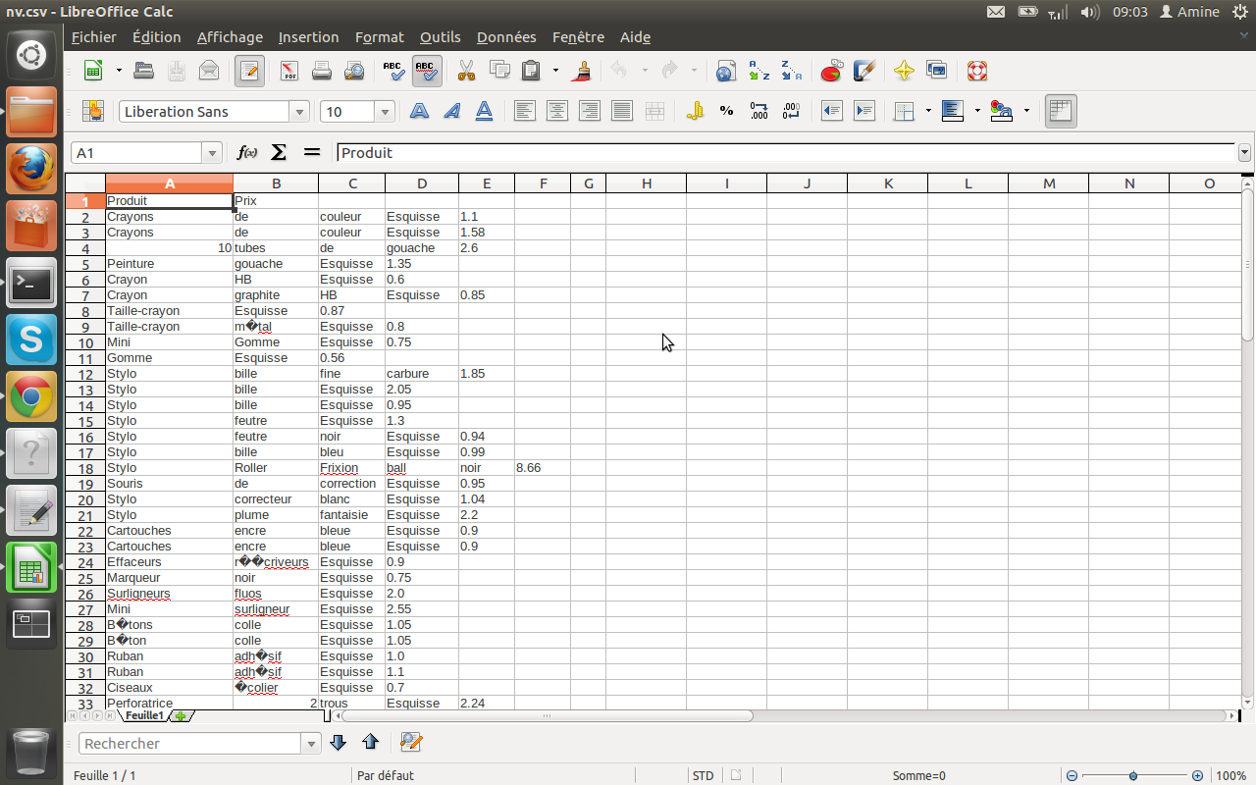


High level Flow
Source Data Analysis (EDA)
Base Data
Data Clean-up
In Progress
Data Transformation
Reference Data

Slide 6
EDA Analysis

Slide 7
EDA Analysis: Players.csv

Slide 8
References

Slide 9
Data set: CS Go Professional Matches
https://www.kaggle.com/mateusdmachado/csgo-professional-matches?select=players.csv
Short Description:
Counter-Strike Global Offensive is a multiplayer online video game released in 2012. The game popularity is shown in numbers recently, as CS:GO reached in March its all-time high concurrent players (1.1M players), making it the most played game on Steam.
The data is split into 4 tables that store data related to:
Results.csv: map scores and team rankings
Picks.csv: order of map picks and vetoes in the map selection process.
Economy.csv: round start equipment value for all rounds played
Players.csv: individual performances of players on each map.
Pros:
Very few Blank data columns so less data cleaning effort
All type of columns in data (numerical, strings and date)
Defined Ids and relationships
Cons:
Repetitive data between sheets – maps/teams
Similar columns names like ratings for players and teams
Probable project Idea
If someone is a new gamer, one can analyse and use the data (using graphs and plots) of the past to find out better Map picks for starting games, strong teams on certain maps, cheaper and better equipment for the players to start their online game journey. Players can find out the ratings for teams over time and predict if they want to join the team or play against them. The data can also be used to predict match winners for the upcoming matches by looking at the past trend and team’s performances.

