Slide 1
AIVac
Justin

Slide 2
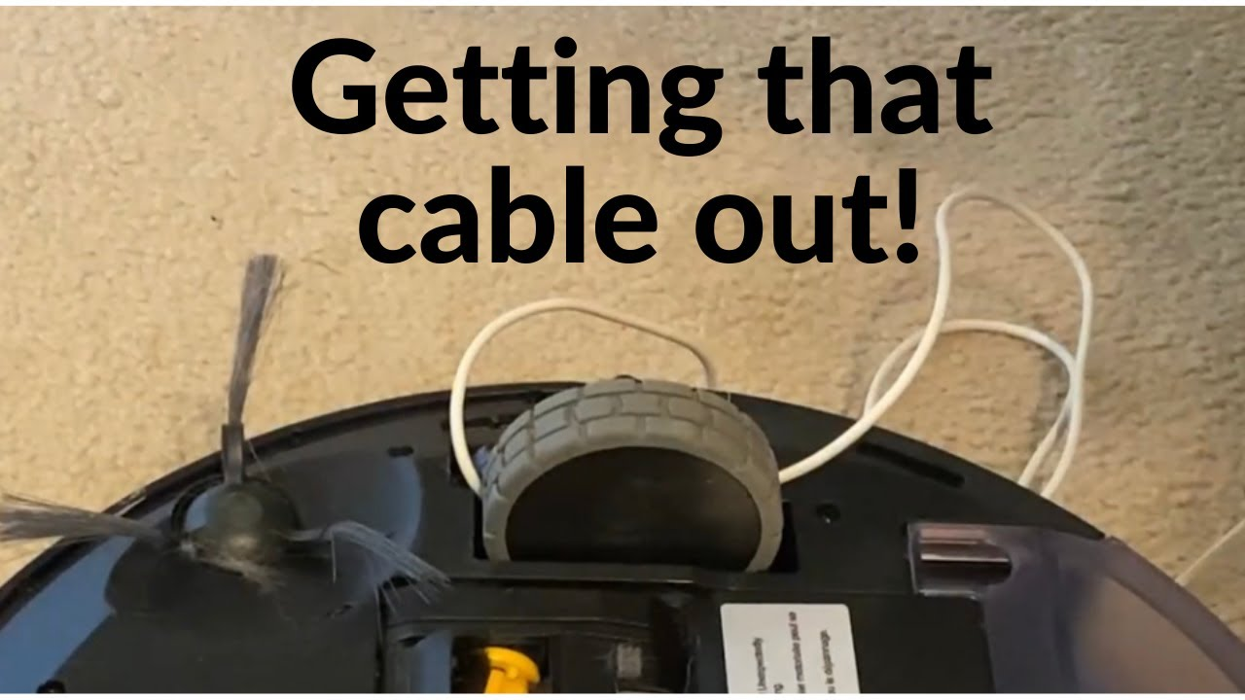
The Problem
Traditional robot vacuums rely solely on LIDAR (Light Detection and Ranging) or bump sensors. They can map walls, but they blindly run over small, complex obstacles like charging cables, socks, or poop, causing damage to the robot or the home.

Slide 3
Solution
Integrate a lightweight Machine Learning model (TensorFlow Lite) via a front-facing camera.
Before the vacuum approaches an area, the camera scans the floor. If it identifies a "high-risk" small object (like a phone charger), it dynamically overrides the ROS (Robot Operating System) navigation stack to establish a "no-go" zone around that specific object.

Slide 4

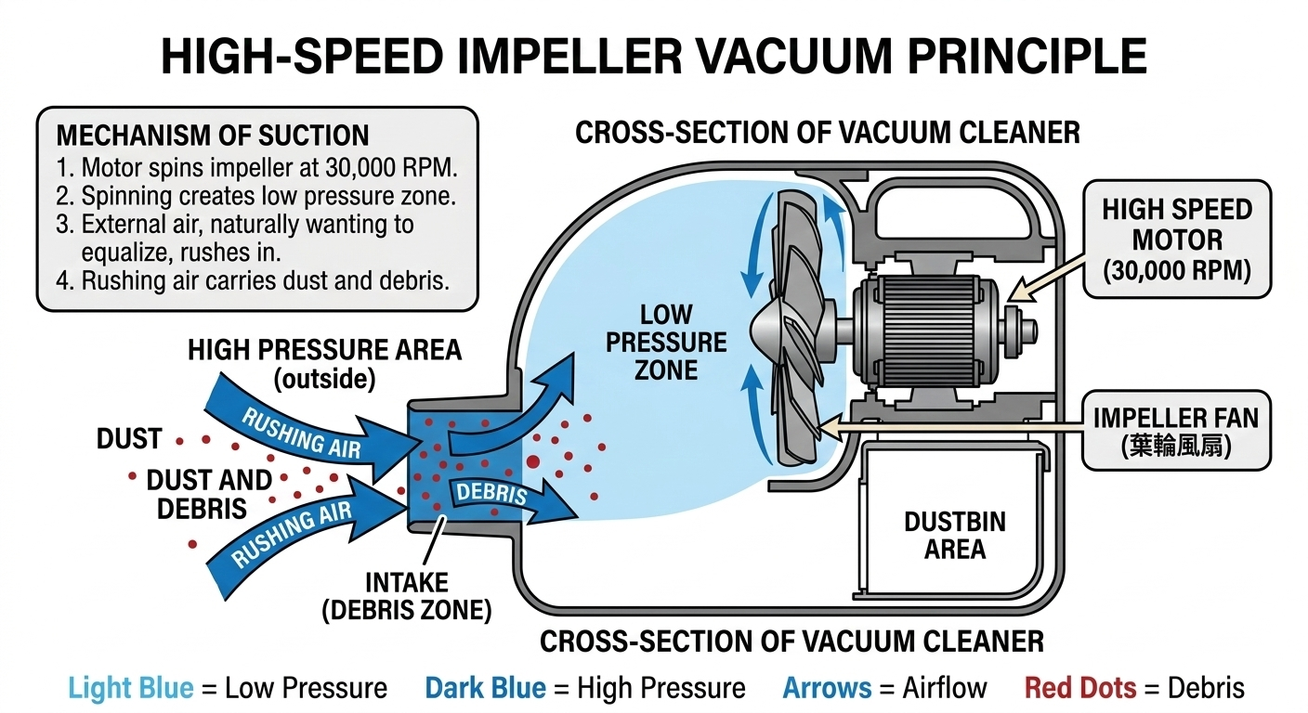
How does a vacuum work?
A high speed motor spins an impeller fan(葉輪風扇) at high speeds around 30,000 RPM. This spinning fan creates a low pressure zone inside the dustbin area. As nature naturally wants to equalize pressure, air from the higher pressure areas( the areas where you want to suck up the debris) rushes in to equalize the low pressure area, carrying dust and debris with it.

Slide 5
System Architecture
High Level Brain: Raspberry Pi 4
ROS navigation
LiDAR mapping(SLAM)
Running the AI vision model
Low-Level Controller: Arduino Mega
Receives velocity commands from the Pi
Converts to electrical pulses for the motors
Sensors:
2D Mini LiDAR - for room mapping
Raspberry Pi Camera Module V2 - AI object detection

Slide 6
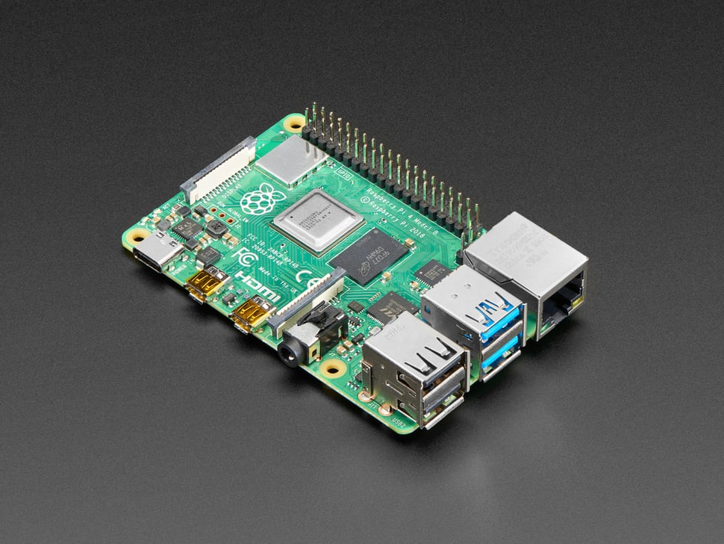
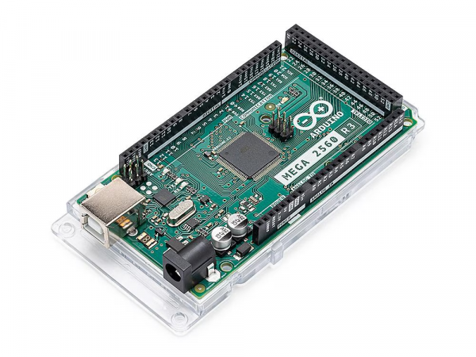
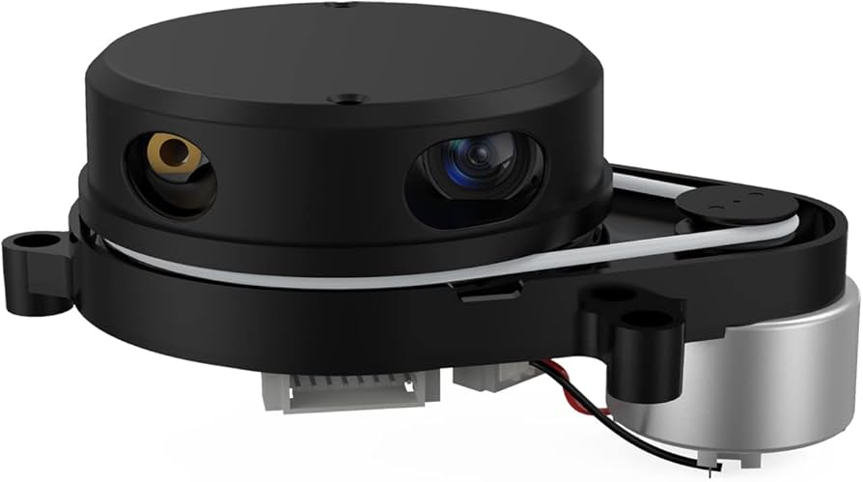
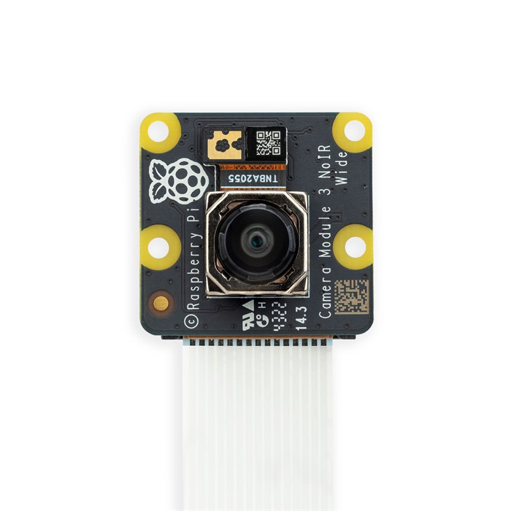
Bill of Materials
Computing and Control:
Raspberry Pi 4(4GB)
Arduino Mega 2560
Sensors:
360-degree LIDAR scanner
Raspberry Pi Camera Module 3 NoIR 120 degree

Slide 7
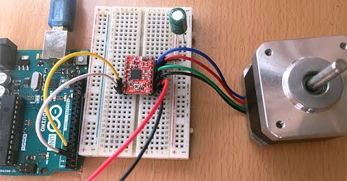
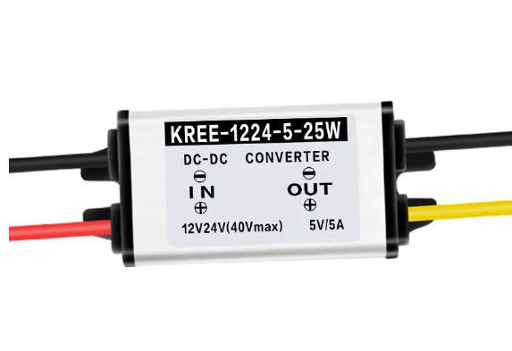
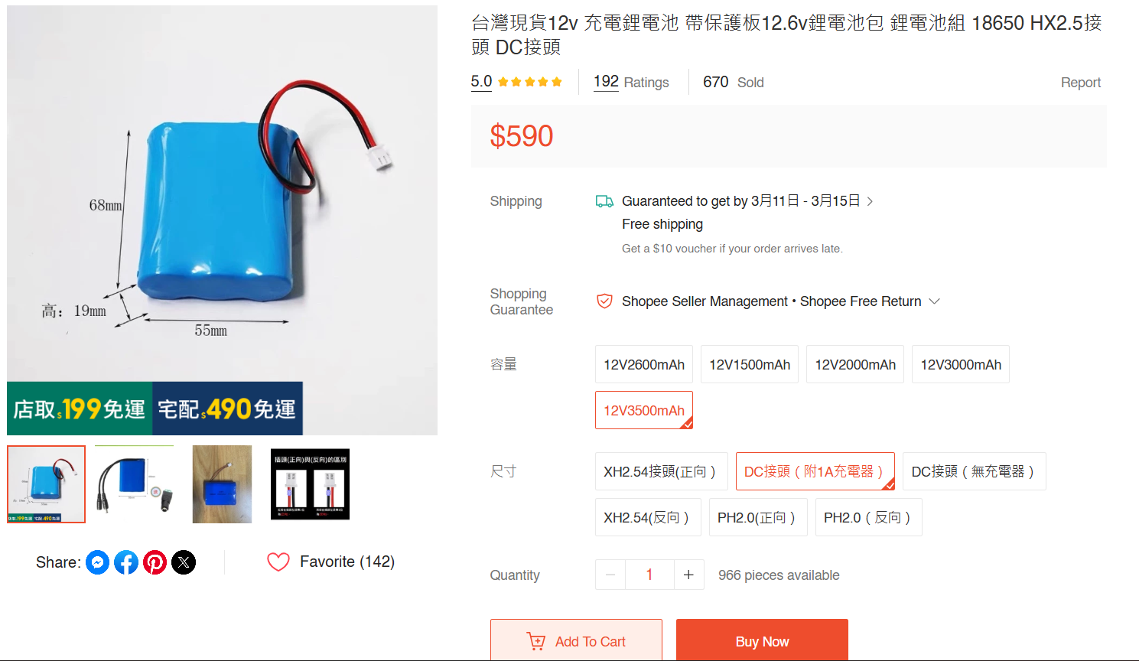
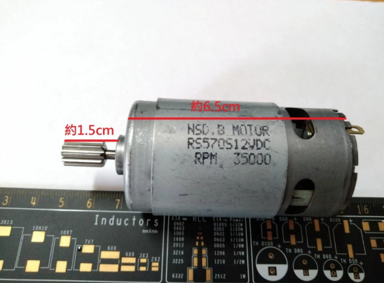
Bill of Materials
2x NEMA 17 Stepper Motors
2x A4988 Stepper Motor Drivers
2x Rubber Wheels( with 5 mm converters for Nema motors) and 1 front caster wheel
Power System:
12V Lithium-Ion Battey Pack(3500 mAh)
5V/5A Buck Converter
Chassis & Vacuum
(MDF(Medium density Fiberboard) or 3D printed PETG)for the base
High RPM DC Motor
Impeller fan
DIY dustbin

Slide 9
Development Roadmap
Phase 0(Design): Order parts, design cad, some more further planning
Phase 1 ( Hardware & Kinematics): Cut chassis, mount motors, establish basic remote control movement using Arduino
Phase 2 (ROS & Mapping): Connect Raspberry Pi, configure the ROS navigation stack, and get the LiDAR to generate a 2D map of a room
Phase 3 (AI): Train a basic object detection model using images of cables and socks and things you wouldn’t want the robot to suck up by accident. Mount the camera and test the accuracy of the detection system
Phase 4(Integration & Vacuum): Merge the AI data with the ROS navigation map. Install vacuum and dustbin

Slide 10
Anticipated Challenges
Odometer Drift: Over time, wheels can slip, which can lead to inaccurate positioning, and the robot will lose track of where it is.
Potential Solution: Rely on LiDAR scans continuously correct the robot’s location.
Weak Suction: The DC motor may not be strong enough to pick up the dust and hair on the floor.
Potential Causes:
Since air is lazy and will always take the path with the least resistance, if there are any tiny gaps then the impeller fan will pull air through the gap rather than from the floor.
  Add silicone rubber seals
  Compress the dustbin against the impeller fan design to make it airtight

Slide 11
Resources and references
https://www.youtube.com/watch?v=n8C8cyyUXuY

