Slide 1
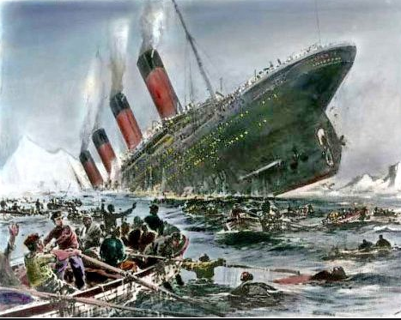
Titanic Survival Model

Slide 2
Model Population and Target Definition
Target definition:
Passengers that survived in Titanic
Target Value:
1 = Passengers survived
0 = Passengers did not survive
Cohort Population:
891 passengers that boarded Titanic
Survival Rate:
38.4%

Slide 3
Model Iterations
- Preliminary model
Initial characteristic analysis identifies a set of strong characteristics that should be considered for final model.
At the preliminary stage, various predictive modeling techniques can be used to select a set of characteristics that, together, offer the most predictive power. Some of the techniques used in the industry are decision trees, random forest , gradient boosting machine etc. In general, the final model produced in this stage should consist of between 8 and 15 characteristics. This is done to ensure a stable scorecard whose predictive powers will be strong even if the profile of one or two characteristics were to change. Model with too few characteristics are generally unable to withstand the test of time, as they are susceptible to minor changes in the customer profile.
We have used Random Forest/Gradient Boosting machine technique to produce the model consisting of the optimal combination of characteristics, taking into account issues such as:
• Correlation between characteristics
• Final statistical strength of the model
• Interpretability of characteristics
• Transparency of methodology for regulatory requirements

Slide 4
Feature Creation and Selection
Initial characteristic analysis
Generate basic statistics (Mean, Median, Mode, Missing % etc.) for numeric variables
Generate distribution report for categorical variables
Finally create a summary report combining the above two
Data preparation
Variable reduction
Drop variables with high missing % and no variation
Calculate Information Value (IV) for the remaining set of variables
Identify variables which are above the threshold value IV
Run variable clustering with the potential set of variables from the previous step
Run a stepwise regression within each cluster and identify the significant ones
Accumulate the significant variables from each of the cluster and create an exhaustive list
Variable visualization/ trend
Split each of the variables into bins
Plot response rate vs. population percentage by each bin
Check trend of the variables whether it’s going with the business trend or not

Slide 5
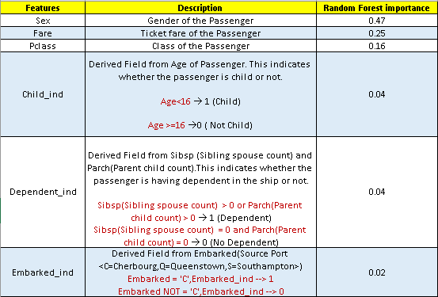
List of Promising Variables

Slide 6
Model Comparison
Statistical Model Comparison
The Following classification models have been executed and performance metrics of each of the model have been compared to identify the best model.
Decision Tree Classification: Decision Tree Classifier uses a decision tree to go from observations about an item to predict the target variable.
Random Forest Classification :The Random forest classifier consists of multiple decision trees and it uses bagging and feature randomness when building each individual tree to try to create an uncorrelated forest of trees, whose prediction by committee is more accurate.
Gradient Boosting Machine(GBM) Classification :Gradient Boosting Machine classifier produces a prediction model in the form of an ensemble of weak prediction models, typically decision trees. It builds the model in a stage-wise fashion like boosting methods and generalizes them by allowing optimization of an arbitrary differential loss function.
Development Performance Metrics | Decision_Tree | Random Forest | Gradient Boosting Machine
Accuracy | 88.44% | 85.39% | 91.65%
Recall | 81.81% | 75.20% | 86.77%
Precision | 87.61% | 85.44% | 91.30%
F1_Score | 84.61% | 80.00% | 88.98%
Confusion Matrix | [[353 28] [ 44 198]] | [[350 31] [ 60 182]] | [[361 20] [ 32 210]]
Validation Performance Metrics | Decision_Tree | Random Forest | Gradient Boosting Machine
Accuracy | 83.95% | 80.97% | 84.32%
Recall | 75.00% | 71.00% | 80.00%
Precision | 80.64% | 76.34% | 78.43%
F1_Score | 77.72% | 73.57% | 79.20%
Confusion Matrix | [[150 18] [ 25 75]] | [[146 22] [ 29 71]] | [[146 22] [ 20 80]]

Slide 7
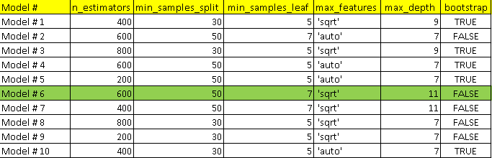
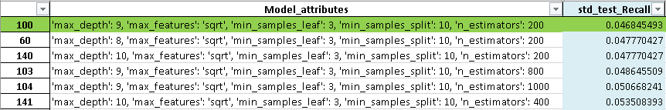
Hyper Tuning - Parameter Optimization
Random Search Cross Validation
This Implements a “fit” and a “score” method. It tries out a random hyper-parameter combinations from the fixed number of parameter settings to build different random forest models. These random selected hyper-parameters are optimized by the cross-validation search techniques.
Grid Search Cross Validation
This Implements a “fit” and a “score” method. It tries out all hyper-parameter combinations from the fixed number of parameter settings to build different random forest models. The hyper-parameters are optimized by the cross-validation search techniques.

Slide 8
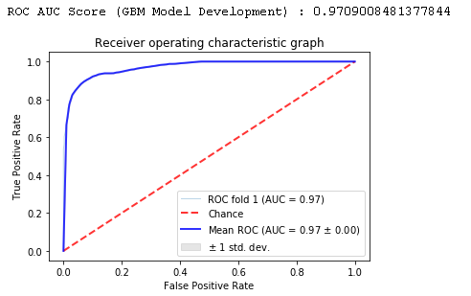
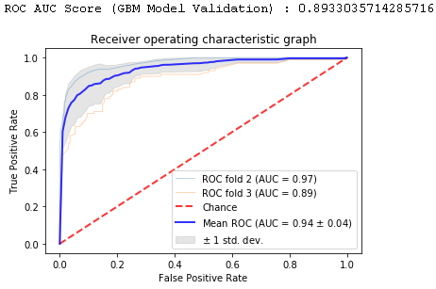
Model Performance : Gradient Boosting Machine
Development
The Cohort Population has been split into Training and Test data based on the ratio 70:30 respectively. The Gradient Boosting Machine model has been build on the Training Data and validated on Training(development) sample.
In Time Validation
The Cohort Population has been split into Training and Test data based on the ratio 70:30 respectively. The Gradient Boosting Machine model has been build on the Training Data and validated on Test sample.
Development Performance Metrics | Gradient Boosting Machine
Accuracy | 91.65%
Recall | 86.77%
Precision | 91.3%
F1_Score | 88.98%
Confusion Matrix | [[361 20] [ 32 210]]
Validation Performance Metrics | Gradient Boosting Machine
Accuracy | 84.32%
Recall | 80%
Precision | 78.43%
F1_Score | 79.2%
Confusion Matrix | [[146 22] [ 20 80]]

Slide 9
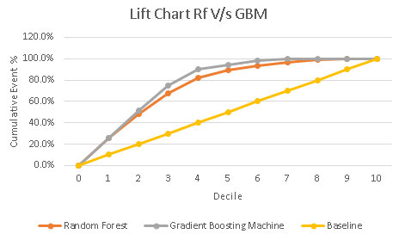
Lift Chart
Lift Chart
Lift is a measure of the effectiveness of a predictive model calculates as the ratio between the results obtained with and without the predictive model

Slide 10
Appendix

Slide 11
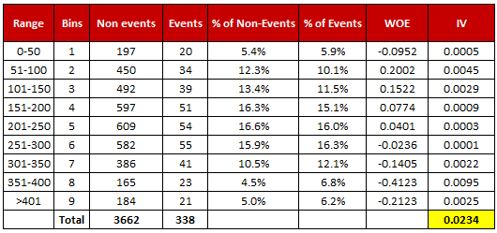
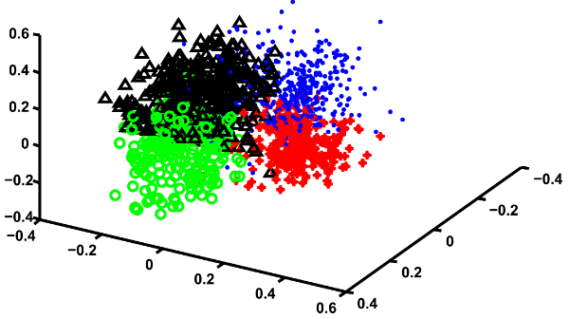
Basic Concepts
Information Value (IV)
Information Value measures the predictive power of the characteristic.
One rule of thumb regarding IV : WOE = In(% of non-events ➗ % of events)
• Less than 0.02: unpredictive
• 0.02 to 0.1: weak
• 0.1 to 0.3: medium
• 0.3 +: strong
Variable Clustering
When there are hundreds of variables that can be used to create model, it becomes difficult to determine
the correct relationships between variables. Some of the variables are highly correlated with one another.
In order to speed up the modeling process, the predictor variables should be grouped into similar clusters.
A few variables can then be selected from each cluster basis of their predictive power.
Variance Inflation Factor (VIF)
VIF of a predictor tells you what percentage of the variance is explained by other predictors.
A rule of thumb for interpreting the variance inflation factor:
1 = not correlated
Between 1 and 2 = moderately correlated
Greater than 2 = highly correlated
IV = ∑ (% of non-events - % of events) * WOE

Slide 12
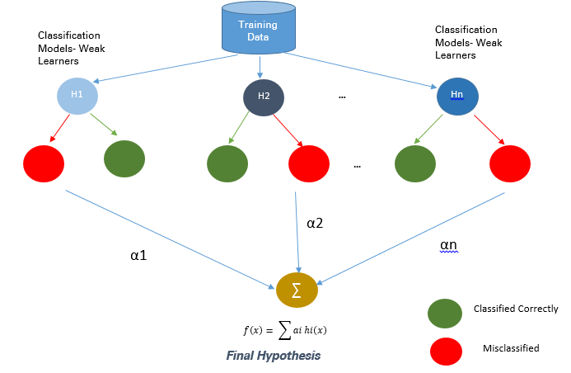
Introduction to the Gradient Boosting Algorithm
Gradient boosting is one of the most powerful techniques for building predictive models
How Gradient Boosting Works
Gradient boosting involves three elements:
A loss function to be optimized.
2. A weak learner to make predictions.
3. An additive model to add weak learners to minimize the loss function.
Improvements to Basic Gradient Boosting
Gradient boosting often over fits the model thus the regularization methods
Become important to improve the performance
Four ways to enhance the basic gradient boosting
1. Tree Constraints
2. Shrinkage
3. Random sampling
4. Penalized Learning

