Slide 1
TFS Finance Basic Training Tutorial

Slide 2
Syllabus
Business Overview
Assets & Revenue
Funding Sources & Interest Expense
Credit & RV Losses
Operating Expenses
Insurance

Slide 3
Business Overview

Slide 4

Stakeholders Analysis
TFS generates income by providing finance and insurance solutions to consumers and dealerships in the United States.
Capital Markets
Corporations
Sovereign Gov’ts
Investment Pools
Dealers
Toyota Family
TMC, TFSC
TMS, TEMA, TMA
TMCC
Suppliers
Buyers
Cash
Banks & Credit Unions
Insurance Companies
Direct Lending
Alternative Mobility
Individual Consumers
Dealers
Competition

Slide 5
US Toyota Entities
Toyota Motor Engineering & Manufacturing (TEMA), headquartered in Erlanger, Kentucky, is responsible for Toyota's engineering design and development, R&D, and manufacturing activities in the U.S., Mexico and Canada. In 14 manufacturing locations across North America, team members are producing 12 vehicles including the Avalon, Camry, Corolla, Highlander, Matrix, RAV4, Sienna, Sequoia, Tacoma, Tundra, Venza and the Lexus RX 350. Our newest plant, where we build the Corolla, opened in Blue Springs, Mississippi in November 2011.
Toyota Motor Sales (TMS). Toyota’s U.S. sales and marketing arm, oversees sales and other operations in 49 states. TMS regional offices coordinate Toyota and Scion vehicle sales, parts and service for dealers in ten regional areas, with two additional regions being served by private distributors. Of the nearly 1,500 Toyota dealers located throughout the U.S., 1,002 are authorized to sell Scion vehicles.
The Lexus Division directs sales and operations for 232 Lexus dealers located throughout the U.S. through four area offices.

Slide 6
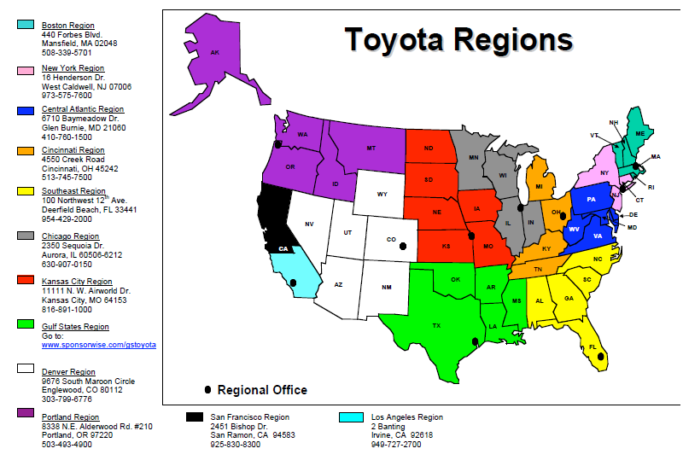
TMS US Regional Map

Slide 7










Top US Dealer Groups

Slide 8
Value Drivers
Auto Market
Incentive Spend
Consumer Behavior
Interest Rates
Capital Markets
Capital & Cost Structure
Tax Rules
Toyota Share
Used Car Market

Slide 9
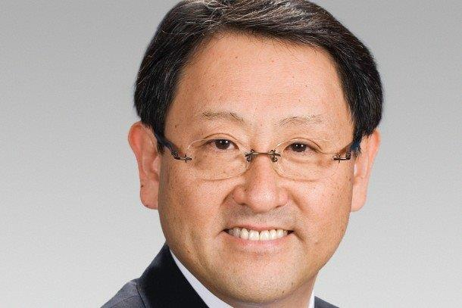

TFS within the Bigger Toyota Picture
TMC (Akio Toyoda)
TFSC (Yoshimasa Ishii)
Americas
USA | Venezuela
Puerto Rico | Mexico
Canada | Argentina
Brazil
Europe / Africa
Germany | Czech
UK | Denmark
Finland | Hungary
Italy | Spain
Norway | Slovakia
France | Russia
Sweden | Kazakhstan
Poland | Netherlands
South Africa
Asia / Pacific
Australia | China
New Zealand | Korea
Thailand | Indonesia
Malaysia | Vietnam
Philippines | India
Taiwan | Japan

Slide 10
TFS Functional Organization Chart
*Mike Groff, CEO
*Mike Wells, GVP
*Chris Ballinger, SVP
David Christ, VP
Karen Ideno, VP
Dave Crandall, VP
*Julia Wada, GVP
*Wei Shi, GVP
Ron Chu, VP
Sales
Marketing & Brand
Commercial Finance
Kim Cerda, VP
*Ron Guerrier, VP
Finance
(APPM & Treasury)
Finance
(Acctg & Tax)
Insurance
Finance Products
International Operations
Human Resources
Business Tech Solutions
Business Intelligence
Remarketing
Vendor Management
Japan Staff
*Kawai, EVP
*Ken Baruth, VP
*Katherine Adkins, VP
Ueno
*Al Smith, GVP
Risk Management
Legal
Ochiai
Paul Moss, VP
*Ann Bybee, VP
Dealer Credit
Enterprise Compliance
Oku
Service Operations
Corporate Strategy
Information Security
Privacy Compliance
*Management Committee

Slide 11
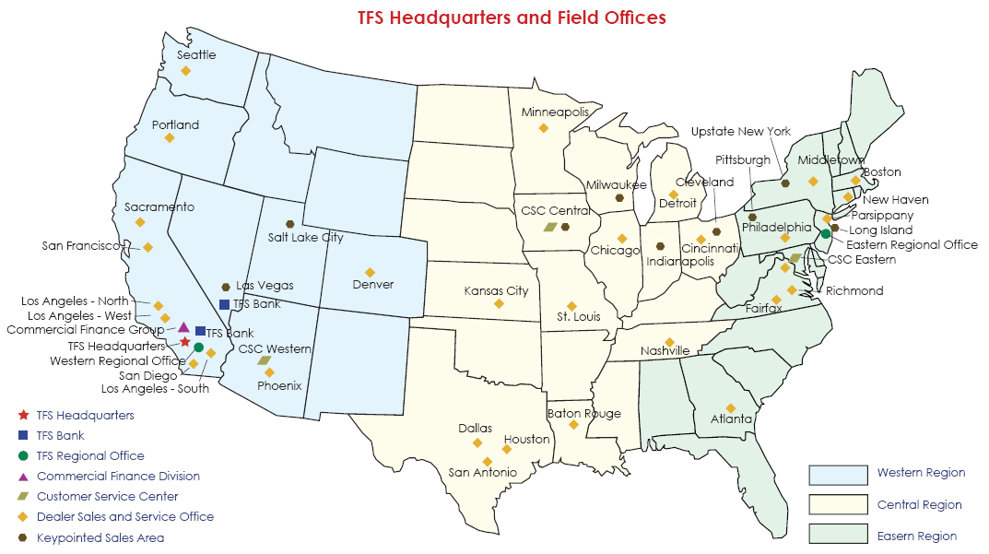
TFS Headquarters and Field Offices

Slide 12
Field Sales Organization Structure
Regional Manager
Regional Sales Manager
Regional Marketing Manager
Nat’l Dealer Lending Manager
Dealer Sales & Service Manager
Business Support Manager
Nat’l Regional Insurance Manager
F&I Product Managers
Business Marketing
Manager
Dealer Lending Manager
Dealer Services Operations Manager
Area Sales Manager
Pricing Analyst
Credit Supervisor
Credit Analyst
Contract Analyst

Slide 13
Financial Statements
Balance Sheet
Retail Earning Assets
Lease Earning Assets
Dealer Earning Assets
Investments
Liquidity
Total Assets
Commercial Paper
Term Debt
Secured Debt
Deferred Tax
Capital
Total Funding
Portfolio Interest Rate Hedges
Income Statement
Revenue, Net of Depreciation
Interest Expense
Gross Financing Margin
Credit Losses
Credit Loss Provision
Residual Value Losses
Residual Value Loss Provision
Insurance Margin
Operating Expense
Total Expenses
Operating Income
Core Earnings (Op Income + Provisions)

Slide 14
Financial Statements (continued)
Earning Assets (as of March 31, 2014)
Income Statement (as of March 31, 2014)

Slide 15
Asset & Revenue Overview

Slide 16
Consumer Revenue Overview
Stakeholders
Product Cycle
TMS sells vehicle to dealer (wholesale)
Dealer sells vehicle to consumer (sale)
Customer decides how to pay
TEMA manufactures vehicle
TEMA / TMS
Customer Options
 | Cash | Finance | Lease
Factors | Amount | Amount, Term, Interest | Amount, Term, RCF, RV
Competition | NA | Banks, Credit Unions | None
Incentives | -- | Some | Most
Consumer
Dealer

Slide 17


How does a contract get booked?
Stage 1
Stage 2
Stage 3
Customer
Dealership
Dealer F&I
TFS DSSO Credit Analyst
Dealership
TFS DSSO Contract Analyst
Customer agrees to terms of a purchase agreement of a vehicle with the dealership.
Customer submits a credit application to obtain FICO score and credit history (current and closed loans, delinquencies, revolving credit, etc.)
F&I Manager and Customer agree to terms of a financing agreement (Term, Rate, Amount) (NOTE DATE)
Customer drives away with a newly acquired car
Dealer F&I Manager submits deal to the local TFS DSSO and competitors
DSSO Credit Analyst processes and reviews the details of the deal in carLOS
DSSO Credit Analyst submits “Buy Rate” back to Dealer after considering
DSSO Rate Sheet
Subvention
Marketing Programs
Exceptions
Dealer Loyalty
Dealer profits on spread between “Buy Rate” and “Customer Rate”
Dealership delivers paper contract to local TFS DSSO or if it is an eContract then it is transmitted electronically
DSSO Contract Analyst processes final details of deal in carLOS before it is uploaded into TFS’ HOST system* (BOOK DATE)
(a) Retail → SHAW
(b) Lease → LEMANS
*Systems will be updated in next few years (CORE Receivables Project)
SHAW & LEMANS
Competition
Competitive Advantages
TFS | Banks
Distributor (subvention) & Dealer Relationships Leasing Programs | Cost of Capital (deposit base)

Slide 18
Summary of Transactions
TFS
Financing
Consumer
Promise to Repay & Collateral
Subvention Cash
Cash
Dealer Payout & Floor Plan Financing
Sale of Vehicle
TMS
Dealership
Wholesale of Vehicle

Slide 19

Finance Option
Payment Mathematical Formula
Payment Lifecycle
$Payment=$ $\frac{Loan Amount x Interest Rate}{1−{(1+Interest Rate)}^{−Term}}$
Loan Modeling in Excel
Payment Function
PMT=(Periodic Interest Rate, Term, -Loan Amount)
Principal Payment Function
PPMT=(Periodic Interest Rate, Period, Term, -Loan Amount)
Interest Payment Function
IPMT=(Periodic Interest Rate, Period, Term, -Loan Amount)
OR Beginning Balance x Periodic Interest Rate
Balance
Ending Balance = Beginning Balance – Principal Payment
Beginning Balance = Prior Period Ending Balance

Slide 20
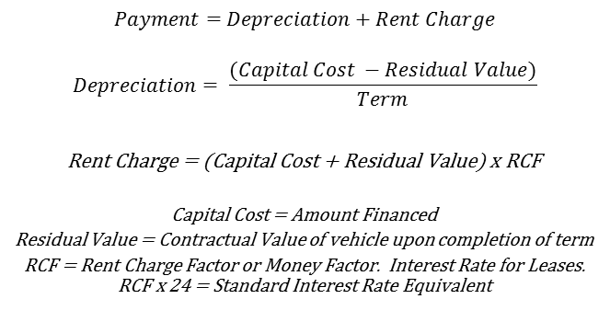
Lease Option
Payment Mathematical Formula
Deriving the Lease Payment
$Payment=$ $Depreciation+Rent Charge$
$$Depreciation= \frac{(Capital Cost −Residual Value)}{Term}$$
Rent Charge = (Capital Cost + Residual Value) x RCF
Capital Cost = Amount Financed
Residual Value = Contractual Value of vehicle upon completion of term
RCF = Rent Charge Factor or Money Factor. Interest Rate for Leases. RCF x 24 = Standard Interest Rate Equivalent
A lease payment can be viewed as 2 separate finance loans. One for the Depreciation and one for the Residual Value
Depreciation Loan: Principal is paid as if the loan is a 0% loan. Interest is paid on the lifetime average balance.
Residual Value Loan: Interest Only Loan.
EXAMPLE
Capital Cost = $25,000
Residual Value = $15,000 (60%)
RCF = 0.003 (7.2%)
Term = 36 months
Lease Payment = (($25,000 - $15,000)/36) + ($25,000 + $15,000)*0.003
Lease Payment = $398
1. Depreciation Loan Payment = ($10,000/36) + ($10,000/2*7.2%/12)
1. Depreciation Loan Payment = $308
2. Residual Value Loan Payment = $15,000*7.2%/12
2. Residual Value Loan Payment = $90
Total Loan Payments =$398
Payment Lifecycle
Similar to Finance payments, lease payments are fixed over the span of the term
However, unlike Finance payments, the components do not change over the lifecycle (in a finance loan you pay more interest in the beginning and less at the end)
The depreciation and rent charge payments are constant over the life of the lease

Slide 21
Retail & Lease Basic Accounting Overview
Retail Transaction
Lease Transaction
Cash | $--
Accounts Receivable | +$25,000
Total Assets | +$25,000
Debt | +$25,000
Total L&E | +$25,000
Cash | $--
Investment in Op Lease | +$25,000
Accumulated Depreciation | $--
Total Assets | +$25,000
Debt | +$25,000
Total L&E | +$25,000
Retail Customer Payment
Lease Customer Payment
Cash | +$450
Accounts Receivable | -$350
Total Assets | +$100
Retained Earnings | +$100
Total L&E | +$100
Cash | +$400
Investment in Op Lease | $--
Accumulated Depreciation | +$300
Total Assets | +$100
Retained Earnings | +$100
Total L&E | +$100
Revenue | +$400
Depreciation Expense | +$300
Net Revenue | +$100
Net Revenue | +$100

Slide 22
Dealer Revenue Overview
Dealerships requiring financing to operate its business. TFS supplies financing in many forms to support them (both Toyota and Non-Toyota dealerships).
Floor Plan Financing (Wholesale): Financing for the dealer to purchase inventory. Typically priced as 3 month LIBOR + spread. Principal is paid when the dealer sells the vehicle.
Real Estate / Working Capital (REWC) : Financing to finance the actual real estate of the dealership or for other working capital needs. Loans can be either fixed or floating rate loans. Other common features are interest only periods and amortization schedules which are independent of the term.
Revolving Line of Credit (RLC or RCL): Short-term revolving financing, similar to a consumer credit card for dealerships. Typically priced as 3 month LIBOR + spread. Terms are generally about a year.

Slide 23
Deferred Revenue
Overview
Rate Differential Calculations (Subvention & Dealer Participation)
When a customer finances the purchase or lease of their vehicle with TFS, there are typically cash payments and receipts that occur near the origination date. For accounting purposes these payments and receipts must be recognized over the life of the contract.
Subvention: TMS payments to TFS to subsidize lower than market rates. TMS does this to incent customers to purchase their vehicles. Subvention can occur via APR or Lease.
Subvention is a huge driver of our business. Currently 50% and 90% of retail and lease is subvened respectively.
Subvented business is lower margin and typically lower risk and there is no competition.
Dealer Payouts: Much like the dealer can profit on the sale of the vehicle, it can also profit on the financing. The dealer can mark-up the financing rate on select deals and participate in the upside. If a minimum amount is not obtained we typically still pay the dealer a “Flat Fee.”
Acquisition Fees: Amount paid by the customer on each lease contract. Market convention.
Cash Distribution = PMT₁ – PMT₂ x Term x Cost Share
EXAMPLE
Payment Customer Rate = $532
Payment Buy Rate = $553
Cost Share = 70%
Cash Distribution = $706
Loan Amount = $25,000 | Customer Rate = 1%
Term = 48 months | Buy Rate = 3%
Amortization
Retail contracts with deferred revenue are recognized on an “effective yield” method
More interest is earned in the beginning of the contract’s life therefore more deferred income is earned in the beginning
Lease contracts with deferred revenue are recognized on a “straight-line” method
Since rental income is constant throughout the contract’s life then deferred revenue should also be constant

Slide 24
Finance Concept: Portfolio vs Originations
Time
Portfolio View
Origination Date
Vintage View

Slide 25
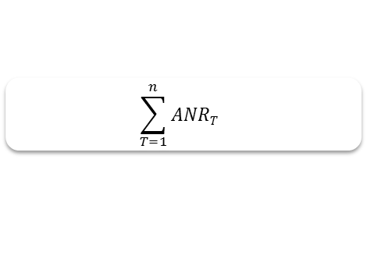
Finance Concept: ANR
Illustration of ANR
$$\sum_{T=1}^{n}{ANRT }$$
ANR Calculation
ANR Uses
Weighted Average Maturity (WAM): Time weighting of principal balance. Similar to duration.
WAM (months) = Sum of Monthly Balances / Original Balance
ANR = Original Balance x WAM / 12
ANR is often used in the context of quoting “lifetime” figures
Example – Lifetime Revenue
Lifetime Revenue = ANR x Interest Rate
Lifetime Revenue = $52,703 x 5%
Lifetime Revenue = $2,635
Loan Amount = $25,000 | WAM = 25.3 months
Interest Rate = 5% | ANR = $52,703
Term = 48 months

Slide 26
Finance Concept: Portfolio Modeling Considerations
Prepayment
Fixed Maturity vs Fixed Payment
It is quite common for customers to not pay according to their predetermined payment schedule.
When a customer pays extra, the extra dollars are used to pay down principal. This reduces the amount of income we will receive over the life of the contract.
Prepayment is one of the biggest challenges to forecasting our business.
Prepayment can take the form of over payments, cash payoffs, and refinancing.
Unscheduled payments can be modeled using Single Month Mortality (SMM) prepayment curves.
SMM = Unscheduled Payment / (Balance – Scheduled Principal Payment)
For a single loan, if there is any unscheduled prepayment then the maturity will become earlier since it is a fixed payment loan.
As you aggregate single loans into a portfolio, you will observe some loans that pay as scheduled and some that will have unscheduled payments. You must modify your modeling to reflect the behavior of the aggregate portfolio.
To do this you need to
Develop prepayment curve assumptions
Model the portfolio as fixed maturity vs fixed payment
To model as a fixed maturity, you recalculate what the total payment is at each period given the current loan balance and the time remaining (Orig Term – Periods Elapsed). Interest will remain constant.

Slide 27
Funding, Hedging and Cost of Funds Overview

Slide 28
Liquidity Management Overview
Cash Flow
Liquidity Risk
Uses of Cash
Asset Origination
Debt & Interest Payment
Capital Investment
Operations
Dividend Payout
Other – Tax, CSA, InterCo etc.
Risk
Month | 1 | 2 | 3 | 4 | 5
Cash In | 100 | 80 | 60 | 40 | 20
Cash Out | -50 | -200 | -30 | -10 | -10
Cum. Gap | 50 | -70 | -40 | -10 | 0
Sources of Cash
Customer Payments
Debt Issuance Proceeds
Investment Redemption
Credit Line Draw-down
Other
To Fund the Cash Short-fall | Sources | Priority
 | Capital Markets – Issue New Debt | Primary
 | Internal Reserve – Redeem investment; draw credit line | Contingent

Slide 29
Funding Profile
Total Funding Profile (as of March 31, 2014)
Debt Profile (as of March 31, 2014)
Tenor
3 mos (0-9)
3 yrs (1-10)
1.5 yrs (1-2)

Slide 30
Hedging Interest Rate Risk
Interest Rate Risk
Fixed
Fixed
We primarily originate Fixed rate assets
We fund ourselves with primarily floating rate debt (Commercial Paper, Unsecured Term Debt, Asset Backed Secured Debt)
This creates interest Rate Risk
Floating
Floating

Slide 31
Interest Rate Hedge Transaction
We enter into interest rate swap agreements to hedge our interest rate risk
TFS
Pay Fixed
3rd Party
Receive Floating

Slide 32
Hedging Interest Rate Risk
Fixed
Fixed
Fixed
Pay Fix Hedge
Hedged Assets
Floating
Floating

Slide 33
Why do we Hedge Interest Rate Risk?
Net Interest Margin Before Pay Fixed Swap
Volatile and Unpredictable
Net Interest Margin After Pay Fixed Swap
Volatility Eliminated

Slide 34
Finance Concept: Cost of Funds
Debt Expense
3 mL
Funding Spread
Hedge Expense
Swap Rate
3 mL

Slide 35
Finance Concept: Cost of Funds Simplified
Debt Expense
3 mL
Funding Spread
3 mL
Hedge Expense
Swap Rate
3 mL
3 mL
Cost of Funds
Swap Rate
Funding Spread

Slide 36
Finance Concept: Strip Funding Transfer Price Methodology
Principal Repayment
Excel Calculation
Double Weighted Average Rate – Weighted by both Time and the Balance Amortization Curve
Sumproduct (R,C,T) /
Sumproduct (C, T)
R | Interest Rate Array by Tenor (Swap or Funding Spread)
C | Balance Amortization Curve
T | Time Array
Swap Curve
Commentary
The loan’s cash flows are stripped into the time period when they are expected to be paid
Each strip is funded with appropriate tenor debt and hedged with corresponding tenor swaps
Strip Funding combines the expected loan life cycle with the current swap yield curve to calculate an expected cost of funds over the life of the loan
Used to approximate what an individual loan would cost to fund on a lifetime basis

Slide 37
Credit & RV Overview

Slide 38
Credit & Residual Value Losses
Credit Losses
Residual Value Losses (Termination Losses)
Failure of consumer or dealer to pay as agreed which results in a write-off of that account and an attempt by TFS to recover its investment.
Key Drivers:
Accounts Outstanding
Default Frequency
Severity (Average Write-Off)
Upon the termination of a lease, if a customer returns the vehicle, it is the difference between the depreciated book value of investment in operating lease and auction value
Key Drivers:
Lease Maturities
Return Rate
Severity (Auction Loss)
Lease RV is similar to Call Option
Customer/Dealer has option to purchase vehicle at contractual strike price. Customer/Dealer will exercise this option if market value is greater than strike price. Vehicle will be returned if it is out of the money. Customer does not typically exercise this right – it is mostly monetized by the dealer.
Credit Allowance and RV Loss Reserve
An Allowance for Credit Losses and RV Loss Reserve is established on the balance sheet to cover for probable future losses.
Provisions are made quarterly to adjust for actual credit losses/termination losses and changes in outlook

Slide 39
Credit
Net Charge-offs
Provision
Net Charge-offs Calculation:
Cash Charge-offs
+ Repo Inventory Adjustment
+ 120dpd+ Adjustment
Recoveries
= Net Charge-offs
Provision:
Auto Provision
+ CF Provision
+ Wholesale Provision
= Total Provision
Topside
Adjustments
Components
Auto:
Forecasted Gross Losses for Fwd Looking 12 Months
- Forecasted Recoveries for Fwd Looking 12 Months
- New Volume
= Net
+ Econometric Adjustment
+ Modeling Error Adjustment
+ Extraordinary Events Adjustment
= Required Balance
Beginning Balance
= Period Provision
Cash Charge-offs (Losses):
Gross Losses / Consumer / Auto
Dealer / Wholesale
Commercial Finance
Repo Inventory Adj:
Consumer / Auto
Commercial Finance
120+dpd Adjustment:
Consumer / Auto
Commercial Finance
CF:
Same as Auto (above)
Recoveries:
Consumer / Auto
Dealer
Commercial Finance
Wholesale:
General Reserve
Specific Reserve
Calculation is for General Reserve. Change in Specific Reserve must also be accounted for here.
Excluding Equipment Wholesale and Hino Wholesale from Wholesale EA Forecast

Slide 40
Factors Considered in Developing the Credit Loss Forecast
Credit Quality at Origination
Portfolio Credit Quality
Historical and current delinquency trends
Portfolio Size and Mix
Economic Conditions
Unemployment
Consumer Confidence and Spending
Consumer Debt Levels
Used Car Market Performance

Slide 41
Portfolio Trends – Grade C/D/X originations
Portfolio and Regional Segments
C/D/X ratios had declined for 6 straight months, but increased again in October and November.
Remain elevated relative to historical levels especially for Lease
Performance on KPI’s remain strong.

Slide 42
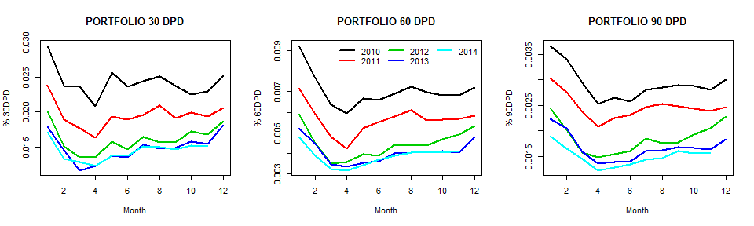
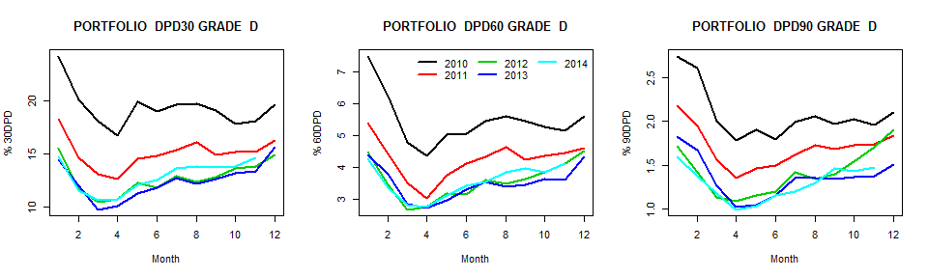
Portfolio Trends – Delinquency trends remain favorable, but low quality increasing
Overall delinquency continues to perform better than prior years across all stages and segments
However, Trends in an aging base of lower quality paper are a concern…….

Slide 43
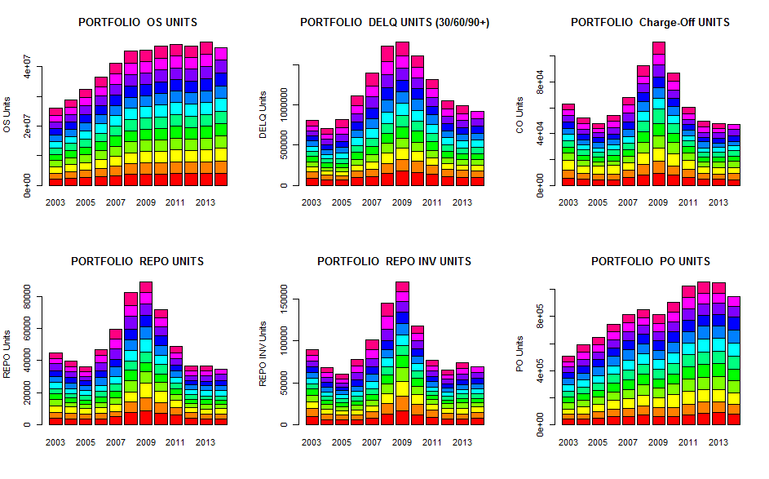
Portfolio Trends – Remain favorable to historical results across performance metrics

Slide 44
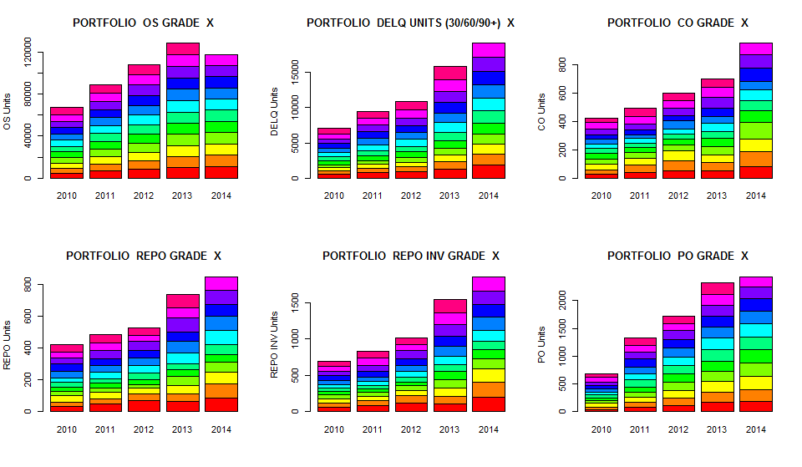
Portfolio Trends – Grade “X” bookings remain a growing concern,
But not yet impacting overall performance.

Slide 45
Portfolio Size – Loss Emergence Pool
The pool of “accounts at risk” for default is trending higher and will continue to grow through Q4 FY15 due to the combination of strong current sales and the diminishing impact of past supply disruptions
Loss Emergence Pool represents all accounts aged from 6-months to 18-months
In general, the size of the loss emergence pool positively impacts the size of credit losses
Size of pool is increasing based on the volume of current bookings

Slide 46
Portfolio Trends (November 2014)
Sandy Impact

Slide 47
FY15 Q3 Credit Loss Forecast – FY15
Loss $
Severity*Frequency
 | Q1 | Q2 | Q3 | Q4 | FY15
Loss ($, MM) | 81 | 74 | 93 | 116 | 364
Frequency (#, K) | 13 | 12 | 14 | 17 | 55
Severity ($, avg) | 6,323 | 6,475 | 6,761 | 6,922 | 6,649
Loss ($, MM) | 81 | 77 | 89 | 105 | 352
Frequency (#, K) | 13 | 12 | 13 | 15 | 52
Severity ($, avg) | 6,321 | 6,498 | 7,056 | 7,069 | 6,753
Loss ($, MM) | 81 | 77 | 89 | 110 | 357
Frequency (#, K) | 13 | 12 | 13 | 15 | 53
Severity ($, avg) | 6,321 | 6,498 | 7,097 | 7,192 | 6,801
Q2 View
$ 364mil
$6,649*55K
0.48% loss
Q3 Model View
$ 352mil
$6,753*52K
0.45% loss
Q3 Scenario
$ 357mil
$6,801*53K
0.46% loss
 | Assumptions and Results from the Model view
View | Total Loss $ | Frequency | Severity | Recovery | New Vol
Baseline | $352M | 52K | $6,753 | 67M | 1.480M
Q3 Scenario | $357M | 53K | $6,801 | 67M | 1.480M

Slide 48
Portfolio Charge Off Trend

Slide 49
Operating Expense Overview

Slide 50
Strategic Expense Management Capability
What:
Maximizing the value of our spend.
How:
Comprehensive OPEX
Enhancing the financial discipline framework:
Visibility and Transparency
Decision Rights
Flexibility
Accountability
1
Performance Measurement
3
Workforce
Operating
Technology
Investment
Decision Rights
Productivity Metrics
Drivers
Capabilities
Business Cases
VCAs:
Benefits
Direct Budget
Management
Planning & Target Setting
Accountability
IT Cost
Value
Model Transparency
Decision Rights
By Technology Service
2
Total Cost of Operations

Slide 51
Historical OpEx by Expense - by Type

Slide 52
Historical OpEx – Total
($ in millions) | FY11 | FY12 | FY13 | FY14 | FY15 | % of Total |  | Annualized Growth FY11-FY15
Total Workforce | $400.4 | $404.5 | $435.3 | $464.2 | $459.3 | 53.5% |  | 3.5%
Variable Operating Costs | 70.4 | 72.4 | 75.9 | 74.5 | 77.3 | 9.0% |  | 2.3%
Overhead Expense | 220.2 | 237.6 | 242.9 | 243.8 | 258.3 | 30.1% |  | 4.1%
Technology Investment | 20.8 | 28.5 | 28.7 | 41.5 | 63.9 | 7.4% |  | 32.3%
Total Operating Expenses | $711.9 | $743.0 | $782.8 | $823.9 | $858.8 | 100% |  | 4.8%

Slide 53
Historical OpEx - Workforce
($ in millions) |  | FY11 | FY12 | FY13 | FY14 | FY15 |  | Annualized Growth FY11-FY15
Workforce |  | $400.4 | $404.5 | $435.3 | $464.2 | $459.3 |  | 3.5%
Internal | Salaries | 250.0 | 241.9 | 265.5 | 285.2 | 289.1 |  | 3.7%
 | Health Benefits | 32.0 | 41.4 | 46.2 | 51.1 | 48.3 |  | 10.9%
 | Retirement (Pension and 401K) | 26.5 | 26.6 | 30.1 | 37.5 | 24.3 |  | -2.1%
 | Other Benefits | 34.9 | 34.9 | 36.9 | 36.1 | 36.2 |  | 0.9%
 | Total | $343.4 | $344.7 | $378.7 | $409.9 | $397.9 |  | 3.8%
 | Headcount | 3,138 | 3,123 | 3,169 | 3,178 | 3,161 |  | 0.2%
External | Temp Help (all except project) | 24.1 | 30.1 | 29.4 | 27.3 | 31.3 |  | 6.7%
 | Outsourced Functions (CSC/Risk) | 29.7 | 26.4 | 24.3 | 24.9 | 26.3 |  | -3.1%
 | Consulting(IT) | 3.2 | 3.3 | 3.0 | 2.2 | 4.1 |  | 6.8%
 | Total | $57.0 | $59.8 | $56.6 | $54.3 | $61.4 |  | 1.9%

Slide 54
Historical OpEx - Variable Operating Costs (Metric Driven)
($ in millions) |  | FY11 | FY12 | FY13 | FY14 | FY15 |  | Annualized Growth FY11-FY15
Variable Operating Costs |  | $70.4 | $72.4 | $75.9 | $74.5 | $77.3 |  | 2.3%
Volume* | Floorplan Audits, RouteOne, Fiserv | 4.3 | 4.6 | 6.7 | 9.5 | 10.7 |  | 25.7%
 | WMS | 2.0 | 1.5 | 2.2 | 2.6 | 2.1 |  | 1.6%
 | GST Fees | 2.5 | 3.1 | 3.0 | 3.1 | 3.2 |  | 6.5%
 | Credit Bureau | 2.4 | 2.2 | 2.2 | 2.4 | 2.5 |  | 1.6%
 | New Volume | 1,345 | 1,128 | 1,317 | 1,443 | 1477 |  | 2.4%
Accounts Outstanding (AA O/S)* | Statement Center | 23.1 | 23.6 | 22.3 | 22.6 | 23.2 |  | 0.2%
 | Payment Processing - Bank | 8.3 | 6.8 | 7.0 | 5.9 | 6.1 |  | -7.2%
 | Privacy Notices | 4.9 | 4.0 | 5.1 | 5.4 | 4.3 |  | -3.4%
 | Phone, Freight, Postage - CSC | 6.7 | 6.6 | 6.2 | 6.0 | 5.3 |  | -5.6%
 | AA O/S | 3,941 | 3,942 | 3,945 | 4,055 | 4,288 |  | 2.1%
Delinquent Accounts* | Western Union | 0.5 | 2.7 | 4.5 | 5.4 | 6.0 |  | 85.1%
 | Collection/Repo | 1.5 | 3.5 | 2.7 | 2.5 | 3.0 |  | 19.4%
 | Bankruptcy | 1.1 | 1.1 | 1.1 | 0.8 | 0.7 |  | -9.6%
 | 30+Delinquencies | 1,003 | 802 | 682 | 696 | 752 |  | -7.0%
*Total expenses for each category are not listed, the expenses above represent at least 90% of the total for each category.

Slide 55
Historical OpEx – Overhead Expenses (Non-Metric Driven)
($ in millions) |  | FY11 | FY12 | FY13 | FY14 | FY15 |  | Annualized Growth FY11-FY15
Overhead Expenses |  | $220.2 | $237.6 | $242.9 | $243.8 | $258.3 |  | 30.1%
 | Software Maintenance & Licenses | 27.0 | 26.9 | 26.6 | 33.0 | 35.4 |  | 7.0%
 | Occupancy | 33.0 | 34.3 | 33.3 | 33.0 | 37.2 |  | 3.0%
 | Depreciation | 23.4 | 28.4 | 33.9 | 31.5 | 33.9 |  | 9.7%
 | AMS Costs | 31.9 | 35.0 | 34.9 | 34.6 | 32.6 |  | 0.5%
 | TMS Shared Services | 27.1 | 26.0 | 27.3 | 26.5 | 27.7 |  | 0.5%
 | Non Project Consulting | 24.5 | 32.6 | 32.5 | 25.5 | 33.5 |  | 8.1%
 | Travel | 9.6 | 10.9 | 11.1 | 10.5 | 14.1 |  | 10.1%
 | Communications | 11.9 | 13.1 | 11.5 | 10.3 | 15.1 |  | 6.1%
 | Taxes | 12.0 | 10.3 | 9.4 | 14.8 | 10.7 |  | -2.8%
Technology Investment |  | 20.8 | 28.5 | 28.7 | 41.5 | 63.9 |  | 32.3%
*Total expenses for each category are not listed, the expenses above represent at least 90% of the total for each category.
*Total expenses for each category are not listed, the expenses above represent at least 90% of the total for each category.

Slide 56
OpEx Forecasting Process

Slide 57

Forecasting Process - “Top Down” and “Bottoms Up”
“Top Down”
TMC – Profit Targets
Informed by Global SFC Balance Sheet & Profit Outlook and TMC Expectations
TFSC – Profit Targets
Informed by Balance Sheet & Profit Outlook, Performance Measurement & TFSC Expectations
TFS – Profit Targets
TFS – OpEx Targets
Prioritize
Enterprise Expenses
Driver Based Target Setting
“Run Your Business”
“Invest in Your Business”
Business Unit Detail Budgeting
Operating Expense Allocation
Business Unit Operating Budget
- Identify New Expenses
- Eliminate / Reduce Costs
- Identify Non-Recurring Costs
Department Technology Project Budget
- Informed by 3 Year BU Plans
Rationalize
“Bottoms Up”

Slide 58
Forecasting Process – Total Company Target
“Top Down”
TMC – Profit Targets
Informed by Global SFC Balance Sheet & Profit Outlook and TMC Expectations
TFSC – Profit Targets
Informed by Balance Sheet & Profit Outlook, Performance Measurement & TFSC Expectations
TFS – Profit Targets
TFS – OpEx Targets
Communication to TFSC
Oct/Nov timeframe
Jan/Feb timeframe
High Level Assumptions Considered
OpEx Ratio (85bps)
Operations
Volume, Accounts Outstanding, Delinquencies
Workforce
Merit & Growth
Benefit Changes (Group Insurance, Retirement, Other)
Technology Investment Level
Extraordinary Items (Compliance, Next Chapter, CF Sale, Future Forward)

Slide 59
Forecasting Process – Department Target Methodology
“Top Down”
TMC – Profit Targets
Informed by Global SFC Balance Sheet & Profit Outlook and TMC Expectations
TFSC – Profit Targets
Informed by Balance Sheet & Profit Outlook, Performance Measurement & TFSC Expectations
TFS – Profit Targets
TFS – OpEx Targets
Enterprise Expenses
Major Technology Projects
Organizational Initiatives
Driver Based Target Setting
Run Your Business
Workforce
Variable Operating
Identify Expense Drivers
Allocation based on trend or forecast
Overhead Expense Analysis
Invest in Your Business
Project Spend
Enterprise Expenses
Driver Based Target Setting – Business Units
“Run Your Business”
“Invest in Your Business”
Operating Expense Allocation
Business Unit Operating Budget
- Identify New Expenses
- Eliminate / Reduce Costs
- Identify Non-Recurring Costs
Department Technology Project Budget
- Informed by 3 Year BU Plans

Slide 60
Forecasting Process - “Top Down” and “Bottoms Up”
“Top Down”
TMC – Profit Targets
Informed by Global SFC Balance Sheet & Profit Outlook and TMC Expectations
TFSC – Profit Targets
Informed by Balance Sheet & Profit Outlook, Performance Measurement & TFSC Expectations
TFS – Profit Targets
TFS – OpEx Targets
Business Unit Operating Budget
Identify New Expenses
Cost Savings Opportunities
Run the business expenses
Department Technology Project Budget
Informed by 3 Year BU Plans
Prioritized based on necessity
Organizational Initiatives
Business Unit Detail Budgeting
Business Unit Operating Budget
- Identify New Expenses
- Eliminate / Reduce Costs
- Identify Non-Recurring Costs
Department Technology Project Budget
- Informed by 3 Year BU Plans
“Bottoms Up”

Slide 61

Forecasting Process - Target Finalization Process
“Top Down”
TMC – Profit Targets
Informed by Global SFC Balance Sheet & Profit Outlook and TMC Expectations
TFSC – Profit Targets
Informed by Balance Sheet & Profit Outlook, Performance Measurement & TFSC Expectations
TFS – Profit Targets
OpEx Entered into Hyperion
Task Amounts Acknowledged
TFS – OpEx Targets
Enterprise Expenses
Driver Based Target Setting – Business Units
“Run Your Business”
“Invest in Your Business”
Business Unit Detail Budgeting
Operating Expense Allocation
Sweet
Business Unit Operating Budget
- Identify New Expenses
- Eliminate / Reduce Costs
- Identify Non-Recurring Costs
Department Technology Project Budget
- Informed by 3 Year BU Plans
Spot
“Bottoms Up”

Slide 62
Comprehensive OpEx Spend By Area

Slide 63
Comprehensive OpEx - Spend By Area*
* Total Spend by area relates to FY15 Actuals

Slide 64
IT FP&A Overview
Discipline
Financial Planning & Analysis
Accounting
Total Company
Application of Accounting Policies
ASC 350-40 Board – Capitalized Labor
Prepaid Expenses Including Cloud
Fixed Assets – HW / SW
TCS / Infosys
Financial Relationship
AMM and SOW / SE Accruals
Prepaid Amortization
Move to Depreciable Asset
Capitalized Labor
Hardware / Software
Forecast Consolidation
Actual-to-Forecast Results
Depreciation Forecast
Company Reports
Run-the-Business (RTB) & TSC
Total Company, Direct Report, Project, Account
Report Out to Ron / BTS Leadership
Organizational Awareness of Cost
Application of Accounting Policies
ASC 350-40 Board – Capitalized Labor
Prepaid Expenses Including Cloud
Fixed Assets – HW / SW
TCS / Infosys
Financial Relationship
AMM and SOW / SE Accruals
Prepaid Amortization
Move to Depreciable Asset
Capitalized Labor
Hardware / Software
Forecast Consolidation
Actual-to-Forecast Results
Depreciation Forecast
Company Reports
Run-the-Business (RTB) & TSC
Total Company, Direct Report, Project, Account
Report Out to Ron / BTS Leadership
Organizational Awareness of Cost
Tasks / Deliverables
A
C
Budget Mgr / Specific Support
Monthly Forecasts
Bottoms-Up, Zero-Based Plan
Actual-to-Forecast Results
Incorporation into next forecast
Business Cases
Value Capture Analysis
Ad Hoc / Special Projects
B
D
Monthly Close
Accruals – RTB, Project, Temp Help
Allocations – Salaries, TMS, Bank
Reclassifications
SEC Reporting
iFEM
Accounting Convention

