Slide 1
Entry, Exit, Firm Dynamics, and Aggregate Fluctuations
Clementi and Palazzo (2016)
Eric Bodnar, Ella Walling, Milton Bronstein

Slide 2
Introduction
What is the role of entry and exit of firms on aggregate productivity shocks?
Both propagate the effects of such shocks
Assumptions:
Demand for firms’ product and supply for their input are infinitely elastic
Labor supply has finite elasticity
Findings:
Exit risk is decreases with age
Employment growth decreases with size and age
Entry rate is procyclical and output rate is counter-cyclical (with respect to output)

Slide 3
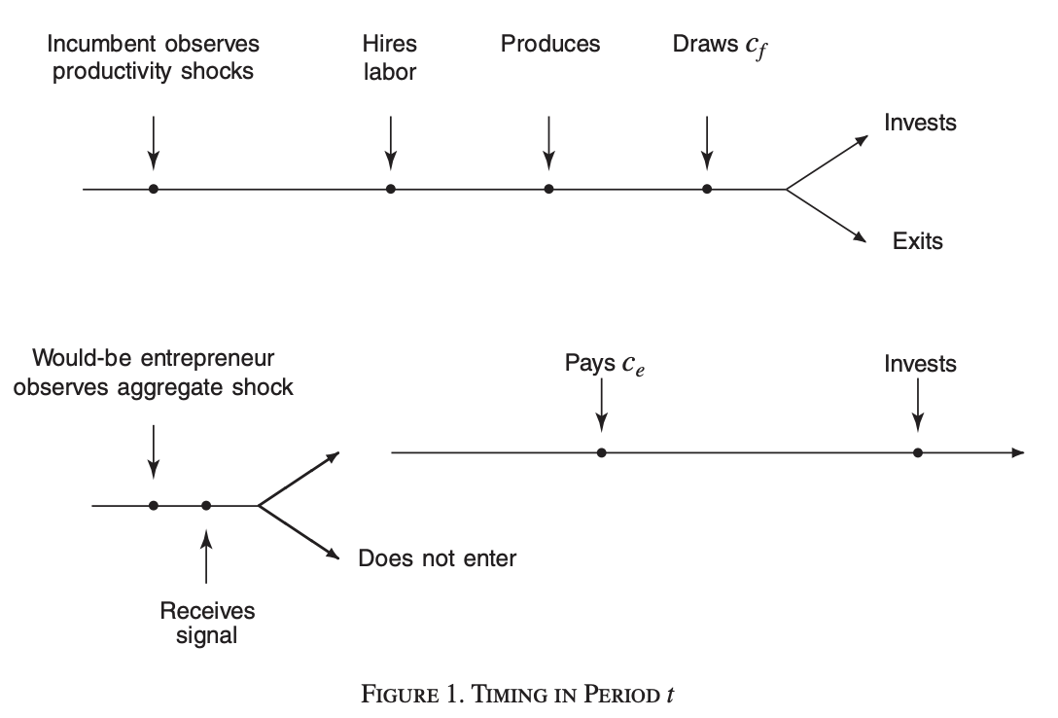
The Model

Slide 4
The Model: Existing Firms
At time t, a positive number of firms produce a homogeneous good
With production function y_{t} = z_{t}s_{t}(k_{t}^{α} l_{t}^{1−α} )^{θ} , with α, θ ∈ (0, 1)
k_{t} is capital
Adjusting k_{t} by x incurs a cost g(x, k)
Capital depreciates at rate 𝛅 ∈ (0, 1)
l_{t} is labor
Firms hire labor at wage rate w_{t}
Labor supply is given by function L_{s}(w) = w^{𝛾}, 𝛾 > 0

Slide 5
The Model: Existing Firms
z_{t} represents aggregate random disturbances
Driven by stochastic process log(z_{t+1})= ρ_{z} log(z_{t}) + σ_{z} ε_{z, t+1} where ε_{z, t+1} ~ N(0,1)
s_{t} represents idiosyncratic random disturbances
Driven by dynamic process log(s_{t+1})= ρ_{s} log(s_{t}) + σ_{s} ε_{s, t+1} where ε_{s, t+1} ~ N(0,1)
Conditional distribution of s_{t+1}: H(s_{t+1}|s_{t})

Slide 6
The Model: Existing Firms
For all t ≥ 0, the distribution of firms over the two dimensions of heterogeneity is denoted by 𝚪_{t}(k,s)
λ_{t} ∈ Λ is the vector of aggregate state variables with transition operator J(λ_{t+1}|λ_{t})

Slide 7
The Model: Existing Firms Optimization Problem
Aggregate state λ, capital k, and idiosyncratic productivity s are given
The firm maximizes profit through the following static problem:
π(λ, k, s) = max_{l}sz[k^{𝛼}l^{1-𝛼}] - wl
Upon exiting the market, a firm receives
V_{x}(k) = k(1-𝛅) - g[-k(1-𝛅), k]
- [undepreciated portion of capital] - [net adjustment cost of dismantling]

Slide 8
The Model: Existing Firms Optimization Problem
Using the previous two equations, the start of period value for an existing firm is given by V(λ, k, s), which solves the following functional equation:
V(λ, k, s) = π(λ, k, s) + ∫ max {V_{x}(k), Ṽ (λ, k,s) − c_{f}} dG(c_{f} )
where
Ṽ (λ, k,s) = max_{x} −x − g(x, k ) +1 ⁄ R∫ _{Λ} ∫ _{ℜ} V(λ′, k′,s′) dH(s′|s) dJ(λ′|λ)
such that k’ = k(1-𝛅) + x
Finally, note that after leaving the market firms cannot re-enter at a later stage and repossess their undepreciated capital stock

Slide 9
The Model: Prospective Firms
Each period there is a constant number of prospective firms M > 0
Receives a signal q about their prospective productivity, where q ~ Q(q)
Conditional on entry, the distribution of idiosyncratic shock in the first period, s’, is H(s’|q)
H(s’|q) is strictly decreasing in q
Potential firms that decide to enter the market will incur entry cost c_{e} > 0

Slide 10
The Model: Prospective Firm Value Function
Given aggregate state λ, the value of a prospective firm with a signal q is:
V_{e} (λ, q) = max_{k’} − k’ + 1 ⁄ R∫ _{Λ} ∫ _{ℜ} V(λ′, k′,s′) dH(s′|s) dJ(λ′|λ)
Note that a prospective firm will invest and start operating if and only if V_{e} (λ, q) ≥ c_{e}

Slide 11
The Model: Recursive Competitive Equilibrium
Given 𝚪₀, a recursive competitive equilibrium is defined by:
(i) Value functions V(λ, k, s), Ṽ (λ, k,s), and V_{e} (λ, q)
(ii) Policy functions x(λ, k, s), l(λ, k, s), and k’(λ, q)
(iii) Bounded sequences of wages {w_{t}}∞_{t=0}
Incumbents’ measures {𝚪_{t}}∞_{t=1}
Entrants’ measures {ɛ_{t}}∞_{t=1}
Basically everyone solves their optimization problems and all markets clear

Slide 12
The Stationary Case: functional forms
No aggregate shocks (σ_{z}=0). Only the idiosyncratic ones
First period shock (t=1): log(s)= ρ_{s} log(q) + σ_{s} 𝜂,
with 𝜂~N(0,1)
All aggregate variables converge to constants
Notes:
The fixed adjustment cost is only paid when there is an actual adjustment (x different from 0) and depends on the current capital stock.

Slide 13
The Stationary Case: functional forms
Investment adjustment costs: g(x,k) = ꭕ(x)c₀k + c₁(x/k)²k
With c0, c1 ≥ 0 and ꭕ(0) = 0 and ꭕ(x) = 1 for x≠0
Productivity signal (q) follows Pareto distribution such that: Q(q) = (q/q)^{𝜁}
With q ≥ q ≥ 0 and 𝜁 > 1
Operating costs (c_{f}) distribution G is log-normal with μ_{cf} and σ_{cf}
Notes:
The fixed adjustment cost is only paid when there is an actual adjustment (x different from 0) and depends on the current capital stock.

Slide 14
The Stationary Case: entry, investment, and exit
V(λ, k, s) is weakly increasing in s
The incumbent’s value may increase with the idiosyncratic shock
The distribution H(s’|q) is decreasing in q.
A greater signal today leads to a distribution around higher shocks tomorrow
V_{e} (λ, q) is strictly increasing in q
The entrant’s value increases with the signal
Thus, there is a cut-off q*
Every firm outside the market observing a signal q ≥ q* will enter because they are optimist about their productivity

Slide 15
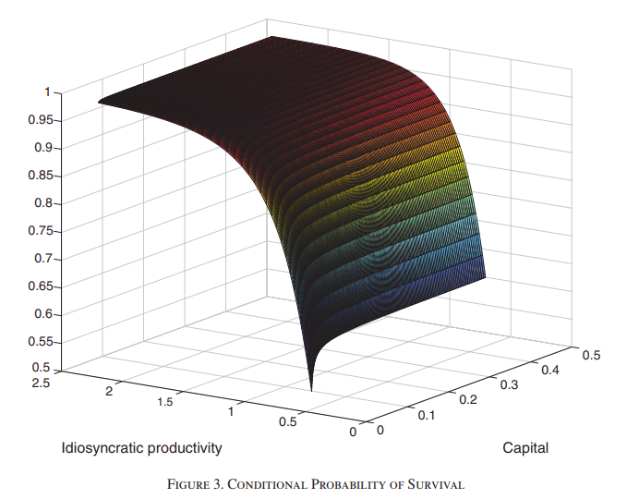
The Stationary Case: entry, investment, and exit

Slide 16
The Stationary Case: entry, investment, and exit
Entrants with greater signals make greater investments and start with greater capital (k)
Incumbents draw their cost (c_{f}) and exit if V_{x}(k) > Ṽ (λ, k,s) -c_{f}
Findings (figure 3):
Exit probability is decreasing in idiosyncratic shock as the value of staying is increasing in such shock while the exit value is not
Increasing the capital stock has a greater impact on the value of staying than in the value of exit
Survival (staying) probability is increasing in k and s

Slide 17
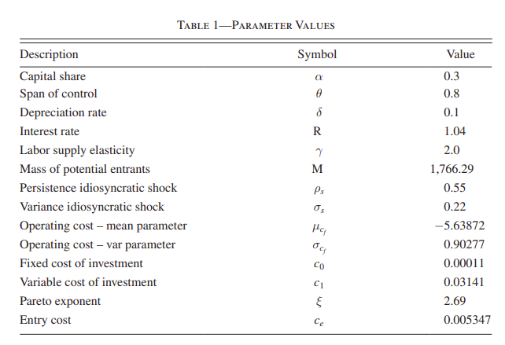
The Stationary Case: calibration
Notes:
R, delta, alpha, theta: based on literature (empirical and theoretical).
All others are chosen such that the computed statistics match their observed values

Slide 18
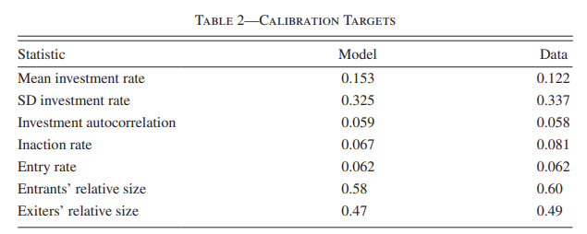
The Stationary Case: calibration
Parameters are chosen based on literature and in order to match these statistics with the observed ones
Arbitrary M. But a greater value increases equilibrium wage and, hence, reduce the firms size. Then, higher exit and entry
Set c_{e} equal to the average operating cost c_{f}
Notes:
Assume M such that the equilibrium w is 3, WLG

Slide 19
The Stationary Case: firm dynamics
Initially, exit rate decreases sharply at the and remains stable. Older firms are less likely to leave because their productivity and value are higher
Firms with low k and high productivity are less likely to exit
Given the age, bigger firms have higher productivity and show smaller growth in labor
Given the size, firms with smaller k and higher s (on average, older) will grow faster then the opposite (on average, younger) as s determines the optimal l
Given the capital, firms with higher s will grow while the others will shrink
Notes:
Observed in US manufacturing sector

Slide 20
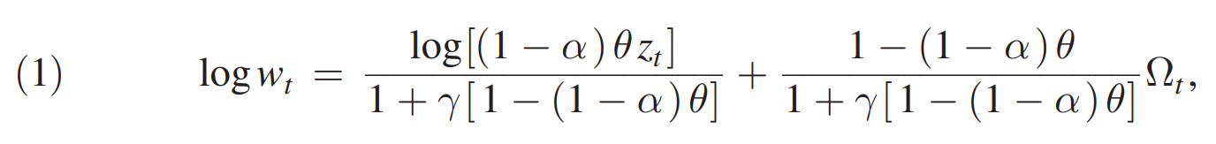
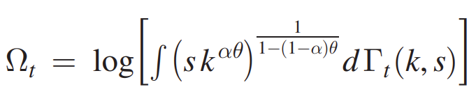
Aggregate Fluctuations: mechanics
Aggegate productivity shocks z affect every firm
Equilibrium wage (w) at time t satisfies:
with
It depends on aggregate shocks as well as a function of idiosyncratic shocks and capital in the distribution of incumbent firms

Slide 21
Aggregate Fluctuations: mechanics
Based on Krussell & Smith (1998), the author affirm that 𝛀_{t+1} depends on 𝛀_{t} and z_{t+1} and boil equation (1) down to
where E(ɛ_{t+1})=0
That is, firms forecast the equilibrium wage depending on its current value and the aggregate productivity shocks

Slide 22
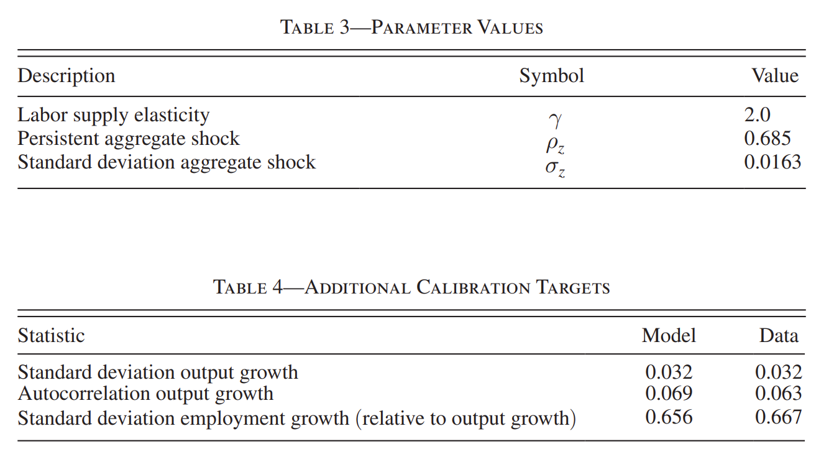
Aggregate Fluctuations: calibration
Parameters targeted to these statistics observed in the US non-farm private sector (1947-2008)

Slide 23
Aggregate Fluctuations: calibration
As a result, firms forecast the equilibrium wage as follows:
log(w_{t+1}) = 0.38385 + 0.65105 log(w_{t}) + 0.53075 log(z_{t+1}) - 0.21508 log(z_{t}) + ɛ_{t+1}
Wage is persistent but it reverts to its mean
A positive aggregate shock increases the demand for labor, hence the equilibrium wage
A past positive shock makes firm expect a smaller one for the current time period. Thus, the demand for labor and the wage decrease

Slide 24
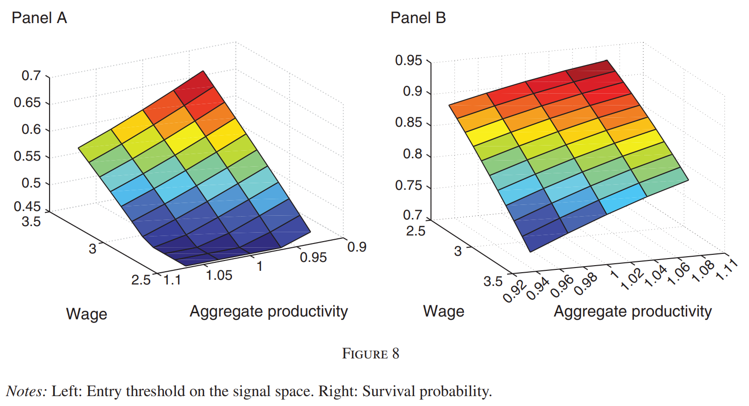
Aggregate Fluctuations: entry and exit
Each firm solves their problem and makes their choice
Potential entrants enter if they observe a signal q is greater than the threshold (increasing in w and decreasing in z)
For incumbents, their probability of staying is decreasing in w and increasing in z (conditional on their capital and idiosyncratic shock)

Slide 25
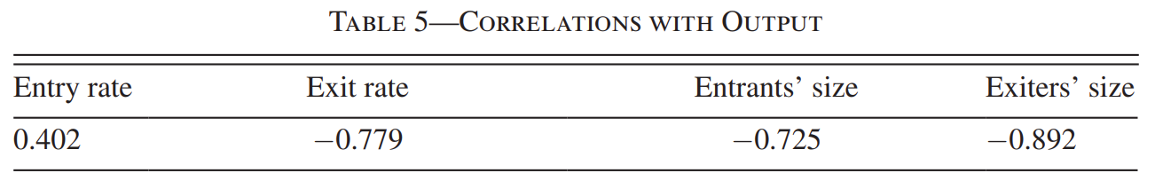
Aggregate Fluctuations: results
While the industry grows, more firms enter and less firms exit
Additionally, entrant firms are smaller. Firms with smaller s will enter too
Exiter firms are smaller as well. During expansion, there is a higher value for staying for every firm
Notes:
Consistent with Campbell (1998) and Lee & Mukoyama (2012) findings
The cut-off for the signal q is smaller when the industry grows. Less productive firms enter as well. Productivity correlates positively with size

Slide 26
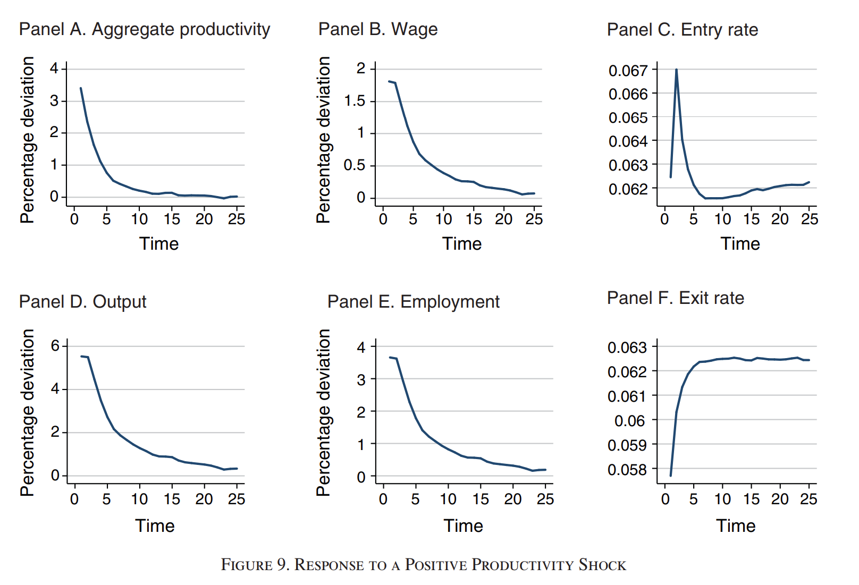
Aggregate Fluctuations: results
Notes:
An aggregate productivity shock generates:

Slide 27
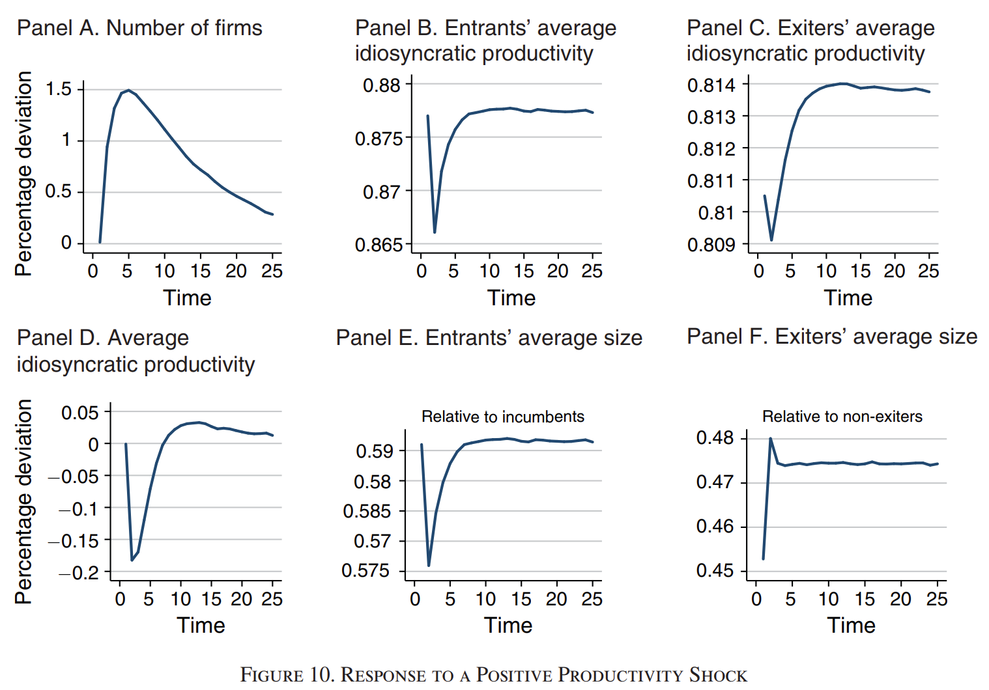
Aggregate Fluctuations: results

Slide 28
Aggregate Fluctuations: results
Wage, output, and labor follow a similar path to productivity. Incumbent firms hire more employees
The rate of entry increases sharply in response to shock and decreases as the effects of shock wear off
At the same time, the exit rate decreases sharply and starts increasing afterwards
Therefore, the shock increases the number of firms in the market
The average idiosyncratic shock for both entrants and exiters also decreases (lower threshold for the signal and higher value of staying)
Notes:
(DON’T READ THIS: FINDINGS FROM FIGURES 9 AND 10)
The size of entrants relative to incumbents declines on average because there are more (smaller) firms entering
The size of exiters relative to non-exiters increases because there are more non-exiters

Slide 29
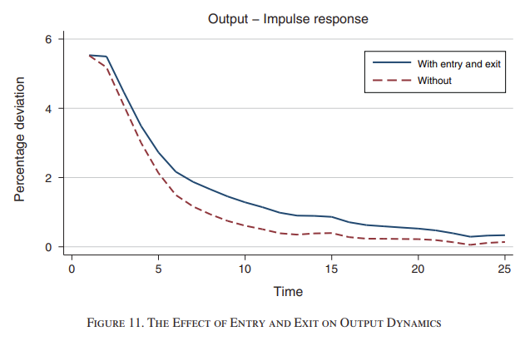
Aggregate dynamics (counterfactual)
If there was no entry and exit, aggregate shocks would be less persistent.
Output still reverts to its mean, but more slowly than in this counterfactual
As entrants become more productive, the reallocation of output favors them

Slide 30
Stationary Replication
-Use Tauchen 1986 method and np.leggauss to approximate the 2 AR(1) processes
-Take in parameters calibrated in other papers (µ_z,µ_m, ρ_z, ρ_m,σ_z,σ_m)
-Generate capital grid as done by McGrattan 1999
Notes:
-Generate the idiosyncratic, stochastic grids, and the transition matrix. Adapt code from Macro 1. Note we are using Numpy and not IMSL
-mean of idiosyncratic shock, mean of stochastic discount factor, autocorrelation for idiosyncratic, autocorrelation for stochastic, standard deviations for idiosyncratic and stochastic, grid of values for covariances
-Create ztrans transition matrix from the stochastic and idiosyncratic grids, run simulation
-Use McGrattan capital grid to then compute adjustment costs and the labor array

Slide 31
Stationary Replication part 2
- Perform VFI on incumbent (kgrid, zgrid, adj, ztrans, vgi, labor) to get desired values(vf, kpol,eprob,etastar)
-Create signal grid and transition matrix from signal to shock from idiosyncratic grid
-Use this grid to calculate conditional distribution of idiosyncratic shock
Notes:
-Capital grid, idiosyncratic shock grid, adjustment cost, transition function for idiosyncratic shock, value function guess, labor demand
-Value function, capital policy function, exit probability, and the operation cost exit threshold
-VFI code can be repurposed to use the 2 AR(1) processes instead (use numpy gamma and error functions). Get exit probabilities and cutoff
-Use scipy in python instead of IMSL functions

Slide 32
Stationary Replication part 3
-Compute entry threshold using interpolation, compute mass on threshold
-Compute distribution of entrants using conditional expectation
-Simulate until equilibrium wage is reached to get stationary distribution, compute summary statistics
Notes:
-Using SCipy interpolation (bspline) instead of BSNAK and BSINT

Slide 33
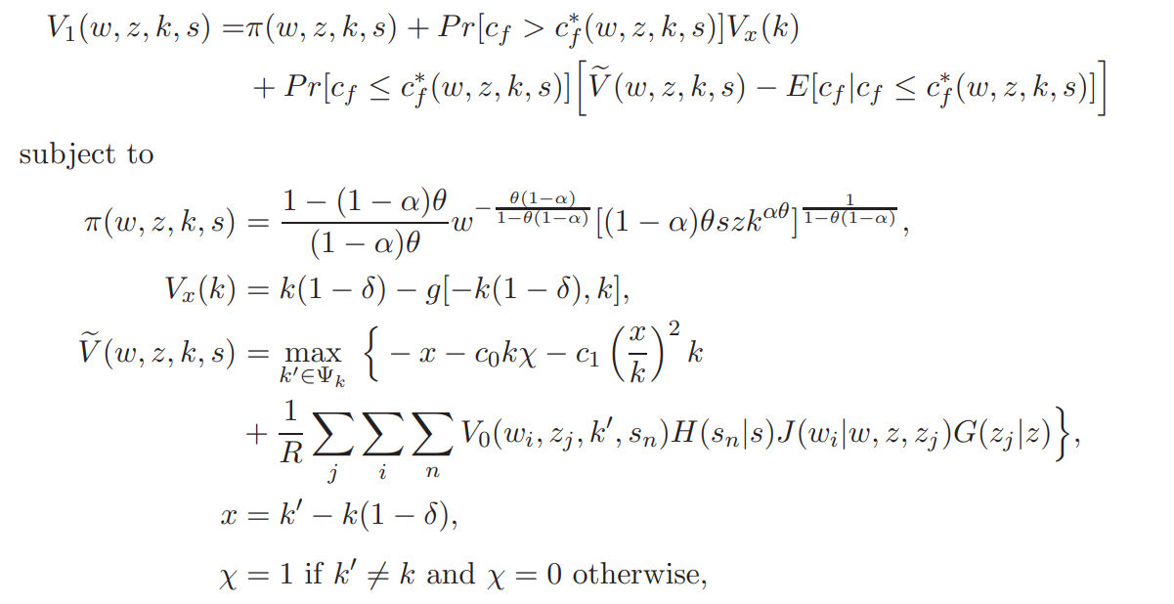
Aggregate Fluctuations Replication
-Guess values of wage forecast
-Modify bellman optimization code to also include wage grid
-Revise according to
Process on the right
Notes:
-Note that much of the code is reusable from the stationary case
-The main difference is that now we have to forecast wages in order to make decisions. Krusell Smith 1998 allows us to do that
-Here, our c_{f}* is the value that makes the firm indifferent between exiting and continuing to invest optimally; our H,J,G distributions are the idiosyncratic, wage, and aggregate respectively
-Use Python mp (multiprocessing) to speed up calculation

Slide 34
Aggregate Fluctuations Replication part 2
-Modify the ‘entry problem’ over triplets instead
-Equate labor demand and supply
-Simulate and run the Krusell Smith 1998 regression
Notes:
-Use bi-dimensional cubic spline

Slide 35
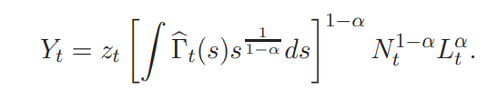
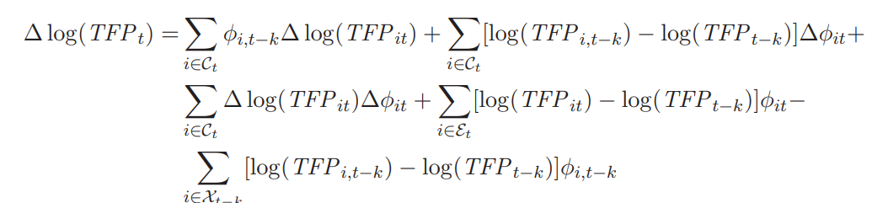
Impulse Response and Decomposition Replication
-Simulate simple model without entry or exit
-Use code from Haltiwanger 1997
Notes:
-This new simple model is driven entirely by z_{t}. The gamma t is measure of firms idiosyncratic productivity normed by the integral; L_{t} is aggregate employment
-Compare this model to the model with entry and exit
-This code from Haltiwanger decomposes growth in TFP into 5 components: 1. Changes in productivity for continuing plants, 2. Changes in output share amongst continuing plants, 3.covariance, 4. Entry, 5. Exit

Slide 36
Extensions
In the model, the authors normalize the output price into 1. What if the demand is not infinitely elastic? What if the output price was endogenous?
Here, entrants only choose their initial investment. What if we let entrants hire labor besides the capital stock (as incumbents do)?
What if firms faced any capacity constraint? They could play a role as a limit investments for entrants and capital adjustment for incumbents (per period)
Notes:
Or can we add a constrained capacity for the input supply?

