Slide 1
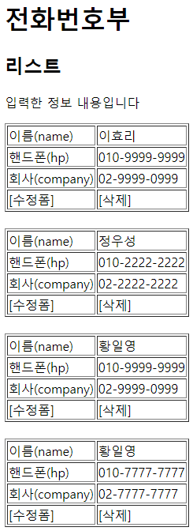
JSP
Controller
Service
Dao
(sqlSession)
phonebook3>list
http://localhost:8000/phonebook3/list
/list
list()
personId=3
getPersonList()
getPersonList()
selectList(“selectList”)
List<PersonVo>
0x777
List<PersonVo>
0x777
List<PersonVo>
0x777
list.jsp
List<PersonVo>
0x777
personId=3
selectOne(“selectOne2”, personId )
phonebook3>writeForm
/writeForm
writeForm()
Map
0x777
http://localhost:8000/phonebook3/writeForm
writeForm.jsp

Slide 2
JSP
Controller
Service
Dao
(sqlSession)
phonebook3>write
http://localhost:8000/phonebook3/write?
name=이효리&hp=010&company=02
/write
write(PersonVo)
PersonVo
PersonVo
PersonVo
writePerson(vo)
peronInsert(vo)
insert(“insert”, vo)
count
count
리다이렉트
phonebook3>delete
/delete
delete(personId)
http://localhost:8000/phonebook3/delete?personid=3
personId
personId
personId
deletePerson(id)
personDelete(id)
delete(“delete”, id)
count
count
리다이렉트

